Slide 1
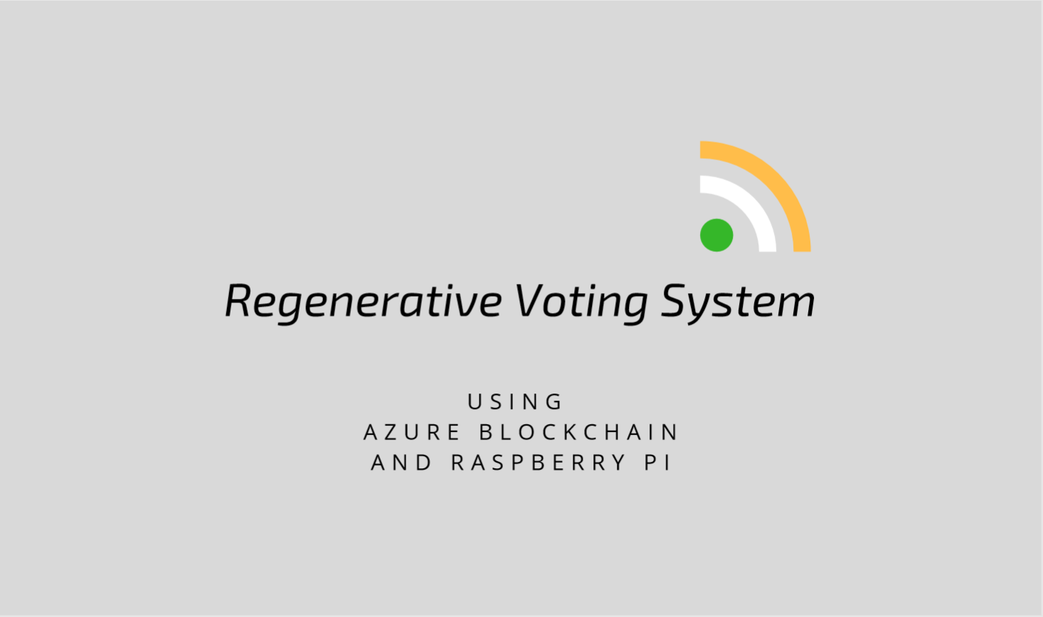

Slide 2
Roles in our Project
Voter
Election Head
Zone Representative

Slide 3
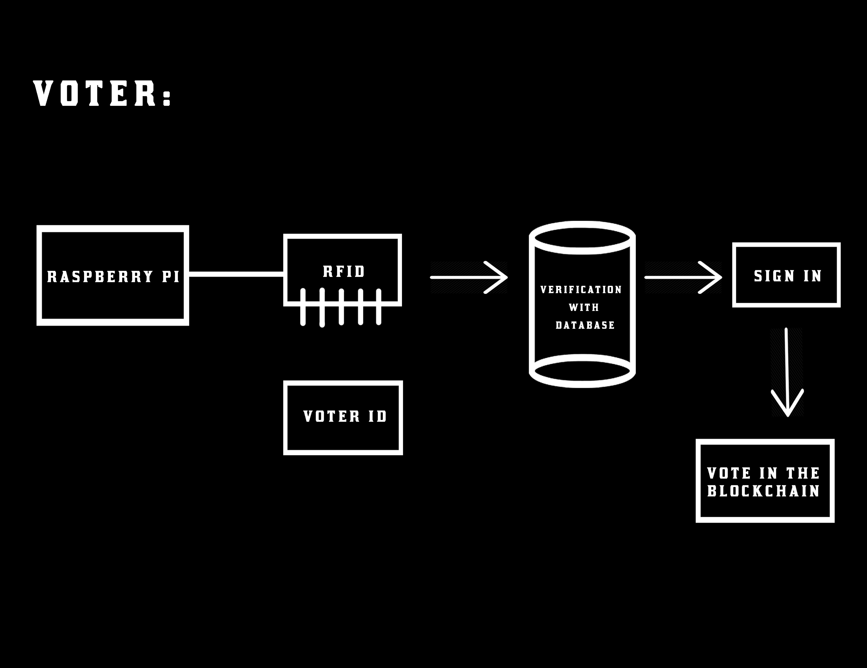

Slide 4
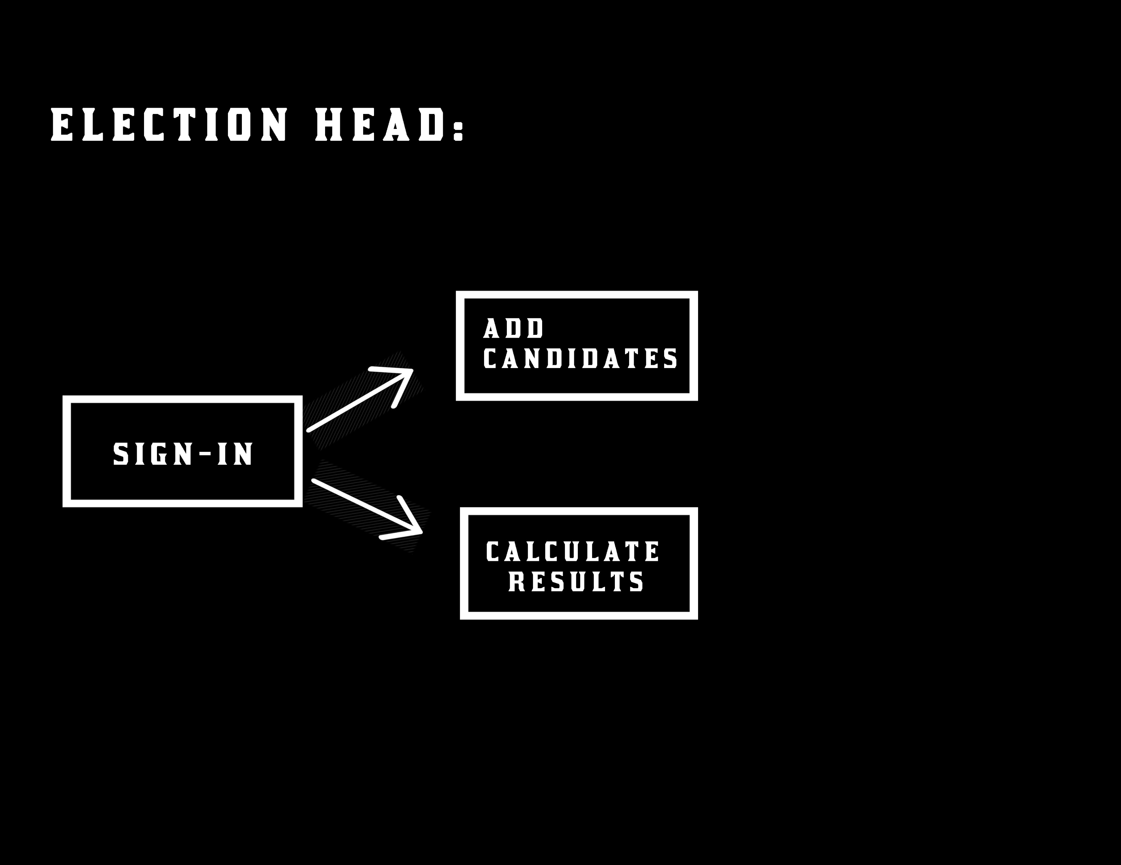

Slide 5
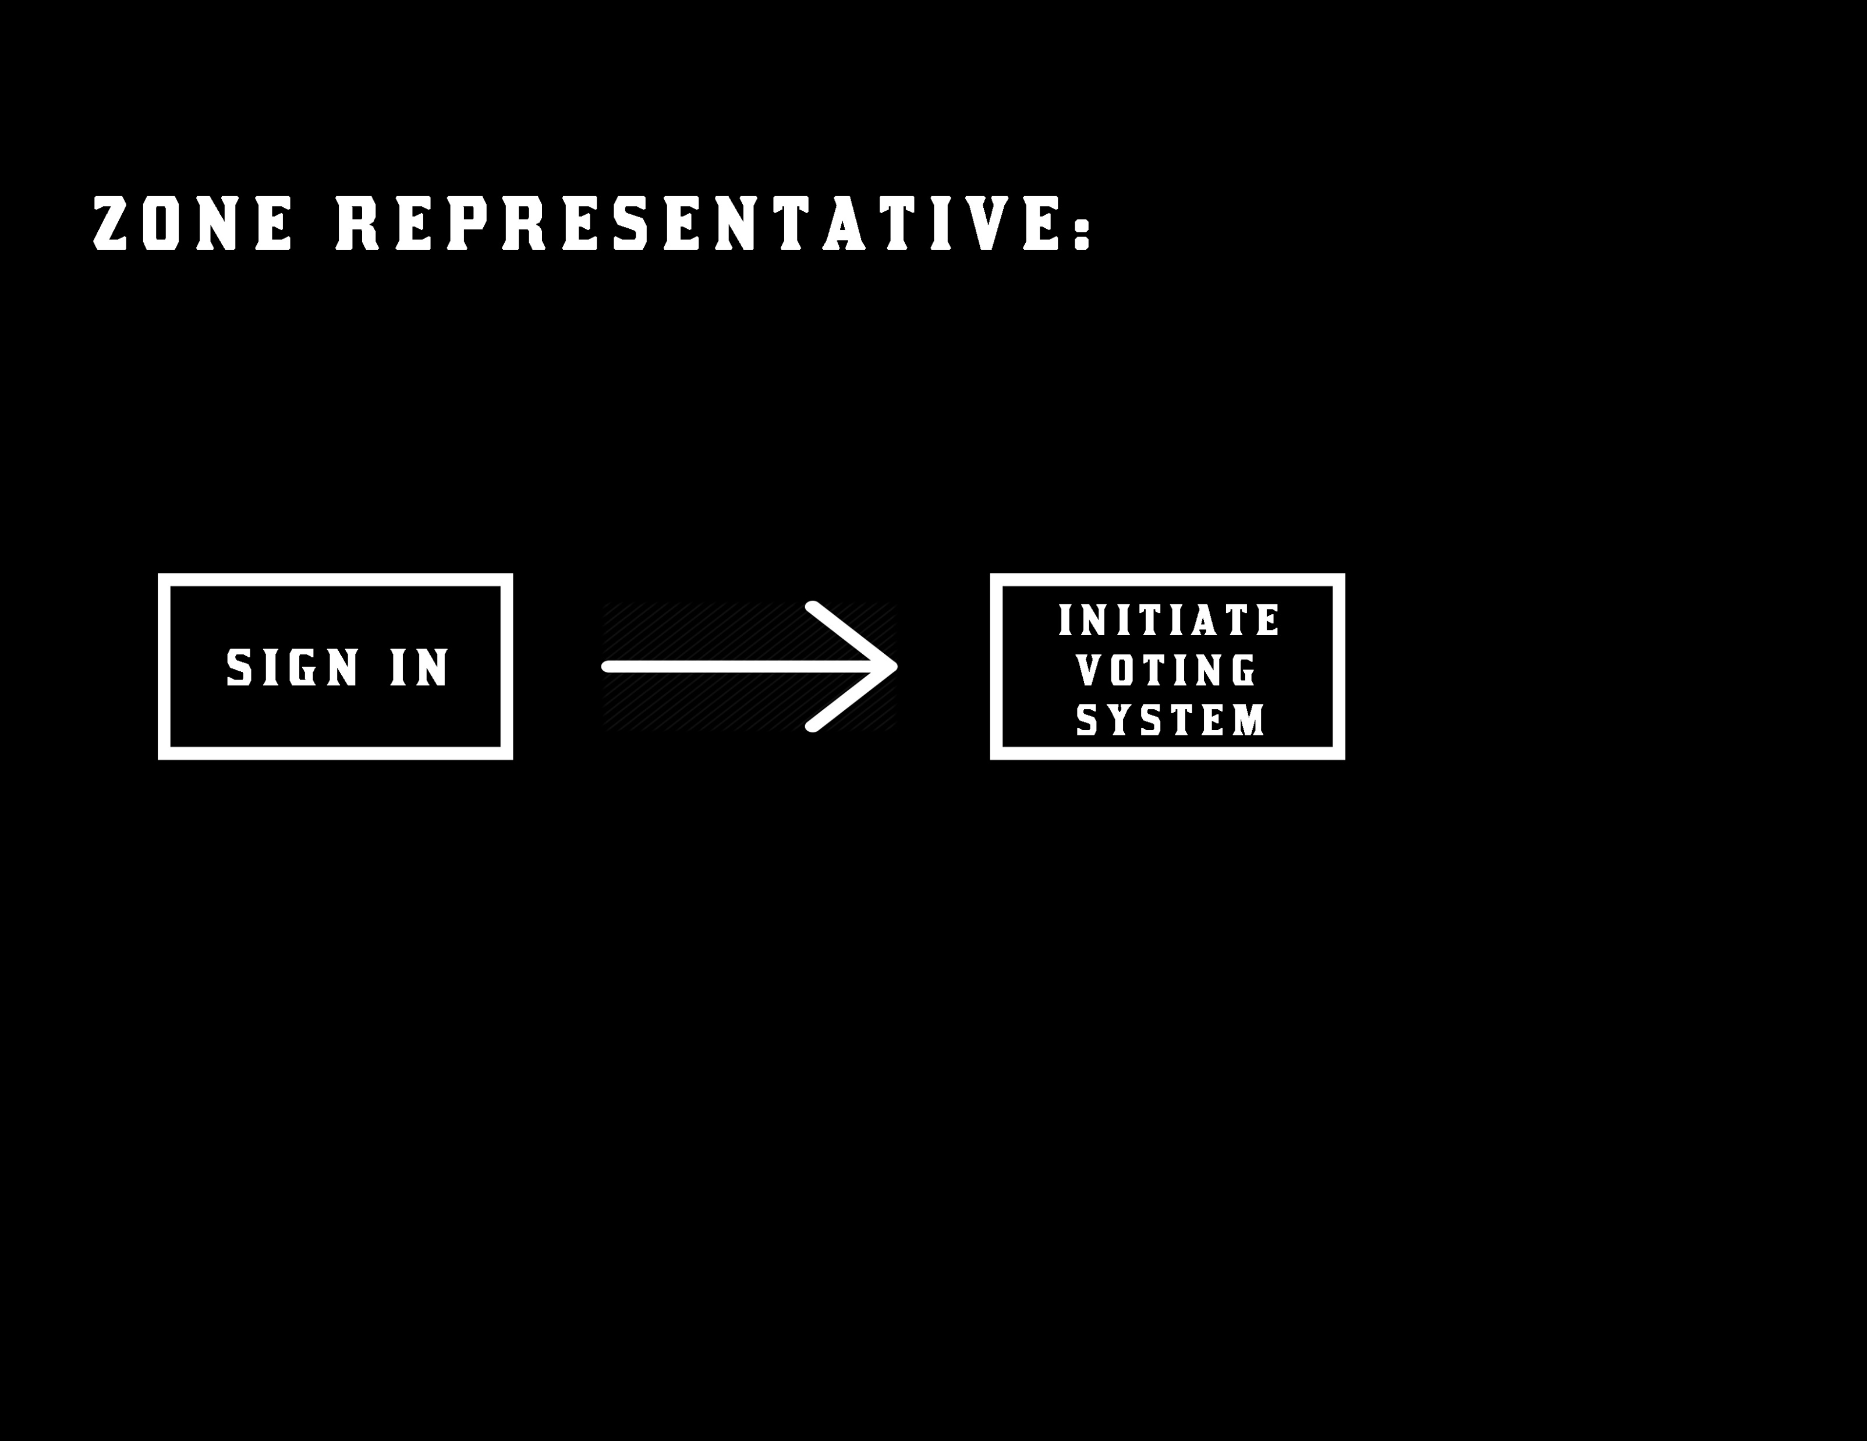

Slide 6
Our project provides solution for:
EVM Hack
Location Independent
Instant Results

Slide 7
Our project is divided into three phase:
Registration Phase
Polling Phase
Result Phase

