Slide 1
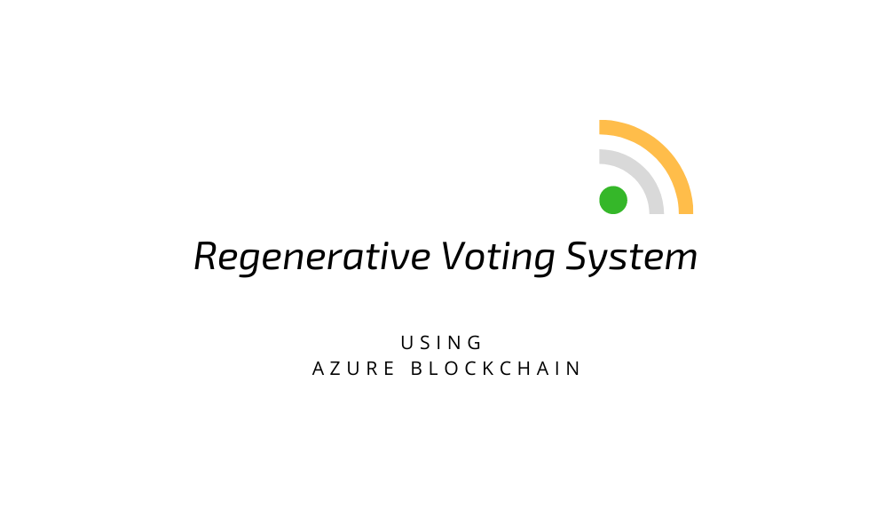

Slide 2
Updates Made
Created GUI for Registration phase.
Migrated from local database to cloud database, this was implemented to make the application access from anywhere.
Added Face Recognition for enhanced security.

Slide 3
Roles in our system
Election Head
Zone Representative
Voter

Slide 4
Election Head:
Add Candidates
Sign In
Calculate
Results

Slide 5
Zone Representative
Sign in
Initiate
Voting Phase

Slide 6
Voter:
Rasberry PI
RFID
Face
Recognition
Verification with the database
Sign in
Voter Id
Vote in the
BlockChain

