Slide 1
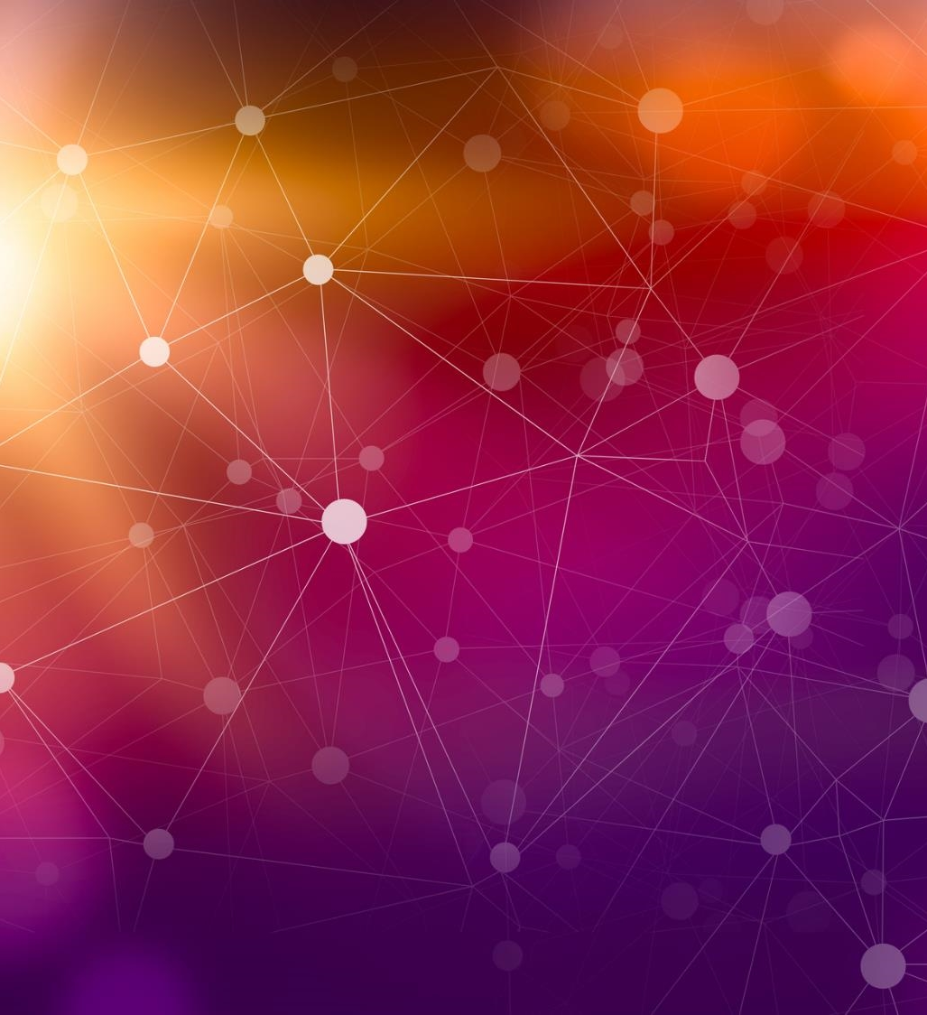
Exploring Neural Network Approaches for Alzheimer's Disease Detection: An Analysis of RNN and CNN Performance
Ritu Priya Singh, Sandeep Kumar, Saloni Singh, Fateh Singh Rana, Dikshit Kukreja, Akarsh Anand, Neelesh Sharma
Lovely Professional University

Slide 2
Agenda
Introduction
Related Works
Research Methodology
Result and Discussion
Future Scope
Conclusion
Acceptance and Publication

Slide 3
Introduction The Growing Challenges of Alzheimer’s Disease
Alzheimer’s as a Global Concern
Impact on the Population
Disease Progression and Impact
Societal and Economic Burden
Importance of Early Detection

Slide 4
Related Works
Algorithm | Data Type | Accuracy | Year | Highlights
SVM | Image Data | 92% | 2021 | Effective for complex pattern recognition in AD detection
CNN | Neuroimaging | 90.8% | 2021 | High capability in feature extraction from visual data
RNN | Longitudinal patient data | 95% | 2023 | Strong in handling sequence data, useful for tracking AD progression
RF | Various, including cognitive data | 73.8% AUC | 2021 | Best precision and AUC for AD progression classification
Multiple (DT, RF, SVM, LR, KNN) | Multiple datasets (ADNI, OASIS) | 71% to 90.25% | 2020 | Comparative study revealing strengths of different approaches

Slide 5
Research Methodology
Dual Model Approach
CNN Model Process
RNN Model Process
Algorithmic Steps:
Start: Initial point marking the beginning of the machine learning model development process.
Data Input: Relevant data from sources like Kaggle and OASIS used for training the model.
Data Pre-Processing: Preparation of data including handling missing values, normalization, and data augmentation for cleaning and suitability.
Model Building: Construction of the machine learning model involving selection of appropriate architecture and algorithms.
Model Evaluation and Testing: Testing the trained model against the dataset using evaluation parameters like accuracy and precision.
End: Conclusion of the model development process, marking the completion of tasks in the workflow.

Slide 6
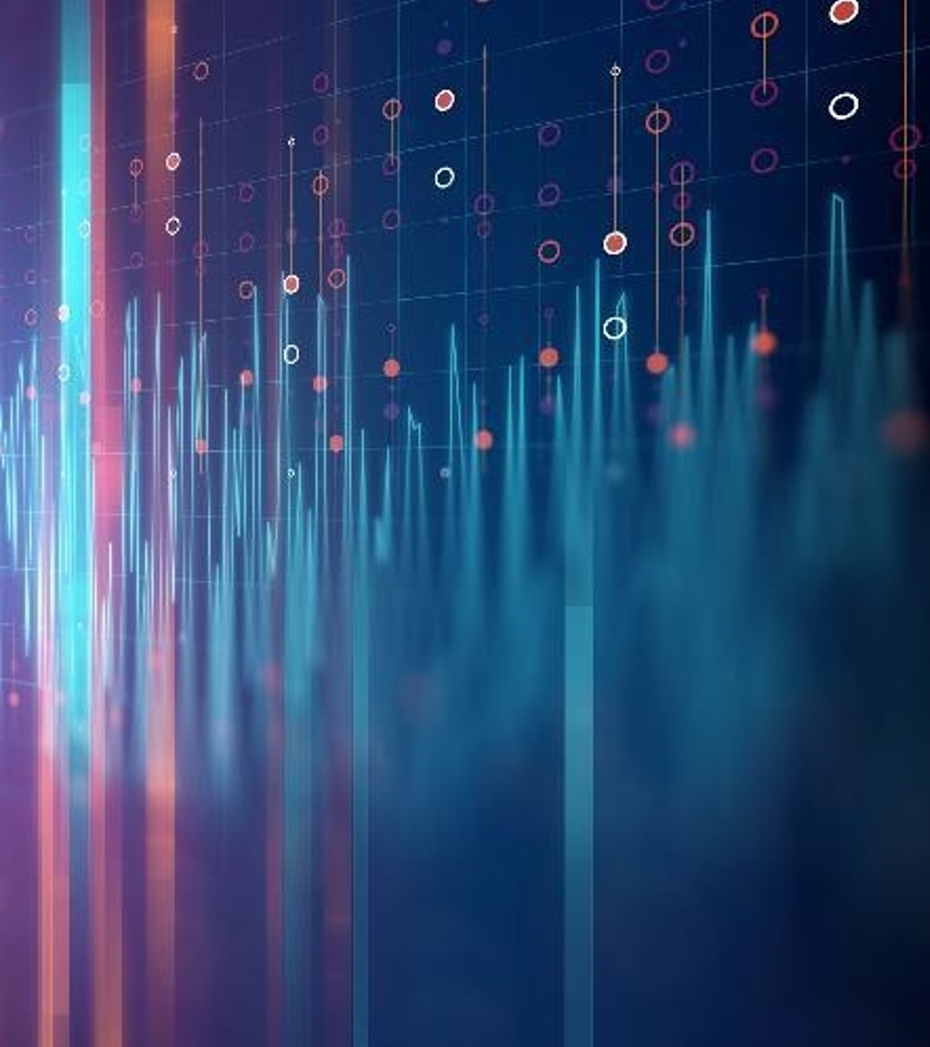
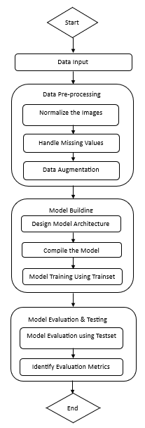
Our Model Workflow

Slide 7
Result and Discussion
Utilization of CNN and RNN Models
Data Sources and Preprocessing
Model Architecture and Training
Performance Evaluation
Results and Insights
Future Directions

Slide 8
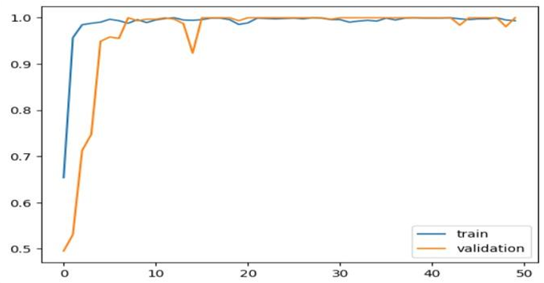
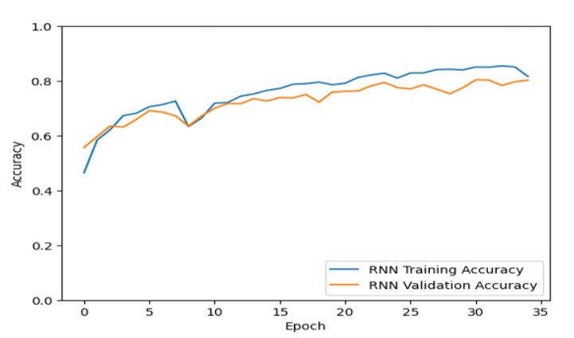
Our Accuracies Graph of CNN & RNN
Accuracy Graph of CNN- 100% (OASIS Dataset)
Accuracy Graph of RNN- 80.27% (Kaggle Dataset)

Slide 9
Our Result Comparison with Other Works

Slide 10
Future Scope
Leveraging Larger Datasets
Enhanced Model Design
Sophisticated Data Augmentation Strategies
Integration of Multimodal Data
Clinical Translation and Validation

Slide 11
Conclusion
Effectiveness of CNN and RNN
Achieved Accuracies
Future Advancements
Importance of Research and Development
Clinical Applicability

Slide 12
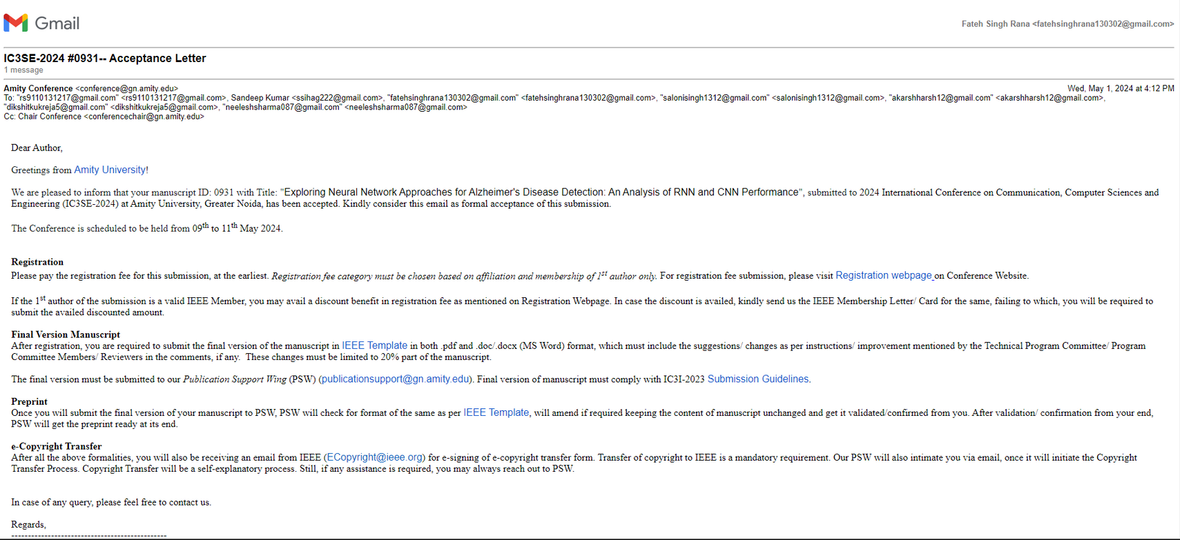
Acceptance and Publication

Slide 13
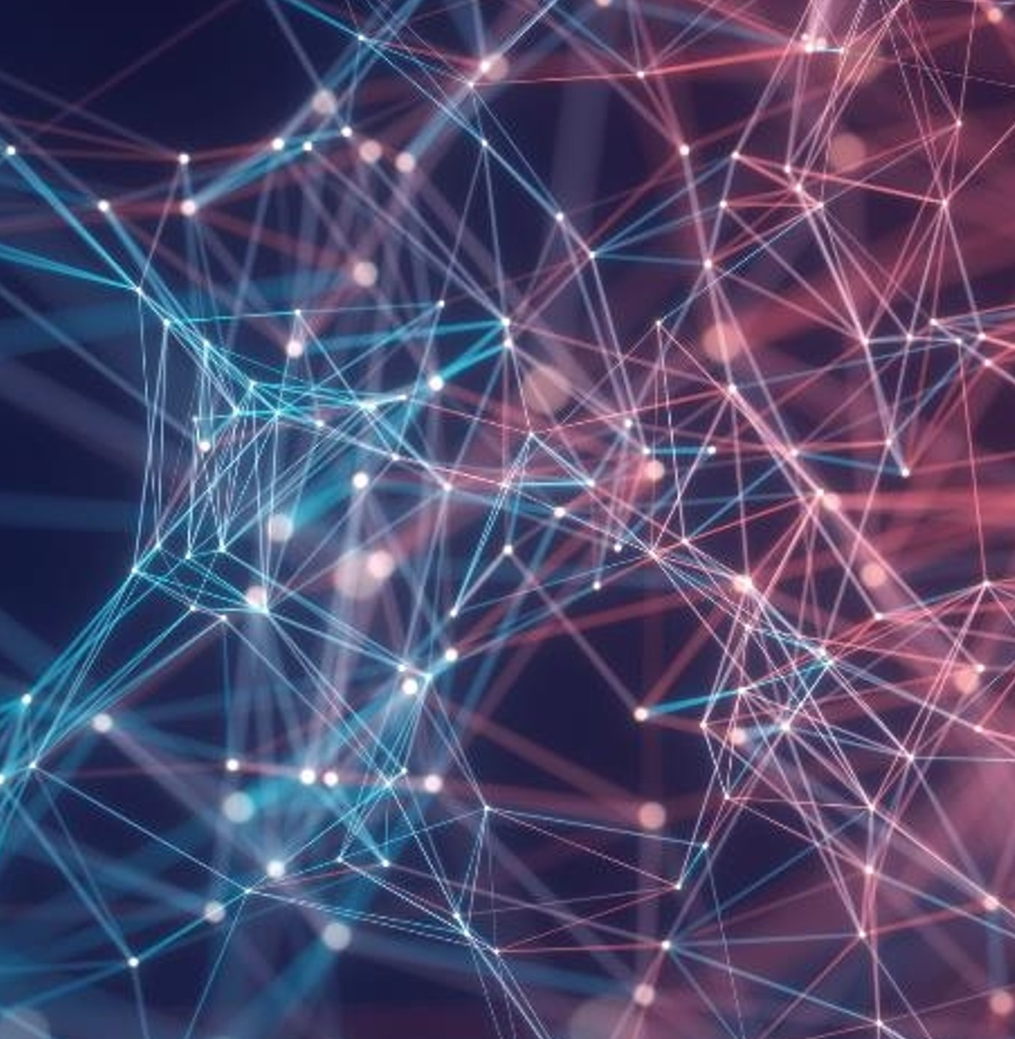
Thank you

