Slide 1

SǪL and Databases:
Project Report
Name: Vamsi Krishna Bommu
Batch: PGPDSBA.APRIL23.B
Proprietary content. © Great Learning. All Rights Reserved. Unauthorized use or distribution prohibited.

Slide 2
Overview
No of Precinct
No of total crimes reported
No of areas
No of offenders
5
800
23
345
No of officers
Total population
No of CCTV
Count of cases where status is IC
70
fi00000
fi60
fifi0

Slide 3
Metrics

Slide 4
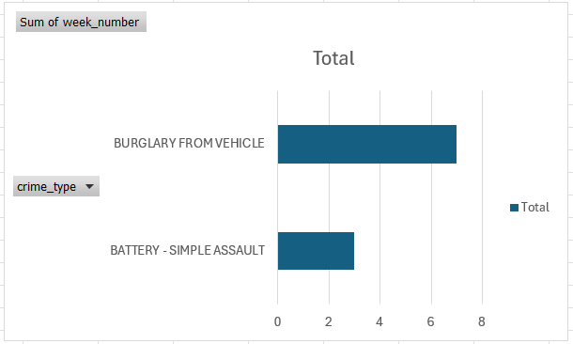
Distribution of most frequent crimes occurred on weekly basis
The most frequent crime reported on a weekly basis is "BATTERY - SIMPLE ASSAULT," accounting for 3 occurrences out of a total of 10 reported incidents.
"BURGLARY FROM VEHICLE" follows with 7 occurrences, indicating it's the most prevalent crime type during the observed period.

Slide 5
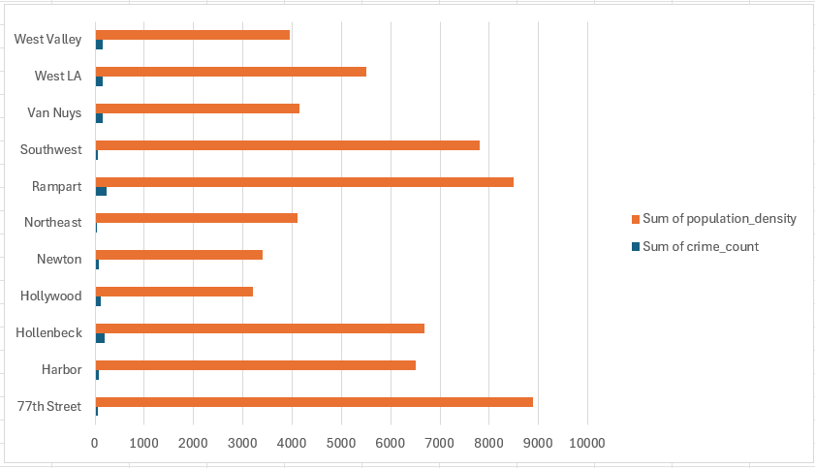
Chart to compare population density, precinct area, officer’s count with crime rate
Areas with higher population densities, such as Rampart and 77th Street, tend to have higher crime counts, suggesting a possible correlation between population density and crime rates.
Precincts with larger areas, like West LA and Hollenbeck, also show relatively high crime counts, indicating that the geographical size of a precinct may influence the occurrence of crimes.

Slide 6
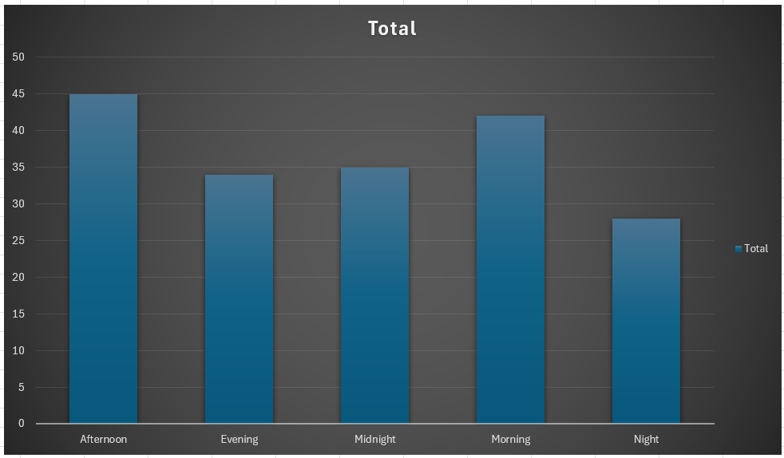
Distribution to see which crime types are most prevalent throughout the day
Crime types such as "Battery - Simple Assault," "Theft-Grand," and "Burglary from Vehicle" are more prevalent during the midnight and early morning hours.
Crimes like "Shoplifting - Petty Theft" and "Assault with Deadly Weapon" show higher counts during the afternoon and evening hours, suggesting different patterns of criminal activity throughout the day.

Slide 7
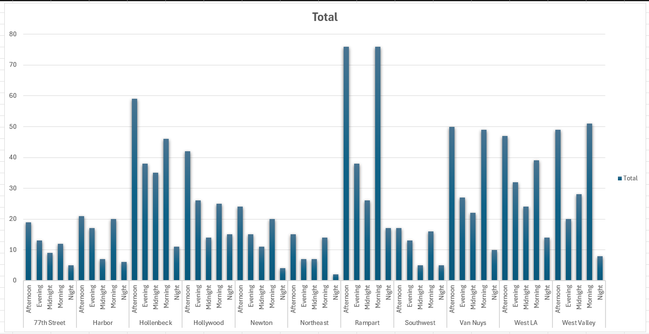
Distribution to see each area’s maximum crimes reported across a day
Morning and afternoon periods witness the highest crime rates in areas like Rampart and Van Nuys.
Evening and night crime rates vary across neighborhoods, indicating a need for location-specific safety measures.

Slide 8
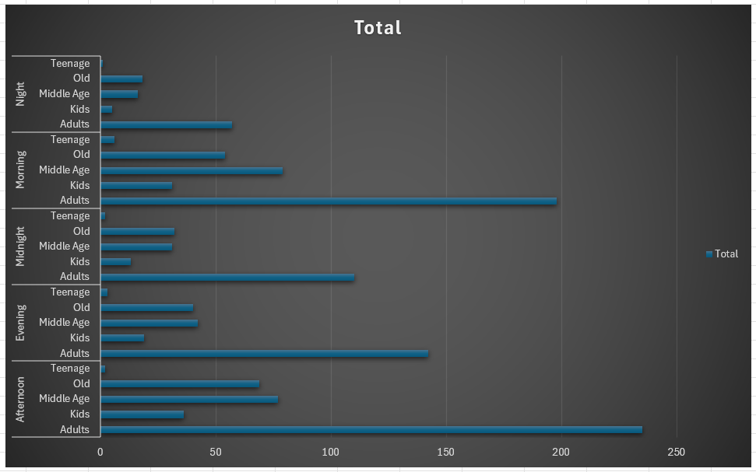
Distribution of the crime rate for victims of various ages over the course of a day
Adult victims are the most frequent targets of crimes, especially in the afternoon.
Crime incidents involving kids and teenagers are comparatively lower, with the least occurring at night.

Slide 9
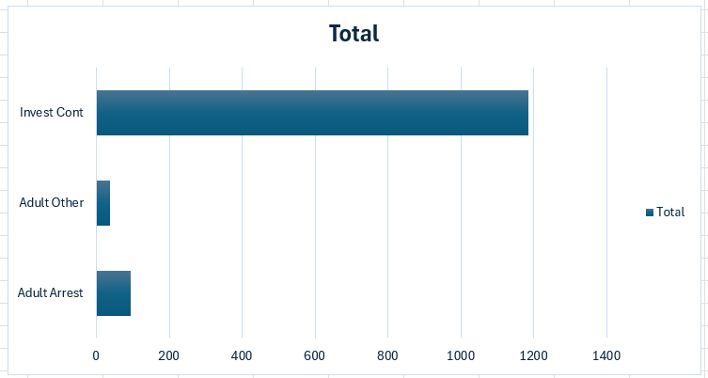
Distribution of the case status across a week
The majority of cases are under investigation (Invest Cont), indicating a high number of ongoing investigations.
Arrests and other resolutions involving adults are significantly lower in comparison, showing a smaller proportion of cases leading to immediate legal actions.

Slide 10
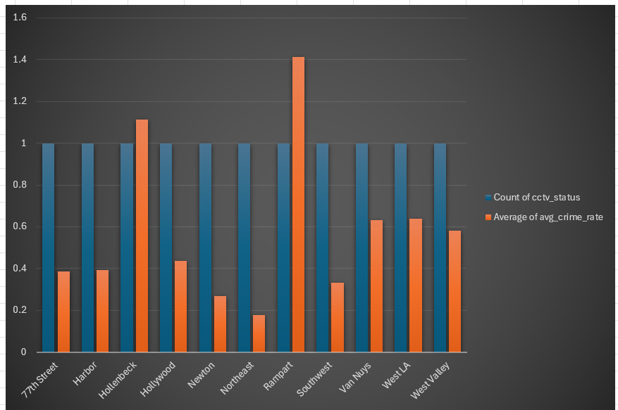
Distribution of area and CCTV count in relation to crime rate
Areas with CCTV, such as Rampart and Hollenbeck, show a higher average crime rate, suggesting active surveillance may be correlating with higher reported crime rates.
Despite having CCTV, the variation in crime rates across areas like West Valley and Northeast indicates that other factors besides surveillance intensity might influence crime occurrences or reporting rates.

Slide 11
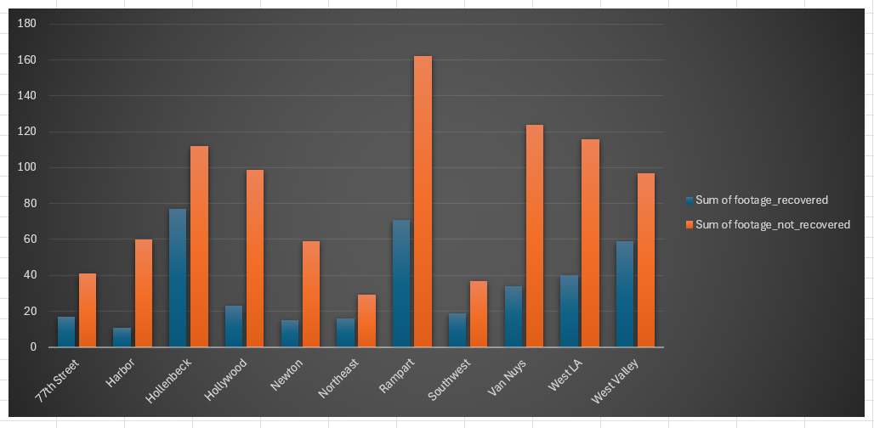
Distribution to see whether CCTV footage is available or not at the crime scene for each area
Hollenbeck and Rampart have the highest counts of CCTV footage recovered, indicating potentially better surveillance infrastructure or more effective retrieval processes in these areas.
While some areas like Harbor and Northeast have lower overall counts of CCTV footage recovered, the ratio of recovered to not recovered footage varies, suggesting differences in CCTV maintenance or usage practices across different regions.

Slide 12
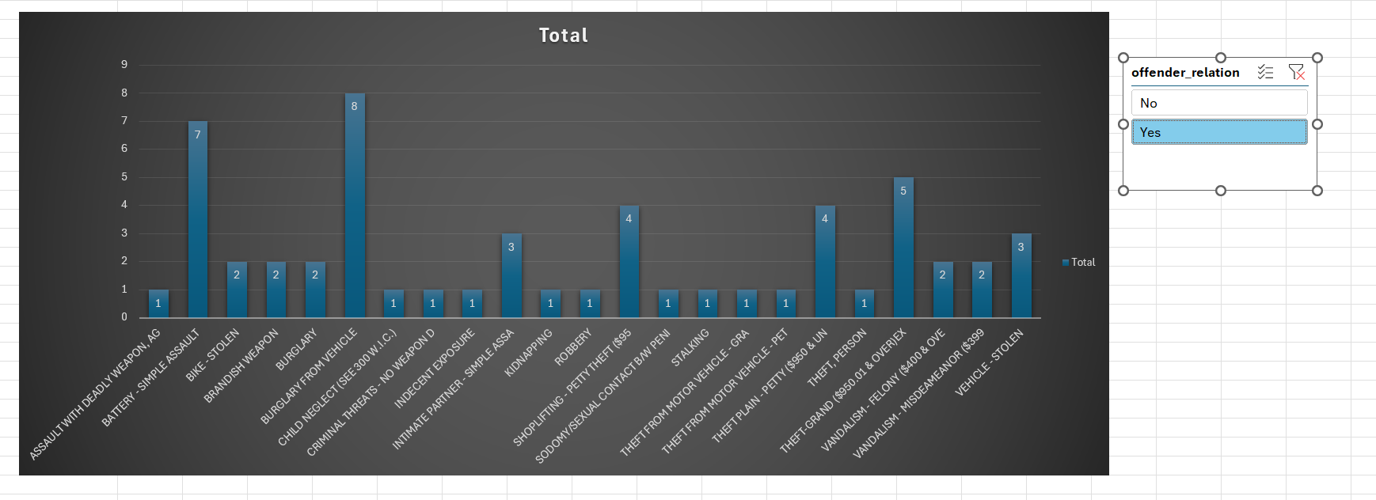
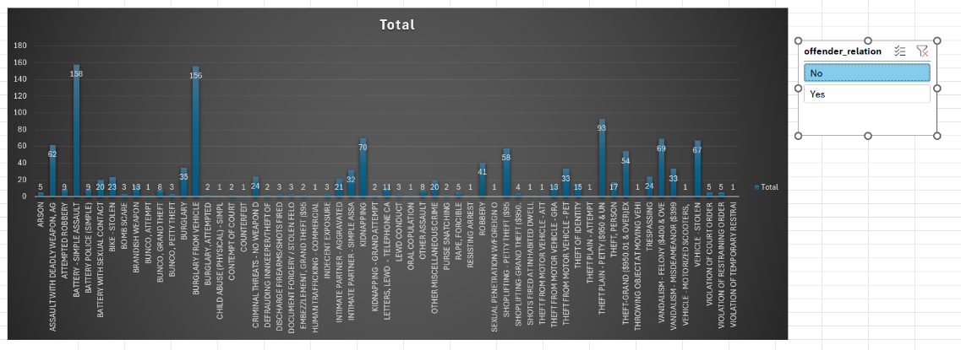
Crimes committed by relation of victim/strangers
The majority of crimes are committed by strangers, with offenses like battery, theft, burglary, and assault being the most common.
However, there are a few instances where crimes are committed by individuals known to the victim, particularly in cases of burglary from a vehicle and simple assault, highlighting the significance of interpersonal relationships in certain types of criminal activity.

Slide 13
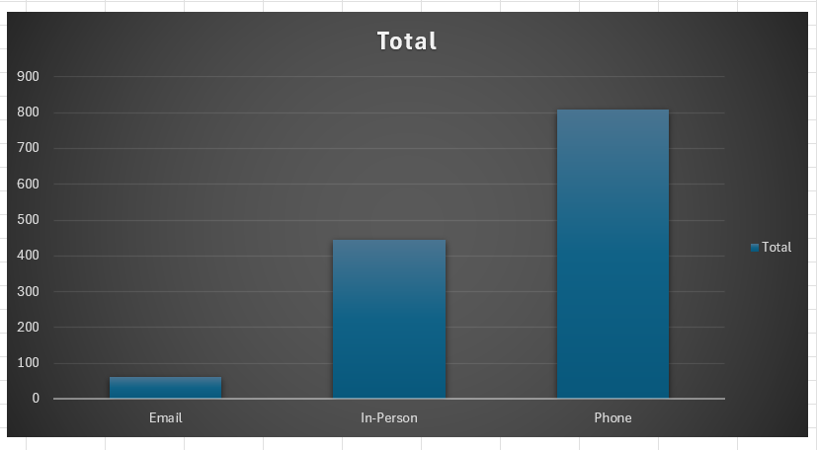
Distribution for the complaint type and the crime rate
The majority of crime reports are made via phone, indicating that it's the most preferred method of reporting incidents to authorities.
In-person reports are the second most common, suggesting that some individuals still prefer to directly interact with law enforcement or visit police stations to report crimes.

Slide 14
—

Slide 15
Insights and Recommendations
Crime rates exhibit distinct patterns throughout the day, suggesting the importance of targeted policing during peak hours.
The presence of CCTV cameras may deter crime in certain areas, highlighting the potential benefits of surveillance.
Crimes involving known offenders differ from those involving strangers, indicating the need for tailored intervention strategies.
Understanding preferred reporting channels can enhance the accessibility and efficiency of crime reporting mechanisms.
Analysis of case statuses enables law enforcement to identify areas for improvement and resource allocation.
High-crime areas can be targeted for proactive policing efforts and community engagement initiatives.
Demographic trends in crime rates emphasize the importance of tailored interventions for vulnerable populations.
Data-driven decision-making empowers law enforcement to optimize resources and develop proactive crime prevention strategies.

