Slide 1




Rajasthan Police Hackathon 1.0

Slide 2
RPS
FEEDBACK SYSTEM

Slide 3
Aman Saini
Team Leader
Bhanu Shakya
Team Member
Our Team
Vatsal Shukla
Team Member
Anshul Jain
Team Member

Slide 4
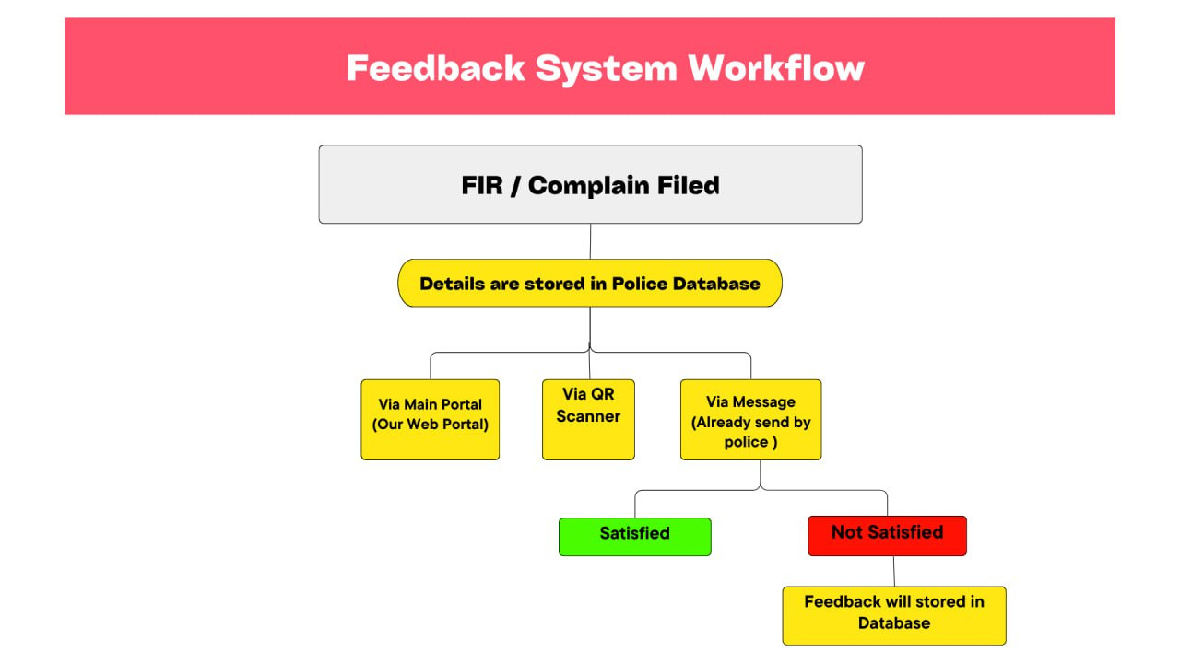

Slide 5
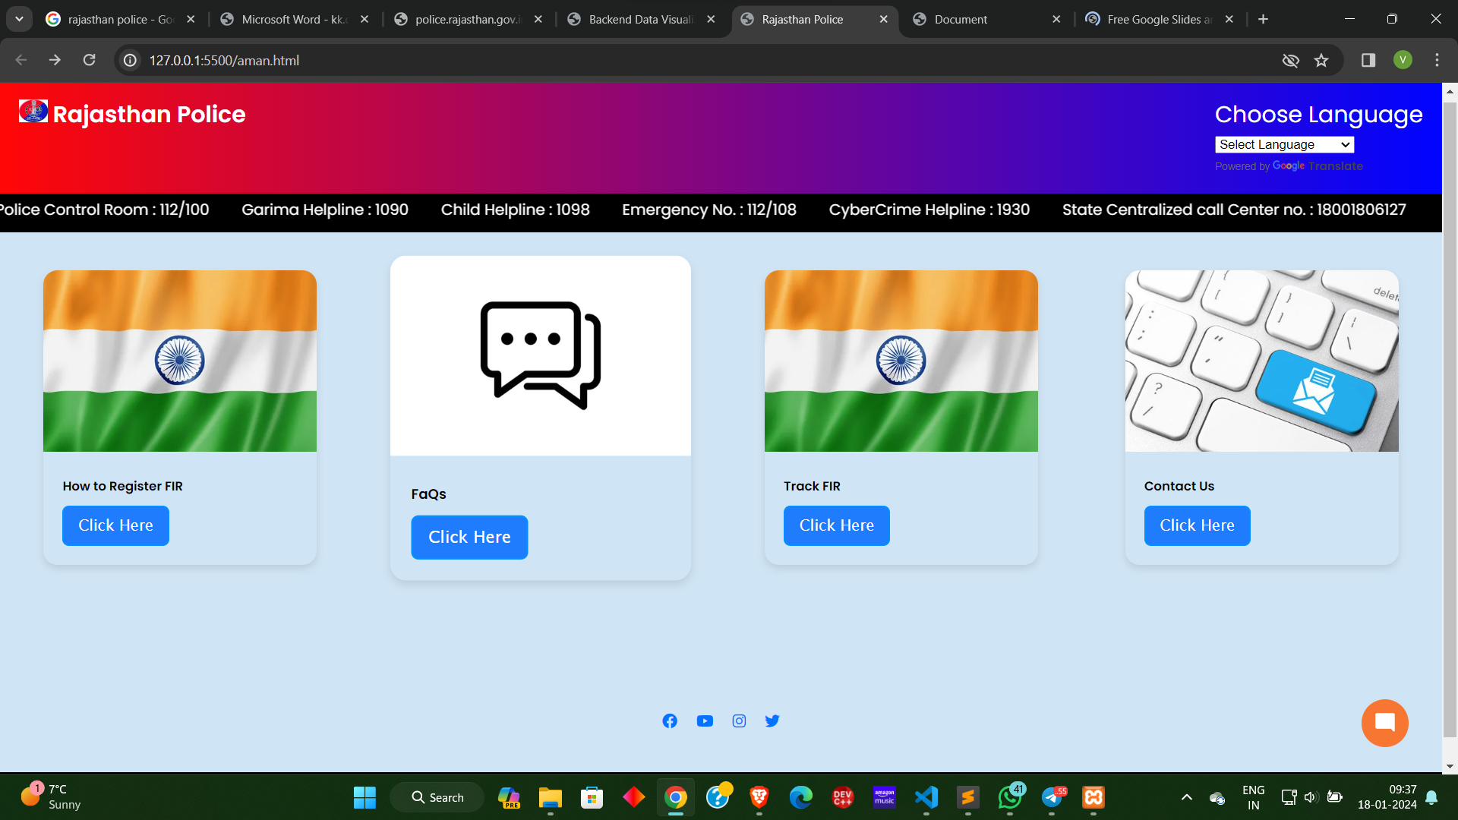

Slide 6
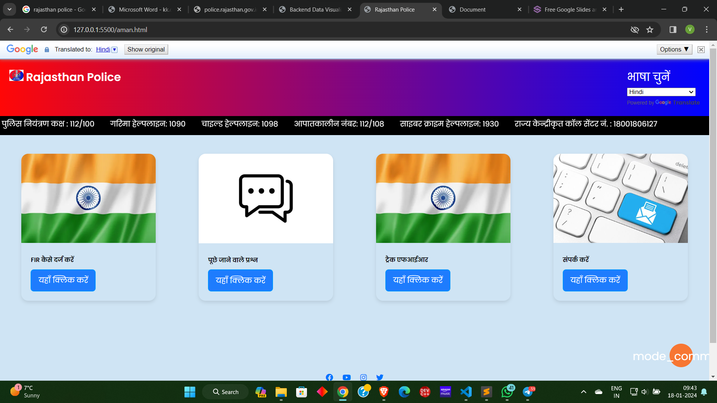

Slide 7
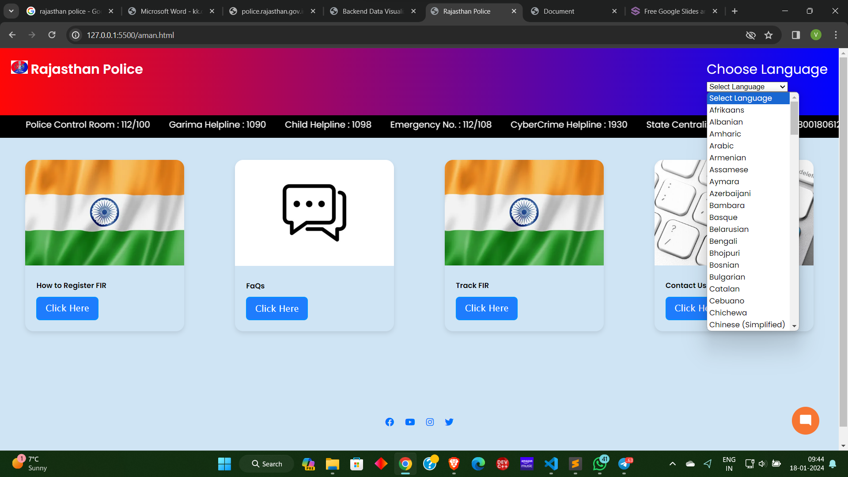

Slide 8
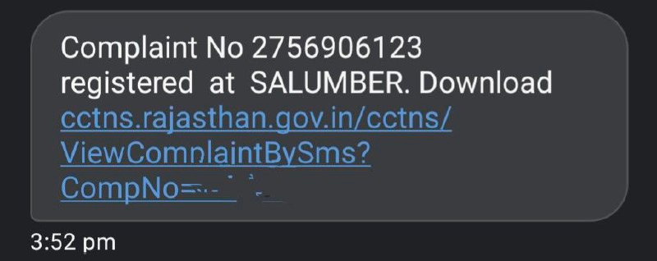

Slide 9
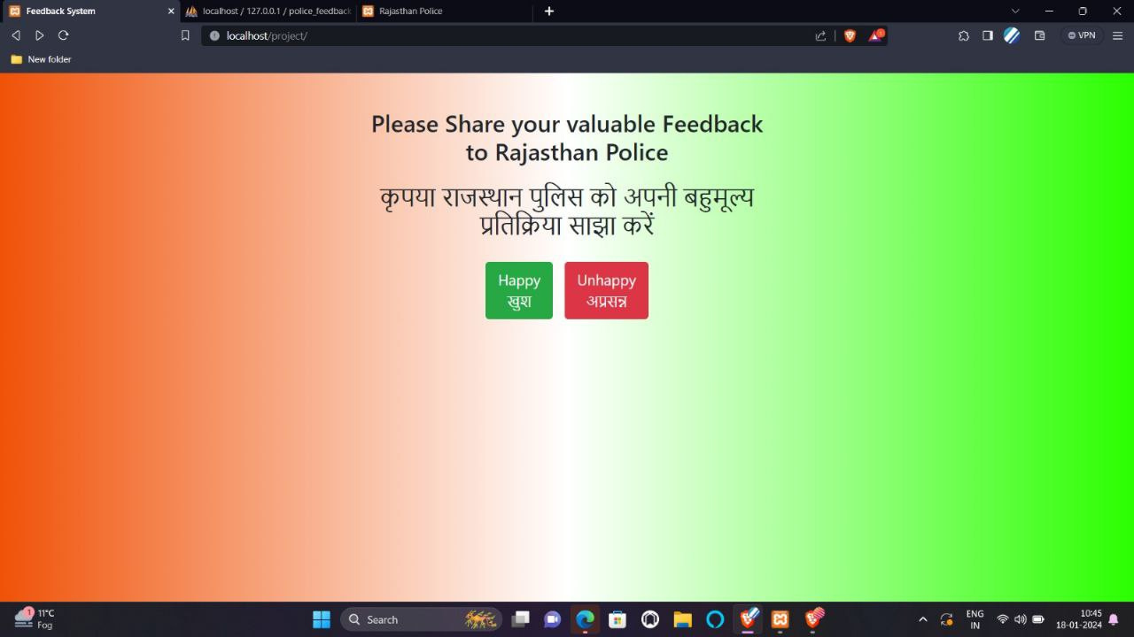

Slide 10
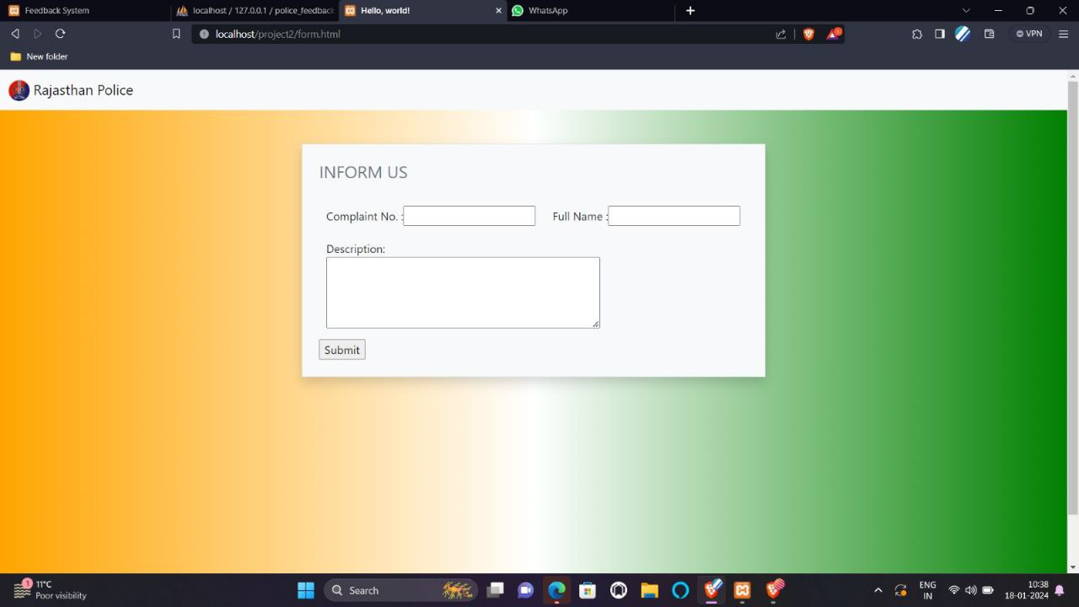

Slide 11
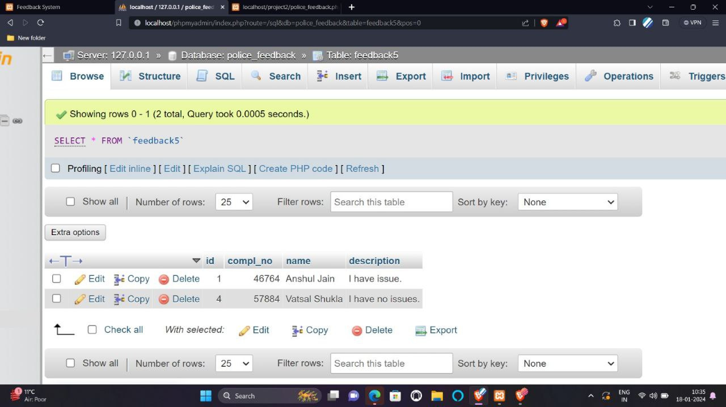

Slide 12







FIR Tracking
Citizen track their FIR
Additional Features
QnA chatbot
Elaborate on your
second goal here.
MULTILINGUAL
Many languages are translated as per user requirement

Slide 13

FUTURE WORK
CALL
BOT
WHATSAPP
BOT
QR SCANNER

Slide 14
THANK YOU!

