Slide 1


Introduction
Git: A distributed version control system.
GitHub: A platform to host and collaborate on Git repositories.
🔑 Main goal: Manage code efficiently and work in teams seamlessly.

Slide 2


Git History
2005 – Git is Created by Linus Torvalds
At the time, the Linux kernel project was using a proprietary version control system called BitKeeper.
Design goals:
Distributed
Fast
Secure
Reliable branching and merging

Slide 3
Github History
2008 – GitHub Launches
Founded by Tom Preston-Werner, Chris Wanstrath, PJ Hyett, and Scott Chacon.
Public launch: April 10, 2008
Purpose:
Make Git easier to use
Provide hosting for Git repositories
Enable collaboration, issue tracking, and code review

Slide 4


Git != GitHub

Slide 5
GIT
version Control System is a tools that helps to track changes in code
Git is a Version Control System. It is:
popular
free & Open Source
fast and Scalable

Slide 6
Primarily 2 use of Git
1) Track the history
2) Collaborate

Slide 7
GitHub
Website that allows developers to store and manage their code using git.
https://github.com
Provides tools for:
Code review
Issue tracking
Pull Requests (PRs)
Collaboration
Project management

Slide 8
Git vs GitHub
Feature | Git | GitHub
Type | Version Control Tool | Cloud Hosting Platform
Works Locally | ✅ | ❌ (Needs Internet)
Collaboration | Limited (local only) | Full (PRs, Issues, Comments)
Interface | Command Line | Web-based GUI

Slide 9
GitHub Account
. Create a new repository
. make our first commit

Slide 10
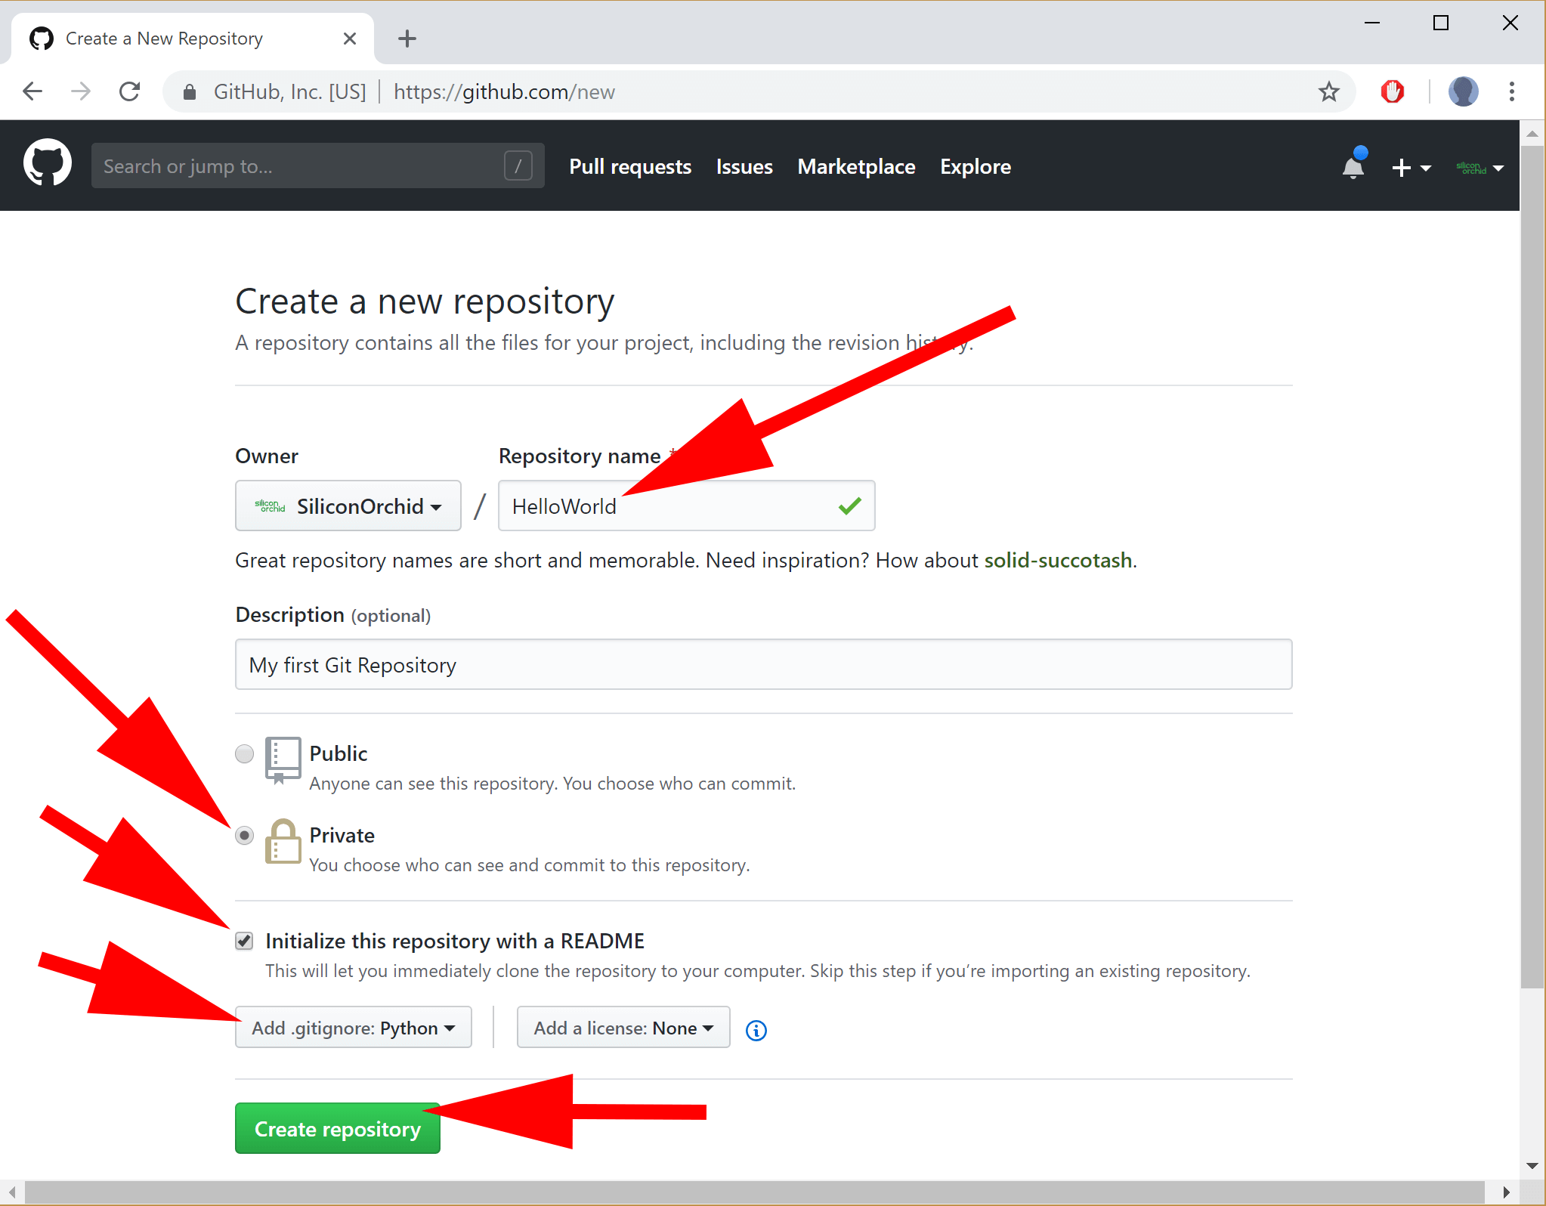

Slide 11
Setting up Git
Visual studio Code
git --version

Slide 12
Configuring Git
git config --global user.name "my name"
git config --global user.email "someone@gmail.com"
git config --list

Slide 13
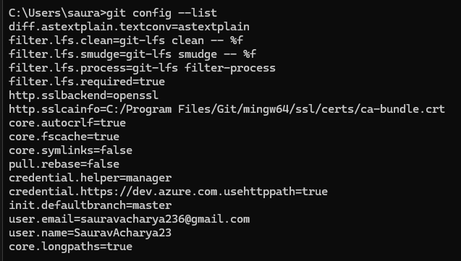

Slide 14

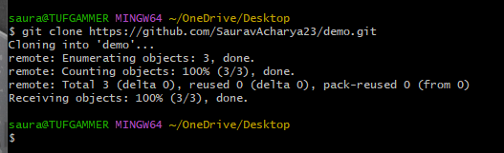
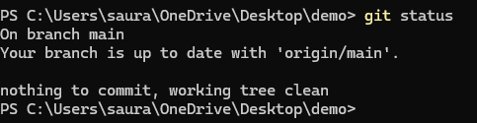
Clone & Status
Clone - Cloning a repository on our local machine
git clone <-some link->
status - displays the state of code
git status

Slide 15


Untracked
- new files that git doesn't yet track
Modified
- changed
Staged
- file is ready to be committed
Unmodified
- unchanged

Slide 16

Add and Commit
add- adds new or changed files in your working directory to the Git staging area.
git add <-file name->
git add .
commit - It is the record of change
git commit -m "some message"

Slide 17
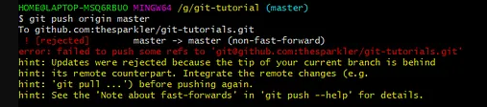
Push Command
Push
- upload local repo content to remote repo
git push origin main

Slide 18
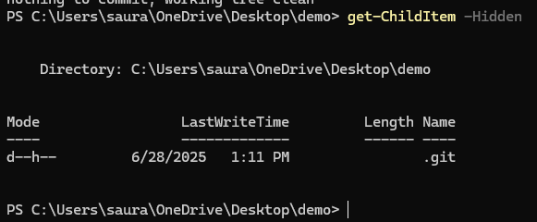



Init Command
init - used to create a new git repo
git init
git remote add origin <-link->
This command adds a new remote repository named "origin" to your local Git configuration.
git remote -v (to verify remote)
This command lists all configured remote repositories and their URLs.
The -v flag stands for "verbose" and shows both fetch and push URLs.
git branch (to check branch)
This command lists all local branches in your repository.
git branch -M main (to rename branch)
This command renames the current branch to "main".
-M is a combination of --move --force, which forces the rename even if "main" already exists.
git push origin main
This command pushes your local "main" branch to the remote repository named "origin".

Slide 19
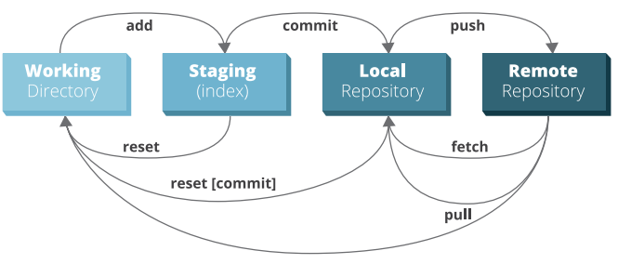
WorkFlow
Clone Repository
Create Branch
Make Changes
Add & Commit
Push to GitHub
Create Pull Request
Review & Merge

Slide 20

Git Branches

Slide 21
Branch Commands
git branch (to check branch)
Lists all local branches in your Git repository.
git branch -M main (to rename branch)
Renames the current branch to main (or another specified name).
git checkout <-branch name-> (to navigate)
Switches to an existing branch.
git checkout -b <-new branch name-> (to create new branch)
Creates a new branch and switches to it immediately.
-b glag Create a new branch before checking it out.
git branch -d <-branch name-> (to delete branch)
Deletes a local branch (only if it has been merged).

Slide 22

Alternate Branch Commands
git branch <-newbranch name->
Create new branch that you have specified
git checkout <-branchname->
Switches to an existing branch.

Slide 23
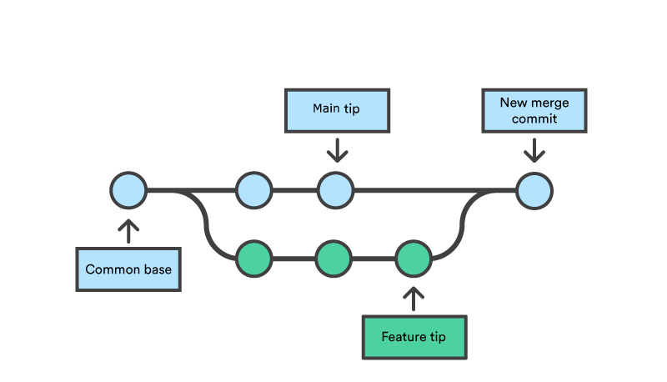
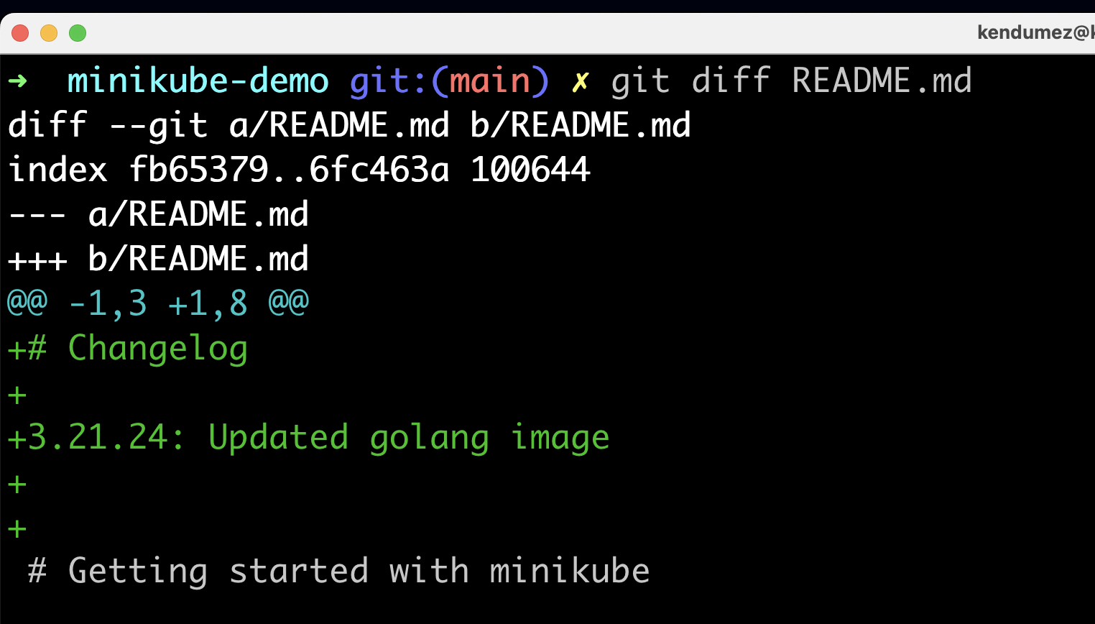
Merging Code
Way 1
git diff <-branch name-> (to compare commits, branches, files & more)
git merge <-branch name-> (to merge 2 branches)
Way 2
Create a PR (Pull Request)

Slide 24
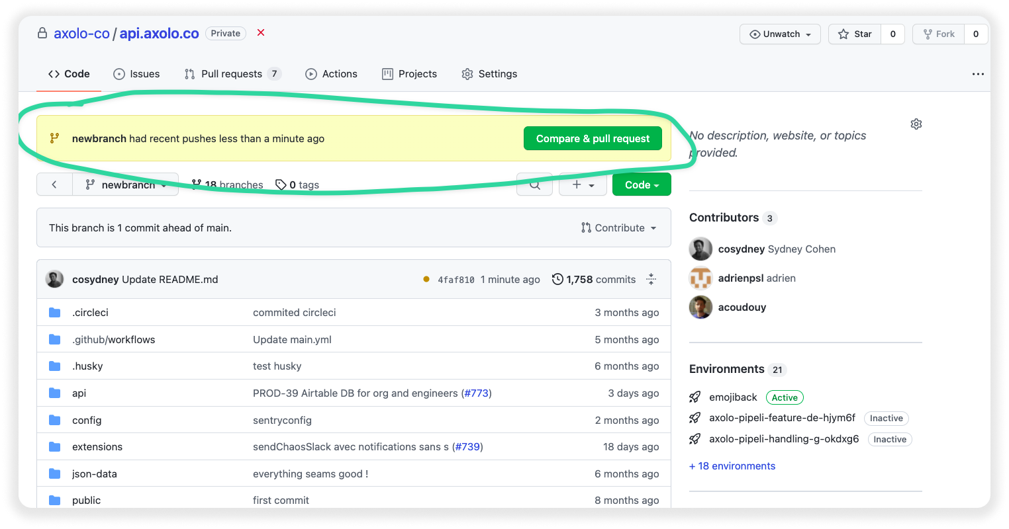
Pull Request
It lets you tell others about changes you've pushed to a branch in a repository on GitHub.

Slide 25

Pull Command
git pull origin main
- used to fetch and download content from a remote repo and immediately update the local repo to match that content.

Slide 26

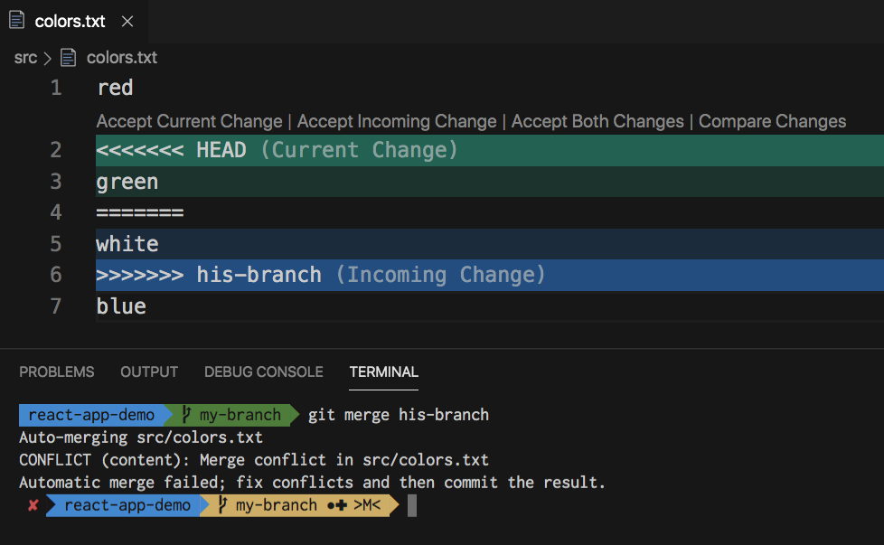
Resolving Merge conflicts
An event that takes place when Git is unable to automatically resolve differences in code between two commits.

Slide 27
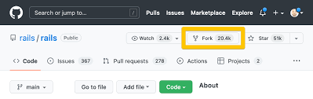
Fork
A fork is a repository that shares code and visibility settings with the original "upstream" repository.
Fork is a rough copy.

