Slide 1
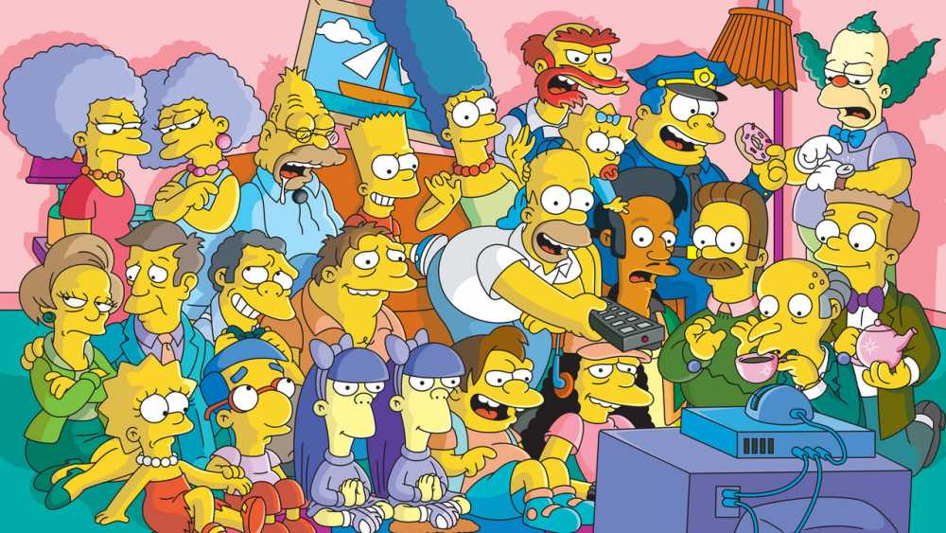
Image Detection of Simpsons Characters
DAEN 690 Project
Summer 2019

Slide 2


Problem Definition and Planning
Project Phase
Sprint 1 – Week 2 Presentation
4 June 2019

Slide 3
Project Sprints
Sprint
Milestone Goals
Presentation
Problem Definition and Project Plans
Problem (decision) defined
Understanding of complexity
Potential data source identified
Potential analytics identified
Project schedule defined
Participant roles assigned
Risks identified and mitigation plan
Mid-Sprint 28 May; Full Sprint 4 Jun
Data Sets
Data located and accessed
Initial processing underway
Risks identified and mitigated
Mid-sprint 11 Jun;
Full Sprint 18 Jun
Analytics/algorithms
Algorithms defined and coded
Initial applications completed
Risks identified and mitigated
Mid-sprint 25 Jun
& 2 Jul;
Full Sprint 9 Jul
Visualizations
Visualization concepts defined
Visualization implemented
Risks identified and mitigated
Mid-sprint 16 Jul;
Full Sprint 23 Jul
Final Presentations
Project components completed
Project components integrated
Project supports final decision
Presentation made
Mid-Sprint 30 July;
Full Sprint 6 Aug

Slide 4
Sprint Goals
Participant roles assigned
Define Problem Statement
Define Project scope – include core and stretch goals
Develop high level Project Timeline/Project plan
Technology
GitHub repository setup – code & other artifacts
Define individual laptop setup requirement (software/tools/versions)
Identify topics for learning
Understanding of complexity
Risks identified and mitigation plan defined.

Slide 5
Team Organization
Team Roles:
Product Owner – Ravi Rane
Scrum Master – Manju Prasad
Developer – Yinchen Niu
Developer – Zegang Liu
Business Rhythm:
All days: Individual work on tasks/as needed collaboration
Sat/Sun afternoon: Sprint planning & meetings, Backlog grooming, Sprint deliverables

Slide 6
Problem Definition
We want to classify Simpson characters from images and from videos.
We also want to extend this functionality when we have multiple characters in an image.
We should be able to recognize each individual character and draw bounding box around each.
We need to have good interface to perform the classification.

Slide 7
Project Scope
Core Scope:
Architecture for Image detection and Image classification
Scope | Deep Learning Architectures to explore
Image Classification | 1. CNN 2. Hybrid CNN-ELM - Image Classification 3. Mask R-CNN - Image Segmentation
Object Detection | 1. Faster R-CNN with different Hyper-parameters 2. YOLO (You only look once) 3. SSD (Single shot Multi-box detection)
Stretch Scope:
Building UI or Visualization
Standardized Framework to support any image classification/object detection use case
Ability to identify Simpson’s characters in a video at pre-defined intervals.
Explore use of Cloud Computing

Slide 8
Project Data
Data for Core Image Classification and Object Detection
400-2000 images for 20 characters from the Simpsons cartoon series
Images are of various sizes, from different scenes and extracted from episodes (season 4 -24).
Images could have multiple characters, with subject character being the primary one or centered in an image
Existing data suffices for all identified algorithms, but may not work as is for Mask R-CNN algorithm.
Data for Stretch scope
May require additional dataset/s to build the standardized framework. Team plans to research this in a later Sprint (post Sprint 3)

Slide 9
Project Plan
Project Timeline:
Timelines for planned work
Project Plan:
High level Goals and associated activities (snippet shown)
Notes:
Suggest we concentrate on Metadata and NLP and NOT Externals other than what results from associations between metadata and content

Slide 10
Technology/Tools
Repository :
GitHub, Github Desktop, OneDrive, GitLab
Development tool:
Jupyter notebook
Compute:
Argo, AWS
Primary Development Language:
Python 3.7.2
ML Libraries:
Tensorflow, Keras, PyTorch (could include others)
Agile board:
YouTrack
Collaboration tools:
Blackboard, Slack, What’sApp Web
Others:
Explore SSD MobileNet for a live demo.
UI framework – JavaScript Libraries (TBD)
*This list may change over time as we further define scope.

Slide 11
DAEN 690
Project Complexity

Slide 12
Project Risks and Planned Mitigation
Risk | Probability | Impact | Mitigations
Computing power required to run image detection code can be high. Risk of programs taking too long to run is possible. This may impact the amount of time the team has to test and implement. | Medium | High | Use GMU’s Argo cluster Use Cloud Computing
Scope includes a few aspirational items, completing of which will be directly dependent on available time. | High | Medium | Prioritization of tasks and communication with team/professors could help mitigate this risk.

Slide 13
Project Assumptions
Images in the dataset are distinct enough to train an image recognition model.
Number of images for each dataset meet the minimal threshold to train a model that can predict with good accuracy.

Slide 14
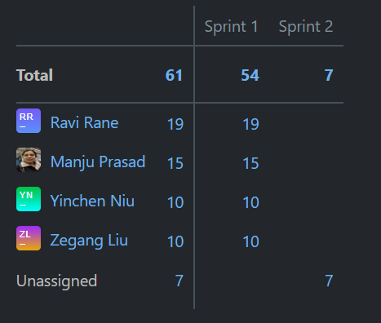
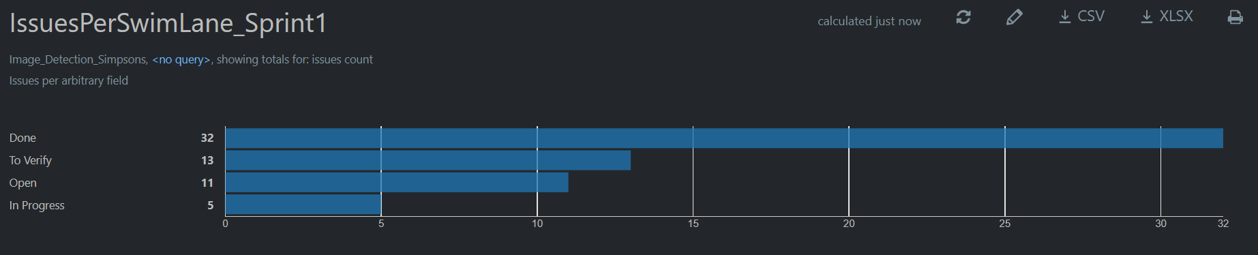
Agile update: YouTrack
Agile report: Task distribution by Sprint
Agile report: Count of Issues by State

Slide 15
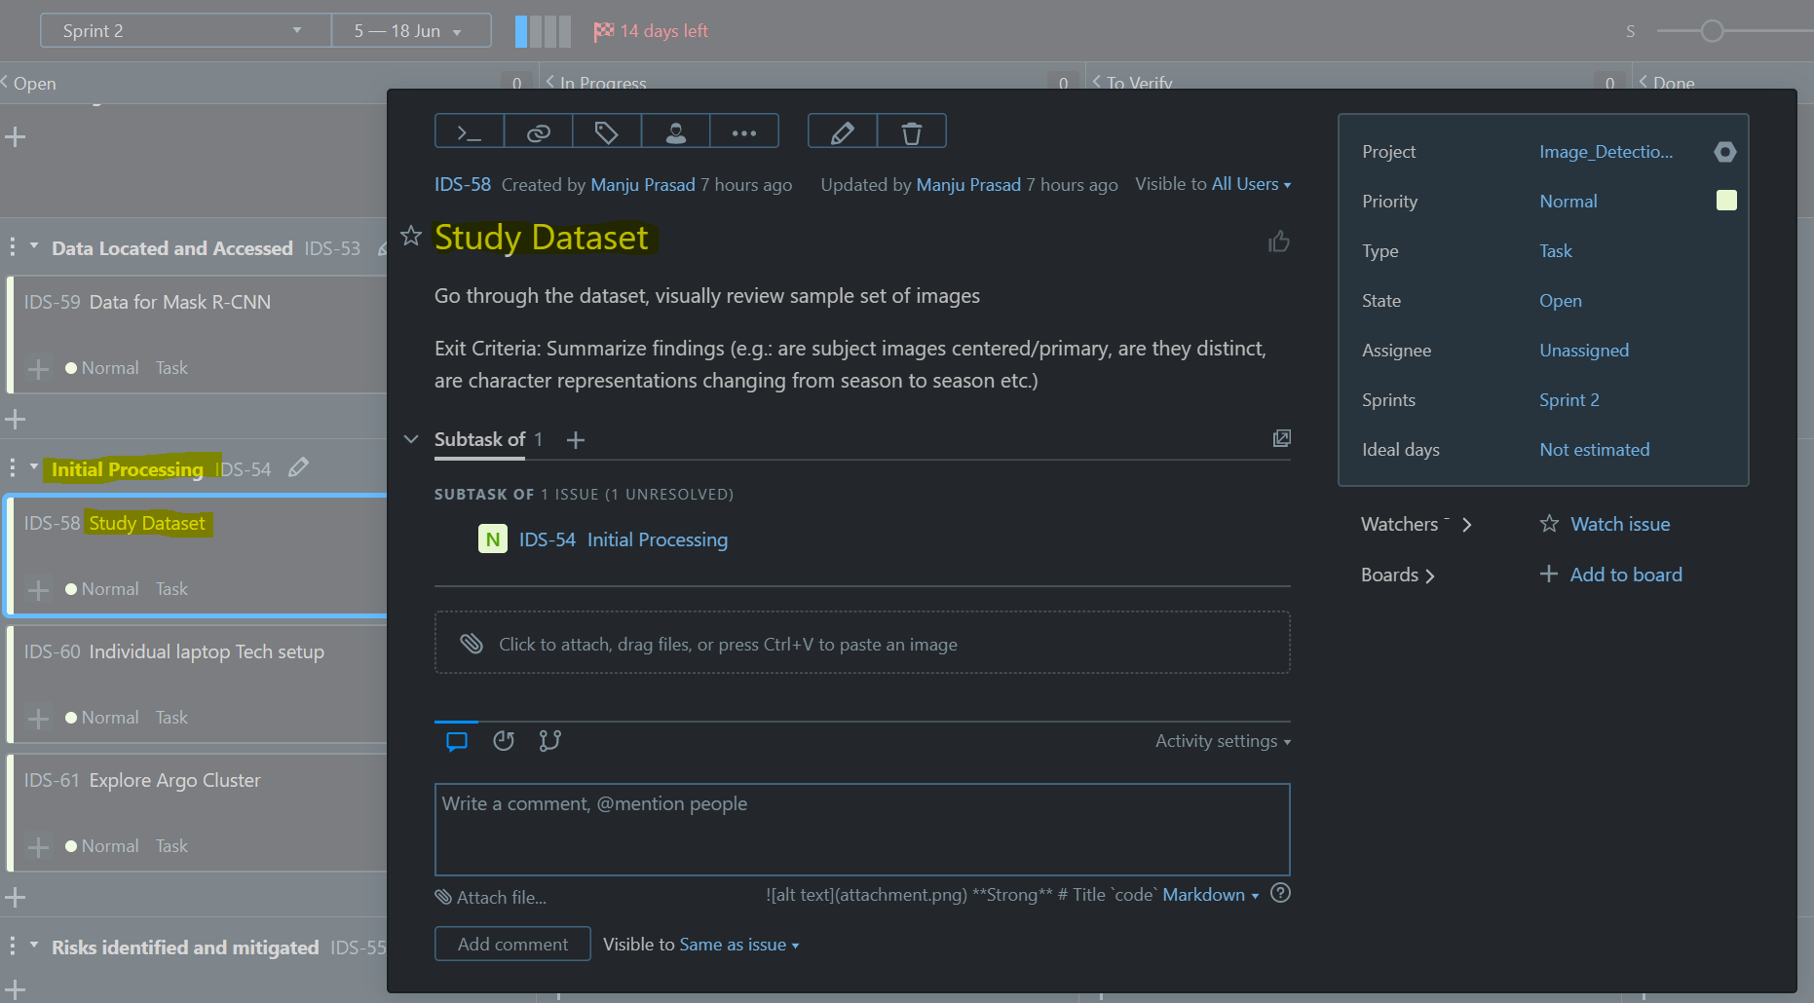
Agile update: YouTrack
Sample Unassigned Task from Sprint 2: Story -> Task -> Description -> Exit Criteria

Slide 16
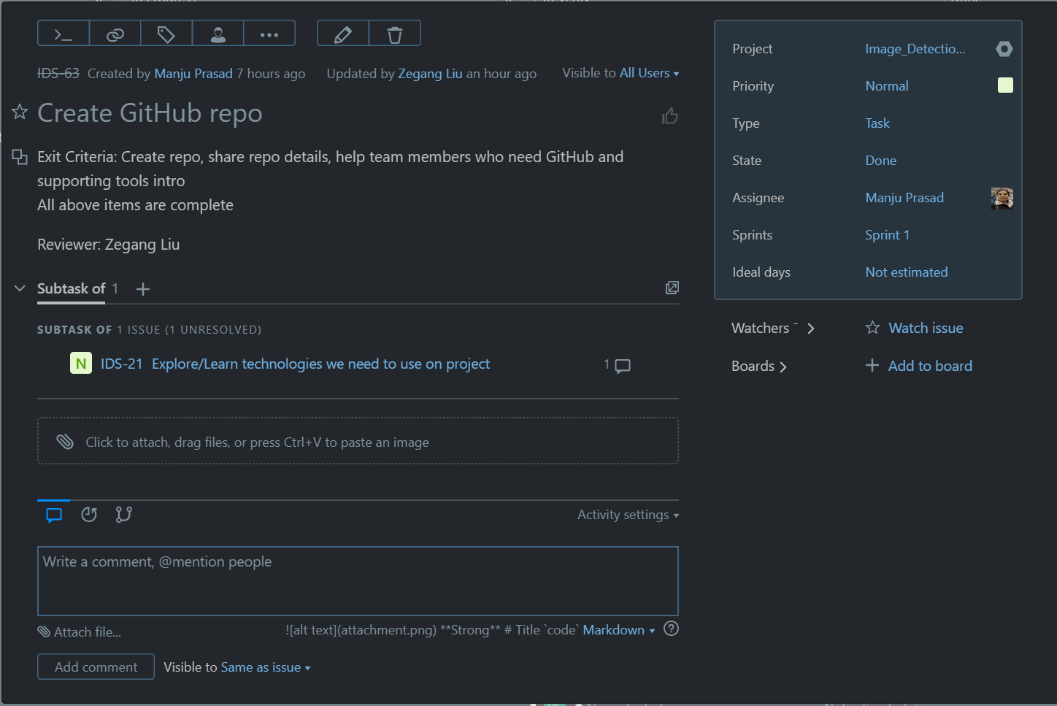
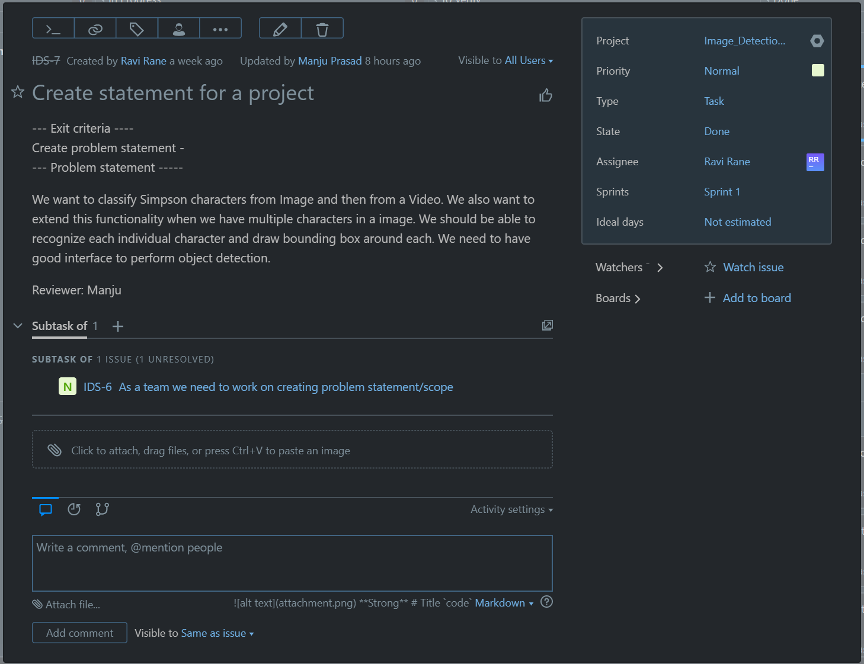
Agile update: YouTrack
Sample Completed Tasks from Sprint 1: Story -> Task -> Description -> Exit Criteria -> Reviewed by

