Slide 1

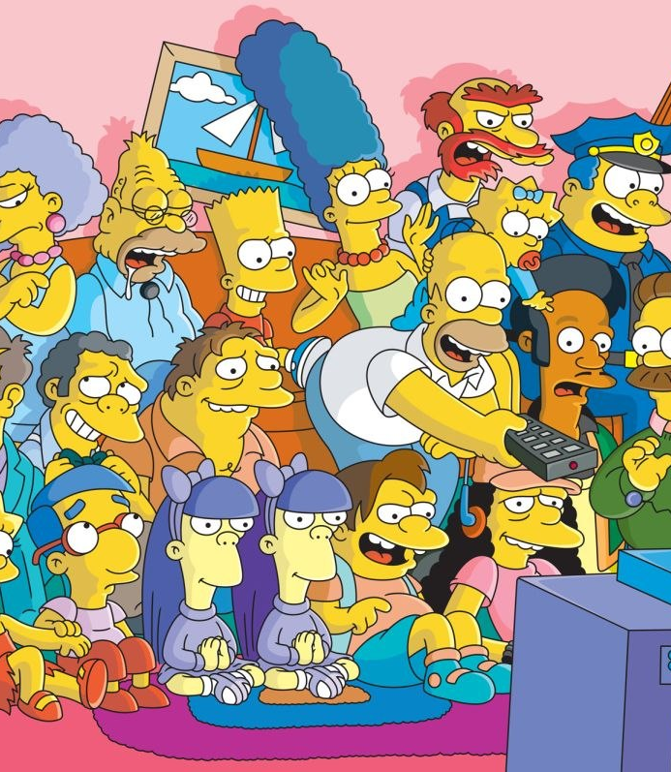
Image Detection of Simpsons Characters
DAEN 690 Project
Summer 2019
Manju Prasad, Ravi Rane, Zegang Liu, Yinchen Niu

Slide 2
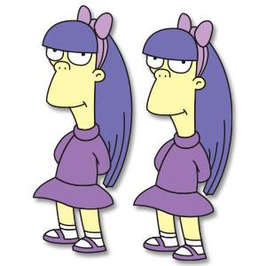
Data Sets
Sprint 2 – Week 2 Presentation
18 June 2019

Slide 3
Project Sprints
Sprint
Milestone Goals
Presentation
Problem Definition and Project Plans
Problem (decision) defined
Understanding of complexity
Potential data source identified
Potential analytics identified
Project schedule defined
Participant roles assigned
Risks identified and mitigation plan
Mid-Sprint 28 May; Full Sprint 4 Jun
Data Sets
Data located and accessed
Initial processing underway
Risks identified and mitigated
Mid-sprint 11 Jun;
Full Sprint 18 Jun
Analytics/algorithms
Algorithms defined and coded
Initial applications completed
Risks identified and mitigated
Mid-sprint 25 Jun
& 2 Jul;
Full Sprint 9 Jul
Visualizations
Visualization concepts defined
Visualization implemented
Risks identified and mitigated
Mid-sprint 16 Jul;
Full Sprint 23 Jul
Mid-Sprint 30 July;
Full Sprint 6 Aug
Final Presentations
Project components completed
Project components integrated
Project supports final decision
Presentation made

Slide 4
Project Schedule
Project Timeline:
Finish Data Exploration.
Continue Technology Exploration / Setup
Core Project Scope - Development
Notes:
Suggest we concentrate on Metadata and NLP and NOT Externals other than what results from associations between metadata and content

Slide 5
Sprint Goals
Data exploration - Complete
Laptop setup – Complete
Argo exploration – Complete
Understanding of potential algorithms – Ongoing
Risks identified and mitigated – Complete
Core Goals – Ongoing

Slide 6
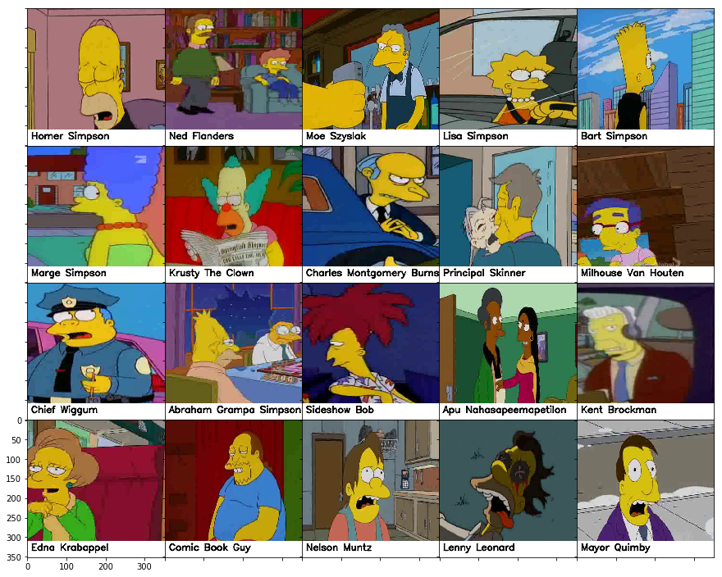
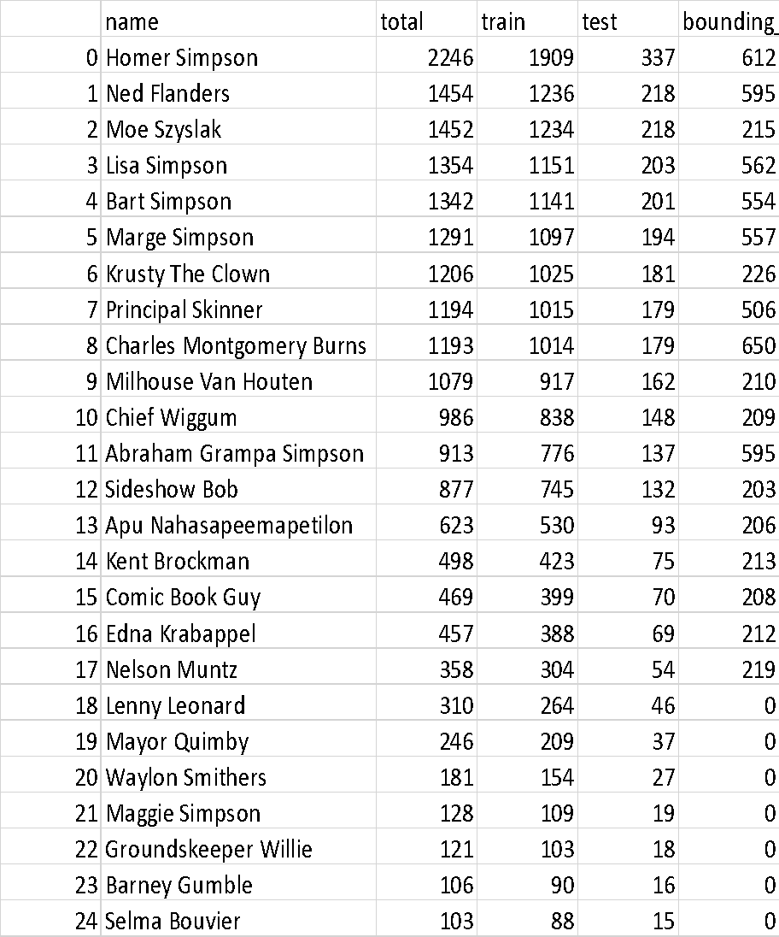
Data Exploration
Table showing all characters with over 100 images in the dataset.

Slide 7
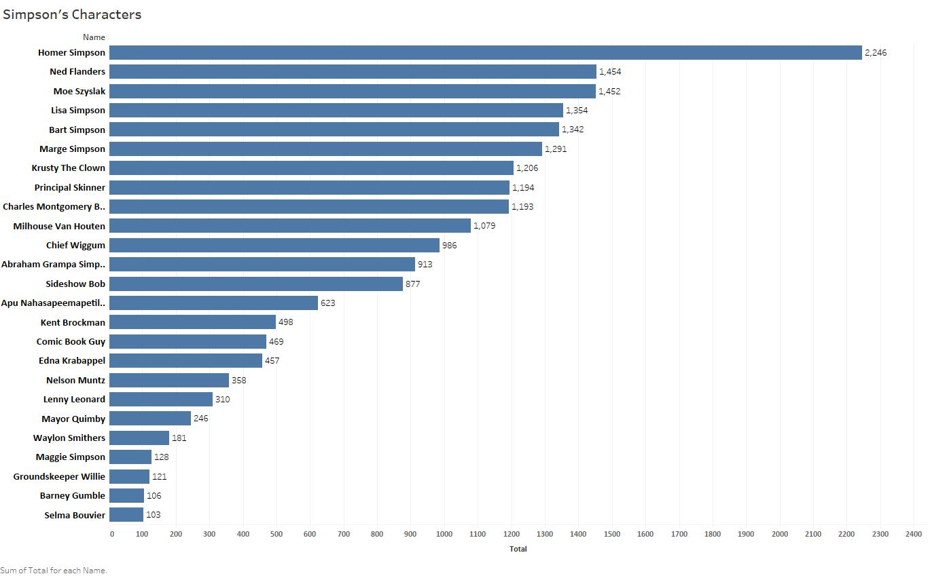
Data Exploration

Slide 8


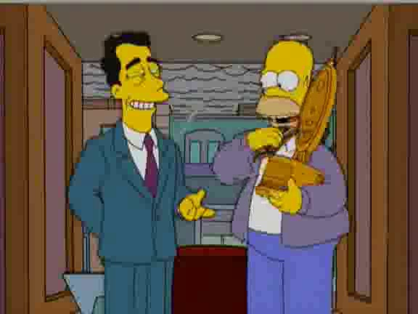

Data Exploration
Example images of Homer Simpson from the dataset. This shows complexity involved in image classification.
Image with Homer Simpson and multiple other characters
Image showing Homer Simpson in different angle (face obscured)
Similar sized characters in an image
Homer Simpson with head wear and body obscured

Slide 9
Data Quality Assessment
Completeness: (All available data is present)
Characters being classified are when subject image count is greater than 100.
Uniqueness: (No data duplication)
Image set consists of mixed images (as depicted in previous slides). Total count of images make it impossible to visually identify uniqueness.
Accuracy: (Data values stored for an object are the correct values)
Not determinable at this time. This can be determined after algorithms have been executed.
Atomicity: (Lowest level of detail)
Training set contains images that are classified and grouped by character.
Image level annotation to box characters is also provided.
Conformity: (conformity to the defined business requirements and syntax)
The dataset provided conforms to one required to run image classification models.
Overall Quality: Good

Slide 10
Data Context
License CC BY-NC-SA 4.0 (Creative Commons License)
(Who)
Agent
Data set was downloaded from Kaggle.com
(How)
Dataset has grown since it was initiated because author has added new images over a period of time.
(What)
Interest in image analytics, deep learning.
(Why)
Cause
Reason
Location
Time
In Kaggle.com
(Where)
Simson’s seasons 4-24
(When)

Slide 11
Laptop Setup
Individual laptop setup includes:
Jupyter notebook or Visual Studio code
Setup Keras, Tensorflow, PyTorch
Python 3.6x
Successfully run sample programs with Keras and PyTorch
Connectivity to GMU GitLab (replacing original plan of using GitHub) – using Git command line or GitHub Desktop
Putty to connect to GMU ARGO
WinSCP or command line scp to secure copy files to ARGO cluster

Slide 12
Argo Exploration
Code base built on GMU’s GitLab
Repository setup for code base and project directory structure created.
Built SLURM scripts to run on cluster
Ran SLURM scripts in ARGO cluster
Included Python libraries
GitHub Desktop based connectivity to update Git repo

Slide 13
Understanding of Potential Algorithms
SafariBooksOnline
Deep Learning with TensorFlow: Applications of Deep Neural Networks to Machine Learning Task – Jon Krohn
Previous coursework material – GMU CS580 (attended by team member)
Publication/Articles
https://blog.keras.io/building-powerful-image-classification-models-using-very-little-data.html
https://machinelearningmastery.com/cnn-long-short-term-memory-networks/
https://blog.algorithmia.com/introduction-to-deep-learning/
https://link.springer.com/chapter/10.1007/978-3-030-01424-7_25
https://arxiv.org/abs/1512.03385

Slide 14
Risks Identified and Mitigated
No new risks since identified since Sprint 1

Slide 15
Core Goals - Algorithm Milestone Progress
Initial implementation of CNN with 4 convolution layer and one Dense layer.
Successfully ran on laptop for small dataset of Simpson images.
Execution setup for Argo is completed and tested. This is running successfully.
15

Slide 16
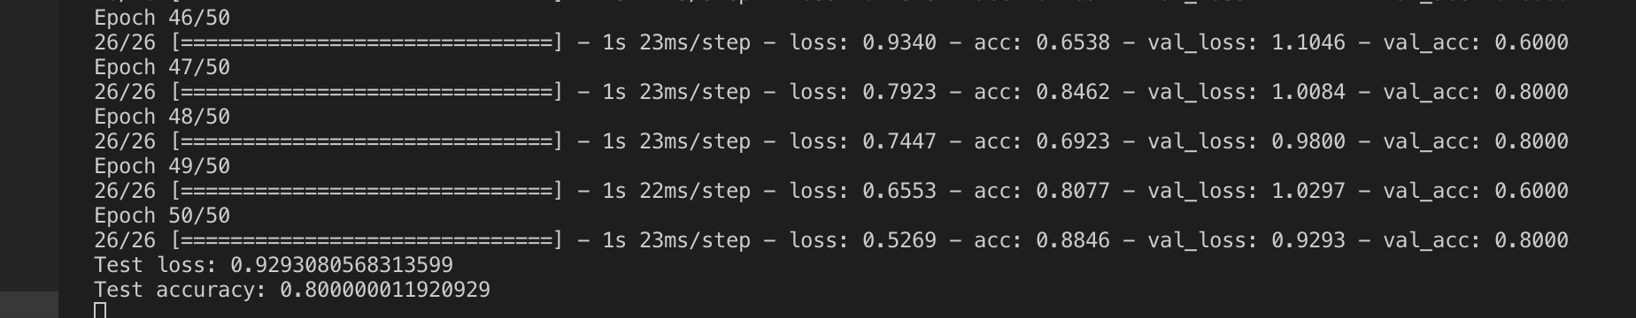
Core Goals - Execution Log
From ARGO:

Slide 17
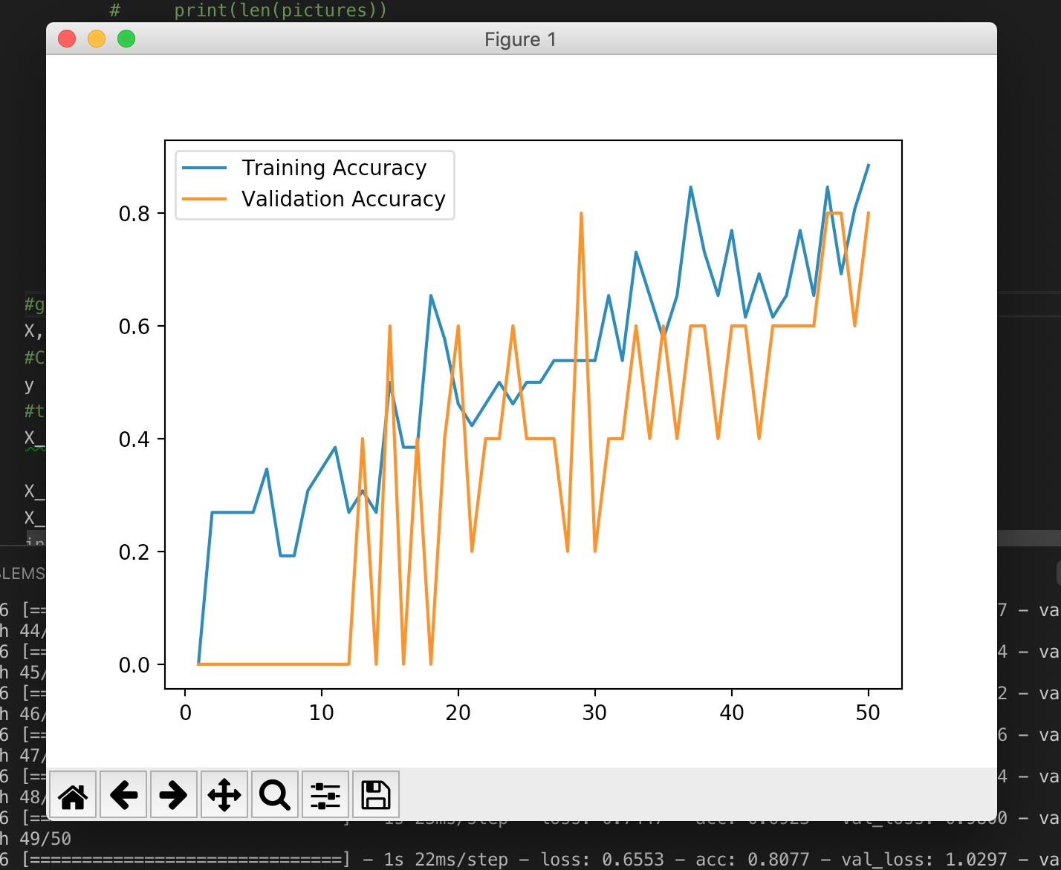
Core Goals - Performance for Small Dataset

Slide 18
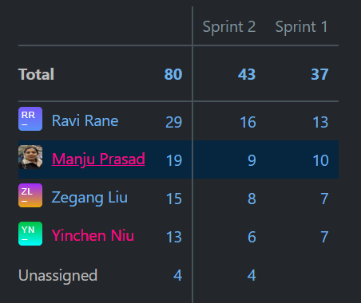
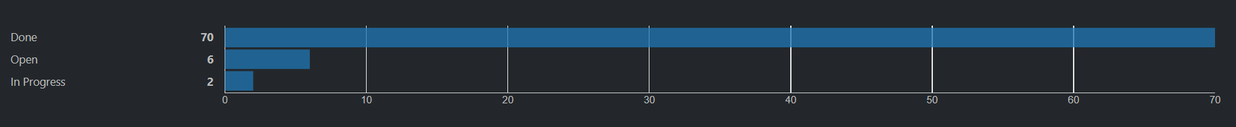
Agile update: YouTrack
Agile report: Task distribution by Sprint
Agile report: Count of Issues by State

