Slide 1


Image Detection of Simpsons Characters
DAEN 690 Project
Summer 2019
Manju Prasad, Ravi Rane, Zegang Liu, Yinchen Niu

Slide 2
Analytics / Algorithms
Sprint 3 – Week 1 Presentation
25 June 2019

Slide 3
Project Sprints
Sprint
Milestone Goals
Presentation
Problem Definition and Project Plans
Problem (decision) defined
Understanding of complexity
Potential data source identified
Potential analytics identified
Project schedule defined
Participant roles assigned
Risks identified and mitigation plan
Mid-Sprint 28 May; Full Sprint 4 Jun
Data Sets
Data located and accessed
Initial processing underway
Risks identified and mitigated
Mid-sprint 11 Jun;
Full Sprint 18 Jun
Analytics/algorithms
Algorithms defined and coded
Initial applications completed
Risks identified and mitigated
Mid-sprint 25 Jun
& 2 Jul;
Full Sprint 9 Jul
Visualizations
Visualization concepts defined
Visualization implemented
Risks identified and mitigated
Mid-sprint 16 Jul;
Full Sprint 23 Jul
Mid-Sprint 30 July;
Full Sprint 6 Aug
Final Presentations
Project components completed
Project components integrated
Project supports final decision
Presentation made

Slide 4
Project Schedule
Project Timeline:
Core Project Scope – Development.
Aided by learning Neural Networks
Notes:
Suggest we concentrate on Metadata and NLP and NOT Externals other than what results from associations between metadata and content

Slide 5
Sprint Goals
Core Project Scope – Develop algorithms for image classification and object detection
Show your research and deep dive into proposed models and algorithms.
Show the mathematics and statistics supporting your algorithms.
Show your implementations and comparison of algorithms.
Test and validate your model with actual historical observations.
Discuss what metrics you would use to assert your results.
Present your incremental and final results.
Early presentation and visualization effort.

Slide 6
Algorithm Development Status
Deep Learning architectures to explore | Updates Sprint 3 – Week 1 | Plans for Sprint 3 – Week 2
CNN | Initial implementation of CNN with 4 convolution layer and one Dense layer. Run with full dataset on Argo. | Modify/optimize algorithm for better accuracy
Hybrid CNN-ELM - Image Classification | A hybrid model consisting of a Deep Convolutional feature extractor and the Extreme Learning Machine. | Research algorithm and start coding
Mask R-CNN - Image Segmentation | Detects objects in the image while simultaneously generating a high-quality segmentation mask for each instance | Research algorithm and start coding
Faster R-CNN with different Hyper parameter | - | Research algorithm and start coding
YOLO (You only look once) | - | Research algorithm and start coding
SSD (Single shot Multi-box detection) | - | Research algorithm and start coding

Slide 7
Understanding Basic CNN & R-CNN
CNN:
Convolutional layer
Pooling layer
R-CNN
In the image generates 1K~2K candidate regions.
For each candidate area, use the depth network to extract features. The features are fed into SVM classifiers of each class to determine whether they belong to this class. Use regressors to fine-tune candidate box positions.

Slide 8
Research and Deep dive into algorithms
Basic Concepts:
Neurons (Activation functions)
Perceptrons
Sigmoid
Tanh
ReLU
Cost functions
Quadratic
Cross-Entropy
Gradient Descent
Learning Rate
Batch size
Second order functions
Reduce overfitting
L1/L2 norms
Dropout
Expand data
Initialization of weights (and other factors)
Glorot-normal
Glorot-uniform
Layers
Dense
Softmax
Max-pooling
Flatten
Convolutional

Slide 9
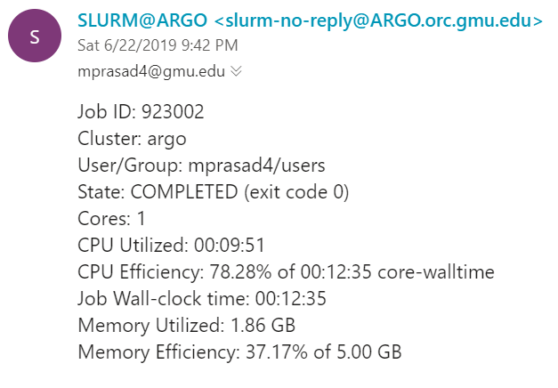
Testing and Validation of models
CNN
15840/16269 [============================>.] - ETA: 0s - loss: 0.4170 - acc: 0.8824
15904/16269 [============================>.] - ETA: 0s - loss: 0.4165 - acc: 0.8826
15968/16269 [============================>.] - ETA: 0s - loss: 0.4179 - acc: 0.8822
16032/16269 [============================>.] - ETA: 0s - loss: 0.4173 - acc: 0.8823
16096/16269 [============================>.] - ETA: 0s - loss: 0.4181 - acc: 0.8823
16160/16269 [============================>.] - ETA: 0s - loss: 0.4180 - acc: 0.8822
16224/16269 [============================>.] - ETA: 0s - loss: 0.4179 - acc: 0.8821
16269/16269 [==============================] - 14s 886us/step - loss: 0.4183 - acc: 0.8822 - val_loss: 0.8011 - val_acc: 0.8318
Test loss: 0.8010630374667288
Test accuracy: 0.8317659352972548

Slide 10
Understanding of Potential Algorithms
SafariBooksOnline
Deep Learning with TensorFlow: Applications of Deep Neural Networks to Machine Learning Task – Jon Krohn
Previous coursework material – GMU CS580 (attended by team member)

Slide 11
Understanding of Potential Algorithms
Publication/Articles
https://blog.keras.io/building-powerful-image-classification-models-using-very-little-data.html
https://machinelearningmastery.com/cnn-long-short-term-memory-networks/
https://blog.algorithmia.com/introduction-to-deep-learning/
https://link.springer.com/chapter/10.1007/978-3-030-01424-7_25
https://arxiv.org/abs/1512.03385
https://www.youtube.com/watch?v=Jy9-aGMB_TE (discusses CNN)
https://towardsdatascience.com/build-your-own-convolution-neural-network-in-5-mins-4217c2cf964f (Convolution Neural Networks)
https://skymind.ai/wiki/neural-network#define (Deep Learning Brief Overview)
https://arxiv.org/abs/1311.2524 (R-CNN)
https://arxiv.org/abs/1504.08083 (Fast R-CNN)
https://arxiv.org/abs/1506.01497 (Faster R-CNN)
https://arxiv.org/abs/1703.06870 (Mask R-CNN)

