Slide 1
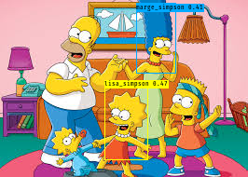
20Epochs_32BatchSize (val_err: 19.x) + 10Epochs_10BatchSize (val_err:12.x)
[mprasad4@ARGO-2 mprasad4]$ cat YOLO-Simpsons-MP-NODE056-928959.out
Image detection mode
Ignoring remaining command line arguments: ./path2your_video,
/scratch/mprasad4/logs/000/20190709-093952trained_weights_final.h5 model, anchors, and classes loaded.
In True
/scratch/mprasad4/SampleData/simpsons4.jpg
in else
(416, 416, 3)
Found 2 boxes for img
marge_simpson 0.41 (146, 3) (188, 78)
lisa_simpson 0.47 (112, 94) (158, 171)
6.4343919940292835

