Slide 1

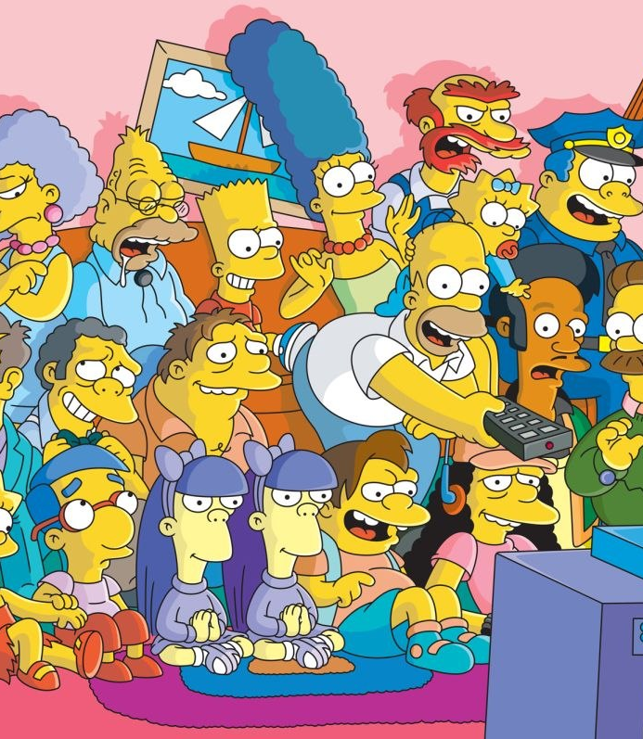
Image Detection of Simpsons Characters
DAEN 690 Project
Summer 2019
Manju Prasad, Ravi Rane, Zegang Liu, Yinchen Niu

Slide 2
Analytics / Algorithms
Sprint 3 – Week 2 Presentation
25 June 2019

Slide 3
Project Sprints
Sprint
Milestone Goals
Presentation
Problem Definition and Project Plans
Problem (decision) defined
Understanding of complexity
Potential data source identified
Potential analytics identified
Project schedule defined
Participant roles assigned
Risks identified and mitigation plan
Mid-Sprint 28 May; Full Sprint 4 Jun
Data Sets
Data located and accessed
Initial processing underway
Risks identified and mitigated
Mid-sprint 11 Jun;
Full Sprint 18 Jun
Analytics/algorithms
Algorithms defined and coded
Initial applications completed
Risks identified and mitigated
Mid-sprint 25 Jun
& 2 Jul;
Full Sprint 9 Jul
Visualizations
Visualization concepts defined
Visualization implemented
Risks identified and mitigated
Mid-sprint 16 Jul;
Full Sprint 23 Jul
Mid-Sprint 30 July;
Full Sprint 6 Aug
Final Presentations
Project components completed
Project components integrated
Project supports final decision
Presentation made

Slide 4

Project Schedule
Project Timeline:
Core Project Scope – Development.
Aided by learning Neural Networks
Notes:
Suggest we concentrate on Metadata and NLP and NOT Externals other than what results from associations between metadata and content

Slide 5
Sprint Goals
Show your research and deep dive into proposed models and algorithms.
Show the mathematics and statistics supporting your algorithms.
Show your implementations and comparison of algorithms.
Test and validate your model with actual historical observations.
Discuss what metrics you would use to assert your results.
Present your incremental and final results.
Early presentation and visualization effort.

Slide 6
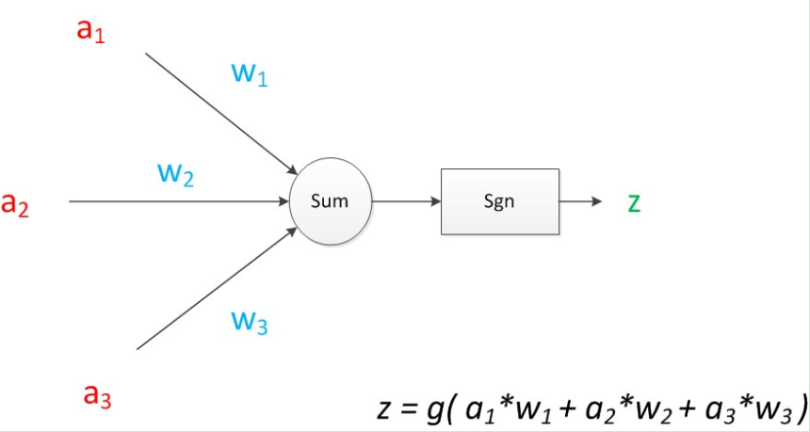
Research and Deep dive into algorithms
CNN:
A kind of artificial intelligence machine learning technology. It has three basic layers: Convolutional Layer, Pooling Layer, Flatten Layer & Fully Connected.
Based on the analysis of each character, build a model to identify each character in the simpsons
Advantages: Sharing convolution kernel, no pressure for processing high-dimensional data.
Ddisadvantages: Need a large samples. And the pooling layer may lose some valuable information and ignore the correlation between the parts and the whole.

Slide 7
Research and Deep dive into algorithms
Hybrid CNN-ELM:
Describe this.
What is it used for?
Provide advantages and disadvantages
Add a graphic
Add some math

Slide 8
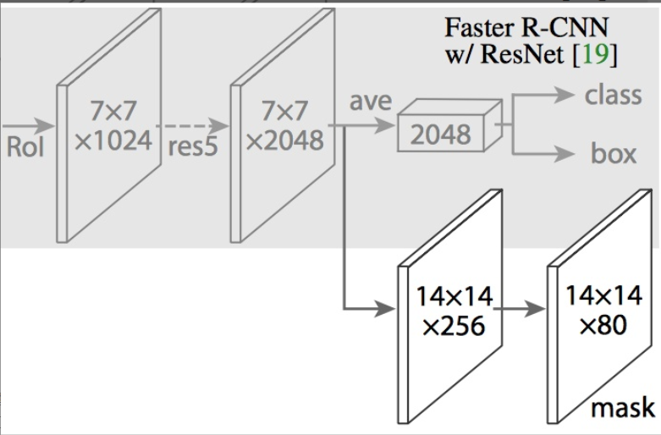
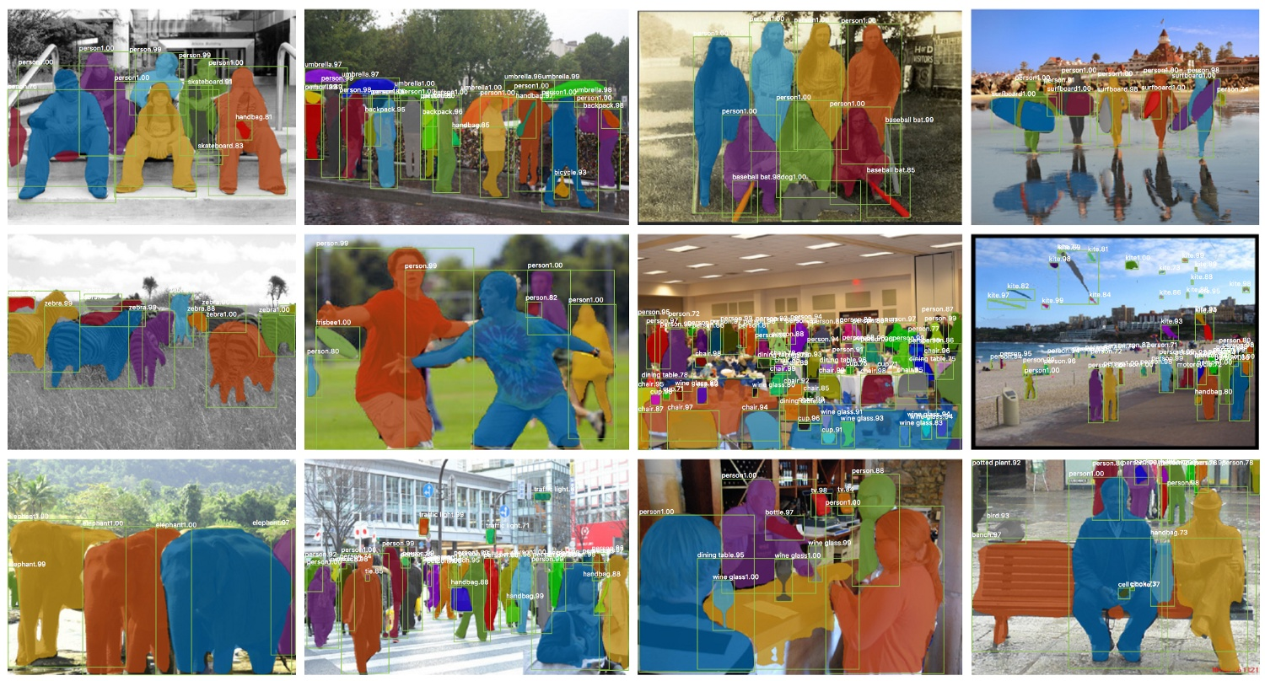
Research and Deep dive into algorithms
Mask R- CNN:
Adding a full convolution network to the top layer of CNN feature extraction layer of Faster R-CNN
Maks R-CNN adds a branch on the basis of Faster R-CNN to output a Binary Mask to determine whether a given pixel belongs to an object
RoIAlign replaced RoIPool to traverse the image, so that the selected region of RoIPool corresponds more accurately with the original image

Slide 9
Research and Deep dive into algorithms
Faster R CNN:
Describe this.
What is it used for?
Provide advantages and disadvantages
Add a graphic
Add some math

Slide 10
Research and Deep dive into algorithms
YOLO:
Describe this.
What is it used for?
Provide advantages and disadvantages
Add a graphic
Add some math

Slide 11
Research and Deep dive into algorithms
SSD:
Describe this.
What is it used for?
Provide advantages and disadvantages
Add a graphic
Add some math

Slide 12
Testing and Validation of models

Slide 13
Metrics used to assert results

Slide 14
Incremental Results

Slide 15
Visualizations

Slide 16
Understanding of Potential Algorithms
SafariBooksOnline
Deep Learning with TensorFlow: Applications of Deep Neural Networks to Machine Learning Task – Jon Krohn
Previous coursework material – GMU CS580 (attended by team member)
Publication/Articles
https://blog.keras.io/building-powerful-image-classification-models-using-very-little-data.html
https://machinelearningmastery.com/cnn-long-short-term-memory-networks/
https://blog.algorithmia.com/introduction-to-deep-learning/
https://link.springer.com/chapter/10.1007/978-3-030-01424-7_25
https://arxiv.org/abs/1512.03385

Slide 17
Core Goals - Algorithm Milestone Progress
Initial implementation of CNN with 4 convolution layer and one Dense layer.
Successfully ran on laptop for small dataset of Simpson images.
Execution setup for Argo is completed and tested. This is running successfully.
17

Slide 18
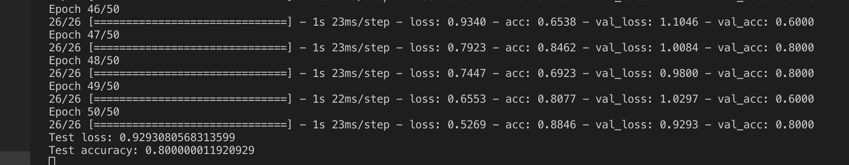
Core Goals - Execution Log
From ARGO:

Slide 19
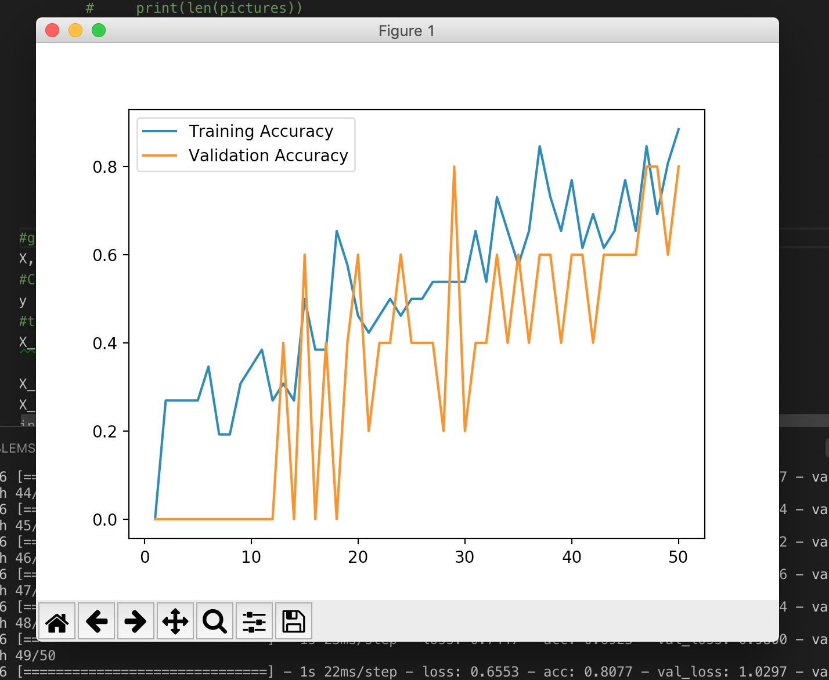
Core Goals - Performance for Small Dataset

Slide 20
Mathematics and Statistics supporting algorithms

Slide 21
Implementation and Comparison of algorithms

