Slide 1
ONLINE MOVIE BOOKING SYSTEM

Slide 2
ABSTRACT
This project is a Business to consumer based Online Movie Ticket Booking. developed using PHP and MYSQL The project objective is to deliver the online shopping.
This project is aimed at developing an online movie ticket booking system website for customers.In online movie ticket booking system booking the tickets can be done from anywhere and at any time (24*7).The user canal so cancel or update their order.

Slide 3
User Register:
A new user will have to register in the system by providing essential details in order to view the movies in the system. The admin must accept a new user by unblocking him. Functional requirement: • System must be able to verify and validate information. • The system must encrypt the password of the customer to provide security.
Functional requirement:
• System must be able to verify and validate information
. • The system must encrypt the password of the customer to provide security.

Slide 4
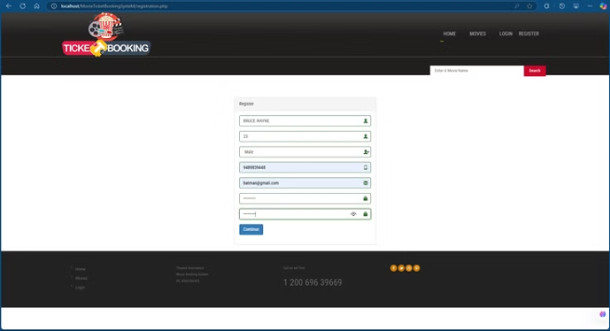
USER REGISTRATION
Here user can register their account for the site, to book movies on further events

Slide 5
USER LOGIN
This feature used by the user to login into system. A user must login with his user’s name and password to the system after registration. If they are invalid, the user not allowed to enter the system.
Functional requirement:
• Username and password will be provided after user registration is confirmed.
• Password should be hidden from others while typing it in the field

Slide 6
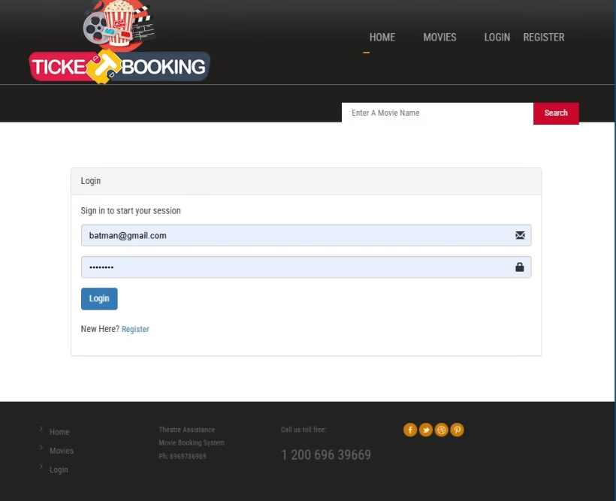
USER LOGIN:
In online movie ticket booking system booking the tickets can be done from anywhere and at any time (24*7). Some features provided to the users are new registration, login in, see movies by category, and Compare ticket price and timing. Customer can book ticket online without registration but if he/she registers then he/she will get different types of special offers.

Slide 7
BOOK A MOVIE
Book the Movie: The user book available tickets while he is searching for one tickets or more tickets. After successful booing user gets message from admin “your Ticket has Successfully Booked”
Functional requirement:
• System must ensure that, only a registered customer can books tickets

Slide 8
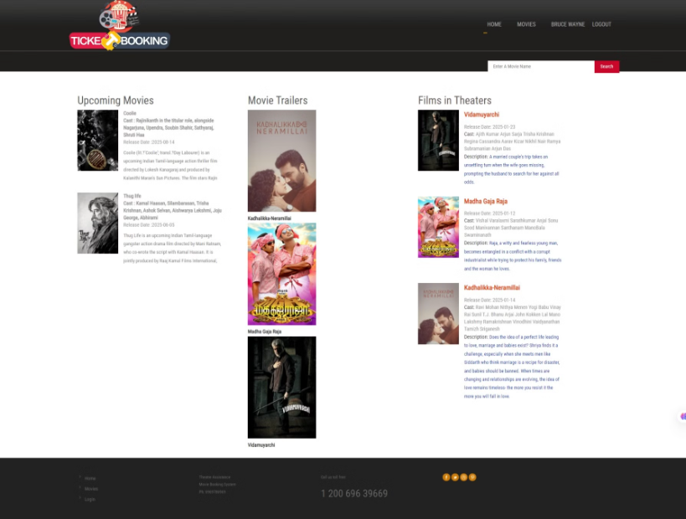
USER INDEX PAGE

Slide 9
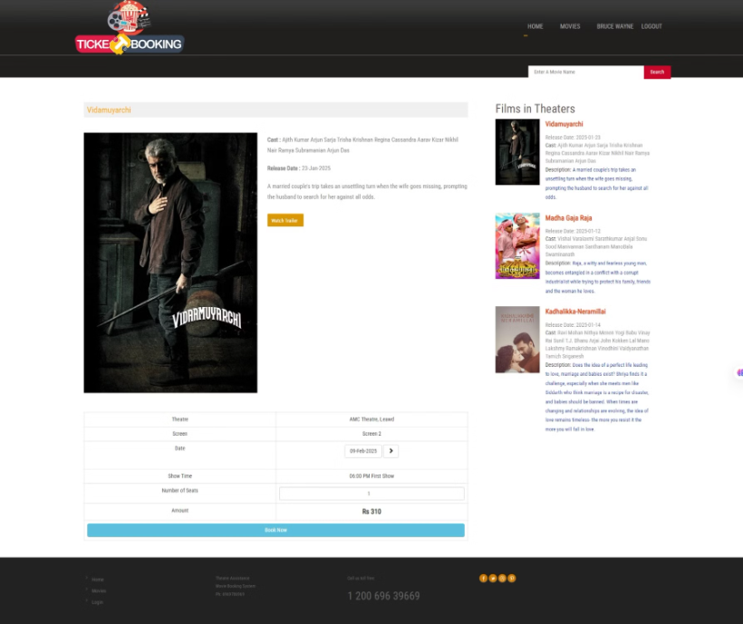
BOOK A MOVIE:
The user book available tickets while he is searching for one tickets or more tickets. After successful booing user gets message from admin “your Ticket has Successfully Booked”
Functional requirement:
• System must ensure that, only a registered customer can books tickets

Slide 10
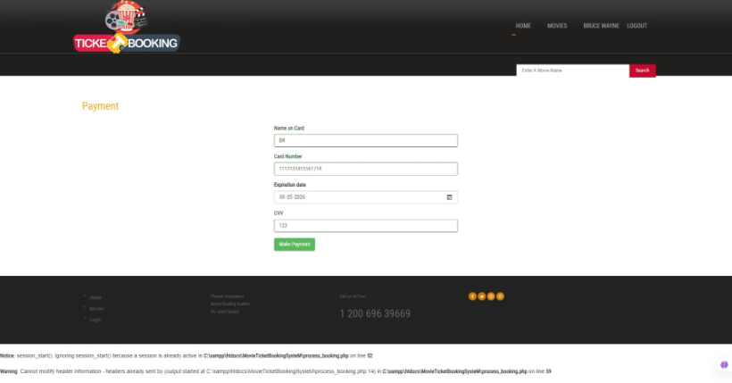
MAKE PAYMENT
Here user can make card transaction with 16 digit number cvv and otp with card expiration date as its a simple payment without gateway.

Slide 11

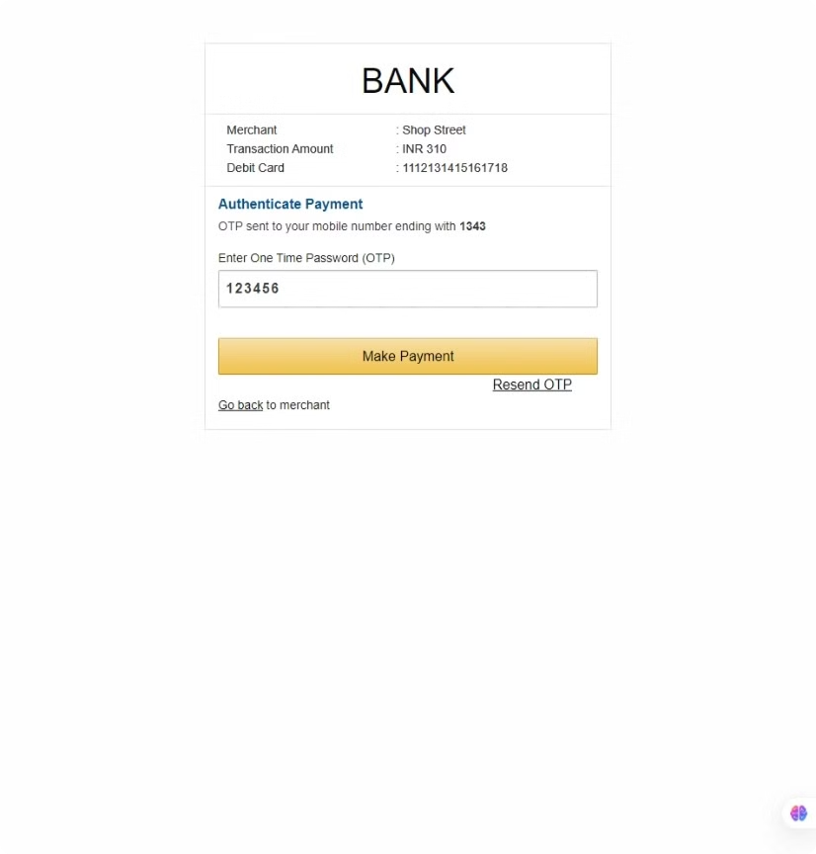
payment confirmation page where user can confirm the payment by otp provided

Slide 12
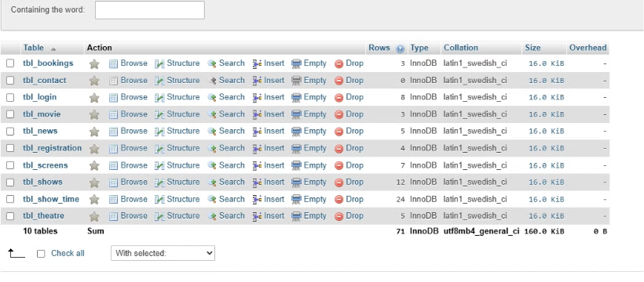
DATABASE AND TABLES
here registeres the required tables for the movie booking website as movies, registration, theatre, screens,users.

Slide 13
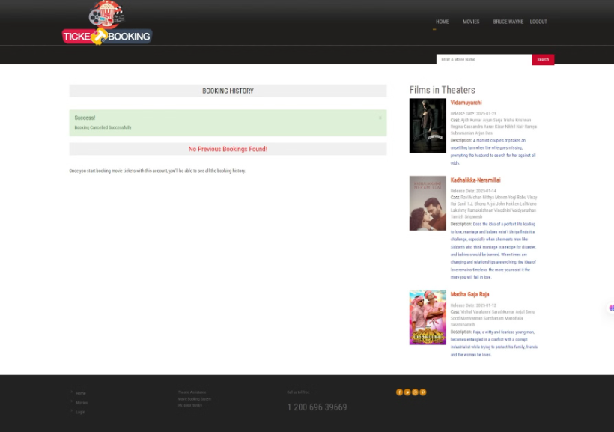
the user can cancel their bookings at any time in the bookings page

Slide 14
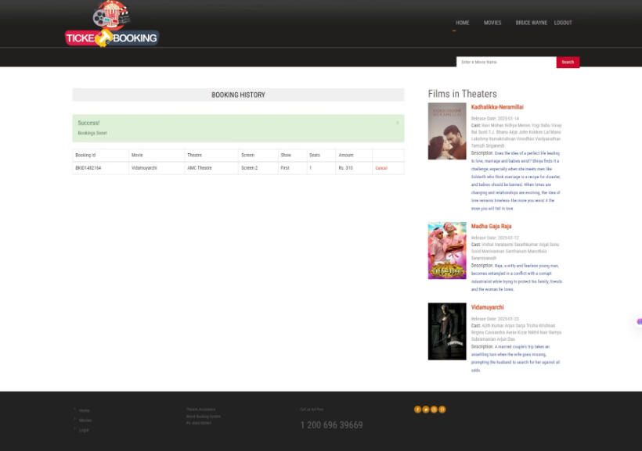
this is users bookings page where user can view their bookings

Slide 15

ADMIN SIDE

Slide 16
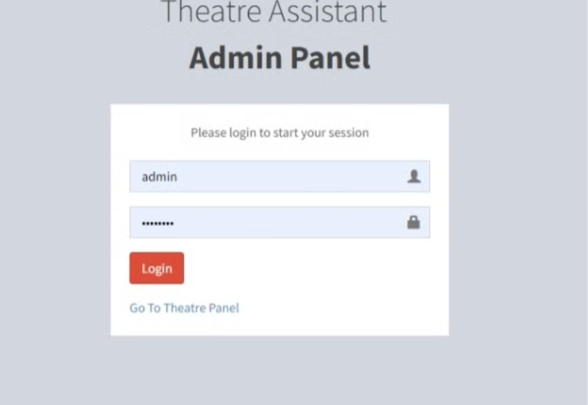
ADMIN PANEL:
here admin can register and login to add movies, upcoming movies news,theatre screens and allot screens for movies

Slide 17
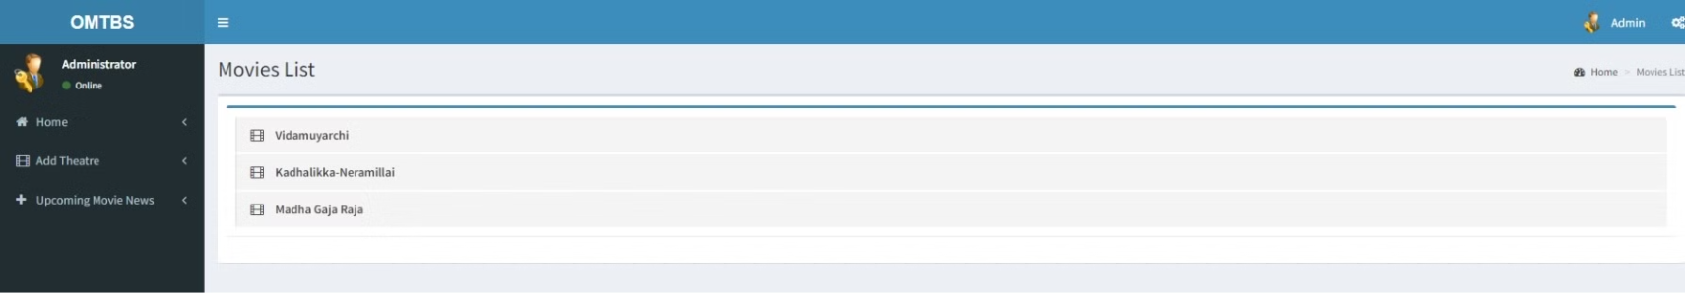
ADD movies
Here the admin can add movies to the theatre and website so the updated movies reflect in index page of user.

Slide 18
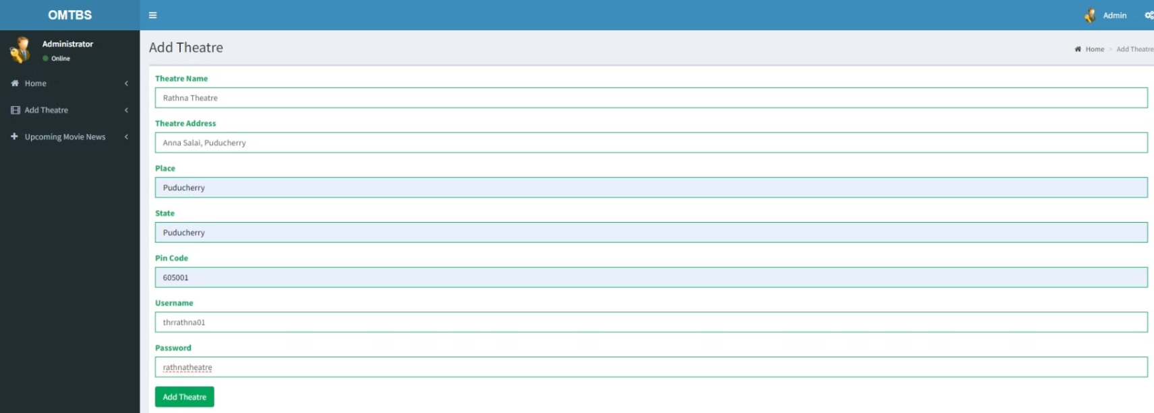
ADD THEATRE
Here admin registers new theatre/delete new theatre so the timings screen are added and mapped.

Slide 19
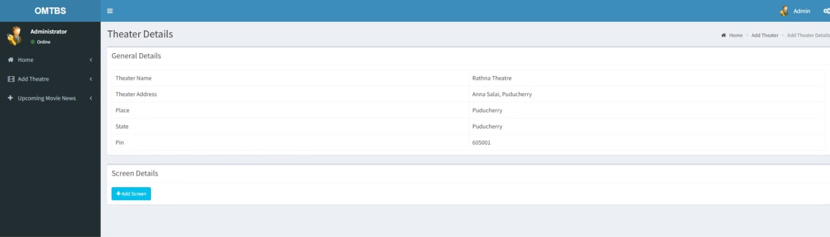
ADD SCREEN
HERE admin add screen to theatres for movies to showcase onthe theater screen

Slide 20
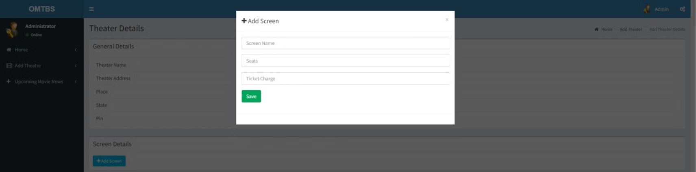
ADD show time
here admin can add showtime for movies as morning , matni, first, second shows with timings.

Slide 21
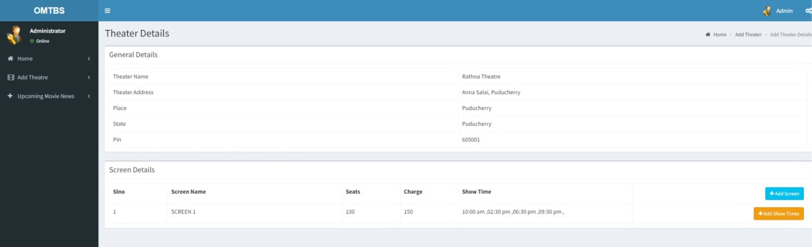
THEATRE DETAILS
Here admin panel shows the added screens , movies to that screen and show times.

Slide 22
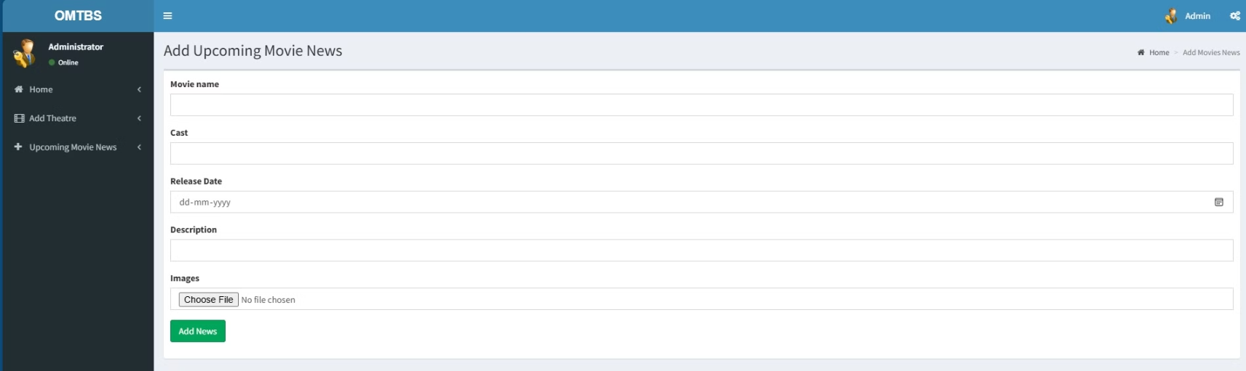
ADD upcoming news
here the admin registers the new movies

