Slide 1
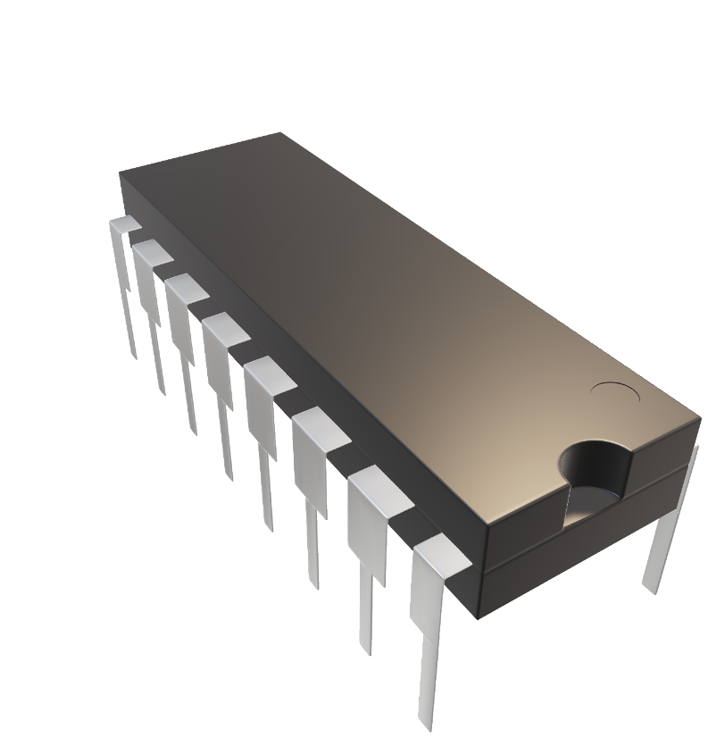
COMPUTER SAYS NO
An introduction to computing services for research
Stefano.montanari1@jcu.edu.au

Slide 2
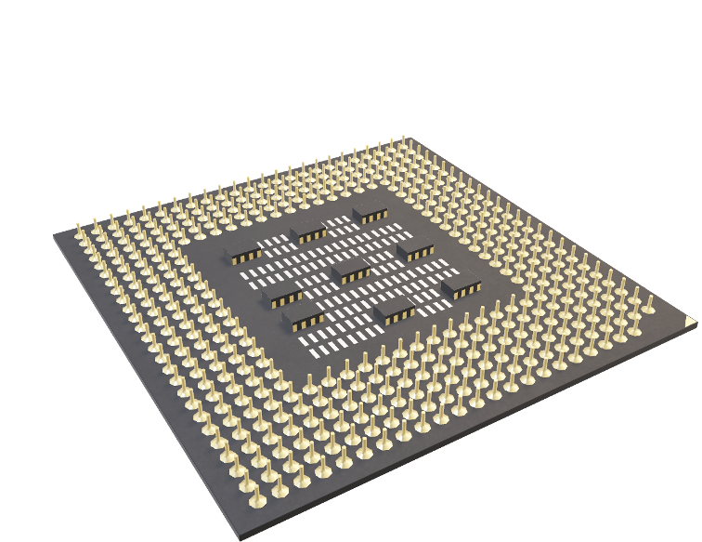
What is this about?
Data management
Storage options
Compute infrastructure
Bioinformatics
Training

Slide 3

How will we do this?
Quick survey
Questions as we go
User experiences (if time permits)

Slide 4
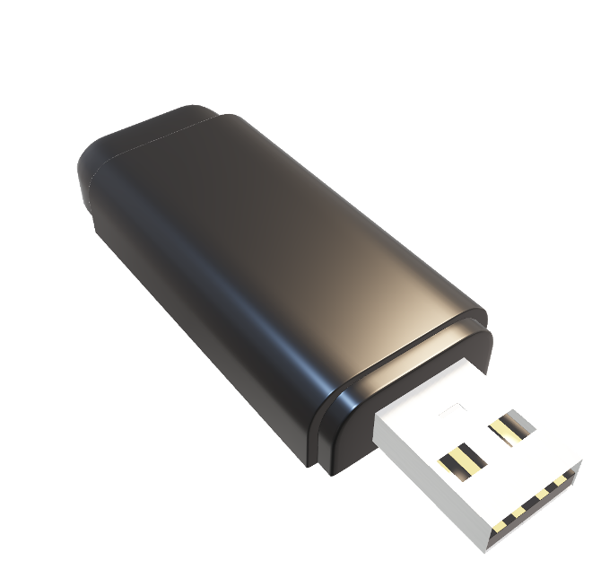
Data management
Research Data JCU
Research Data JCU is an integrated data management platform which supports the research lifecycle — from planning research projects (RDMPs), to establishing Data Records, and creating Data Publications.
https://research.jcu.edu.au/data/default/rdmp/home

Slide 5
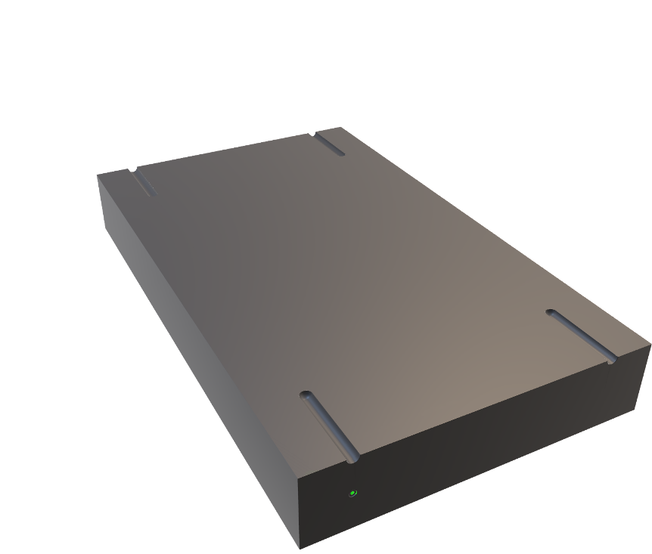
Storage options
QRISCloud
Computational storage is coupled with cloud compute environment and allows for block (or Volume) storage and object storage.
For Collection storage, QCIF are partnering with UQ to broker access to their extensive storage infrastructure. For non-UQ researchers, the storage services are not free, but they are at QCIF Member rates. Storage services include access to active and archive storage services.
https://www.qriscloud.org.au/index.php/services/data

Slide 6
Storage options
AARNET Cloudstor
CloudStor provides the research and academic community with an easy-to-use collaboration workspace and integrated tools for sharing and analysing data. Individual and Enterprise options are available.
https://www.aarnet.edu.au/network-and-services/cloud-services/cloudstor/

Slide 7
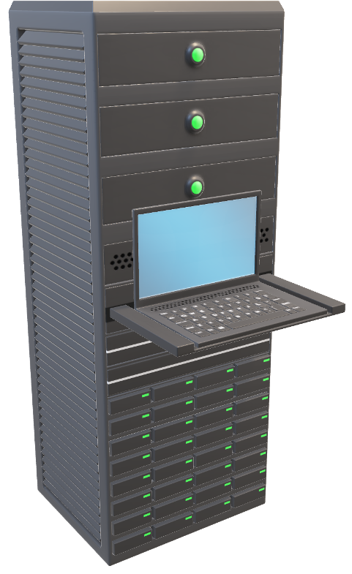
Compute infrastructure
JCU HPC
JCU HPC provides entry-level research computing resources. Other organisations (QCIF, NCI, Pawsey, etc.) provide much larger, high-capability resources.
https://secure.jcu.edu.au/confluence/display/Public/Home

Slide 8
Compute infrastructure
QRISCloud
QCIF provide cloud computing and high-performance computing at no cost to researchers. The cloud computing environment runs OpenStack and is currently at 2,500 vCPUs.
Linux virtual machines can be provisioned for various workloads and cloud size will triple by the middle of this year.
QCIF’s high-performance and high-throughput compute environments give you access to institutional and national scale HPC facilities for your computational analysis needs.
https://www.qriscloud.org.au/index.php/services/compute

Slide 9
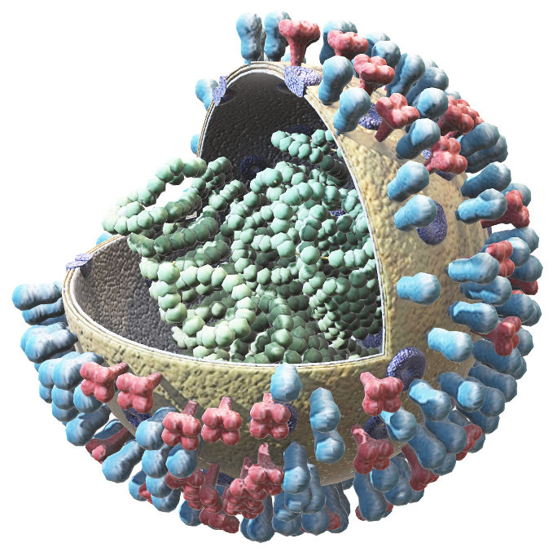
Bioinformatics
QFAB
ACCESS TO SPECIALIST SKILLS AT SALARY COST
On-demand support
Embedded %FTE personnel
Local contact: justin.lee@jcu.edu.au
ADVICE AT NO COST
Members advice https://qfab.org/members-advice-request-form
Queensland Genomic Technology Innovation qgti@googlegroups.com
SOFTWARE PLATFORMS AT NO COST
Galaxy Australia, Web Apollo, SMRT Link
https://qfab.org/

Slide 10
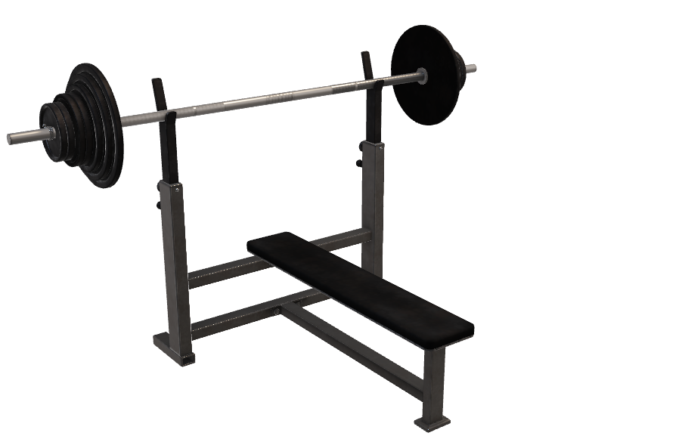
Training
QCIF
100+ WORKSHOPS
Free attendance for all Member researchers (staff and HDR students)
OVER 30 DIFFERENT TOPICS
Introductory coding in R, Python, and Unix
Statistics using R and SPSS
Bioinformatics
Data sharing, reproducibility, and research communication techniques
ACCESSIBLE
All topics available online
Aim to reintroduce selected face to face training late 2021
https://www.qcif.edu.au/training/training-courses/

Slide 11

Thank you!
JCU CONTACTS
eResearch Analyst
Stefano.montanari1@jcu.edu.au
+617 4781 3199
Hacky Hour
Social space for coding and other questions
https://www.qcif.edu.au/training/hacky-hour/
JCU eResearch Centre
We have dedicated, in-house skill to help with your research data, hardware and software needs.
https://www.jcu.edu.au/eresearch

