Slide 1

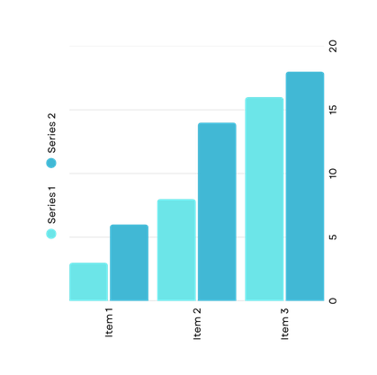
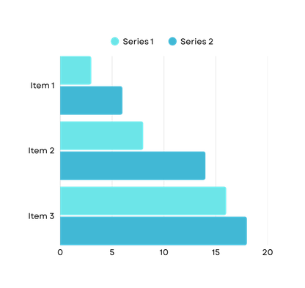
Proposal to Increase Database Replication from 3 to 10 Servers
PRESENTATION
Ujwal Singh
coderujwal@gmail.com

Slide 2
Current Database Environment
  Increasing user traffic causing slower response times
  AReduced performance during peak usage
  Limited scalability for future growth
  Risk of service disruption if a replica fails
  One primary database server (read and write operations)
  Three replica servers (read-only operations)
  Average latency: 20 milliseconds
configuration
challenges

Slide 3
Proposed Replication Expansion
We propose increasing database replicas from 3 to 10 servers using single-primary replication.
Expected performance improvement:
That additional replicas allow read traffic to be distributed efficiently and reduce response time.
Proposed
configuration:
  Latency reduction from 20 ms to approximately 1 ms
  Faster query execution
  Improved application responsiveness
  Better user experience
  One primary database server for writes
  Ten replica servers for read operations
  Distributed read traffic across replicas

Slide 4




Business and Technical Benefits
Benefits of Increasing Replication
Replication improves both performance and availability of enterprise database systems.
Scalability & Reliability:
Lower Latency:
High Availability:
Load Balancing:
Local replicas allow users to access nearby servers, reducing network travel time and improving response speed.
The system will support future growth in users and transactions.
Replication improves system resilience and ensures continuous operation.
If one server fails, other replicas continue serving requests without downtime.
Read requests are distributed across multiple replicas instead of overloading a few servers.

Slide 5
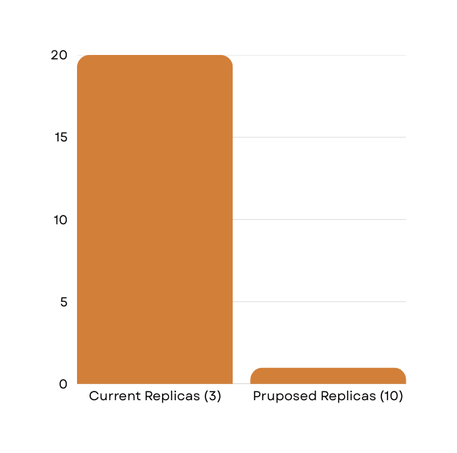
Cost and Risk Analysis
01
02
Infrastructure Costs:
Replication Delay:
Costs and Risk Considerations
  Seven additional database servers required
  Increased cloud or hardware expenses
  Additional storage requirements
  Higher network usage costs
  Maintenance and monitoring costs
  Asynchronous replication may cause temporary data inconsistency
  Some replicas may briefly show older data
03
04
Miliseconds (ms)
System Complexity:
System Complexity:
  More servers require additional monitoring and administration
  Increased configuration complexity
  More servers require additional monitoring and administration
  Increased configuration complexity
Configuration

Slide 6
Thank You
FOR YOUR TIME
Ujwal Singh
coderujwal@gmail.com

