Slide 1

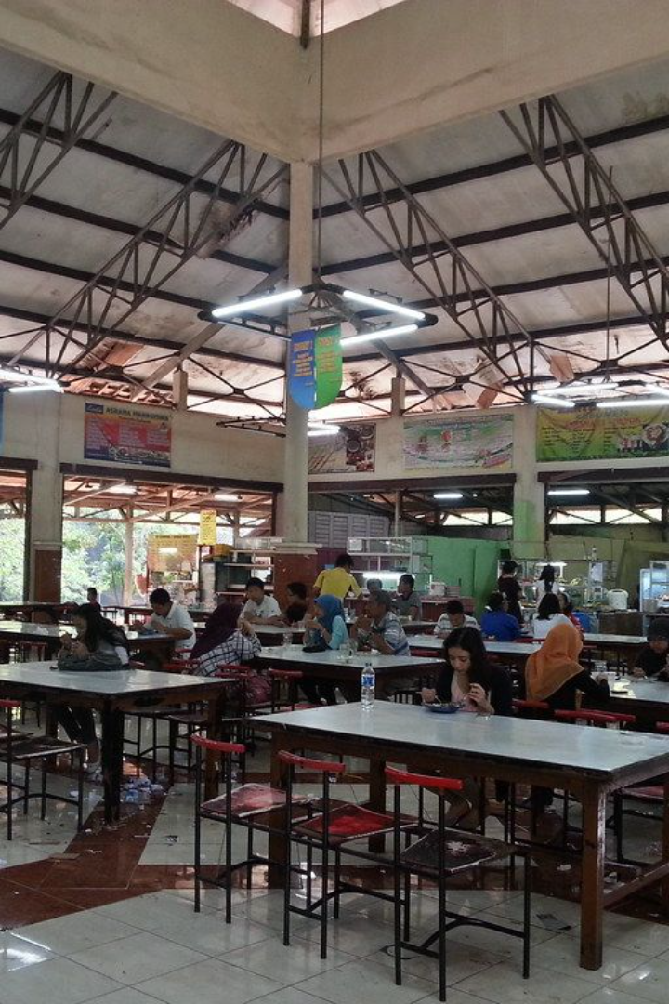
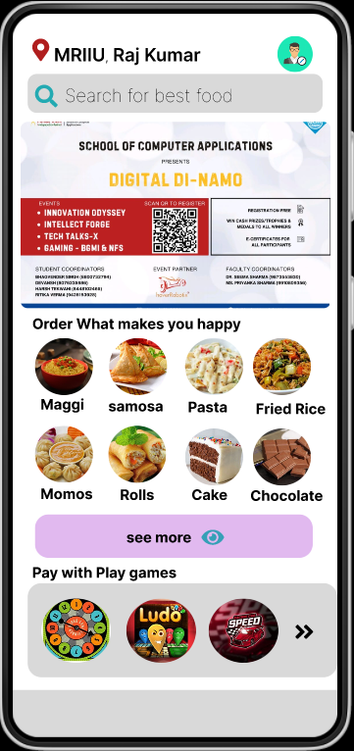
Introduction to Campus Canteen App
The Campus Canteen App is designed to help students easily order food and stay informed about events happening in different college campuses. With a user-friendly interface, it provides a seamless experience for students to access a variety of features.
By Raj Kumar.

Slide 2

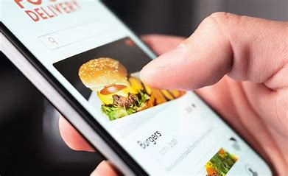
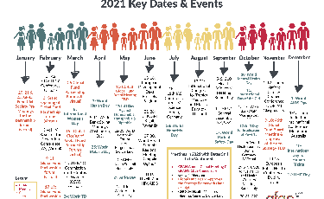
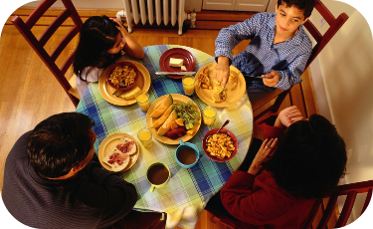
Features of the App
Easy Food Ordering
Events Section
Event Networking
Students can conveniently order food through the app, making their dining experience hassle-free.
Explore and engage with events hosted by various colleges, all in one place.
Connect with fellow students through the app and join college events with ease.

Slide 3



Keeping Students Up-to-Date with College Events
Event Reminders
Announcements
Real-time Updates
Receive timely reminders for upcoming college events for better event planning.
Stay informed with regular announcements about important college events and activities.
Stay up to date with live event updates and happenings around the campus.

Slide 4
Conclusion and Call to Action
300K
95%
Events Access
Student Engagement
Access thousands of college events seamlessly through the app.
Enhance student engagement with a vast network of event opportunities.

Slide 5
THANK YOU!

