Slide 1
Deploy Azure cloud service
Theeranip Pongtongmuang MCT, MCPD VP of Engineering Noonswoon Co.,Ltd

Slide 2
Deploying Azure website Deploying Azure cloud Service with Visual studio Deploying Azure cloud service with command line
Agenda

Slide 3








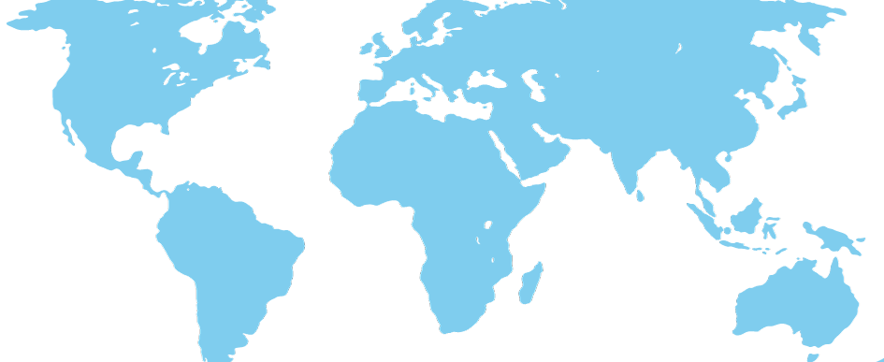
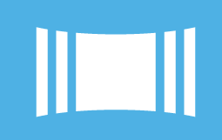


Frameworks
caching
identity
service bus
media
cdn
big data
commerce
integration
analytics
hpc
mobile
Services
.
.
.
.
.
.
.
.
.
.
.
.
.
.
.
.
.
.
Fabric
virtual machines
web sites
cloud services
SQL database
noSQL database
blob storage
connect
virtual network
traffic manager
compute
storage
networking
Global Physical Infrastructure
servers / network / datacenters
Automated
Managed Resources
Elastic
Usage Based
Infrastructure
N Central US, S Central US, N Europe, W Europe, E Asia, SE Asia + 24 Edge CDN Locations

Slide 4
Compute Options on Azure
Web Sites
Cloud Services (Web/Worker Role)
Virtual Machines
Modern web apps
Perfect if your app consists of client side markup and scripting, server side scripting and a database. Powerful capability to scale out and up as needed.
Multi-tier Applications: Cloud-based applications that separate application logic into multiple tiers (i.e. multi tiered app patterns using both Web and Worker Roles
Enterprise server applications: Run your existing enterprise applications in the cloud, such as SQL Server, SharePoint Server or Active Directory.
Continuous delivery
Deploy directly from your source code repository, using Git or Team Foundation Service.
Apps that require advanced administration:
Cloud-based applications that require admin access, remote desktop access or elevated permissions
Porting existing line of business apps
Choose an image from the library or upload your own VHD.
Dev/Test : Run your enterprise dev/test environments on Windows Azure
Popular open source apps
Launch a professional looking site with a few clicks using apps like WordPress, Joomla!, Drupal, DotNetNuke and Umbraco
Apps that require advanced networking: Cloud-based applications that require network isolation for use with Windows Azure Connect or Windows Azure Virtual Network
Windows or Linux operating system Support for Windows Server, along with community and commercial versions of Linux. Connect virtual machines with cloud services to take full advantage of PaaS services.

Slide 5
Running Web(Compute) Workloads
Capabilities
Web Sites
Cloud Services
Web Role
vs.
Access to Azure services like Caching, Service Bus, Storage, SQL Azure
Supports ASP.NET, classic ASP, Node.js, PHP
Shared content and configuration
GIT, FTP
Near-instant deployment
Integrated MySQL as a service support
Environments/Staging
Network isolation
Remote desktop access
Elevated permissions
Start-up tasks
Unsupported frameworks or libraries
Service Model
Virtual Network
*
* Cloud Apps (Web or Worker roles) can integrate with ClearDB’s MySQL as a Service via connection string but not via seamless portal/provisioning workflow

Slide 6
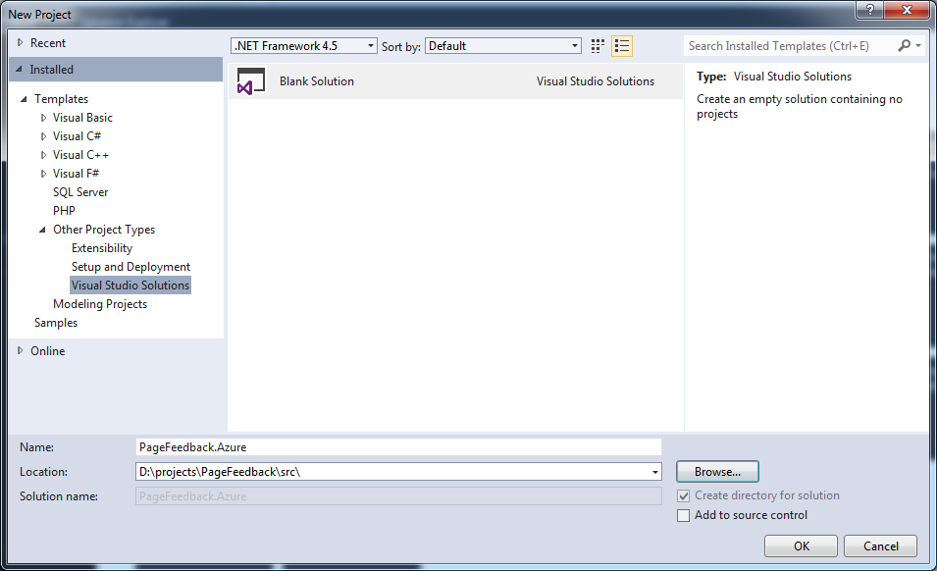
Setup project

Slide 7
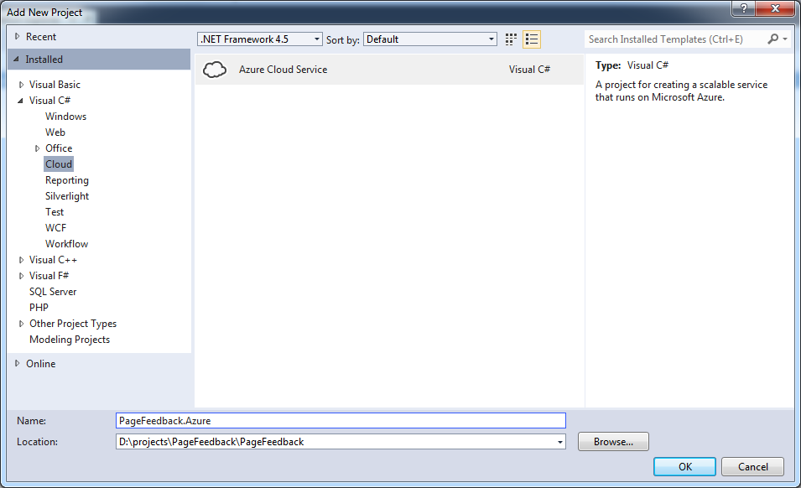
Setup project

Slide 8
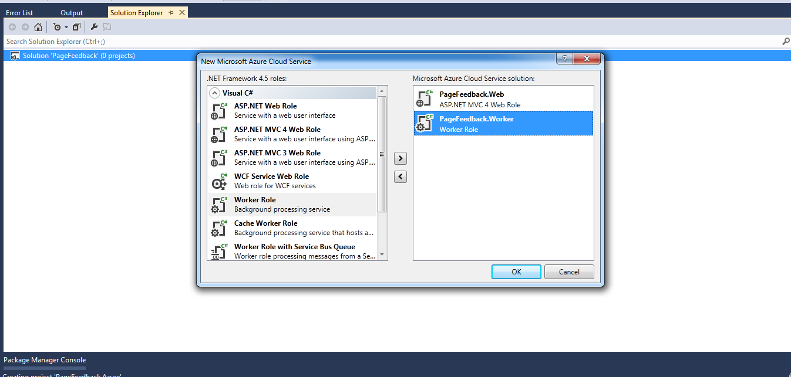
Setup project

Slide 9
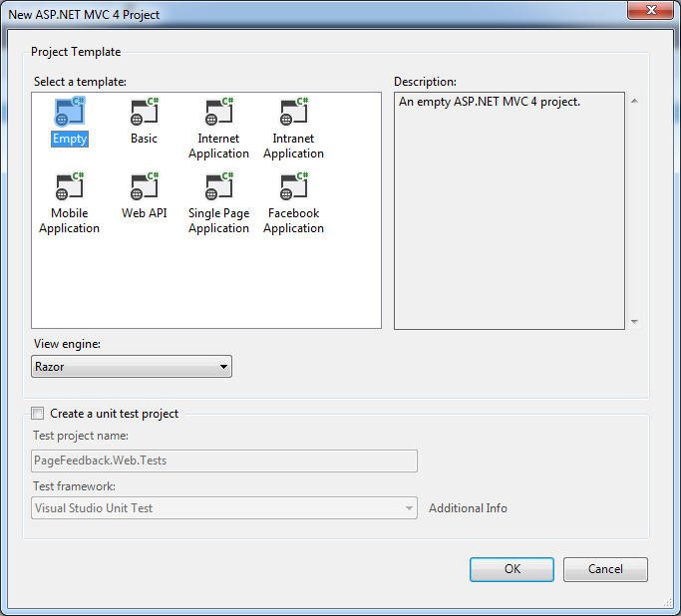
Setup project

Slide 10
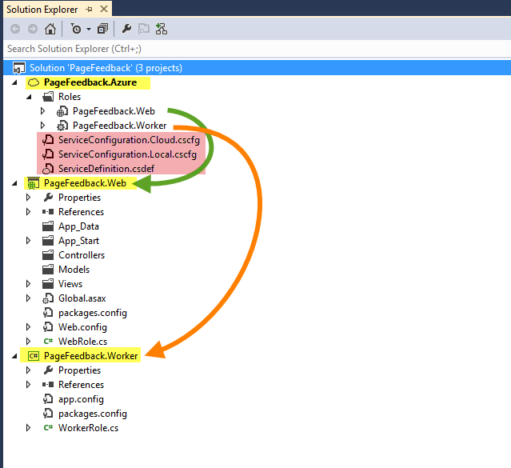

Slide 11
Project structure
Azure cloud service project (PageFeedback.Azure)
Web role project (PageFeedback.Web) => website (usually one per cloud service)
Worker role project (PageFeedback.Worker) => background worker (multiple)

Slide 12
Azure cloud service project (PageFeedback.Azure)
Manage all associated worker roles in solution
Startup project for Azure cloud service project
Container for multiple web roles and worker roles
Contains cloud service configuration file (share to all roles)
ServiceDefinition.csdef (define all configurations)
ServiceConfiguration.Cloud.cscfg ( set configuration values for release environment)
ServiceConfiguration.Local.cscfg (set configuration values for local development)

Slide 13
Web Role Project
Can be any ASP.NET web project (ASP.NET MVC or WebForm)
Only reference with Azure SDK library
Contain base class of RoleEntryPoint (WebRole.cs) as entry point of WebRole, work as controller of machine that web role stay on
Main purpose for web application, request, response, WEB API

Slide 14
Worker Role Project
Just .NET class library project
Only reference with Azure SDK library
Contain base class of RoleEntryPoint (WorkerRole.cs) as entry point of WorkerRole, work as controller of machine that worker role stay on

Slide 15
RoleEntryPoint.cs
3 main method to override
OnStart
Initialize application
Must return true
Run
Working code, in while loop
if it return role will be stop and restart
OnStop
Called when role stop, clear running process, stop consuming message from queue

Slide 16
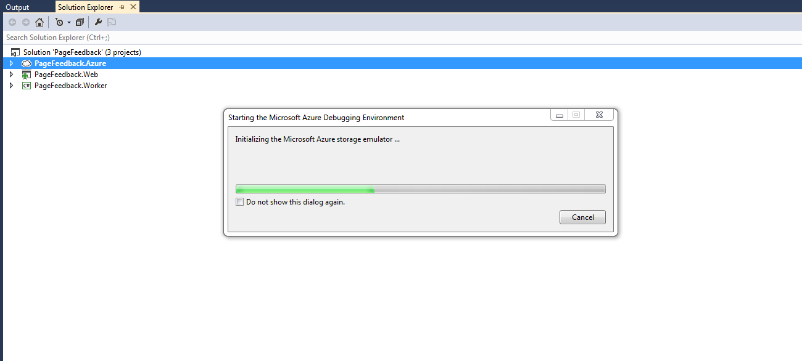
Run Azure cloud project in Emulator

Slide 17
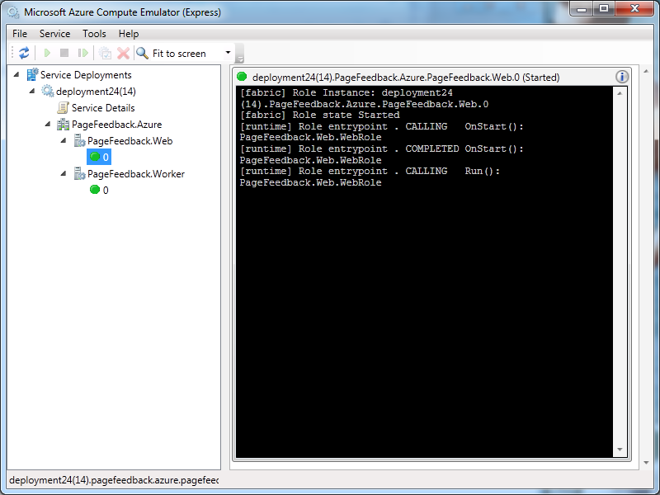
Setup project

Slide 18
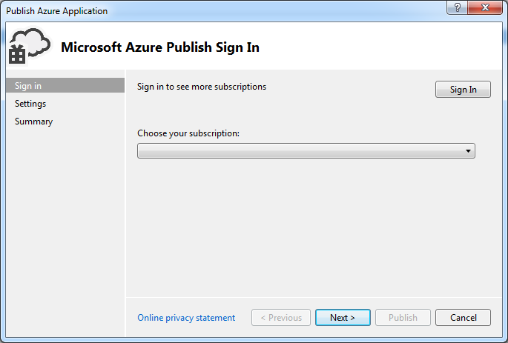
Setup project

Slide 19
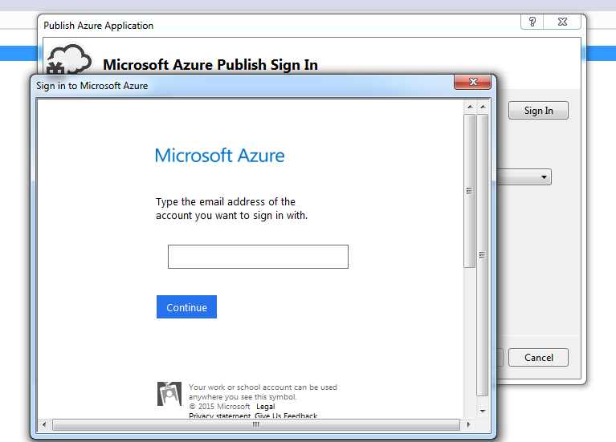
Setup project

Slide 20
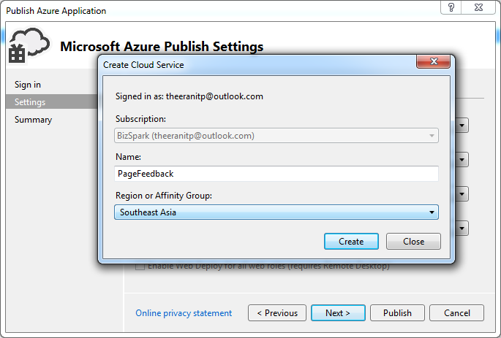
Setup project

Slide 21
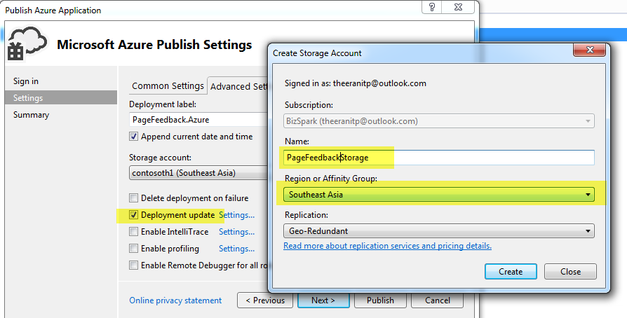
Setup project

Slide 22
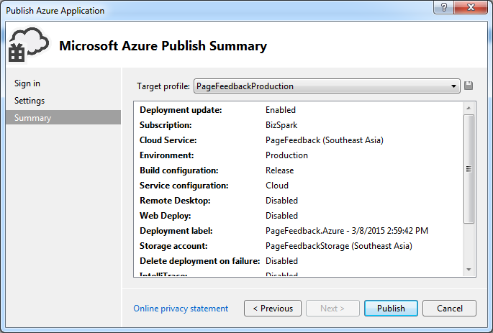
Setup project

Slide 23
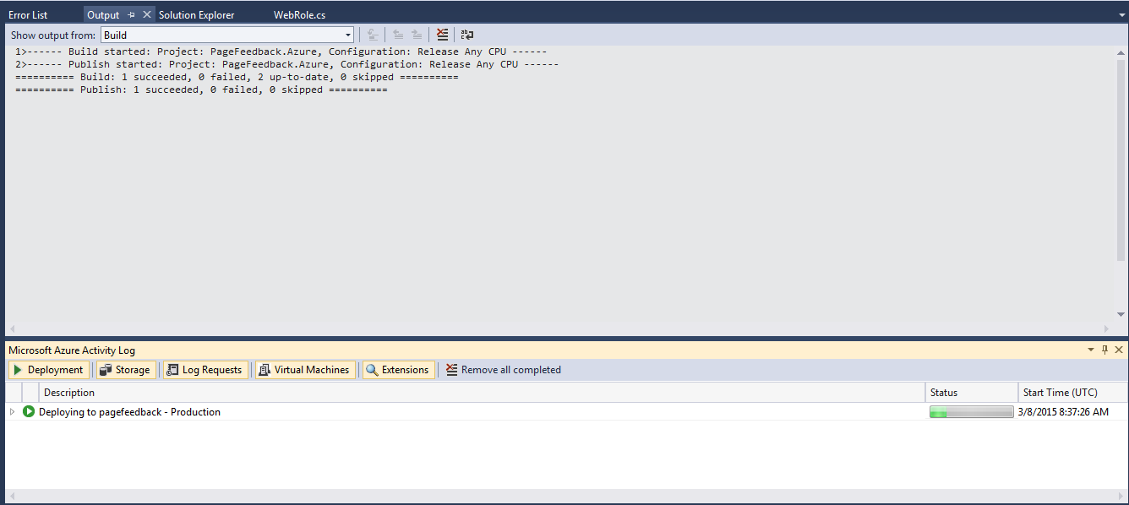
Setup project

Slide 24
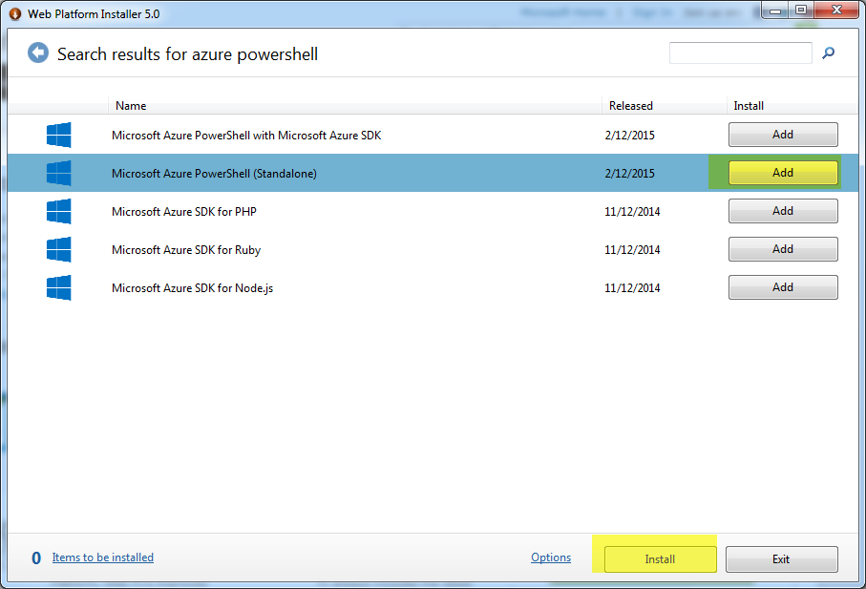
Setup project

Slide 25
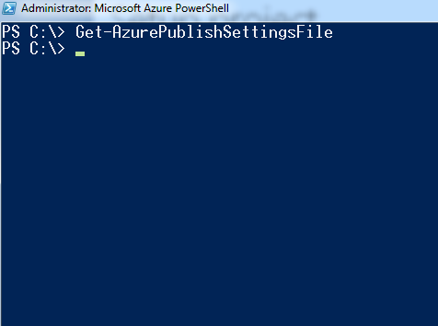
Setup project
> Set-ExecutionPolicy Unrestricted -Force

Slide 26
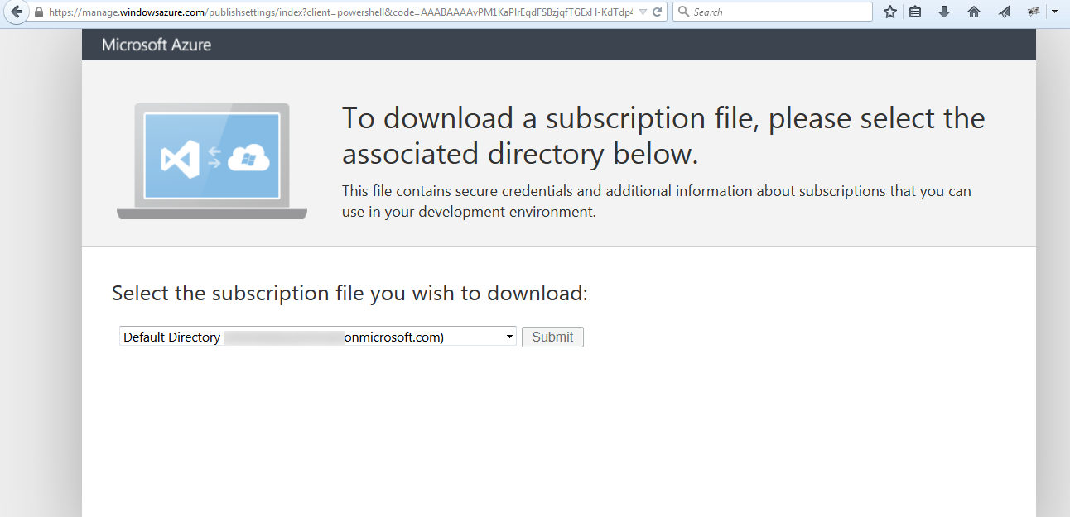
Install Azure PowerShell

Slide 27
Setup project

Slide 28
Setup project

Slide 29

cloud services
Build infinitely scalable apps and services
Support rich multi-tier architectures
Automated application management

Slide 30
Windows Azure Cloud Services Characteristics
Automated, Consistent Application Updates | Updates to the application occur in an automated way Updates result in clean components forcing consistency Local storage and OS are left untouched
Automated, Consistent Configuration Changes | Updates to the settings occur in an automated way Updates result in clean settings Local storage and OS are left untouched
Multi-Instance Management | Identical instances are deployed across the service Large scale-out services are guaranteed to be consistent No configuration drift
Scale-out | Application scale-out can occur automatically
High Availability | The application has no downtime, even in the face of hardware failures.
Automated, Consistent OS Servicing | The OS system hosting the application can be updated with the most recent patches in a coordinated and automated way.

Slide 31
Modeling Cloud Applications
A cloud application is typically made up of different components
Front end: e.g. load-balanced stateless web servers
Middle worker tier: e.g. order processing, encoding
Backend storage: e.g. SQL tables or files
Multiple instances of each for scalability and availability
Windows
Azure
Storage (or) SQL Azure
Front-End
HTTP/HTTPS
Front-End
Middle-Tier
Load Balancer
SQL Server on Virtual Machine
SQL Server on Virtual Machine
Cloud Service Application on Windows Azure

Slide 32
Deploying a .NET App to Windows Azure The 10,000 foot view
.NET Cloud App
Model the Blue Print of your Service definition (CSDef)
Provide Environment specific Service (CScfg)
Package your service code & binaries (Service. CSpkg)
Windows Azure
Portal
Management REST APIs
US-North Central Datacenter
Fabric Controller

Slide 33
Windows Azure SDK for .NET–April 2013 (2.0)
Includes free add-in for Visual Studio 2010 SP1 and Visual Studio 2012
Support for Hi-Mem Skus A6 & A7 specifically useful for HPC workloads
Faster Deployment Support with Simultaneous Update Option
Improved Diagnostics Support
Easier Configuration
View Diagnostics on a Live Services
Update Diagnostics Settings on a Live Service
PowerShell: Tons of new Automation Commands
Cloud Services
>>> Set-AzureDeployment –Mode Simultaneous
Virtual Machines
>>> New-AzureVM
>>> New-AzureQuickVM
PowerShell Remoting by default for CLI Tools

Slide 34

Cloud Services: Build & Deploy
demo

Slide 35
focus on apps, not infrastructure

Slide 36
Virtual Machines: You bring it and we run it
demo

Slide 37
Virtual Machines and Cloud Services

Slide 38
Cloud Services, Roles and Instances Cloud Service is a management, configuration, security, networking and service model boundary
Cloud Service
Web Role
VM₁
VM₂
VM₃
ROLES
Worker Role
INSTANCES
VM₄
VM₅
VM…

Slide 39
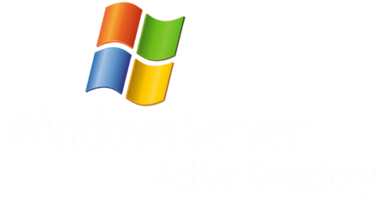
Virtual Machines Virtual Machines are roles with exactly one instance
Implicit Cloud Service
Virtual Machine

Slide 40

The Benefits of Cloud Services (Web/Worker Roles)
Faster App Development
There’s less work for developers to do
Applications can go from idea to availability more quickly
Cheaper to run
There’s less admin and management work to do
Organizations spend less supporting applications
Lower risk - The platform does more… leaving fewer opportunities for error
Creating and running applications gets more reliable

Slide 41
Practical Tips for Availability & Scale

Slide 42
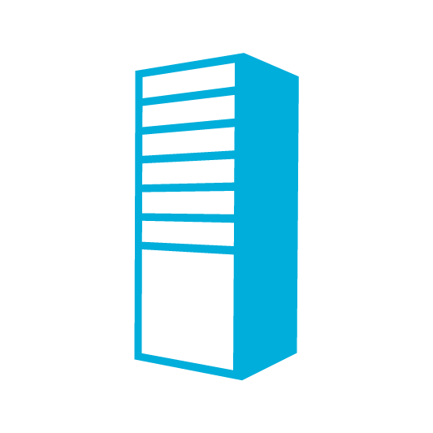

End to End Highly Available Cloud App
Redundancy at every level
Database
SQL-AVSET
Web Role
2 Instances
Internet
LB
Web Role
Database

Slide 43
Heineken – Scaling on Windows Azure

Slide 44
Summary :- Scaling for the Cloud
Design for Scale
Design based on for bursting patterns of your app.
Design for Failure & Fast Recovery
Focus on availability, geo-distribution & disaster recovery
Plan for availability SLA vs Support Model
Decompose workload & loosely coupled
Define SLA based on workloads
Design for Interoperability
Focus on hybrid, cross cloud patterns
Design for Operations & Management

Slide 45
Related Sessions
3-547: Debugging and Troubleshooting Windows Azure Applications Using Visual Studio
Boris Scholl
Wednesday at 5:00PM
3-556: Building Your Dev and Test Sandbox with Windows Azure Infrastructure Service
Drew McDaniel
Thursday at 2:00PM

Slide 46
Summary
Maximize your Azure compute investments across
Take advantage of MSDN offers
Design for Scale & High Availability
Learn to connect Cloud Services & Virtual Machines based on your app scenarios

Slide 47


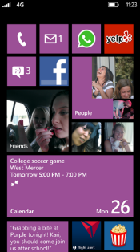
Evaluate this session
Required Slide
*delete this box when your slide is finalized
Your MS Tag will be inserted here during the final scrub.
Scan this QR code to ealuate this session and be automatically entered in a drawing to win a prize!

