Slide 1
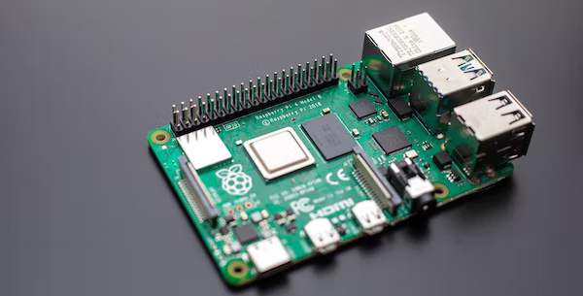
Internet Of Things Lab
Raspberry Pi 4 Setup
15/02/23
Dr. Vijay Bhaskar Semval

Slide 2
Requirements:
INTERNET OF THINGS
USB peripherals like keyboard, mouse, etc.
A 16/32GB memory card
A card reader to flash the memory card
A C-type cable supported power supply
A Raspberry Pi 4B
A monitor supporting VGA input
A micro HDMI to VGA cable
A VGA to VGA cable (optional for ease-of-use)

Slide 3
Installing the OS on the SD card:
INTERNET OF THINGS
Load the SD card onto an SD card reader and plug into your system.
Download and open Raspberry Pi Imager and choose the required OS from the list presented.
Choose your loaded SD card.
Review your selections and click on the Write button to begin writing data to the SD Card.

Slide 4
Connections
INTERNET OF THINGS
Connect the HDMI end of the micro HDMI cable to the Raspberry Pi.
Connect the VGA end of the micro HDMI to one of the ends of the VGA to VGA connector.
Connect the free end of the VGA to VGA cable to the monitor.
Connect the USB peripherals with the Raspberry Pi.
Insert the flashed SD card on the Raspberry Pi.
Connect to a power supply using a C-type cable and your setup is complete!

Slide 5
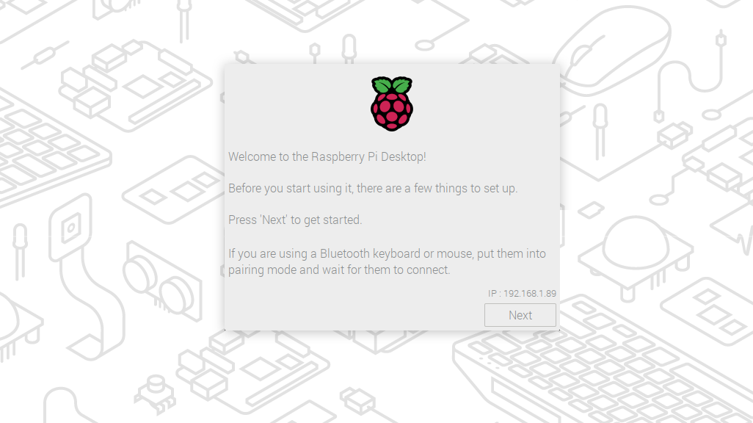
Steps for the bootup:
INTERNET OF THINGS
Follow the configuration wizard prompts and setup username, password, wifi and download updates. This may take a while.
After the updates are done, the system will reboot and will be ready to use.

Slide 6
INTERNET OF THINGS
The End
Have fun with the Pi!

