Slide 1

A Tool for NBA Data Analysis
Team member: Shaowei Gong, Houjue Wang, Wenjing Li, William Grudzinski

Slide 2
Motivation
In 2012, David Stern said that the NBA predicts the revenue of the league to be $5 billion in the 2011-2012 season, which would be a 20 percent increase from the last season. Now the league is worth $37.5 billion dollars and is growing rapidly^{[1]}
[1]Mass Comm, the commercialization of sports, THE ARCHWAY,2016 Feb 25.

Slide 3

Motivation
Better performance Higher Team Value
How to get better performance in field?

Slide 4
Data Collection
Collect Shooting detail data from stats.nba.com API
Collect pull up Shooting data of all players from sportuv API
Collect drives data of all players from sportuv API
Collect denfense data of all players from sportuv API
Collect passing data of all players from sportuv API
Collect touches data of all players from sportuv API
Collect speed data of all players from sportuv API
Collect rebounding data of all players from sportuv API
Collect catchshoot data of all players from sportuv API
Collect shooting data of all players from sportuv API

Slide 5
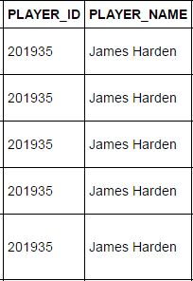
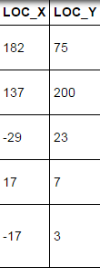
Shooting Detail Data Retrieved from Stat.nba API

Slide 6
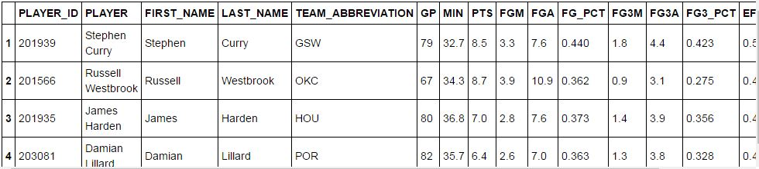
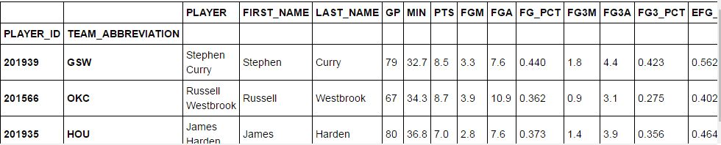
Pull-Up Shooting Data Retrieved from Sportuv API
Set PLAYER_ID TEAM_ARREVIATION as index

Slide 7
Repeat privous step to get other dataset
Merge all the dataset retrieved from Sportuv into one dataset by PLAYERID

Slide 8
Shooting choice chart
Divide the half court into 30*30 section
Count the amount of shooting of every section
Calculate the average field-goal percentage of every section
Use size of circle to represent the amount the shooting in every section.
Use tone of color to represent the average field-goal percentage of every section

Slide 9
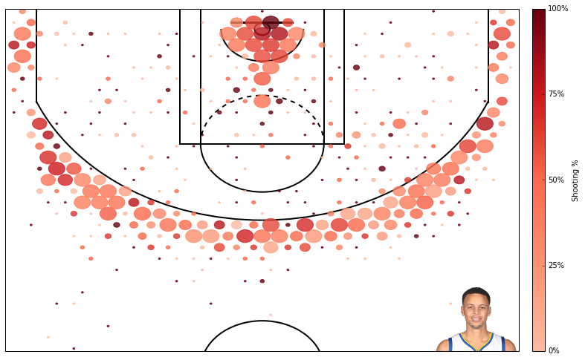
Shooting Chices Chart of Steven

Slide 10
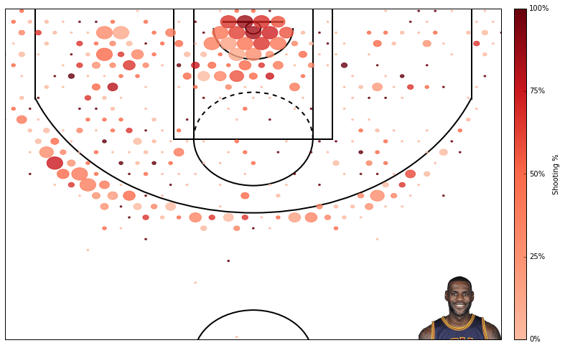
Shooting Choice Chart of Lebron

Slide 11
Clustering of NBA Players
Obtain the correlation matrix of dataset (329*80)
Use Truncated SVD to reduce the dimensionality to 10
Use t-SNE to reduce the dimensionality to 2
Use K-means to cluster data (K iterates from 1 to 15)
Select optimized K (=7) and visualize the result

Slide 12
Methodology Truncated SVD
sklearn.decomposition.TruncatedSVD in Python
SVD (Singular Value Decomposition):
Truncated SVD: set all but the first k largest singular values equal to zero and use only the first k columns of U and V.

Slide 13
Methodology Truncated SVD
Similar to PCA: linear dimensionality reduction
More flexible than PCA
Truncated SVD: operate on any matrix including data matrix
PCA: operate on a covariance matrix

Slide 14
Methodology t-SNE
t-Distributed Stochastic Neighbor Embedding
sklearn.manifold.TSNE in Python
t-SNE: visualize high-dimensional data in a 2 or 3 dimensional space

Slide 15
Methodology t-SNE
Advantages
Capture much of the local structure of the high-dimensional data very well
Reveal global structure (e.g. the presence of clusters at several scales)
Reduce the tendency to crowd points together in the center of the map

Slide 16
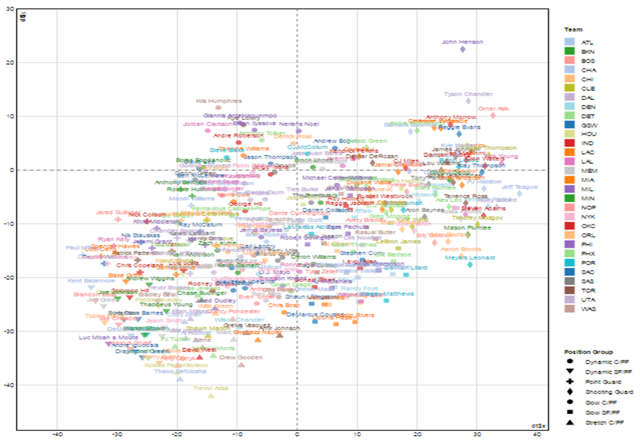
Visualizaiton of Clustering

Slide 17
Our product worth 1 million dollar!

