Slide 1

NBA Data Analysis Tool Demo
Team member: Shaowei Gong, Houjue Wang, Wenjing Li, William Grudzinski

Slide 2
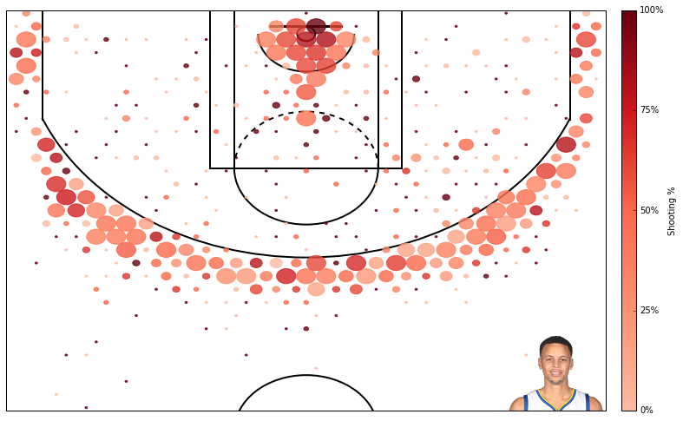
Shooting Choice Analysis Tool

Slide 3
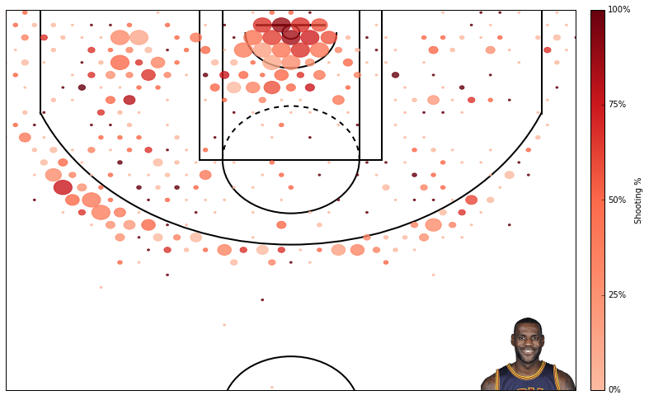
Example of Lebron

Slide 4
Our product worth 1 million dollar!

