Slide 1

Jai Venkateswara Technologies
ANDROID STUDIO SETUP

Slide 2
Jai Venkateswara Technologies
Android Studio setup goes in three steps
Java development kit(JDK ) installation.
Android studio setup.
Creating first android project.
JDK installation
Android studio setup
Creating android
project

Slide 3
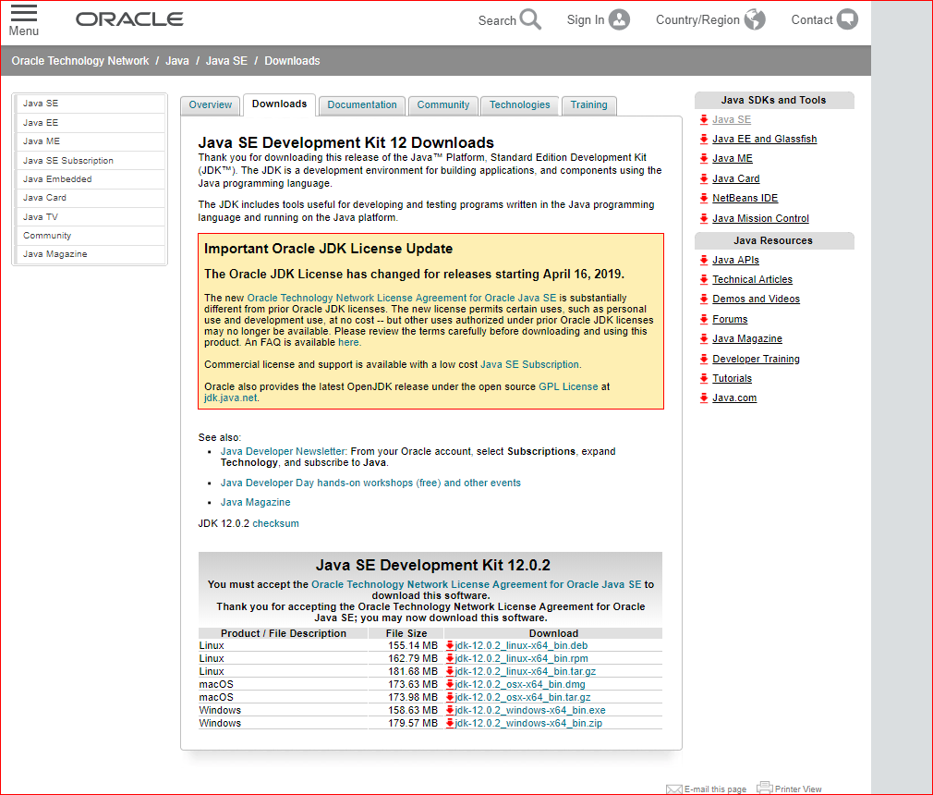
Jai Venkateswara Technologies
JDK installation
Download Java development kit(JDK) from the oracle official website, link is given below.
Go to downloads in oracle website. Find Java SE Development kit at end of the page.
Download executional file according to your system configuration.
Steps after downloading exe files were given in detail in slide number 3.
Reference: https://www.oracle.com/technetwork/java/javase/downloads/jdk8-downloads-2133151.html

Slide 4
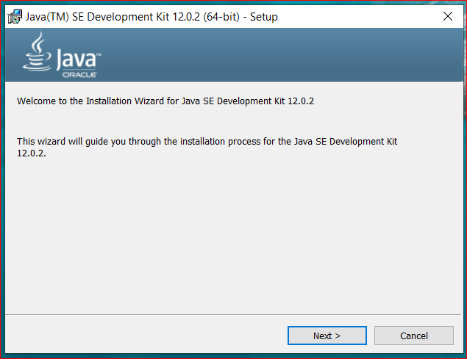
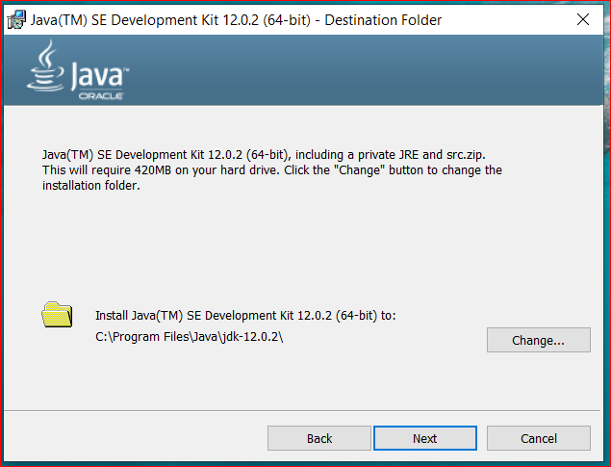
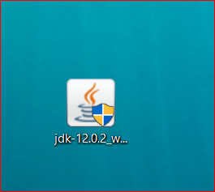
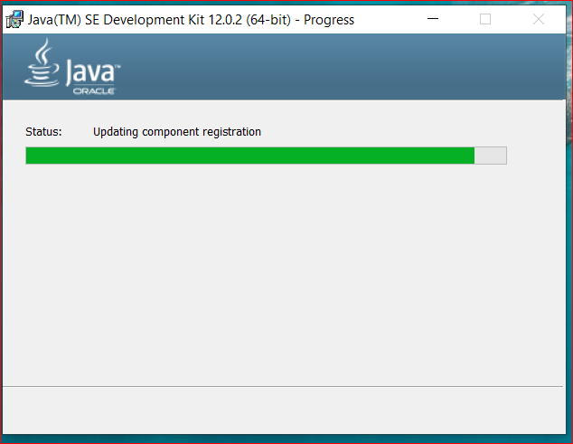
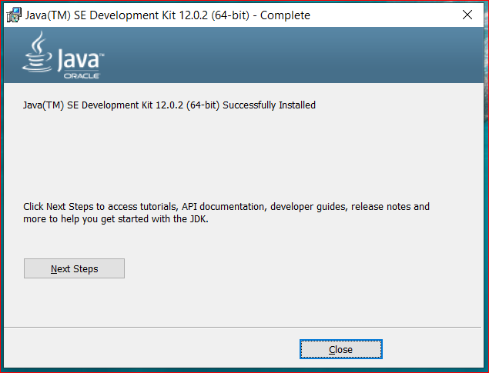
Jai Venkateswara Technologies
1
2
3
4
5

Slide 5
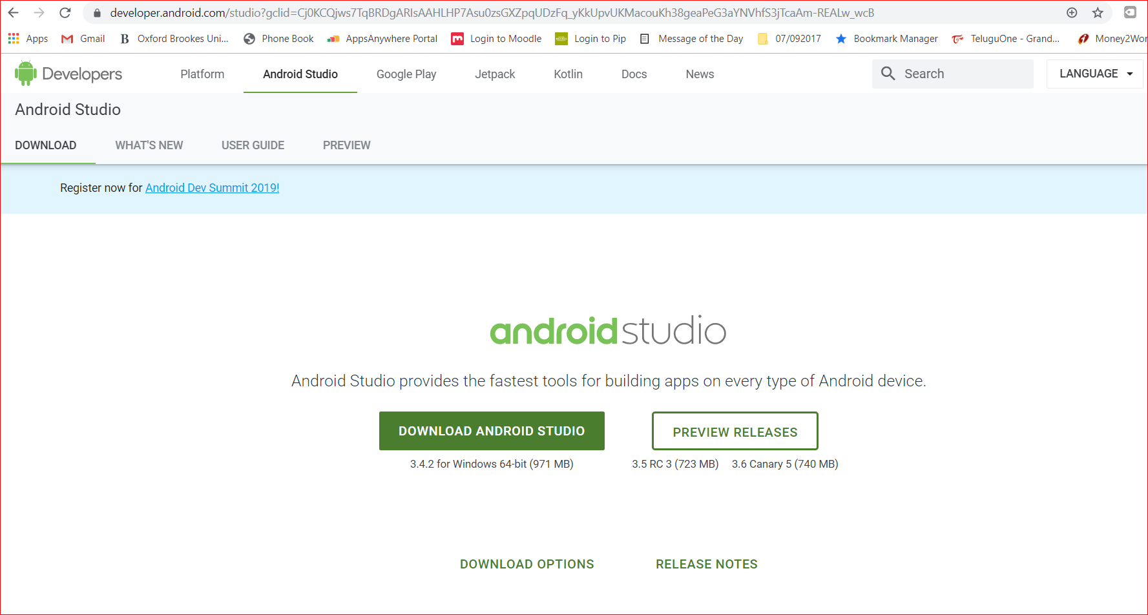
Jai Venkateswara Technologies
Android studio setup
Once JDK is successfully installed browse android studio in google chrome or you can use link in the reference copy and paste in google.
You can find download android studio option once the page appears
Reference: https://developer.android.com/studio

Slide 6
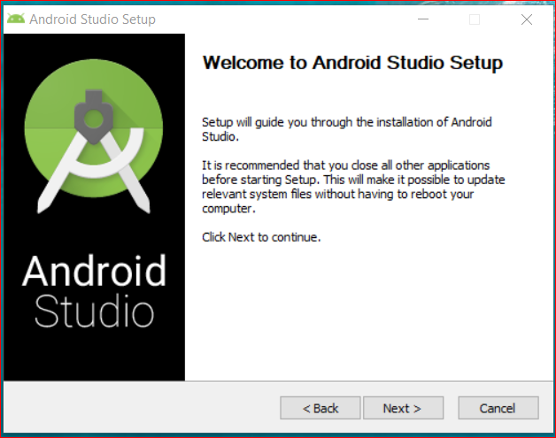
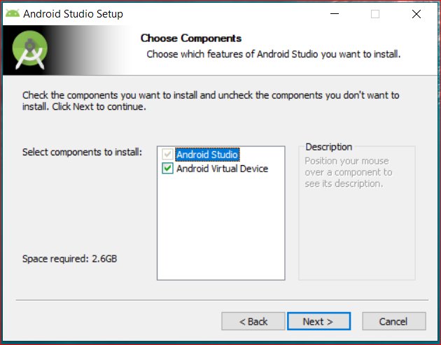
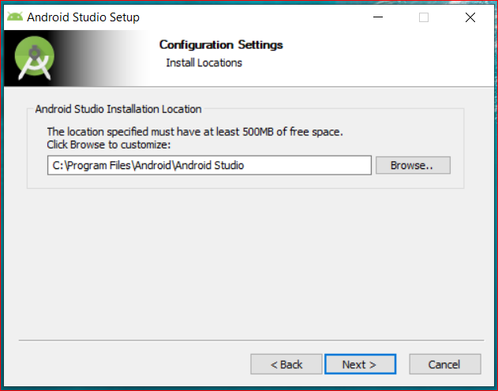
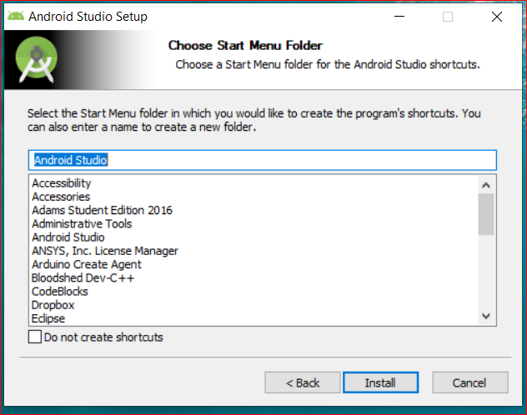
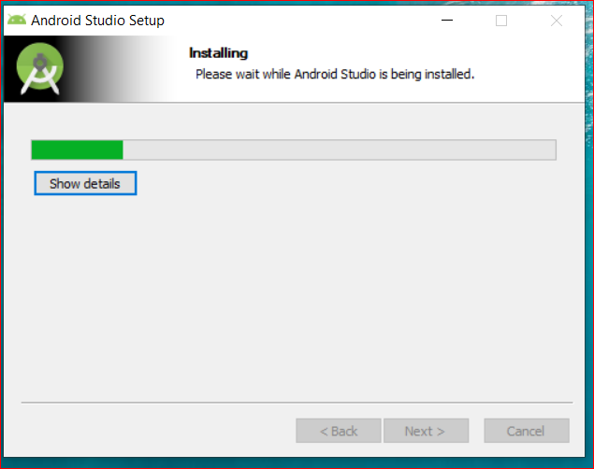
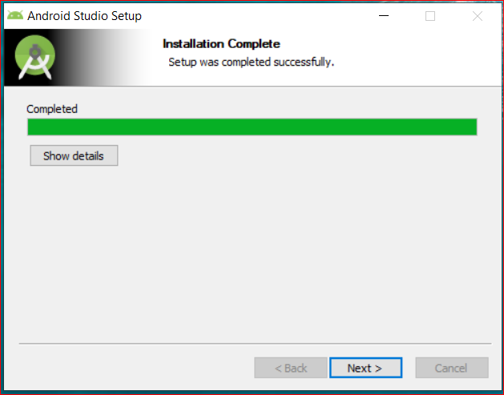
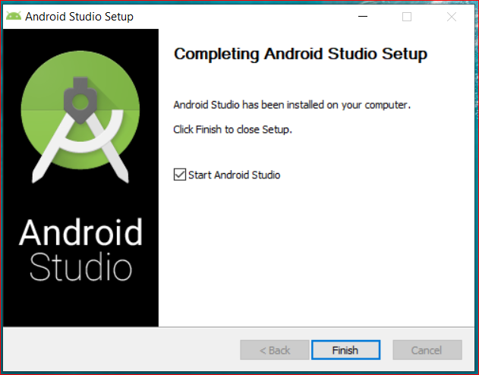
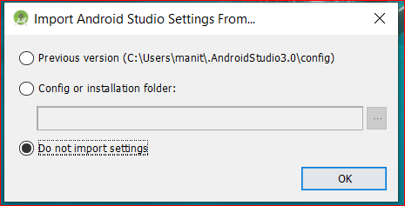
Jai Venkateswara Technologies
1
2
3
4
5
6
7
8

Slide 7
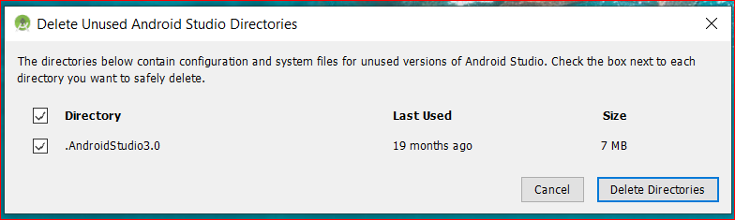
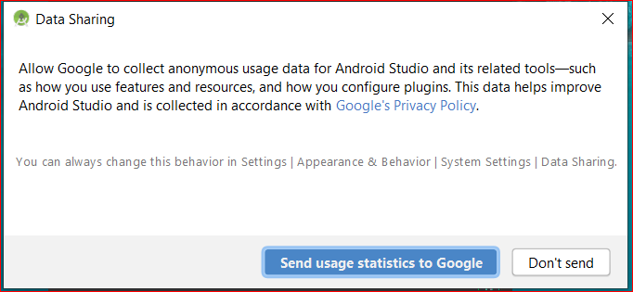
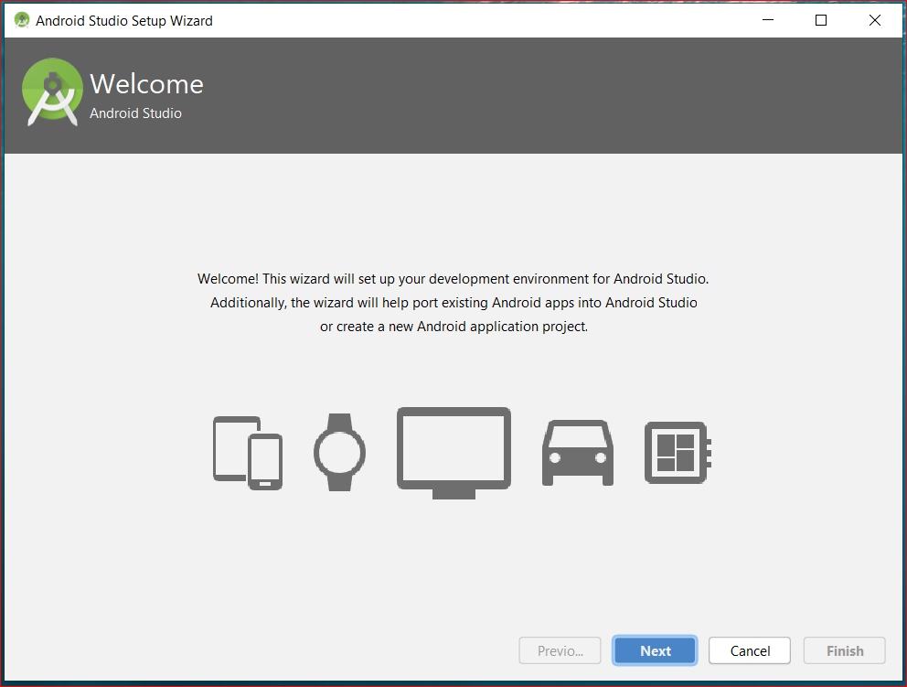
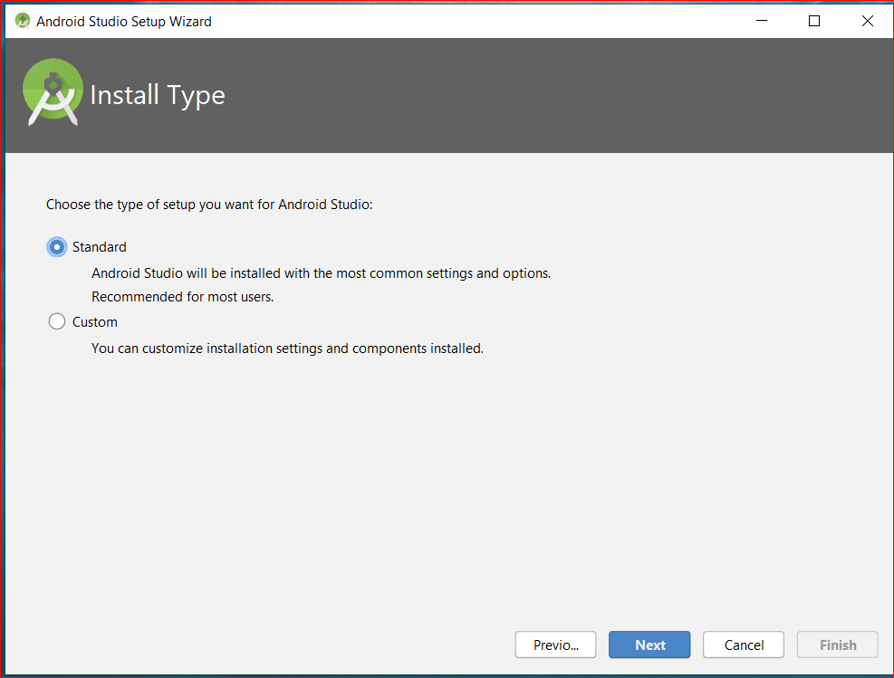
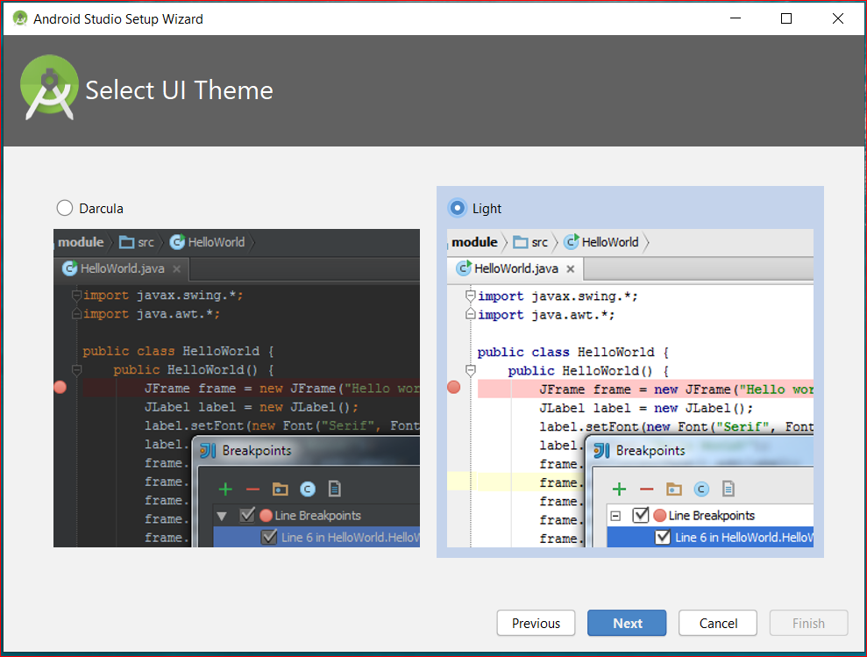
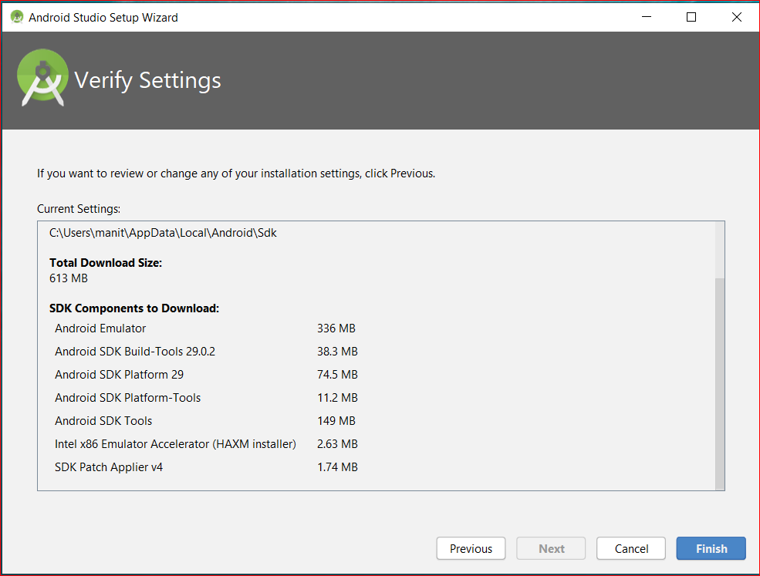
Jai Venkateswara Technologies
9
10
11
13
14
12

Slide 8
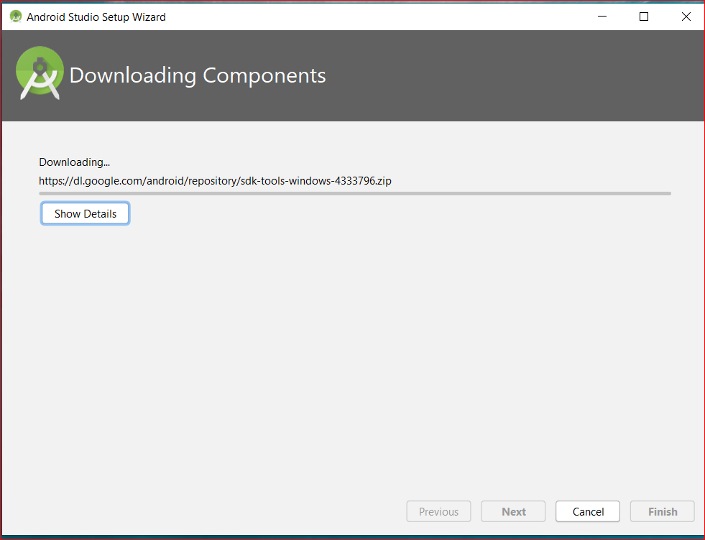
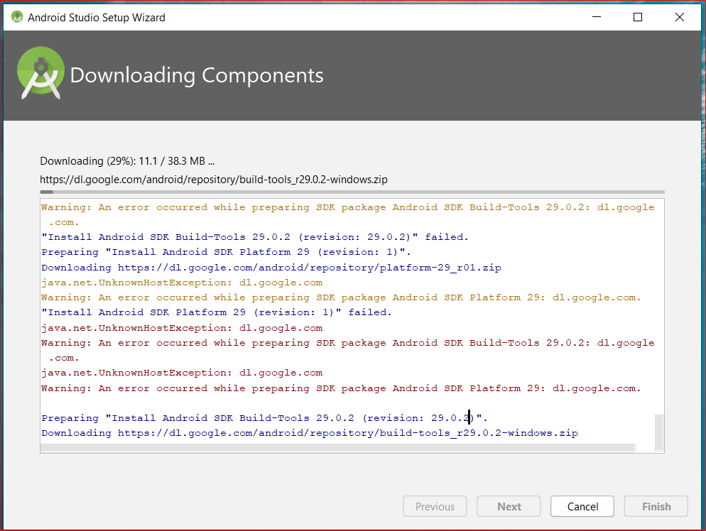
Jai Venkateswara Technologies
15
16
Upon clicking the finish button as shown in figure:16, The Android studio setup is successfully completed

Slide 9
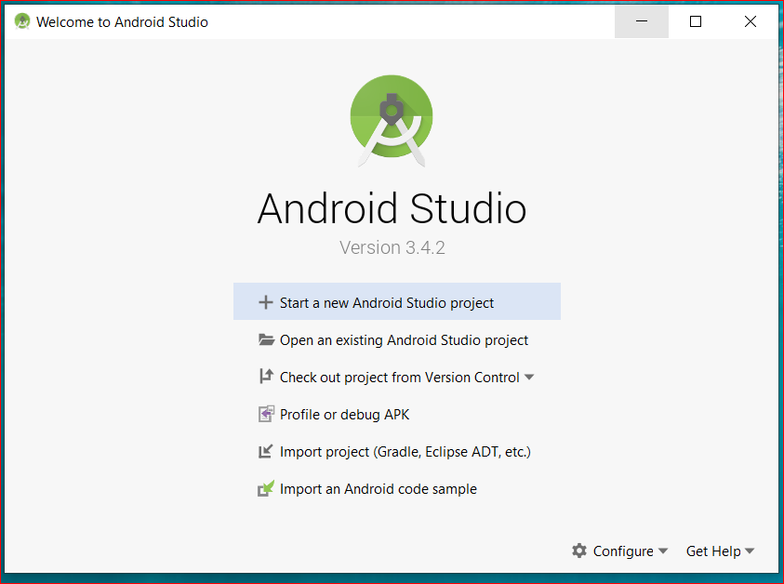
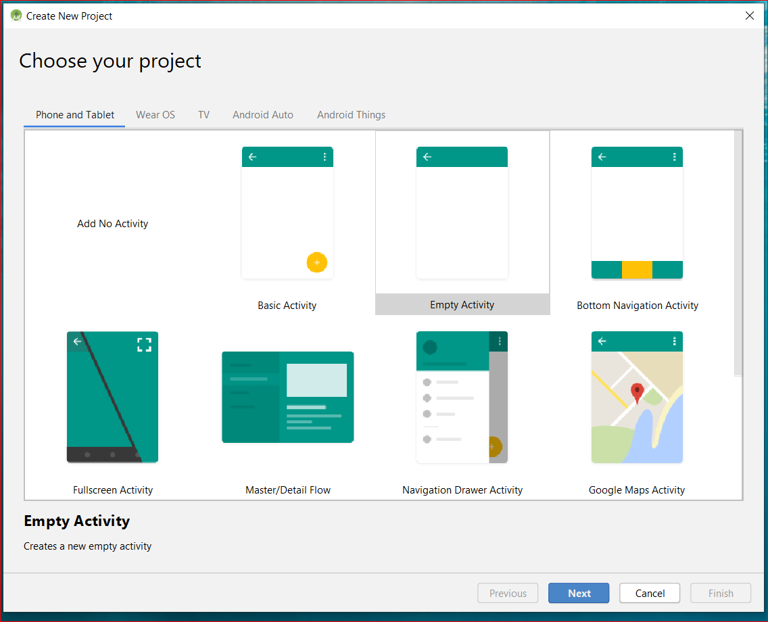
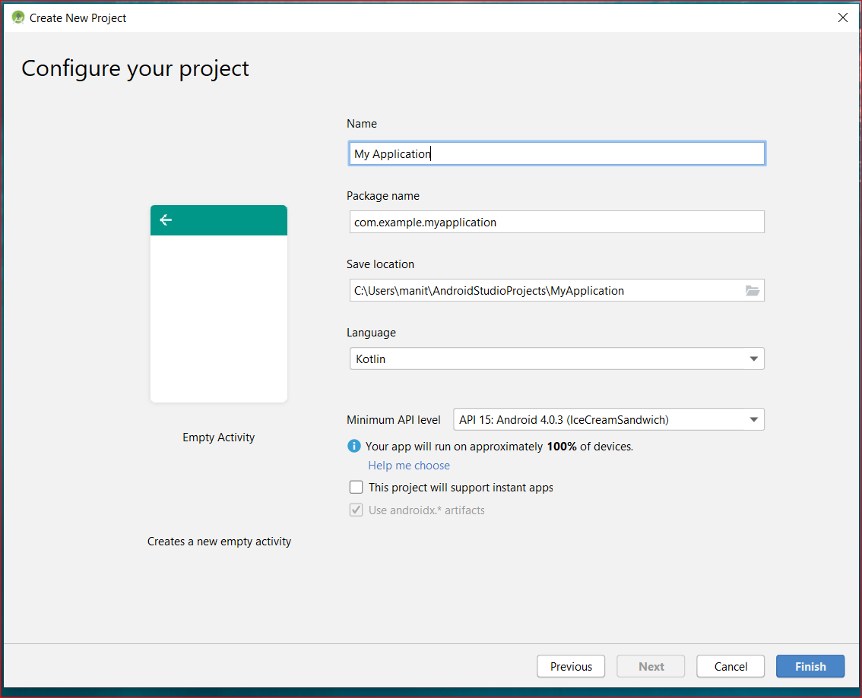
Jai Venkateswara Technologies
Creating button in studio
1
2
3
After opening android studio click on +start a new Android studio project as shown in picture:1.
Choose an empty activity or whatever activity you want to build.
Name the application and click finish to start project.

Slide 10
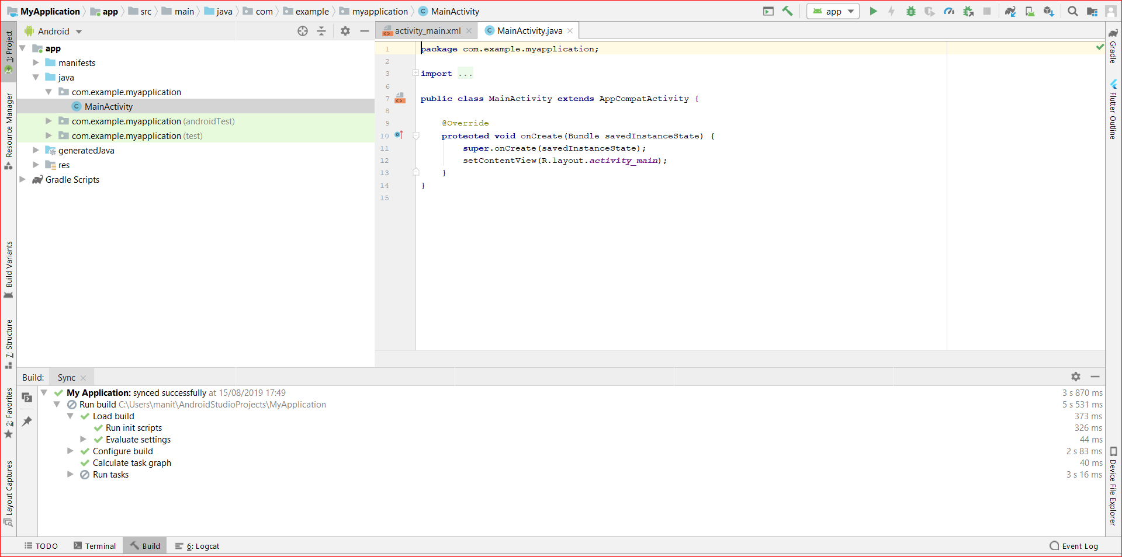
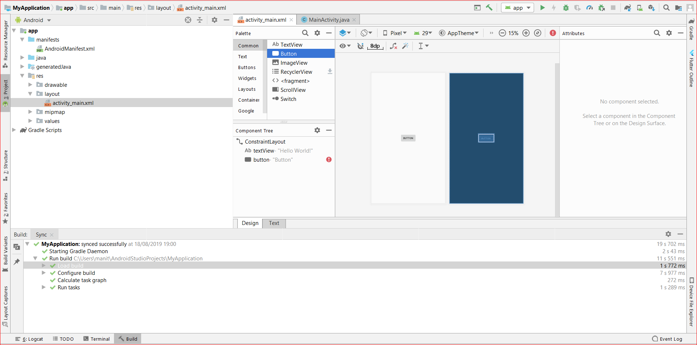
Jai Venkateswara Technologies
4
5
Once you click finish, you will enter into android project with activity chosen by you, it has main activity and xml file where you can create user interface either by writing code or you can just drag whatever attributes you need.
In above pictures a button was dragged into project, it was highlighted in picture 6.
After successfully writing code you can check your application in emulator, to setup this emulator you need to give virtual device configuration given in next slide.

Slide 11
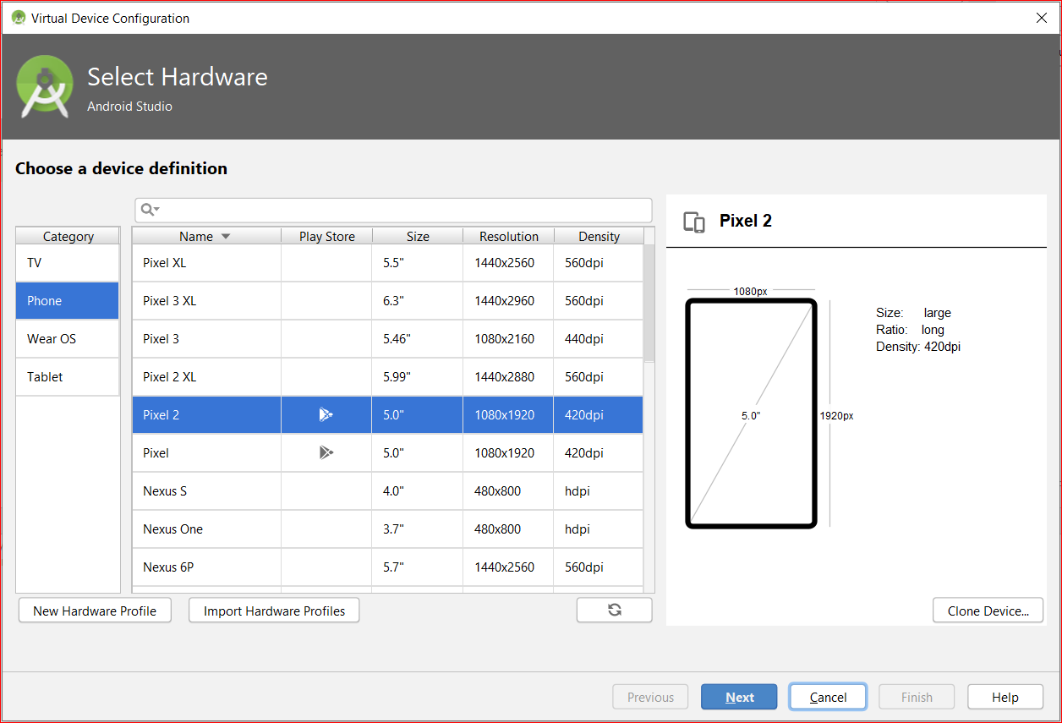
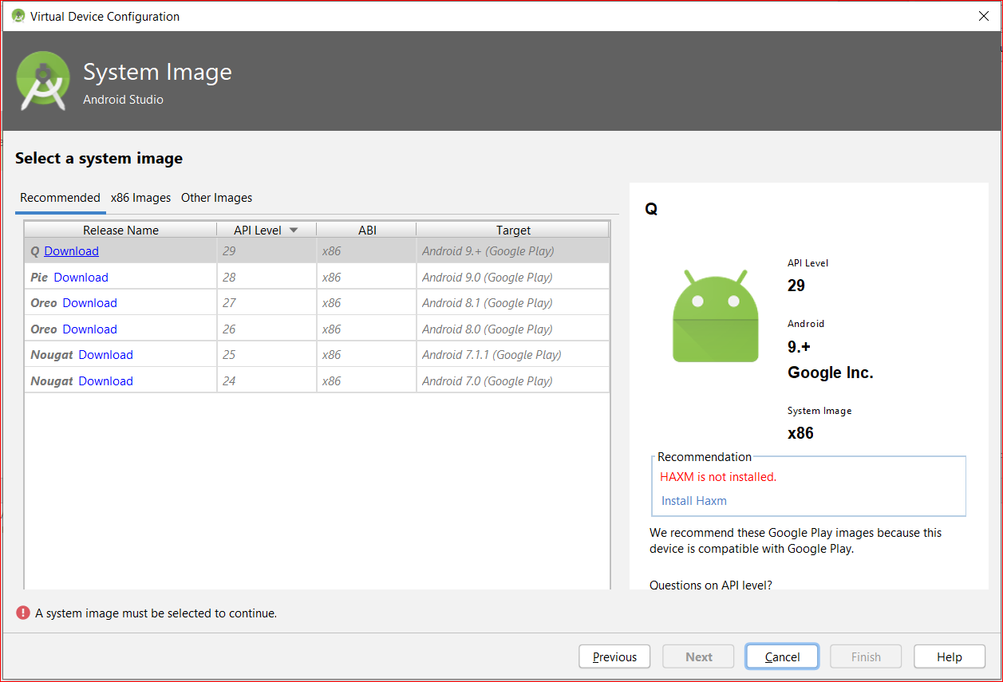
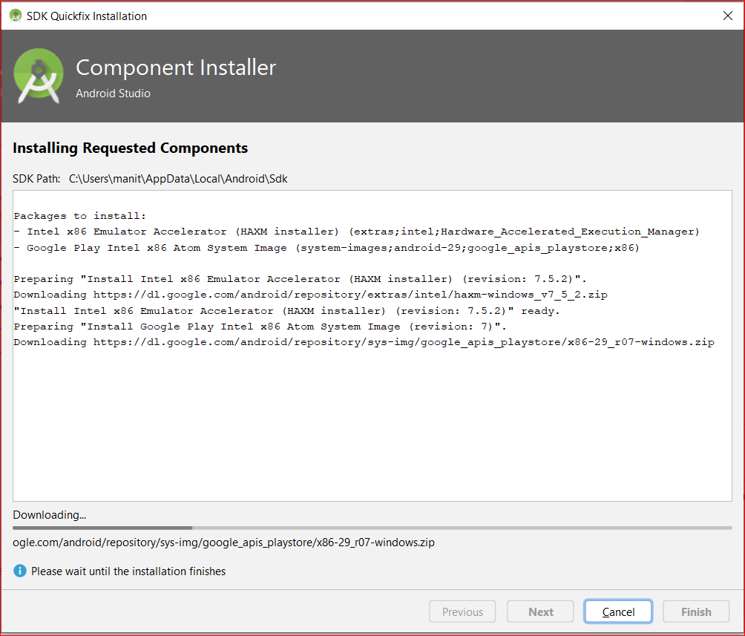
Jai Venkateswara Technologies
Virtual Device Configuration
1
2
3
As discussed in last slide you need emulator or virtual device to check working of your app.
You can choose required android version for your application and you can choose mobile as shown above.

Slide 12
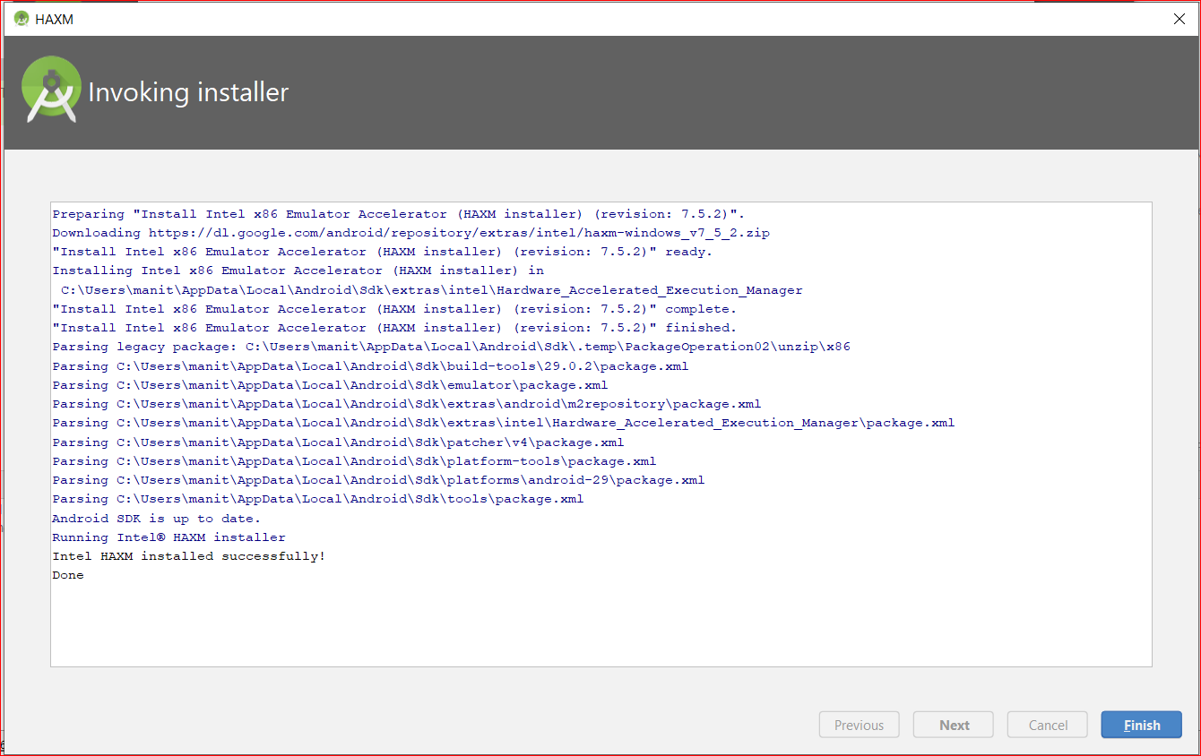
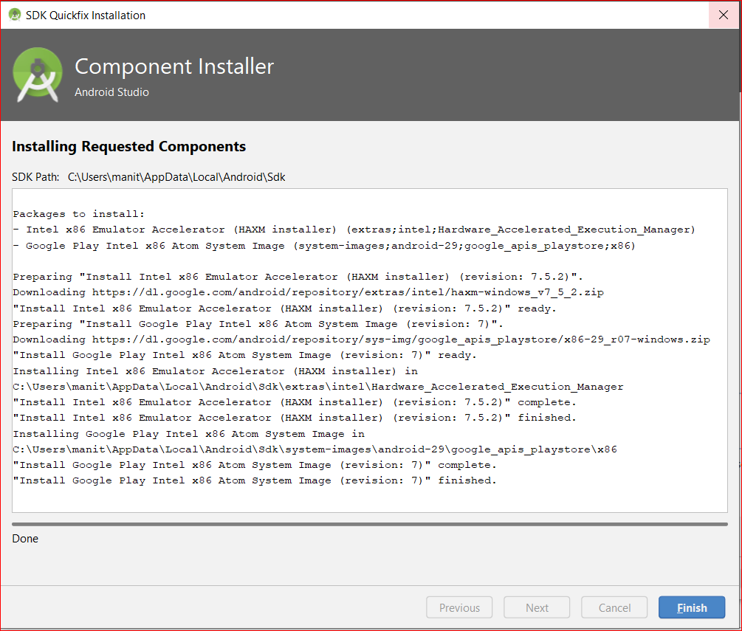
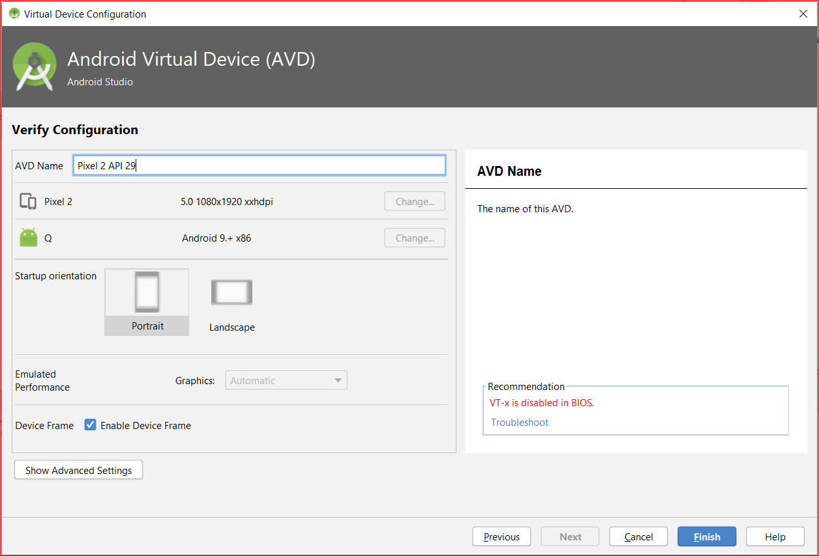
Jai Venkateswara Technologies
Virtual Device Configuration
4
5
6
Upon clicking finish Virtual Device Configuration will be successfully added to android studio.
This Virtual Device Configuration will be worked upon the deployment of the project, this process is shown in next slide.

Slide 13
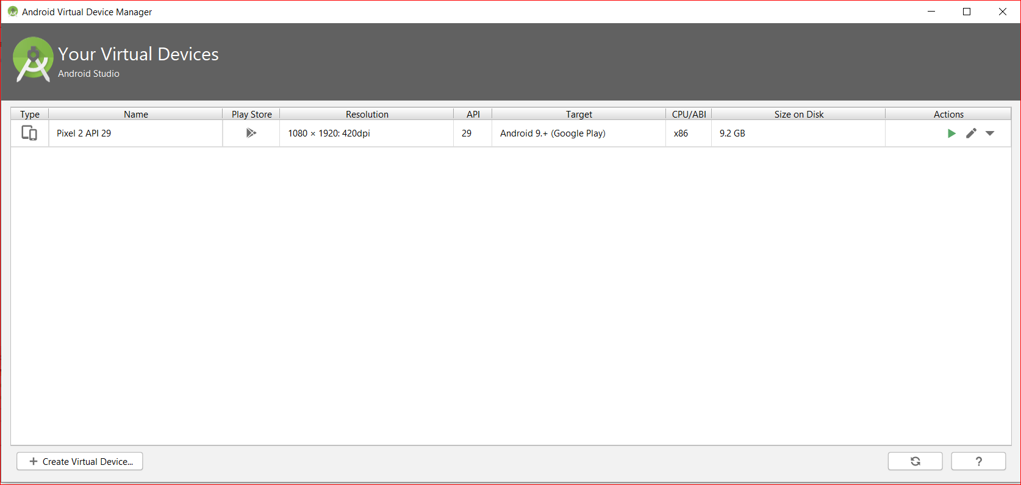
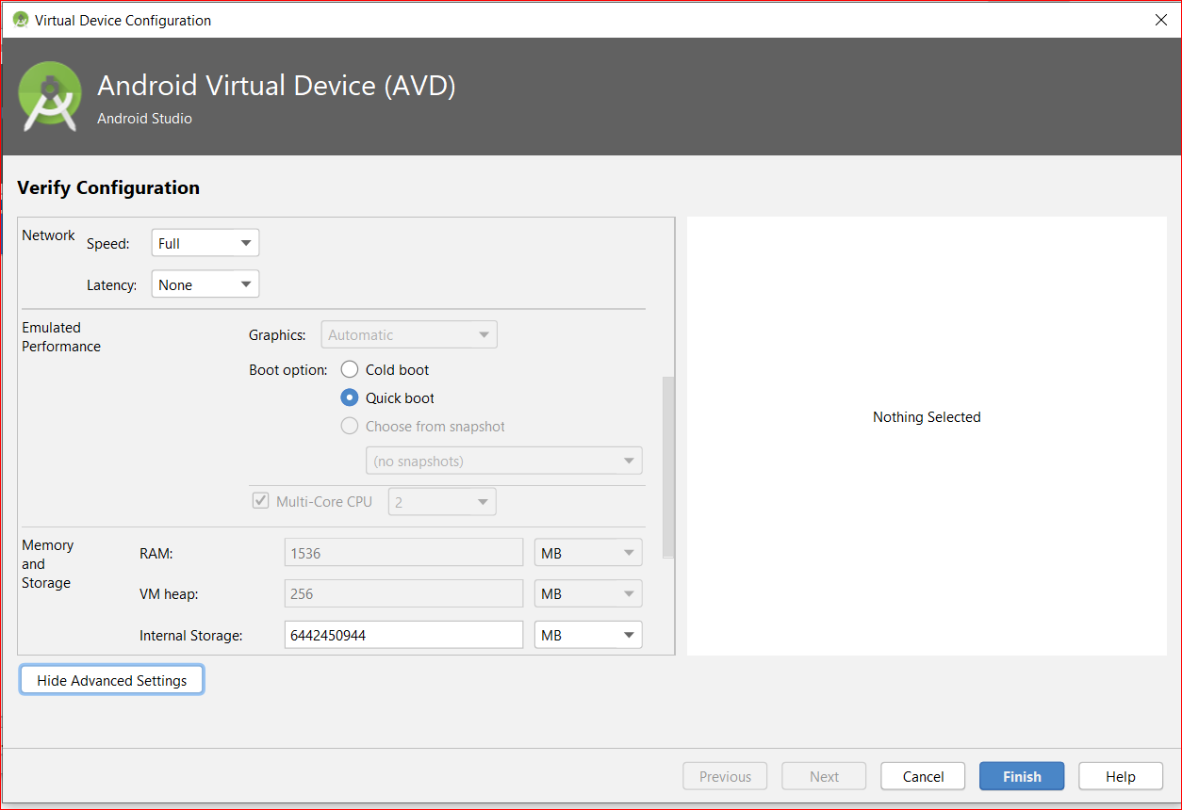
Jai Venkateswara Technologies
Virtual Device Configuration
2
1
Sometimes the emulator will be clumsy, so it’s better to cold boot the virtual device.
To do that we need to go to the tools and select AVD manager and you can see your selected device on the list, on the right end you can find an edit option, click on that it will direct to setting of emulator and then select advanced settings as shown in picture:2.
In boot options you can change it from quick boot to cold boot.

Slide 14
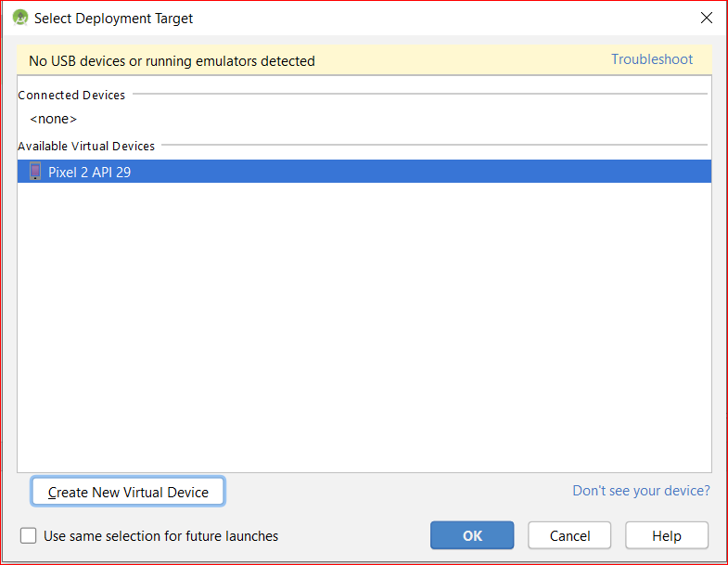
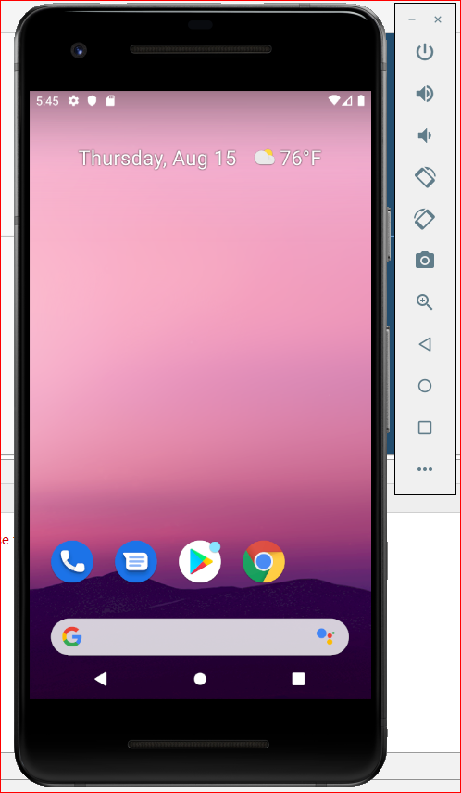
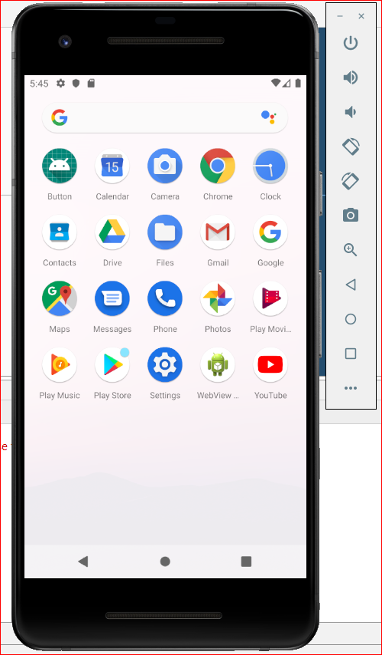
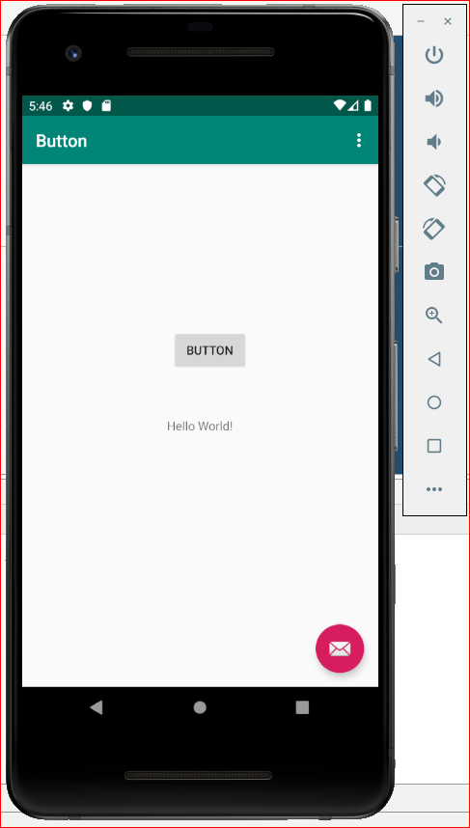
Jai Venkateswara Technologies
Project Deployment
Upon clicking run the android studio will open virtual device and it will deploy the project to the selected device.
This emulator can be used same as a mobile and you can find your deployed application in emulator.

Slide 15
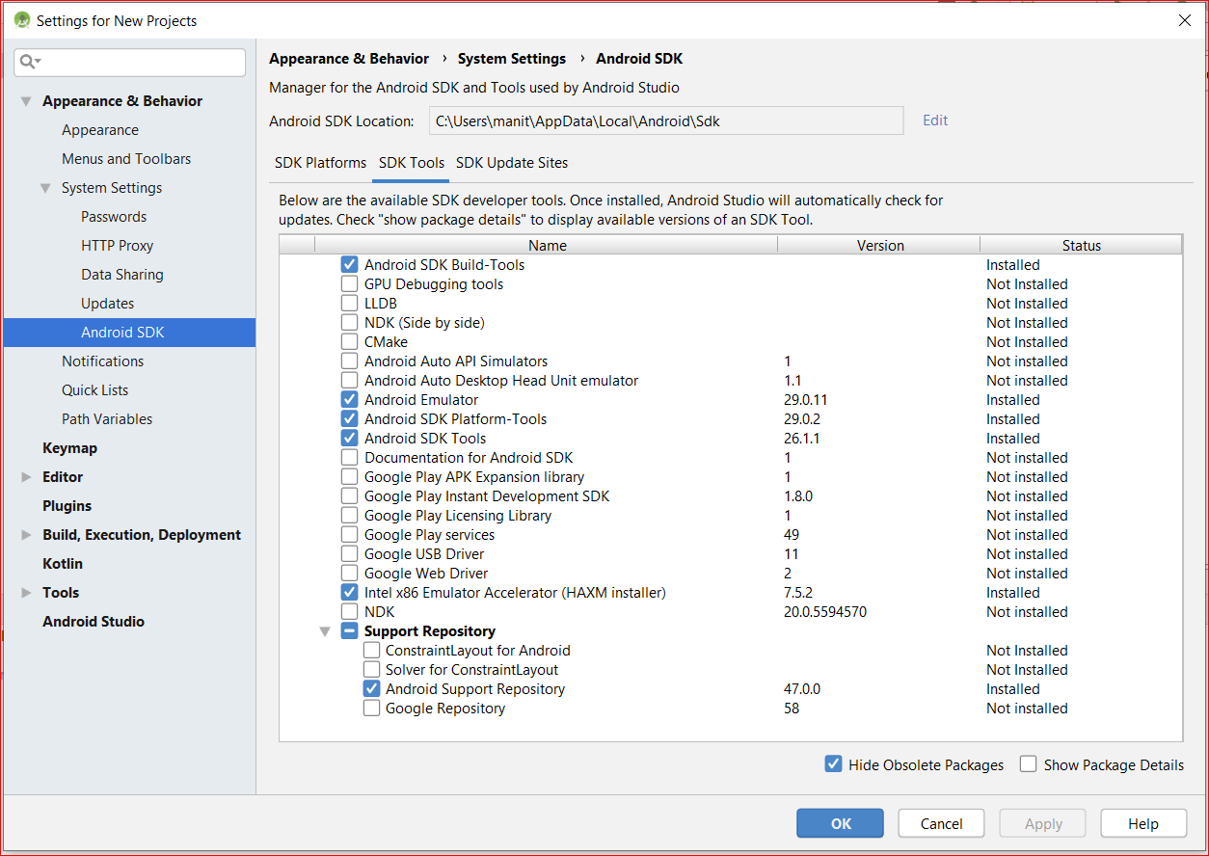
Jai Venkateswara Technologies
Errors in emulator
Sometimes emulator might not work depending on the configurations your systems have, Go to Tool>SDK manager>SDK tools and enable Intel X86 emulator accelerator(HAXM installer).
This will enable the HAXM and emulator will work fine.

