Slide 1
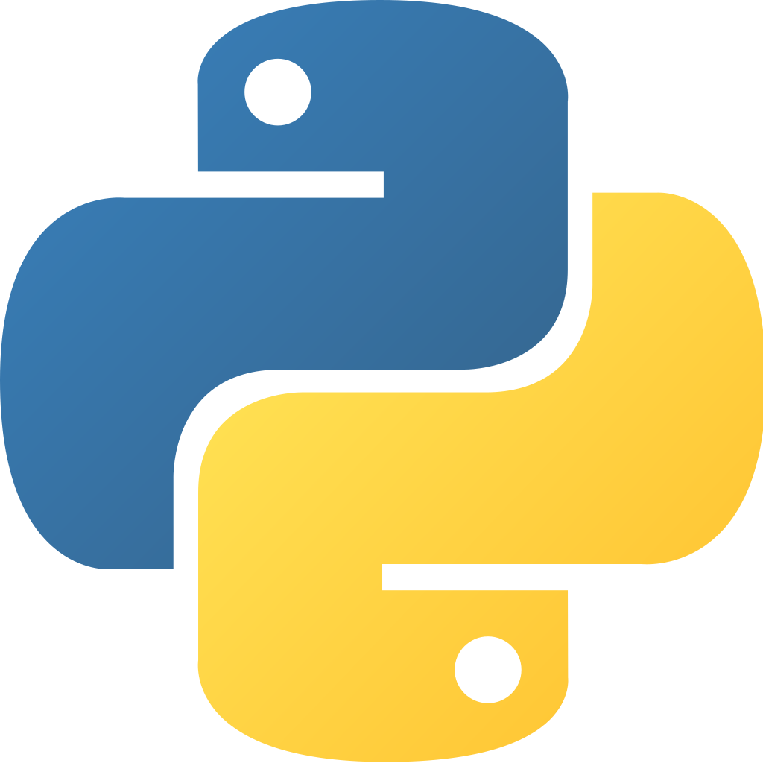

Jai Venkateswara Technologies
PYTHON & Django

Slide 2
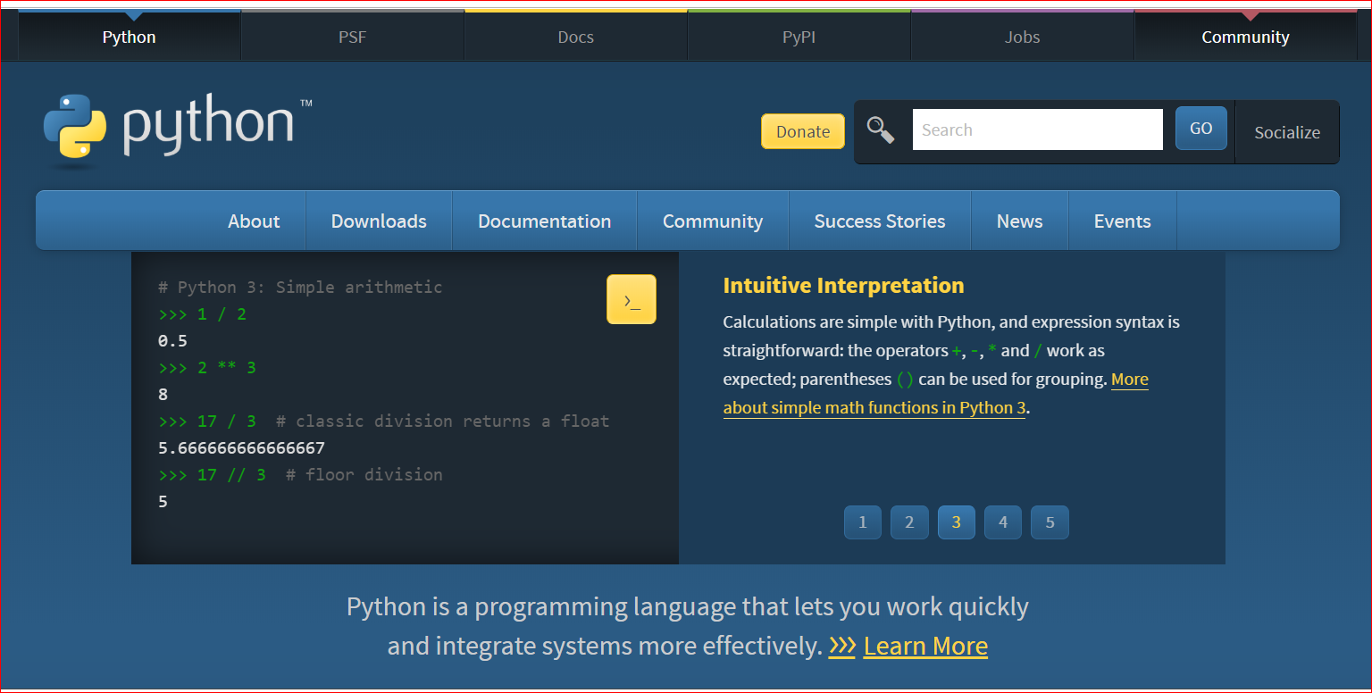
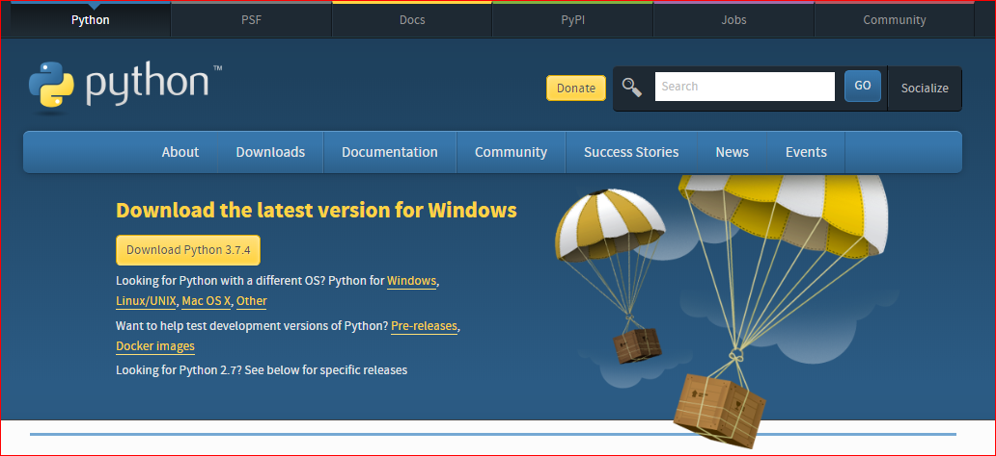
Jai Venkateswara Technologies
Python Installation
Visit https://www.python.org , you can find Downloads tab as shown in below picture.
Click on Download Python 3.7.4.

Slide 3
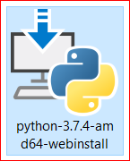
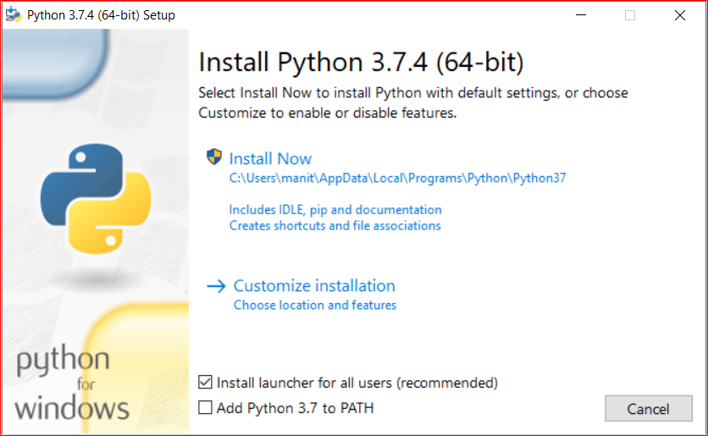
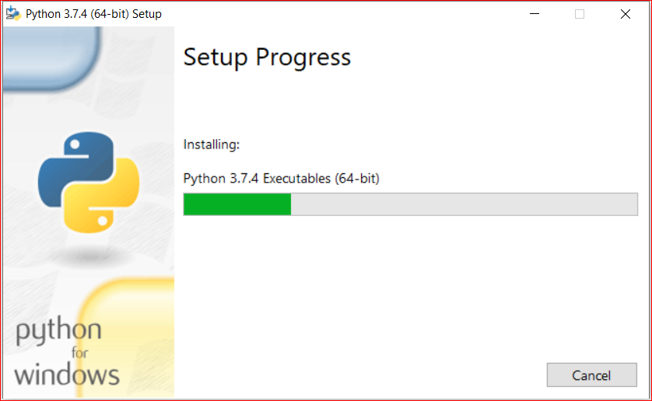
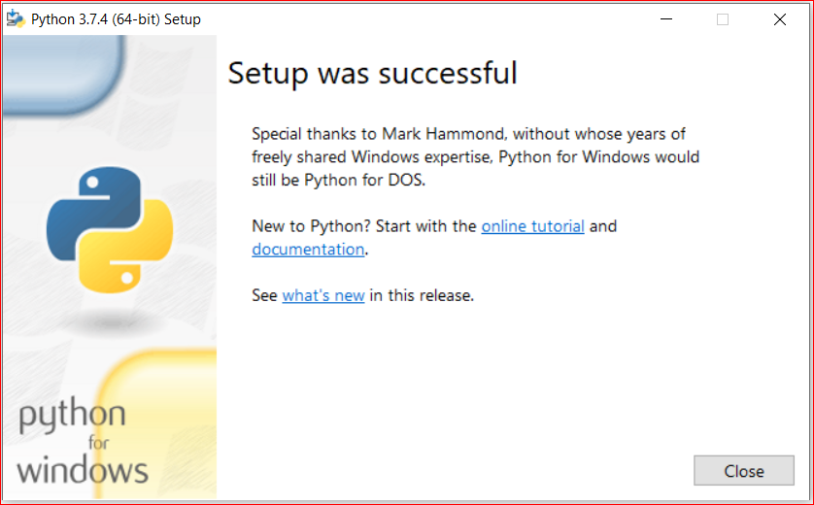
Jai Venkateswara Technologies
After clicking download you will get an executable file as shown in figure, run it
Make sure your directory is given to admin and follow steps shown in pictures above, therefore the setup was successfully completed

Slide 4
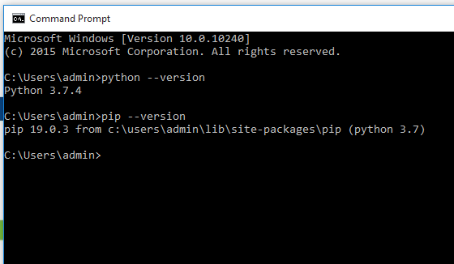
Jai Venkateswara Technologies
Django Installation
On successful installation of python, open command prompt and check the commands
python --version (it shows the version of python as shown in picture.
pip –version

Slide 5
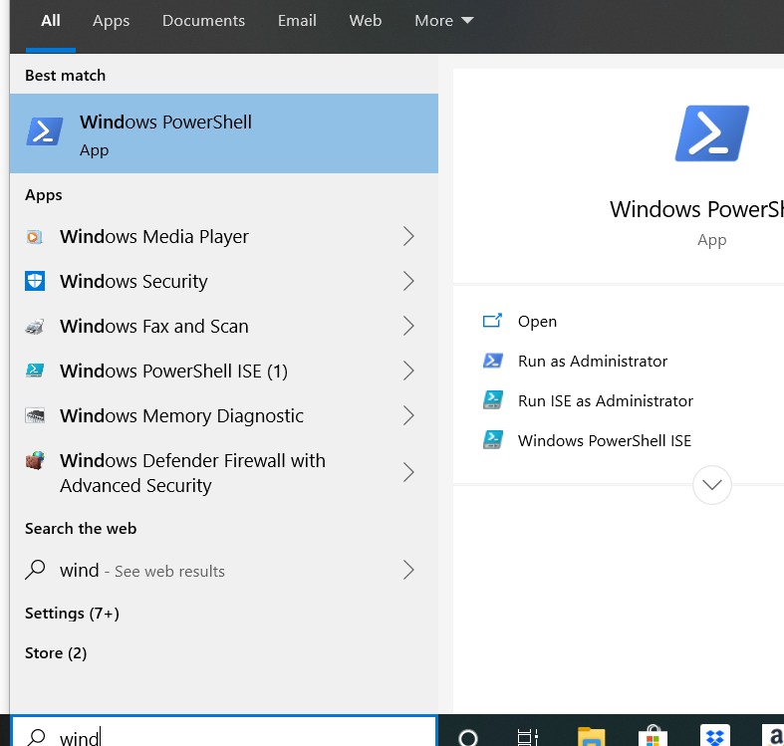
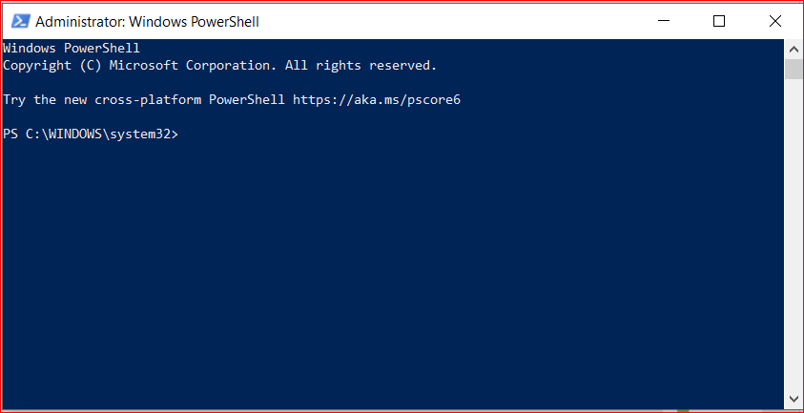
Jai Venkateswara Technologies
Django Installation
Now open windows PowerShell in start menu and run it as administrator, that opens pops up windows PowerShell command prompt.
Enter following commands in PowerShell given in next slide for Django setup

Slide 6
Jai Venkateswara Technologies
Django Installation
Enter these commands for the setup:
pip install virtualenvwrapper –win (virtualenv and virtualenvwrapper provide a dedicated environment for each Django project you create. While not mandatory, this is considered a best practice and will save you time in the future when you’re ready to deploy your project)
mkvirtualenv myproject (this creates a virtual environment for your project).
work on myproject (The virtual environment will be activated automatically and you’ll see “(myproject)” next to the command prompt to designate that. If you start a new command prompt, you’ll need to activate the environment again)
pip install Django (This will download and install the latest Django release.)
After the installation has completed, you can verify your Django installation by executing django-admin --version in the command prompt.

Slide 7
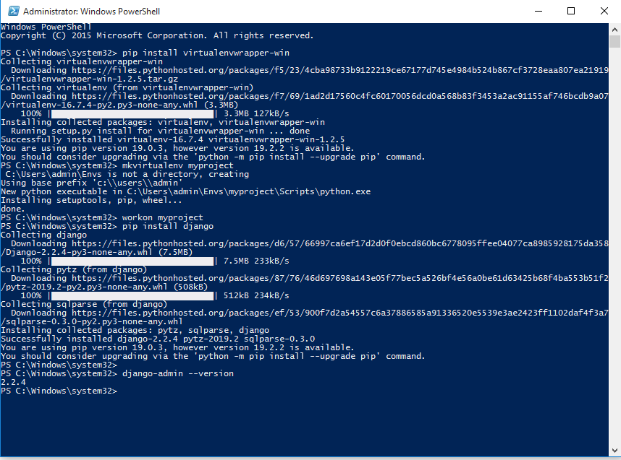
Jai Venkateswara Technologies
Django Installation
Picture below explains detailed process of Django installation.

Slide 8
Jai Venkateswara Technologies
Common errors while installation
The major error while in installation is setting the path, be careful while downloading the python, make sure you give path to users>admin.

