Slide 1


Classical Image Processing for Brain Tumor Segmentation in MRI
Abdulwahab Shaikh | AU2440099
Yash Kyada | AU2340218
Srujan Yendugula | AU2440158
Harshraj Solanki | AU2440218
Group 18 - Project 20
Proffesor - Mehul Raval
TA - Sagar Chavda
1

Slide 2


Motivation
  Brain Tumors are life threatening so their detection is necessary.
  In a volumetric sample, slice by slice contouring by a person takes time.
  Classical methods of detection are faster and efficient.
2

Slide 3
Problem Definition
  Segment the Whole Tumor (WT) from MRI data.
  Use classical image processing techniques instead of ML/DL.
  Create a binary mask of the tumor.
  Compare the predicted masks with ground truth masks from BraTS2020.
3

Slide 4
Literature Review ( Existing Work )
  Hybridized Multilevel Thresholding + Level Set
Dawngliana et al., 2015
  Thresholding + Morphological Operations
Murthy & Sadashivappa, 2014
  Integrated Thresholding + Morphological Processing
Islam et al., 2018
  Classical approaches have been shown to be effective for tumor segmentation in previous studies.
4

Slide 5
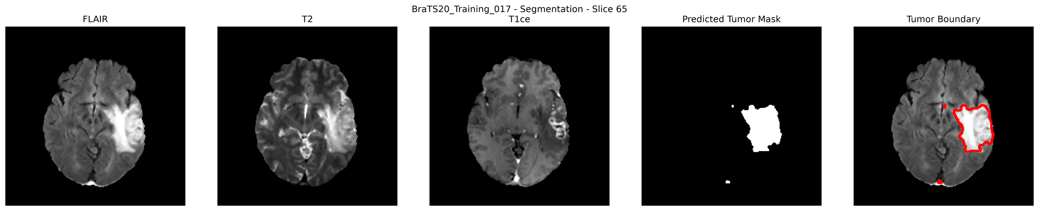
Results: Visual Analysis
  FLAIR → Highlights Tumor Edema and suppresses CSF signals
  T2 → Free Fluid and Edema Highlighted
  T1ce → Tumor (ET) core appears bright because of Paramagnetic contrast agent (Gadolinium)
5

Slide 6
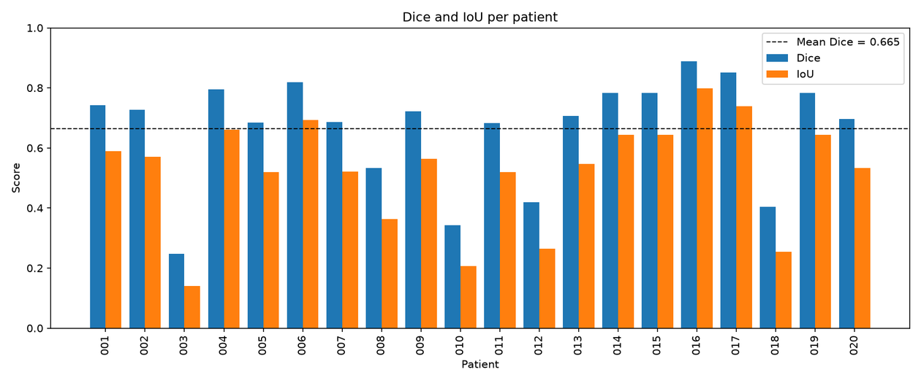
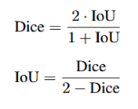
Results: Quantitative
Key Results
  Dice: 0.665 ± 0.179
  IoU: 0.521 ± 0.183
  Precision: 0.787 ± 0.179
  Recall: 0.600 ± 0.211
  Pooled Dice: 0.733
  Dice ≥ 0.50 → 16/20 cases (80%)
  Dice ≥ 0.70 → 11/20 cases (55%)
6

Slide 7
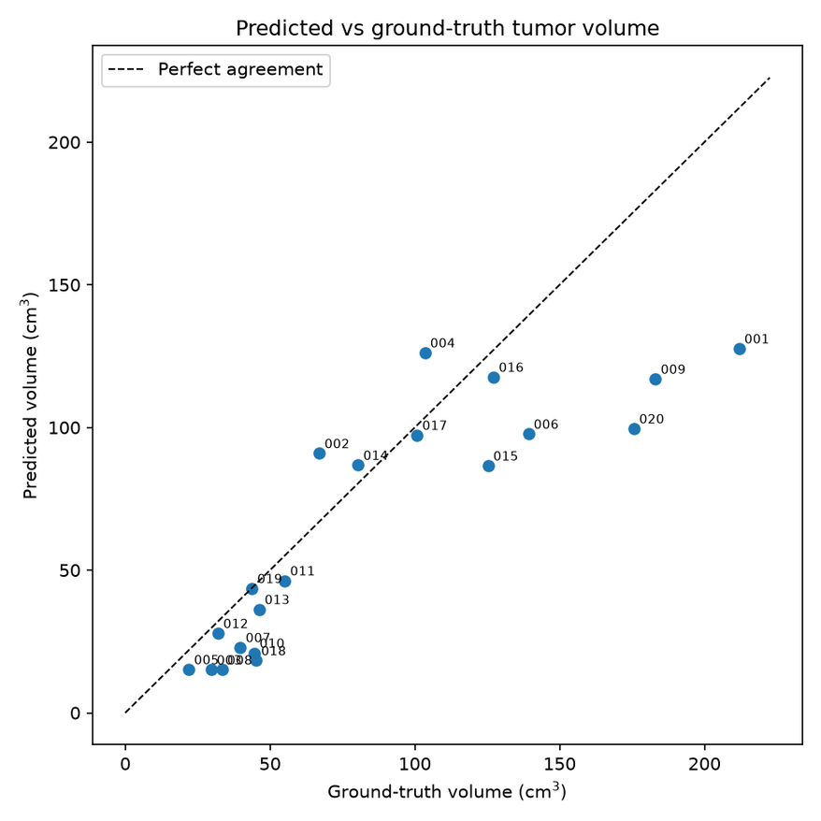
Pipeline Accuracy
Key Observations
  Predicted tumor regions generally match the reference region
  Under-segmentation is the main limitation
  Mean Precision: 0.787
  Mean Recall: 0.600
  13 cases → under-segmentation
  3 cases → mixed boundary errors
  2 cases → over-segmentation
  2 cases → excellent overlap
7

Slide 8
Next Plan
Next Phase
  Improve voxel selection
  Reduce under-segmentation
  Improve boundary accuracy
  Optimize the current segmentation pipeline
  Explore more suitable segmentation methods
  Evaluate improvements using the same metrics and cases
8

Slide 9
Individual Contribution
Abdulwahab Shaikh (Leader + POC)
  Overall Architecture Design and Code Implementation
Yash Kyada
  Mathematical and Morphological Analysis
Srujan Yendugula
  Preprocessing Phase Design
Harshraj Solanki
  Segmentation Method Research
Literature Review and Documentation was a combined effort of the whole group
9

