Slide 1


IT DASHBOARD
Ticket Management Analytics

Slide 2
PROBLEM STATEMENT
Key Objectives for IT Operations Analytics
Three core dimensions analysed
01
02
03
Ticket Dynamics
Analyzed ticket trends, categories, and severity to identify workload patterns and bottlenecks.
Tool & Team Efficiency
Evaluated current software and processes through trends in resolution time, satisfaction, and efficiency score.
Helped determine investment priorities — software, training, or hiring.
Agent Capability
Compared performance by age group to assess skill, experience, and workload balance.
Goal: Identify which factors — issue type, tool effectiveness, or agent capability — most impact overall IT Support performance.

Slide 3
DATA ARCHITECTURE
Data Overview & Schema Structure
Tickets Sheet
Core Support Log Data
ID: Unique identifier for the ticket
Ticket Fetcha: Date of the ticket
Employee ID: Raised by employee
Agent ID: Assigned support agent
Request Category: Login Access, System, Software
Issue Type: IT Error, IT Request
Severity & Priority: Escalation levels
Resolution Time (Days): Turnaround
Satisfaction Rate: Score on 1–5 scale
IT Agents Sheet
Agent Profiles & Demographics
Agent ID: Unique identifier for the agent
Full Name: Agent's complete name
Email: Contact email address
Year of Birth: Birth year
Month of Birth: Birth month
Day of Birth: Birth day

Slide 4
METHODOLOGY & TOOLS
Analysis Conducted & Technologies Used
Analysis Conducted
Tools & Technologies
● Trend Analysis → Ticket volumes, satisfaction, and resolution times over years/quarters.
● Efficiency Analysis → To evaluate team performance.
● Decision Matrix Analysis → Classified agents into Training, Hiring, or Software Upgrade categories.
● Demographic Analysis → Grouped agents by age brackets.
● Comparative Performance Analysis → Individual Agents Performance.
● Category-wise Analysis → Evaluated KPIs across request categories.
● Platforms Used:
• Microsoft Excel
● Key Techniques & Features:
• Pivot Tables
• Interactive Charts
• Advanced Formulas: XLOOKUP / PERCENTILE / IFS
• Slicers for interactive filtering

Slide 5
OVERVIEW METRICS
Key Performance Metrics
Total Agents
Total number of Tickets
Average daily ticket volume
50
97,498
53
Average Resolution Time
Average Satisfaction Rate
Average Tickets Per Agents
4.6 days
4.1
1950

Slide 6
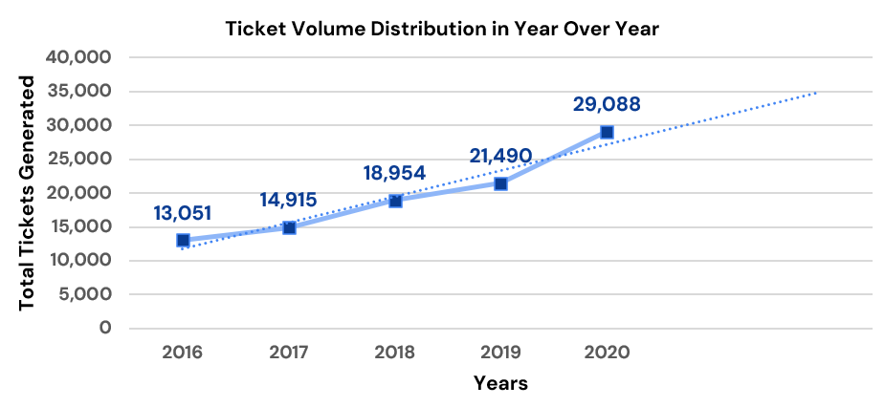
VOLUME ANALYSIS
Volume of Tickets over Time (years)
Key Findings
Tickets volume grew steadily from 13,051 in 2016 to 29,088 in 2020, a increase of about 123% over the 5 years period.
A sharp rise in ticket volume were noticed in between 2019 and 2020, the highest surge recorded in ticket volume since 2016.
Volume of Tickets increases but number of agents has remained constant over the years, resulting in a significantly higher workload per agent.

Slide 7
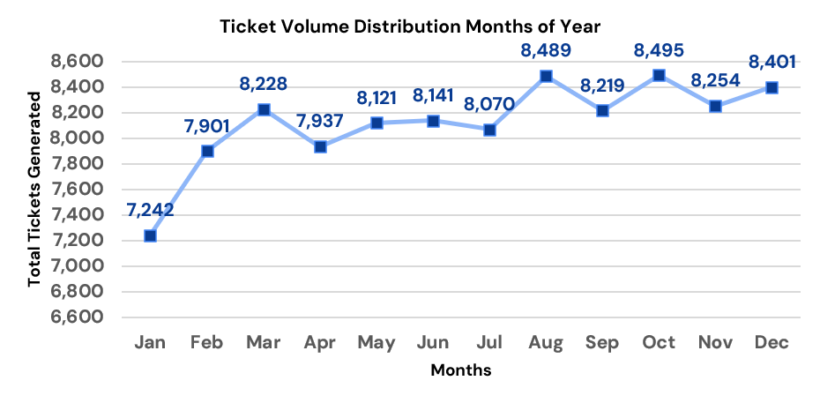
MONTHLY ANALYSIS
Peak & Off-Peak Months Analysis
Key Findings
Peak months (>8,400 tickets across the 5 years): August, October, and December.
Off-peak months (<8,000 tickets across the 5 years): January, February, and April.
The second half of the year is busier: H2 totals about 49,900 tickets verses about 47,600 in H1, roughly 5% higher.

Slide 8

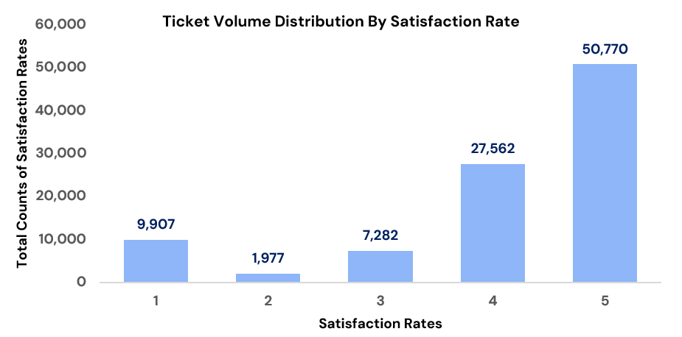
TICKET ANALYSIS
Distribution of Tickets by Severity
Insert Image Here
Key Findings
The average customer satisfaction score is about 4.10 out of 5.
Customers who gave a rating of 4 or 5 make up 80.3% of responses (78,332 tickets), representing the share of satisfied customers.
Ratings of 1 or 2 account for 12.2% of responses (11,884 tickets), while the neutral rating of 3 accounts for the remaining 7.5% (7,282 tickets).

Slide 9
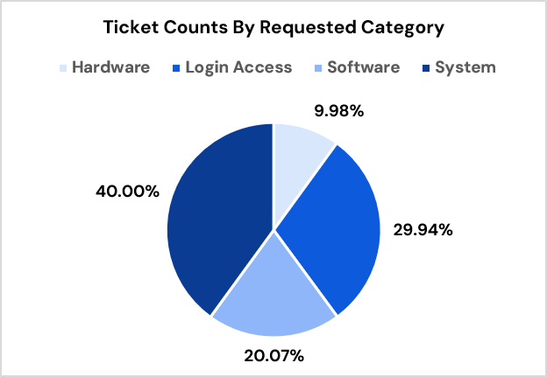
CATEGORY ANALYSIS
Volume of Tickets By Requested Category
Key Findings
System issues are the largest driver of demand. At 40%, System tickets alone account for two out of every five requests, more than any other category.
Hardware is the lowest in ticket volume(about 10%) but they often take longer to resolve, so volume alone understates their effort .
Software tickets are a mid-sized share (20%). This is roughly double Hardware, which suggests recurring application issues

Slide 10
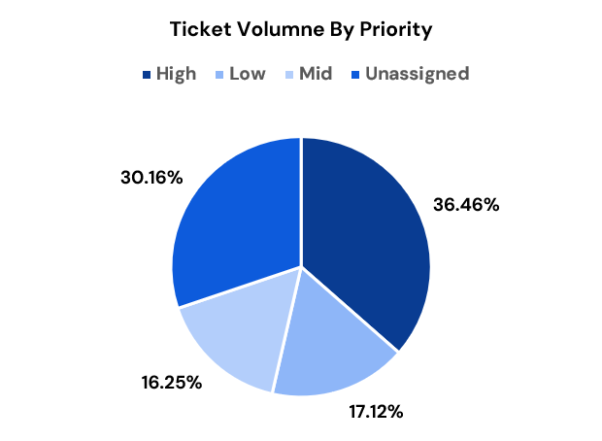
PRIORITY ANALYSIS
Ticket Volume by Priority Level
Key Findings
High priority is the biggest slice. More than 1 in 3 tickets (36.46%) are marked High, which is about double Low or Mid.
Many tickets have no priority at all. Around 30% are Unassigned, Unassigned may hide the true priority mix..

Slide 11
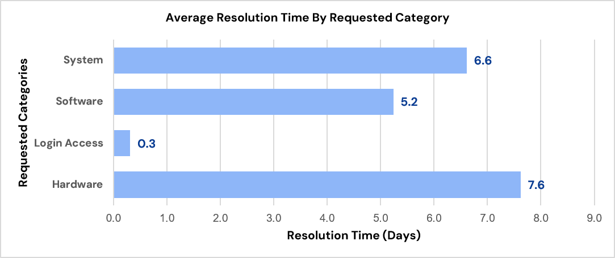
CATEGORY ANALYSIS
Average Resolution Time By Requested Category
Key Findings
Hardware is the slowest category with highest average resolution time (7.6 days). It is also the smallest category by ticket volume (about 10%).
System combines a high average (6.6 days) with the largest volume (40%). This makes it the most important category to improve.
Software sits in the middle (5.2 days on average), about 1.4 days below System and 2.4 days below Hardware. Login Access has the lowest average (0.3 days, about 7 hours).
The averages range from 0.3 to 7.6 days.

Slide 12
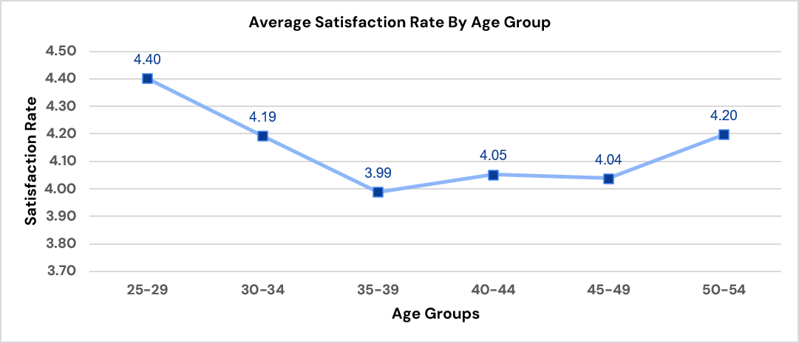
DEMOGRAPHIC ANALYSIS
Average Satisfaction Rate By Age Group
Key Findings
The youngest group aged 25-29 score 4.40, the highest of any group and 0.30 points above the overall average of 4.10.
Satisfaction drops steadily from 25 to 39. Average customer satisfaction rate falls from 4.40 to 4.19 to 3.99, a decline of about 0.41 points across three age bands.
The 35-39 group is the least satisfied (3.99). It is the only group that falls below 4.0,

Slide 13
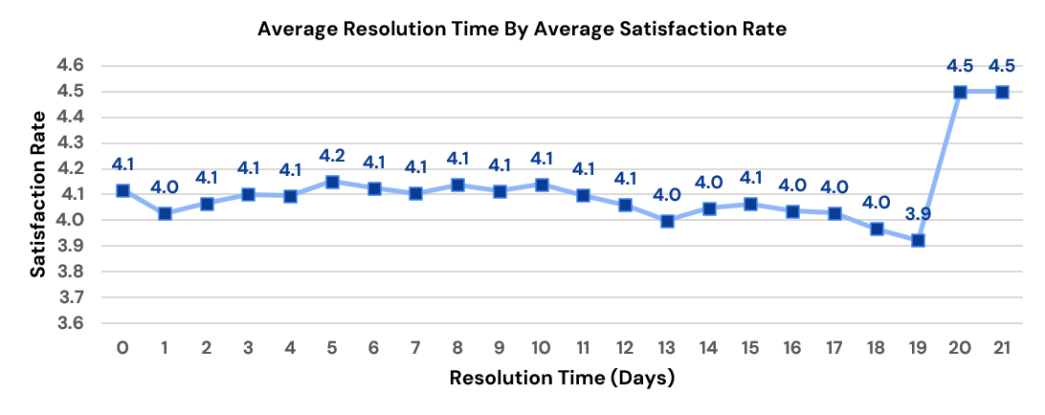
PERFORMANCE ANALYSIS
Satisfaction Rate vs. Average Resolution Time
Key Findings
Average satisfaction is very stable for the first 12 days. Average CSAT stays between 4.0 and 4.2, close to the overall average of 4.10.
There is sharp rise to 4.5 in the satisfaction rate after the lowest dip to 3.9 at day 19.

Slide 14

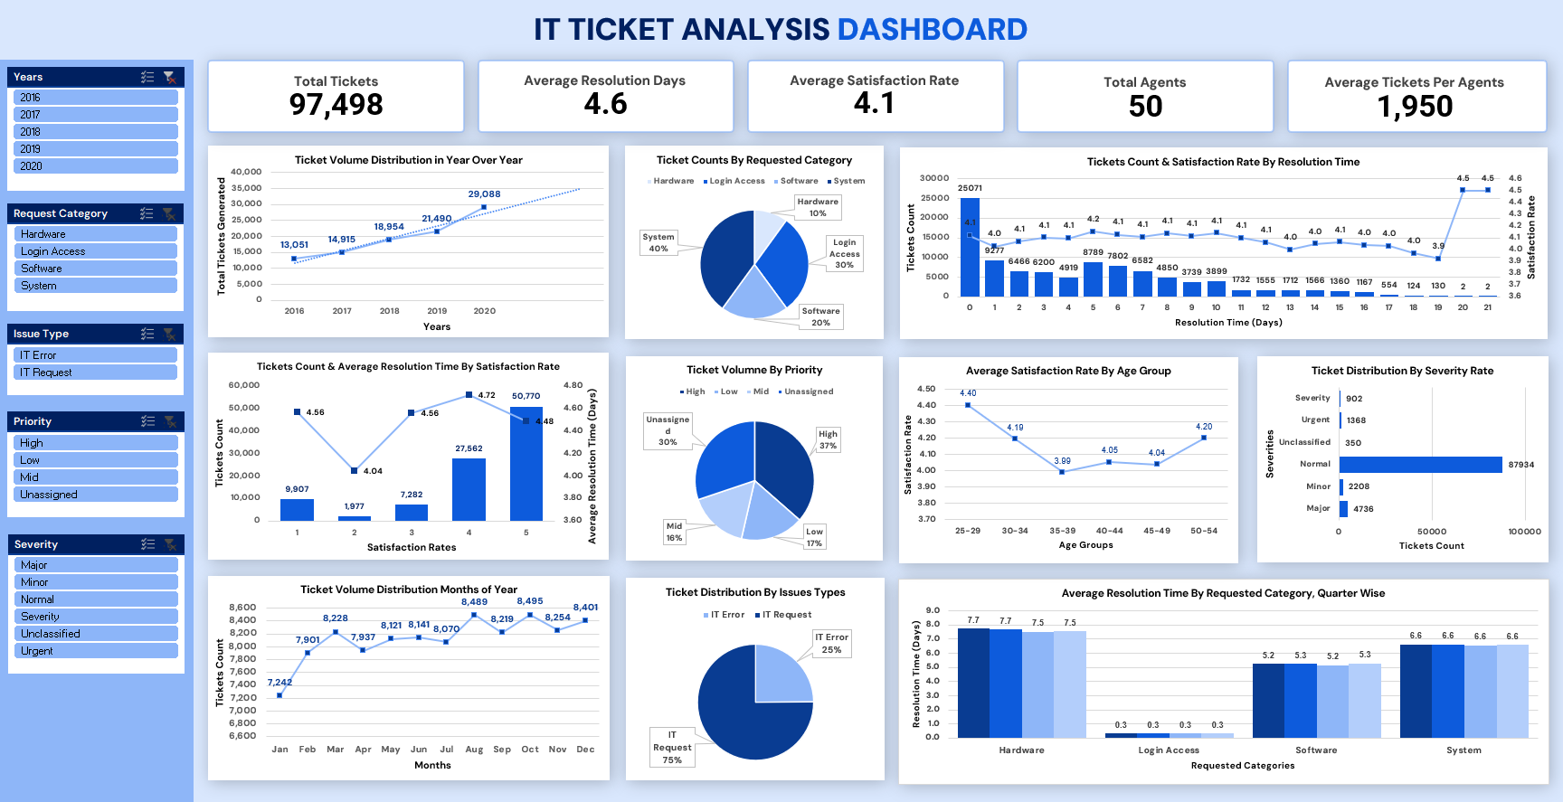
DASHBOARD

Slide 15
EXECUTIVE SUMMARY
Key Insights & Strategic Conclusions
01. Demographics Overview: Youngest users (25–29) score highest CSAT at 4.40. Satisfaction drops steadily across age bands to 3.99, making the 35–39 age group the lowest-performing segment.
02. Resolution Time Trends: Average Customer Satisfaction Rate remains stable between 4.0–4.2 during the initial 12 days. The lowest satisfaction point (3.9) occurs at day 19, followed by a sharp recovery rebounding past 4.5.
03. Strategic Action Plan: Implement system automation to reduce the 6.6-day average resolution for 40% ticket volume, tailor UI/UX to resolve pain points for mid-age users, and overhaul hardware processes to eliminate peak 7.6-day delays.

Slide 16
STRATEGIC ACTION PLAN
Recommendations for Performance Optimization
Key Action Items & Recommendations
Plan staffing before the busy season. August, October, and December are consistently the busiest months, and the second half of the year carries about 5% more tickets. Hiring or onboarding new agents ahead of Q4 will help the team avoid overload when volume peaks.
Coach the agents who need it most. Targeted coaching for the lowest-performing agents is more effective than generic team-wide retraining. It should focus on improving resolution speed and customer satisfaction.
Create a clear improvement plan for Hardware. Hardware tickets are fewer but take the longest, at 7.6 days on average. Standard operating procedures, simple triage rules, and a good knowledge base can help agents resolve them faster.
Automate the routine work. Smart ticketing and automation tools can handle repetitive requests, such as login and access issues, and reduce manual effort. This frees agents to spend more time on complex problems.
Focus on System tickets first. System issues make up 40% of all tickets and take 6.6 days on average to resolve. Adding resources and improving how complex cases are handled here will have the biggest impact on overall efficiency.

Slide 17
Thank You!
Vikrant Chaudhary
chaudharyvikrant2000@gmail.com
Batch: Newton School August B 2026

