Slide 1

Advanced Programming Using Python
Anjali Kulkarni
Sept 2024

Slide 2
Day 1
24 Sept 2024

Slide 3
A bit about myself ☺
Education – Engineering graduate, Pune
18 years of industry experience
Writing code to test code
Technologies - Java, Python, perl, various tools for QA Automation
Domains - Healthcare, Banking, Security, Advertising, Genomics
WTM Ambassador
Actively exploring and pursuing my passion

Slide 4
Agenda
Introduction - Python
Setup
Install Python
Install IDE
Python Basic Syntax
Quiz

Slide 5
Introduction - Python
Created by Guido van Rossum in 1991
Open Source, Free
Simple and readable
Minimalist
Cross-Platform compatible
Dynamically Typed variables
Object-Oriented
High-level, interpreted

Slide 6
Execution of programming languages
Translates source code into machine code
Compiler : Translation before program is run
Eg: C, C++, C#
Interpreter : Translation line-by-line, executing each line as it goes
Eg: Python, Javascript, Ruby, PHP
Hybrid / JIT : Translation to bytecode, interpretation at runtime, by JVM.
Eg: Java

Slide 7
Compiler vs Interpreter
Compiled Languages | Interpreted Languages
Translate directly to machine codes | Translation and execution on the fly
Needs entire program | Line by line execution Can start executing as soon as it starts reading
Creates an exe, native and fast | Slower than compiled languages
Usually statically typed Types known during compilation | Usually dynamically typed
Change in type : recompilation | Non-syntax errors are detected only in run-time
Ideal for compute-heavy and efficiency-intensive tasks | Ideal for small tasks
C, C++, FORTRAN | Python, Perl, PHP, Bash
System Software, games | Scripting, Web development, Data Analytics, visualisations

Slide 8
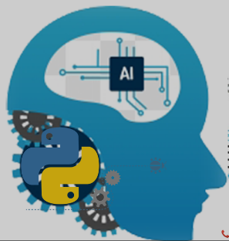
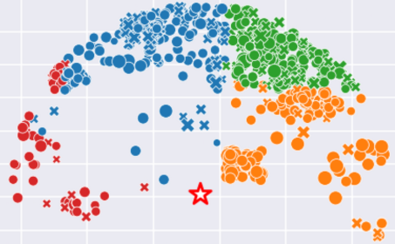
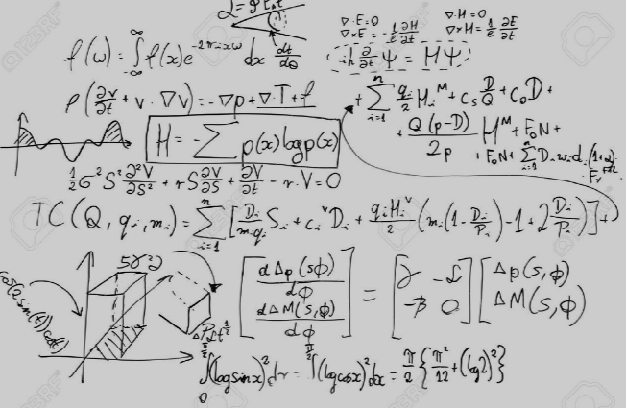

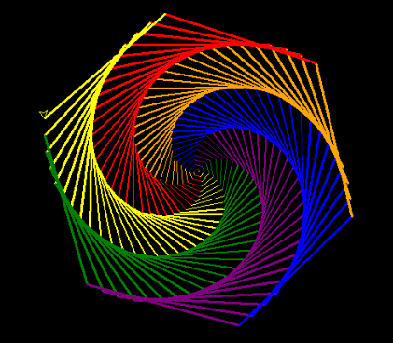
Python Applications
AI Applications
Data Visualisation
Solve Complex Maths Problems
Building Websites
Graphics

Slide 9
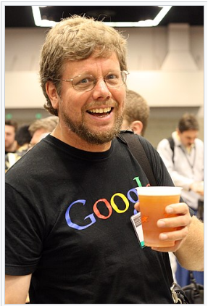
Words of the author!!
“Python is an experiment in how much freedom programmers need. Too much freedom and nobody can read another’s code; too little and expressiveness is endangered.”
- Guido van Rossum

Slide 10



First things first!
Setup :
Anaconda.com/download
Enter email id and get download link
Download windows installer
Follow instructions on installer
IDE :
PyCharm
Visual Studio Code
Jupyter Notebook
IDLE
Spyder

Slide 11
Test your installation!
Hello world !!

Slide 12
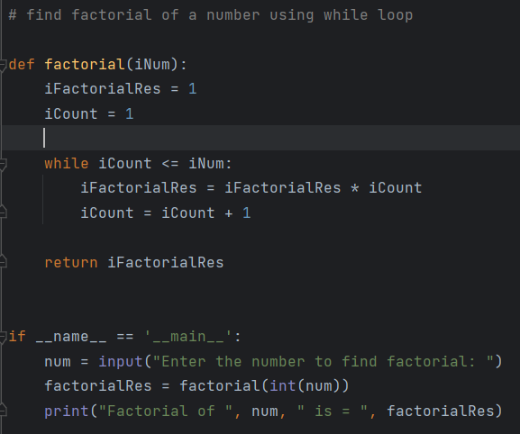
Python Basics (mainExplain1.py, mainExplain2.py)
Indentation
Case sensitive
_ _main_ _

Slide 13
Datatypes
Fundamental datatypes
Custom Types - Classes
Specialized types - Modules
None

Slide 14
Fundamental Datatypes (Variables.py)
Numeric Types
Integer
Floating-point
Complex
Sequence Types
String
List
Tuple
Set
Range()
Mapping Type
Dictionary
None Type
None (null)
Boolean Type
Boolean

Slide 15
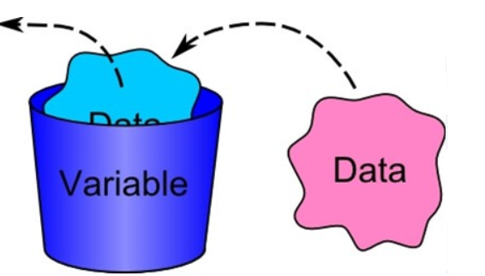
Variables (Variables.py)
Placeholders that allow you to store, modify, retrieve data during execution of a program
Variable Assignment
Dynamic Typing
Reassigning Variables
Multiple assignments
Constants
Dunder variables

Slide 16
Naming conventions
Variable names must start with a letter or an underscore (_), but not a number
Variable names can contain letters, numbers, and underscores (_)
Variable names are case-sensitive: myVar and myvar are different
Avoid using Python keywords (like if, for, while) as variable names

Slide 17
Hands on
Assignment 1: Declare variables of integer, float, boolean and String type and print their values
Assignment 2: Swap values

Slide 18
Operators (Operators.py)
Special symbols or keywords used to perform operations on variables and values
Arithmetic Operators
+, -, *, /, %, //, **, BODMAS
Assignment Operators
=, +=,-=,*=,/=,%=,**=,//=
Bitwise Operators
&,|,^, ~, <<,>>
Logical Operators – Boolean values
and, or, not
Comparison (Relational) Operators
==, !=, >,<, >=, <=
Membership Operators
in, not in
Identity Operators
Is, is not
Ternary Operator
‘value_if_true’ if condition else ‘value_if_false’

Slide 19
Hands on
Assignment 3: Try out Arithmetic and Assignment operators

Slide 20
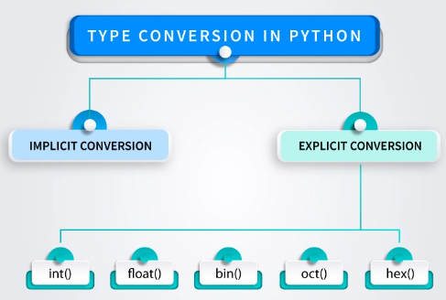
Type casting (inputOutput.py)
Process of converting one datatype to another
int()
float()
str()
bool()
list()
tuple()
set()
dict()

Slide 21
Homework
Assignment 5: Initialise 2 numbers, add them, print them.
Assignment 6: Add an integer and a float, print result and type of result
Assignment 7: Initialise a float value typecast it to float and print its square
Assignment 8: Add a string and a number, print result and type of result

Slide 22
Thank You !!

