Slide 1

Advanced Programming Using Python
Anjali Kulkarni
Sept 2024

Slide 2
Day 11
Anjali Kulkarni
8 Oct 2024

Slide 3
Agenda
File Handling
Exception Handling

Slide 4
Hands on
Assignment 1: Write and Read a List of Numbers
Create a list of random numbers.
Write the list to a file numbers.txt with each number on a new line.
Read the file and store the numbers in a new list.
Calculate and display the sum of the numbers.

Slide 5
Hands on
Assignment 2: Sorting Data from a File
Create a csv file which holds a list of words.
Read data from the file into a list.
Sort the list in ascending order.
Write the sorted data back to the file, also print on console.

Slide 6
Exception handling
Event that disrupts the normal flow of instructions is Exception
Exception Handling is handling errors gracefully
Why Exception handling?
To prevent the program from crashing.
To provide meaningful error messages to the user.
To handle unexpected situations gracefully.

Slide 7
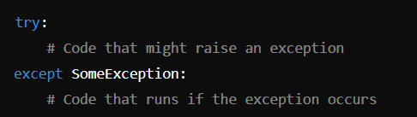
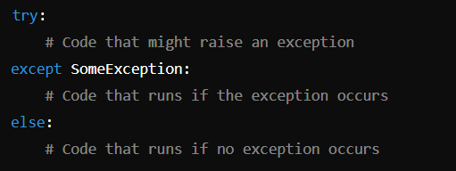
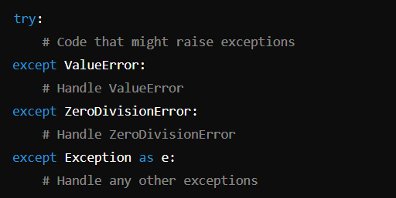
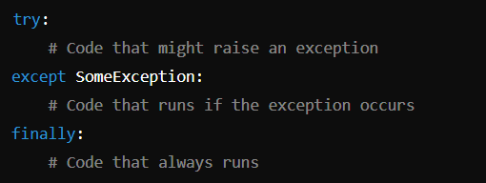

try–except block (ExceptionHandling.py)

Slide 8
Hands on
Assignment 4: Define functions which handle exceptions
Function 1: get_integer_input – Accepts an integer and prints it
Exception to handle :
ValueError exceptions
Function 2: get_element_from_list - Attempts to return element at specified index from list.
Exceptions to handle :
IndexError : if the index is out of bounds
TypeError if the index is not an integer
Use else : Print the element if no exceptions occur
finally blocks : to indicate operation completion
Function3: divide_numbers(a, b) - Raises ZeroDivisionError if b is zero
Exception to handle :
ZeroDivisionError - Custom message in body

Slide 9
Best practices
Avoid using a bare except clause.
Provide meaningful error messages.
Always clean up resources with finally (e.g., close files).

Slide 10
Homework
Assignment 3: Handle file not found exception

Slide 11
Homework
Assignment 1: Temperature convertor
Input from user :
Temperature value and unit
Temperature unit to convert to
Functions :
celsius_to_fahrenheit(celsius)
fahrenheit_to_celsius(fahrenheit)
celsius_to_kelvin(celsius)
Employ exception handling for checking numeric values.
Finally and else block

Slide 12
Thank You !!

