Slide 1

Advanced Programming Using Python
Anjali Kulkarni
Sept 2024

Slide 2
Day 12
Anjali Kulkarni
9 Oct 2024

Slide 3
Agenda
OOP concepts
Classes
Objects
Constructors

Slide 4
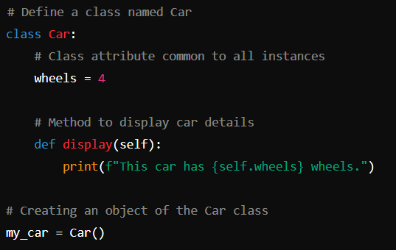
OOP concepts (ClassObjectExample.py)
OOP is a programming paradigm that models real-world concepts as objects
Code organisation
Data modelling
Reusability
Maintainability

Slide 5
Classes and Objects
Class – Custom datatype
Blueprint for creating objects
Defines a set of attributes and methods
Encapsulate data for reusability and modularity
Object – Instance of a class
Created from the class blueprint
Have state and behavior
Objects can have different attribute values

Slide 6
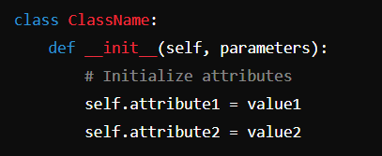
Constructors (ClassObjectExample.py)
Method that is automatically called when object is created
Used to initialize object's attributes
Simplifies object creation
Syntax: _ _init_ _()
‘self’: current instance
‘parameters’ : to pass initial values

Slide 7
Hands on
Assignment 1: Create a class that represents a library and allows basic operations like checking availability and borrowing books.
Class attributes:
bookTitle (string)
bookAuthor (string)
available (boolean)
Methods:
Constructor : sets class attributes for each book.
borrow_book(): Changes the availability status to False if the book is available; otherwise, print "Not available."
return_book(): Changes the availability status back to True.
display_info(): Prints the book's title, author, and availability status.
Create two book objects (e.g., book1 and book2) and demonstrate borrowing, returning, and displaying book information.

Slide 8
Encapsulation
Bundling data and methods so that they operate within a single class
Improved security
Better collaboration
Reduced complexity
Improved code maintainability
Constructors
Getter and setter methods
Access Modifiers

Slide 9
Class Variables (classMethods.py)
Used to store data that is shared among all instances of class
Defined within a class but outside of any instance methods.
Shared among all instances of the class
Any modification to a class variable affects all instances
Can be accessed using
class name - ClassName.variable_name
instance of the class - instance_name.variable_name

Slide 10
Hands on
Convert the following to instance variables
bookTitle (string)
bookAuthor (string)
available (boolean)
Add a class variable “strLibraryName”

Slide 11
Hands on
Assignment 3: Create a class : clsSchool
Class Variable:
school_name = "Green Valley High School" is a class variable that is common to all students.
Instance Variables:
name,
student_id,
maths_Marks,
science_Marks,
English_Marks,
average
Methods:
constructor which will initialise name, student_id and rest of attributes will be initialised to 0
add_marks(): Allows adding or updating marks for a specific subject.
calculate_average(): Calculates the average of all marks for a student and initializes the average variable.
display_info(): Displays the student's details, marks, and average marks.

Slide 12
Hands on
Assignment 4: Create a class : clsSchool
Class Variable:
school_name = "Green Valley High School" is a class variable that is common to all students.
Instance Variables:
name,
student_id,
marks = {maths:100,science:99,english:98,average}
Methods:
constructor which will initialise name, student_id and rest of attributes will be initialised to 0
add_marks(): Allows adding or updating marks for a specific subject.
calculate_average(): Calculates the average of all marks for a student and initializes the average variable.
display_info(): Displays the student's details, marks, and average marks.
Challenge: Display name of the topper

Slide 13
Homework
Assignment 1: Create a class that simulates a simple bank account and allows basic bank operations.
Class Name: BankAccount
Rate of interest
Bank name
account_holder (string)
balance (float, initialized to 0.0)
Methods:
deposit(amount): Adds the given amount to the balance.
withdraw(amount): Deducts the given amount from the balance if sufficient funds are available; otherwise, print "Insufficient balance."
check_balance(): Prints the current balance.
Create an account for a user (e.g., account1 = BankAccount("Alice")), perform deposits, withdrawals, and check the balance.

Slide 14
Thank You !!

