Slide 1

Advanced Programming Using Python
Anjali Kulkarni
Sept 2024

Slide 2
Day 16
14 Oct 2024

Slide 3
Agenda
Client server architecture
Socket Programming

Slide 4
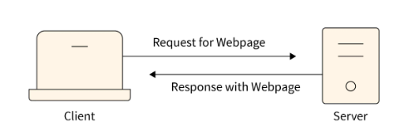
Client Server Architecture
System design model where clients request services, servers provide them
Client is the device or application making a request
Server is the device that responds to the request

Slide 5
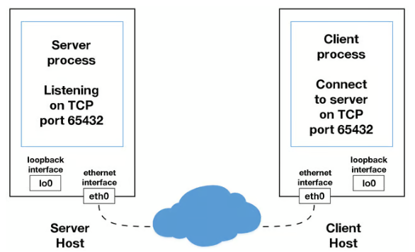
Process Breakdown

Slide 6
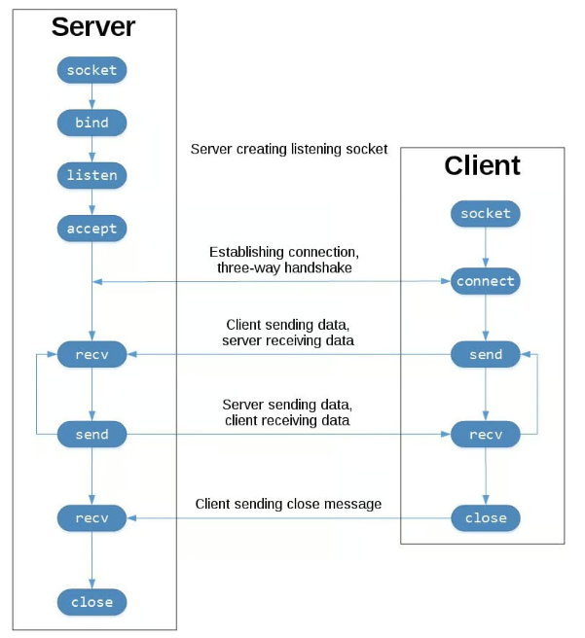
Terminologies
Server side
Socket()
Bind()
Listen()
Accept()
Recv()
Send()
Close()
Client side
Socket()
connect()
Listen()
Send()
Recv()
Close()

Slide 7
Hands on
Assignment :
Send name of a file to read from the client.
Read the file on server side.
Extract IP addresses using regular expressions.
Send the comma separated IP addresses back to client
Print IP addresses at client side (each IP address on a new line)
Employ exception handling
On server side:
Check if file exists
On client side:
Check if user has provided a .txt file

Slide 8
Hands on
Assignment 1:
Remove repetitive characters from a string.
For e.g. : input – laptop, output – lapto
Implement a function which takes an input of the string and returns a string with unique characters.

Slide 9
Hands on - Strings
Assignment 2: Masking PII
Implement a function mask_sensitive_info(info, info_type) that takes two parameters:
string: The string containing the sensitive information.
string_type: A string indicating the type of information. It can be "email" or "credit_card".
Email : Mask the characters in the local part of the email (before the @ symbol) except for the first and last character.
“Mayura.kumari@xyz.com" should become “m***i@xyz.com"
Credit card : Mask all but the last four digits of the credit card number.
"1234 5678 9101 1121" should become "**** **** **** 1121".
Exception handling:
If the info_type is not recognized, raise a ValueError with the message "Invalid info type".
Handle more exceptions for cases such as incorrect formatting of the input information.

Slide 10
Thank You !!

