Slide 1

Advanced Programming Using Python
Anjali Kulkarni
Sept 2024

Slide 2
Day 18
Anjali Kulkarni
16 Oct 2024

Slide 3
Agenda
Plugin development
Vulnerabilities
Exploit analysis
Revision

Slide 4
Plugins
Software component that adds a specific feature or function to an existing application
Extend functionality without modifying the core codebase
Examples:
Browser extensions (Adblock, Grammarly)
IDE plugins (PyCharm themes, Python linters)
Game mods

Slide 5
Advantages of plugins
Modular Design
Allows developers to add or remove features independently.
Flexibility
Easily extend an application without altering its core.
Community Contributions
External developers can contribute to the application’s ecosystem.
Customizations
Users can add functionality based on personal or project-specific needs.

Slide 6
Plugin - Architecture
Host Application
Core system that supports plugins
e.g., a software like a web framework or game
Plugin
Independent module that integrates with host application
Plugin Interface
API or entry points to interact with host application.

Slide 7
Step-by-Step Guide
Define the Plugin Interface
Skeleton for plugins
Subclasses implement methods of this interface
Create a Plugin
Load the Plugin Dynamically
Register and Execute Plugins

Slide 8
Hands on
Read a txt file which has a list of IP addresses
Send one IP address at a time to the plugin to check if its reachable.
Create a new txt file with IP address : output message.

Slide 9
Real-World Plugin Systems in Python
Django: Offers a pluggable app structure.
Flask: Flask extensions (e.g., Flask-Login, Flask-Web Toolkit Forms) act like plugins.
Pandas: Allows third-party extensions for custom operations.

Slide 10
Hands on - Recursions
Assignment 1: Write a recursive function that calculates the sum of digits of a given positive integer.
Define a recursive function sum_of_digits(n) that takes a positive integer n and returns the sum of its digits.
Base case: When n is a single digit, return n.
Recursive case: sum_of_digits(n) = n % 10 + sum_of_digits(n // 10)

Slide 11
Hands on - Recursions
Assignment 2: Define a recursive function reverse_string(s) that takes a string as input and returns the reversed string.
Base case: An empty string or a string with one character is its own reverse.
Recursive case: Reverse the rest of the string and add the first character to the end.

Slide 12
Hands on - Inheritance
Assignment 3:
Base Class: Appliance
Constructor : Takes two parameters: brand (the brand of the appliance) and power_rating (power consumption in watts).
Method : Energy_usage(hours) that calculates the energy consumed by the appliance, given the number of hours it is used.
Use the formula:
energy_consumed = power_rating * hours
Print the result in kilowatt-hours (kWh).
Method display() that prints "This is a {brand} appliance."
Derived classes for Specific Appliances:
WashingMachine:
Add an attribute capacity (in kg).
Override display() to print "This is a {brand} washing machine with {capacity} kg capacity."
Refrigerator:
Add an attribute volume (in liters).
Override display() to print "This is a {brand} refrigerator with {volume} liters capacity."
Microwave:
Add an attribute power_levels (number of power levels).
Override display() to print "This is a {brand} microwave with {power_levels} power levels."

Slide 13
Hands on - Inheritance
Main Program:
Create instances of WashingMachine, Refrigerator, and Microwave.
Call the display() method for each object.
Call the energy_usage(hours) method for each object, with different values for hours (e.g., how long the appliance was used, accept value from user).
Add exception handling wherever appropriate

Slide 14
Hands on – Regular Expressions
Assignment 4:
Input Log File Format:
[2024-10-10 12:34:56] s_kumar (IP: 192.168.1.1) - "Login successful"
Extract Data Using Regular Expressions:
Timestamp: The date and time of the activity.
Username: The user performing the activity.
IP Address: The user's IP address.
Activity: The activity message inside the quotes.
Function extract_log_details(log_entry) log entry as input and returns a dictionary with the extracted details: timestamp, username, ip_address, and activity.
Sample Output:
Timestamp: 2024-10-10 12:34:56
Username: s_kumar
IP Address: 192.168.1.1
Activity: Login successful

Slide 15
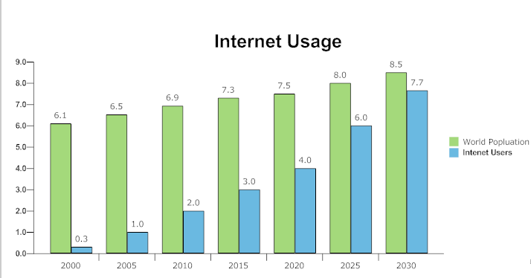
Introduction
Today 50% world population has access to internet
It will rise to 90 % in 10 years

Slide 16
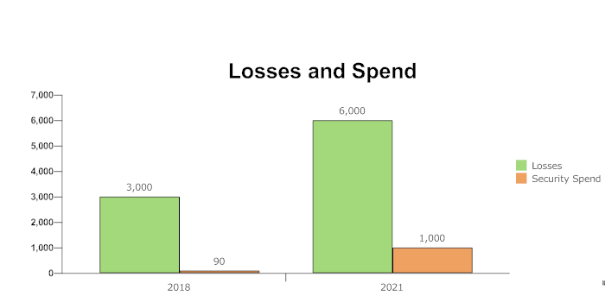
Introduction
Cyber attacks are the number one problem with mankind, even worse than nuclear weapons
- Billionaire businessman Warren Buffet

Slide 17
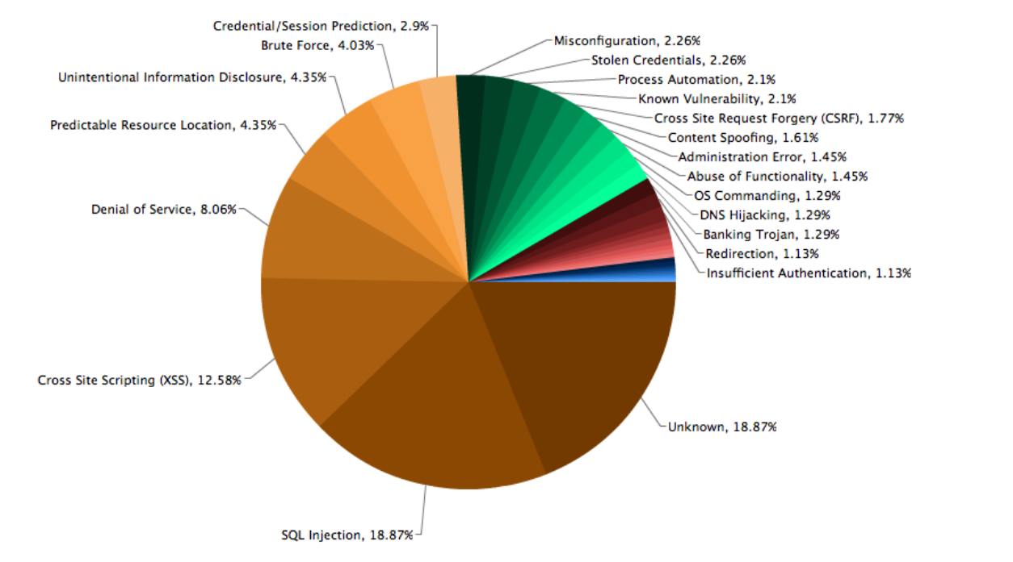
Vulnerability Exploitation
Open Web Application Security Project (OWASP) Report

Slide 18
SQL Injection
SQL Injections can happen via any unprotected user input field which is directly used in a SQL Query.
Why is it dangerous?
Steal Identity.
Gain access to database.
How can they be prevented?
Having correct kind of validations in place for all text input fields.

Slide 19
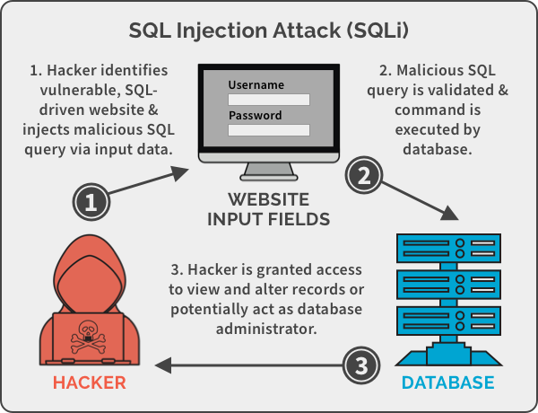
SQL Injection

Slide 20
SQL Injection
SQL Injections can happen via any unprotected user input field which is directly used in a SQL Query.
Why is it dangerous?
Steal Identity.
Gain access to database.
How can they be prevented?
Having correct kind of validations in place for all text input fields.

Slide 21
XSS
Cross Site Scripting attacks can happen when a malicious script is injected illegally, on a client browser.
Why is it dangerous?
Deface websites
Steal Identity.
Can gain access to user’s geolocation or even devices like webcams.
How can they be prevented?
Sanitize all inputs from user, especially the dangerous <script>.

Slide 22
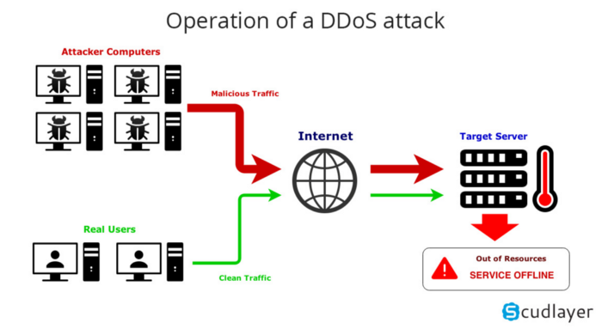
DDoS

Slide 23
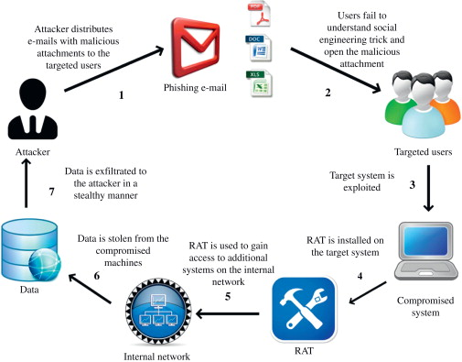
Phishing

Slide 24
AWS Security
Multifactor Authentication
Envelope encryption, rotating keys
Encryption of data in transit
Encryption of data at rest

Slide 25
Hands on
Assignment 5 : Word Frequency Counter
Prompt the user to enter a sentence.
Create a Dictionary:
Use a dictionary named word_count to store each unique word as a key and its frequency as a value.
Count Words:
Write a function called count_words(sentence) that populates the word_count dictionary based on the input sentence.
Print Word Frequencies:
Write a function called print_word_frequencies() that prints each word and its corresponding frequency in the format:

Slide 26
Hands on
Assignment 6 : Create a product inventory
Tuple: (Product Name (a string), Price (a float), Quantity (an integer))
Dictionary : product_inventory to store multiple product records. Use the Product ID as the key and the product tuple as the value.
Functions to Manage the Inventory:
Add Product:
Write a function named add_product that takes the product_inventory, a tuple representing a new product, and adds it to the inventory.
Update Quantity:
Write a function named update_quantity that takes the product_inventory, a Product ID, and the new quantity. Update the quantity of the specified product.
Display All Products:
Write a function named display_products that prints all product records in the inventory in a readable format.
Challenge:
All details are added to a CSV File, with columns : Product ID, Product Name, Price , Quantity, Total Price

Slide 27
Hands on - Strings
Assignment 7: Write a function named find_substring that takes two strings: the main string and the substring to search for. It should return the starting index of the substring in the main string or -1 if the substring is not found.
Assignment 8: Write a function named format_full_name that takes a first name and a last name as inputs and returns the full name in the format "Last, First".
Assignment 9: Write a function named even_indexed_chars that takes a string as input and returns a new string consisting of characters at even indices.
Assignment 10: Write a function named reverse_string_slicing that takes a string and returns the reversed version of that string using slicing.
Assignment 11: Write a function named substring_from_end that takes a string and an integer as parameters and returns the last n characters of the string.

Slide 28
Hands on - Lists
Assignment 12:
Create a list of tuples. Each tuple represents marks of students. Each tuple contains three records, one per subject.
Calculate and print the average score for each student in a separate list.
Student Scores: [(85, 90, 78), (92, 88, 91), (70, 75, 80)]
Average Scores: [84.33, 90.33, 75.0]

Slide 29
Hands on - Lists
Assignment 13: Basic List Slicing
Create a list of the first ten prime numbers.
Slice the list to obtain:
The first three prime numbers.
The last two prime numbers.
All prime numbers except the first and last.
Print all the sliced lists

Slide 30
Thank You !!

