Slide 1

Advanced Programming Using Python
Anjali Kulkarni
Sept 2024

Slide 2
Day 2
25 Sept 2024

Slide 3
Agenda
Revision
If – Else statements
While loops
For loops
Debugging basics
Break and control statements
Quiz

Slide 4
Input/output from console (inputOutput.py)
Interface between end users and programs
Input :
Reads a line of text from end user / console and returns it as a string
Syntax : input(“prompt”)
Output :
Simple print statement - print(“ …… ”)
Multiple arguments to print statement - print(“….”, “….”, “….”)
Custom separators - ‘sep’
Custom endings - ‘end’
Formatted output - format() or f-strings
Truncate a float number to 2 decimal places – {var_name:.2f}

Slide 5
Hands on
Assignment 1: Accept 2 strings from user and print them with format function.
Assignment 2: Accept 2 numbers from user and add them. Print result to console.

Slide 6
Hands on
Assignment 3: Calculate area of a circle – constant PI = 3.14
Assignment 4: Objective : Calculate savings of a person
Input:
Prompt the user to enter their monthly income (as a float).
Prompt the user to enter their total monthly expenses (as a float), which include rent, groceries, utilities, and other expenses.
Calculation:
Calculate the total savings by subtracting the total expenses from the income.
Calculate the percentage of income saved and the percentage of income spent.
Output:
Display the total savings.
Display the percentage of income saved and spent, formatted to two decimal places.

Slide 7
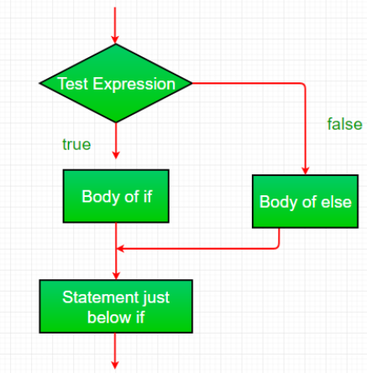
Conditional statements (ifElseControlStructure.py), (elif.py), (nestedifElse.py)
Fundamental control structure used to make decisions based on conditions
Evaluates to ‘true’ or ‘false’
If else condition
If – elif condition
Nested if-else condition

Slide 8
Operators (Operators.py)
Special symbols or keywords used to perform operations on variables and values
Arithmetic Operators
+, -, *, /, %, //, **, BODMAS
Assignment Operators
=, +=,-=,*=,/=,%=,**=,//=
Bitwise Operators
&,|,^, ~, <<,>>
Logical Operators – Boolean values
and, or, not
Comparison (Relational) Operators
==, !=, >,<, >=, <=
Membership Operators
in, not in
Identity Operators
Is, not is
Ternary Operator
‘value_if_true’ if condition else ‘value_if_false’

Slide 9
Hands on
Assignment 5: Implement all comparison operators
Assignment 6: Build a calculator for +, -, * and / operations using if and else condition statements

Slide 10
Hands on
Assignment 7: Create a program that determines whether a given year is a leap year.
Input: Prompt the user to enter a year (integer).
Logic: A year is a leap year if: It is divisible by 4.
Output: Display whether the year is a leap year or not

Slide 11
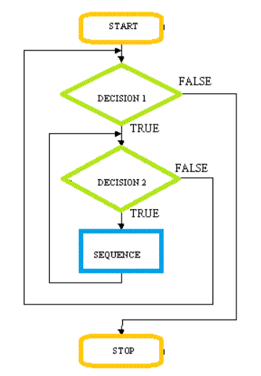
Loops (forLoop.py), (whileLoop.py)
Execute a block of code repeatedly
Execute for specific number of times - for loop
Iterate over a sequence (list, tuple, string, range)
Until specific condition is met – while loop
As long as the condition is true

Slide 12
Hands on
Assignment 8: Write a program to generate and display the multiplication table of a given number.
Input: Prompt the user to enter a number.
Logic: Use a while and for loop to calculate and display the multiplication table for the number.
Output: Display the multiplication table.
Assignment 9: Factorial of a number: using for loop, while loop
Assignment 10: Write a program to calculate the sum of the numbers upto 1, while decrementing the number.
Input: Prompt the user to enter a positive integer.
Logic: Use a while / for loop to iterate through each number and calculate the sum.
Output: Display the sum of the numbers.

Slide 13
Hands on
Assignment 11: Extract each character from a string and print it
(Use for loop)

Slide 14
Hands on
Assignment 12: Write a program to calculate the sum of the digits of a number.
Input: Prompt the user to enter a positive integer.
Logic: Use a while / for loop to iterate through each digit and calculate the sum.
Output: Display the sum of the digits.

Slide 15

Debugging
Debugging helps identify
Syntax Errors
Runtime Errors
Logical Errors
Infinite Loops
Print Statements
Use Debugger
Set Break point
Step through code line by line
Inspect variables

Slide 16

Loop control statements (breakStatement.py)
Break – exits loop completely
Continue – skips current iteration

Slide 17
Hands on
Assignment 13: Print numbers upto the number given by user
Step 1: Print numbers from 1 – 10.
Step 2: Accept a number from the user.
Step 3: Print only upto the number that user has given.
(Take care that the number is less than 10) use break statement

Slide 18
Hands on
Assignment 14: Build a program that calculates the ticket price based on the age of the customer.
Input: Prompt the user to enter their age.
Logic:
Use if-else statements to determine the ticket price based on age:
Under 5 years: Free
5 to 12 years: Rs 5
13 to 60 years: Rs 10
Over 60 years: Rs 7
Use nested if-else statements if necessary for more granular control.
Output: Display the ticket price based on the user's age

Slide 19
Hands on
Assignment 15: Develop a program that simulates an ATM withdrawal process.
Input: Prompt the user to enter their account balance and the amount they wish to withdraw.
Logic:
Check if the withdrawal amount is greater than the account balance. If so, display an error message.
If the withdrawal amount is valid, subtract it from the balance.
Ensure the withdrawal amount is a multiple of 10 (as ATMs typically dispense money in multiples of 10).
Output:
Display the remaining balance if the withdrawal is successful.
If not, display an appropriate error message (e.g., "Insufficient balance" or "Amount must be a multiple of 10").
Check if user wishes to withdraw more money, else exit

Slide 20


Slide 21
Homework
Assignment 1: Objective: Create a program that converts inches to feet, meters and centimeters and continue until the user wishes to
Input:
Prompt the user to enter a value (float) and the unit of measurement (e.g. inches).
Prompt the user to select the target unit for conversion
Prompt the user to press ‘Yes’ or ‘No’ to repeat
Calculation:
Convert the input value to the target unit using appropriate conversion factors.
Use typecasting where necessary to handle different types of input.
Use a while loop to repeat
Use break statement to stop calculations one user enters ‘No’
Output:
Display the converted value along with its unit.
Continue until the user presses No.
Conversion Options:
Inches to feet, meters, and centimeters.

Slide 22
Homework
Assignment 2: Build a calculator for +, -, * and / operations using if and else condition statements. Ask user for next input. Repeat until user presses ‘Y’

Slide 23
Hands on
Assignment 3: Print a Fibonacci series of numbers starting from 2 until 100

Slide 24
Thank You !!

Slide 25
Hands on
Assignment 20: Write a program that evaluates the strength of a user's password based on specific criteria
Input: Prompt the user to enter a password.
Logic: Evaluate the password based on the following criteria:
Length of at least 8 characters.
Contains both uppercase and lowercase letters.
Includes at least one numeric digit.
Includes at least one special character (e.g., !, @, #, $, etc.).
Use nested if-else statements to check each criterion and determine the strength of the password.
Output:
Display one of the following messages based on the criteria met:
"Weak" if the password meets only one criterion.
"Moderate" if the password meets two or three criteria.
"Strong" if the password meets all four criteria.

