Slide 1

Advanced Programming Using Python
Anjali Kulkarni
Sept 2024

Slide 2
Day 8
Anjali Kulkarni
3 Oct 2024

Slide 3
Agenda
Revision
Functions

Slide 4
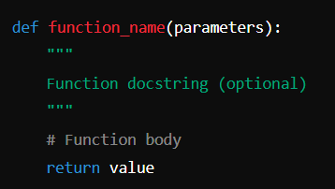
Functions
Blocks of reusable code that perform a specific task
Building blocks
Defining
Calling
Parameters
Arguments
Return values
Organize code
Make code readable
Reduce redundancy
First class objects

Slide 5
Return values (retValues.py)
Single Return Value
Value is returned as its type
Type is computed at runtime
Multiple return values
Return values - bundled into a tuple
How does this work?
Tuple Creation:
Python internally creates a tuple of return values
Return Value:
The tuple becomes the return value
Unpacking (Optional):
Return values can be unpacked into individual variables

Slide 6
Hands on
Assignment 1: Sum of Elements in a List
Write a function sum_of_list(lst) that takes a list of numbers as input and returns the sum of the elements in the list.
Assignment 2: Count the Frequency of Elements in a List
Write a function count_frequency(lst) that takes a list as input and returns a dictionary where the keys are the elements of the list and the values are the number of times each element appears.
Assignment 3: Return Sum and Product of Tuple Elements
Write a function sum_and_product(tup) that takes a tuple of numbers as input and returns a tuple containing the sum and the product of the elements.

Slide 7
Default Arguments (arguments.py)
Default arguments
Default arguments are specified in the function definition
Default value is used, when a value is not provided for a parameter
Default arguments must be placed after non-default arguments

Slide 8
Keyword Arguments (arguments.py)
Keyword Arguments / Named Arguments
Allow passing of arguments in any order by specifying the parameter names.
Keyword arguments improve code clarity.
Keyword arguments can also be used in conjunction with default arguments.

Slide 9
Hands on
Assignment 4:
Given a dictionary of students and their favourite colours: people={Vinay':'Blue’,’Ram':'Yellow',''Vinod:'Purple’,’Radha':'Pink’}
Find out how many students are in the list
Change Ram’s favourite colour
Remove ‘Vinod’ and his favourite colour
Sort and print students and their favourite colours alphabetically by name

Slide 10
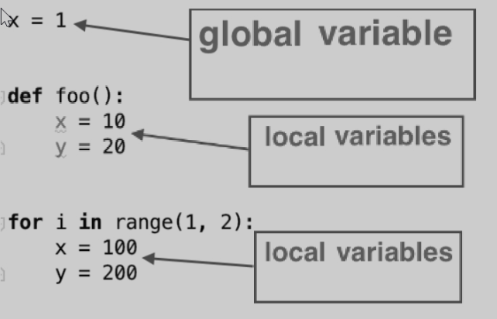
Global and local variables (variableScope.py)
Global Variables:
Defined outside of any function or block
Accessible throughout the script or module
Local Variables:
Defined within a function or block.
Accessible only within that specific function or block

Slide 11
Hands on
Assignment 3: Global and Local Summation
Objective: Create a program that calculates the sum of numbers using both global and local variables.
Tasks:
Declare a global variable to store the sum of numbers.
Write a function that accepts a list of numbers and calculates the sum using a local variable.
Update the global sum variable with the local sum calculated in the function.
Print the global sum before and after calling the function.
Challenge: Implement another function that resets the global sum to zero and compare the results.

Slide 12
Homework
Assignment 4: Voting System for Favorite Movies
Implement a function manage_votes() that manages votes for a list of movies.
Dictionary:
Key : movie name (string)
Value : Number of votes (integer)
Implement the following operations:
Add a new movie: Add a new movie to the voting list with 0 initial votes.
Vote for a movie: Increment the vote count for a specific movie.
Remove a movie: Remove a movie from the voting list.
Display voting results: Display the current vote count for each movie.
Find the top movie: Find and return the movie with the highest number of votes.

Slide 13
Thank You !!

