Slide 1

Advanced Programming Using Python
Anjali Kulkarni
Sept 2024

Slide 2
Day 9
Anjali Kulkarni
4 Oct 2024

Slide 3
Agenda
Revision
Functions

Slide 4
Hands on
Write a function to find length of a string
Write a function to find cube of a number

Slide 5
Lambda functions (lambdaFunctions.py)
A single expression that returns a value
Also called as anonymous functions
Used for
creating small, one-time and inline functions
creating higher order functions
functions like map(), filter() and reduce()
lambda arguments: expression

Slide 6
Hands on
Assignment 1: Multiply List Elements by a Constant
Use a lambda function to multiply each element in a list by a constant value.
Given a list [2, 3, 4, 5]. Multiply each element by 3
Expected Output: [6, 9, 12, 15]

Slide 7
Hands On
Assignment 5: Conditional Lambda Functions
Objective: Create a program that uses a lambda function to check if a number is positive, negative, or zero.
Tasks:
Input: List of integers. E.g. numbers = [10, -5, 0, 7, -3, 4, -2]
Logic: Use the map() function with a lambda function to return "Positive", "Negative", or "Zero" based on the value of each integer.
Output: Display the resulting list of strings.
E.g. : ['Positive', 'Negative', 'Zero', 'Positive', 'Negative', 'Positive', 'Negative']

Slide 8
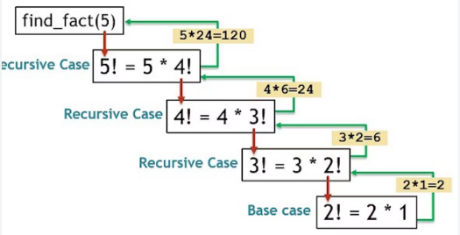
Recursions
Programming technique where a function calls itself directly or indirectly
Base Case:
The condition that stops the recursion.
Prevents the function from calling itself indefinitely.
Recursive Case:
The part of the function where the function calls itself.
Reduces the problem into smaller instances leading towards the base case.

Slide 9
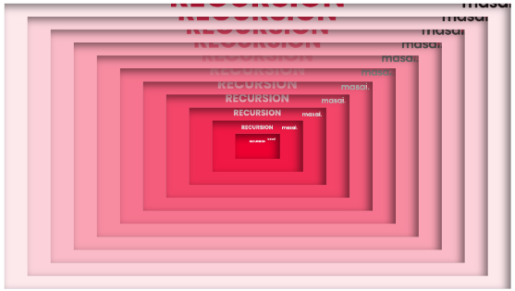
When to use recursions?
Use Recursion When:
The problem can be divided into similar sub-problems.
The problem is naturally recursive (e.g., trees, graphs).
Simplicity and clarity are more important than performance.
Avoid Recursion When:
Performance is critical and depth of recursion is large.
An iterative solution is more straightforward.

Slide 10
Hands On
Assignment 6: Convert factorial program to use recursive functions

Slide 11
Homework
Assignment 1: Convert Celsius to Fahrenheit
Use a lambda function with map() to convert a list of temperatures from Celsius to Fahrenheit.
Given a list of temperatures in Celsius [0, 20, 37, 100], use map() and a lambda function to convert each value to Fahrenheit using the formula F = (C * 9/5) + 32.
Expected Output: [32.0, 68.0, 98.6, 212.0]
Assignment 2: Add Two Lists Element-wise
Use a lambda function with map() to add corresponding elements from two lists.
Given two lists [1, 2, 3] and [4, 5, 6], use map() and a lambda function to return a new list where each element is the sum of the corresponding elements from the two lists.
Expected Output: [5, 7, 9]

Slide 12
Homework
Assignment 3: Capitalize Words in a List
Use a lambda function with map() to capitalize the first letter of each word in a list.
Given a list of lowercase words ['apple', 'banana', 'cherry'], use map() and a lambda function to capitalize each word.
Expected Output: ['Apple', 'Banana', 'Cherry']
Assignment 4: Find the Length of Strings
Use a lambda function with map() to find the length of each string in a list.
Given a list of strings ['hello', 'world', 'python'], use map() and a lambda function to return a new list containing the length of each string.
Expected Output: [5, 5, 6]

Slide 13
Homework
Assignment 5: Daily Temperature Tracker
Create a dictionary to store and manipulate daily temperature data for a week.
Write a program that stores daily high temperatures for a week in a dictionary, where keys are days of the week and values are temperatures. The program should:
Allow the user to update the temperature for any day.
Calculate the average temperature for the week.
Example Input: {'Monday': 30, 'Tuesday': 32, 'Wednesday': 29, 'Thursday': 31, 'Friday': 30, 'Saturday': 28, 'Sunday': 27}
Expected Output: Average temperature: 29.57°C.

Slide 14
Homework
Assignment 6: Bird Species Observation Tracker
Create a dictionary to track the number of sightings of different bird species.
Given a dictionary where keys are bird species (e.g., 'sparrow', 'eagle') and values are the number of sightings, write a program to:
Add a new species with its count.
Update the sighting count for an existing species.
Display the bird with the highest number of sightings.
Example Input: {'sparrow': 10, 'eagle': 5, 'hawk': 7}
Expected Output: The bird with the highest sightings is 'sparrow'.

Slide 15
Thank You !!

