Slide 1
SPRINT-1

Slide 2
content
Geometry
Left-Handed coordinate system
Right-Handed coordinate system
Cartesian coordinate system
Cylindrical coordinate system
Spherical coordinate system
Vector and Linear Algebra
Vector and Scalar,
Unit Vector
Dot product and its physical significance
Cross Product and its physical significance
Matrices
Identity matrix
4 x 4 Matrix / 3 x 3 Matrix Addition and Multiplication
Column Matrix and Row Matrix
Basic of C++ Programming

Slide 3
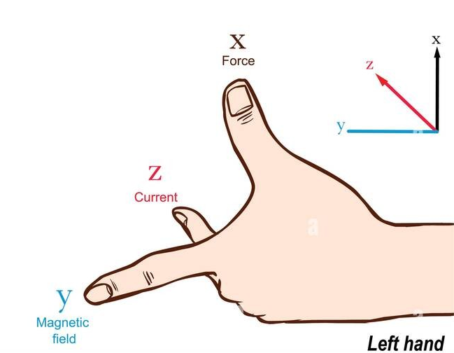
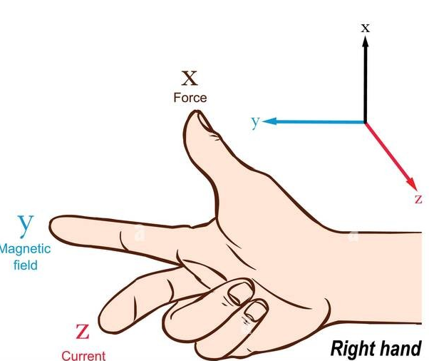
Geometry
Left-Handed coordinate system
Right-Handed coordinate system

Slide 4
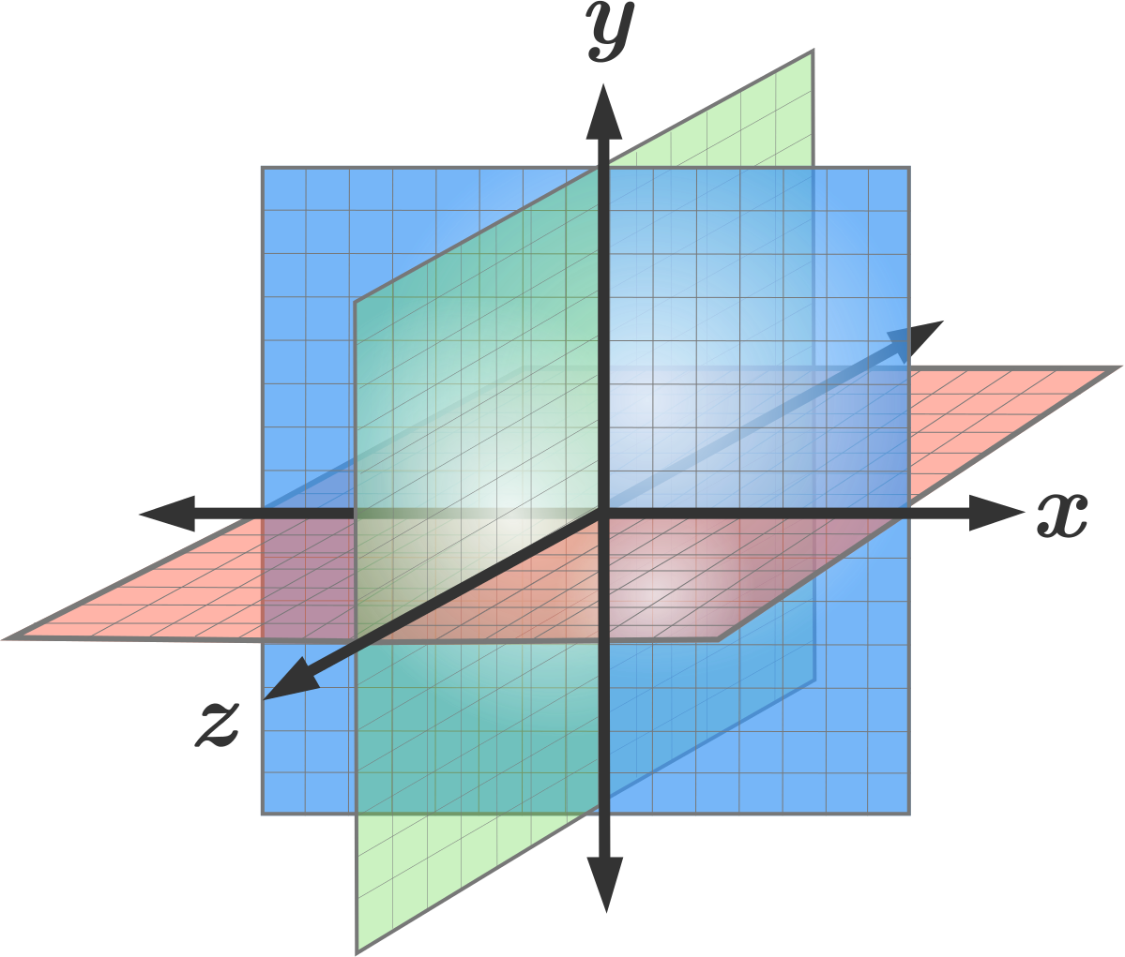
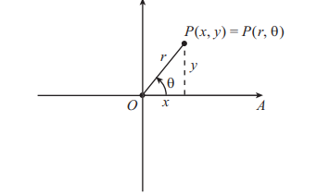
Cartesian coordinate system
Three-dimensional Cartesian coordinate axes. A representation of the three axes of the three-dimensional Cartesian coordinate system. The positive 𝑥-axis, positive 𝑦-axis, and positive 𝑧-axis are the sides labeled by 𝑥, 𝑦 and 𝑧. The origin is the intersection of all the axes. The branch of each axis on the opposite side of the origin (the unlabeled side) is the negative part. You can drag the figure with the mouse to rotate it.
Cartesian co-ordinates (x, y) and polar co-ordinates (r, θ)
x = r cos θ , y = r sin θ
r ² = x ² + y ² , tan θ =( y / x)

Slide 5
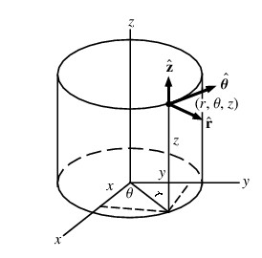
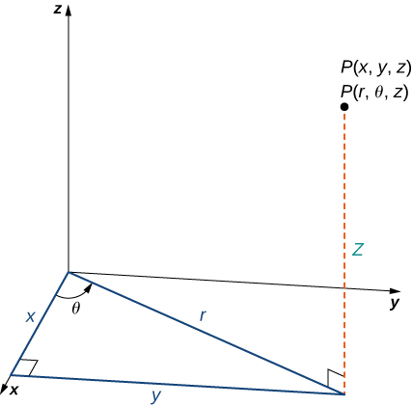
Cylindrical coordinate system
These equations are used to convert from cylindrical coordinates to rectangular coordinates.
x= r cos θ
y= r sin θ
z=z
These equations are used to convert from rectangular coordinates to cylindrical coordinates
𝑟²=𝑥²+𝑦²
tan θ=(y/x)
z=z

Slide 6
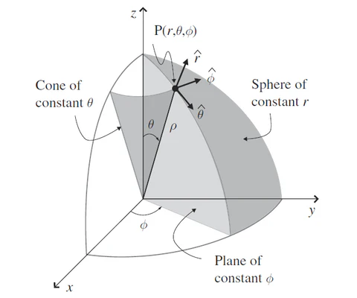
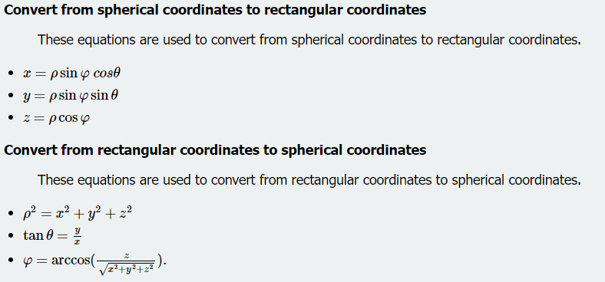
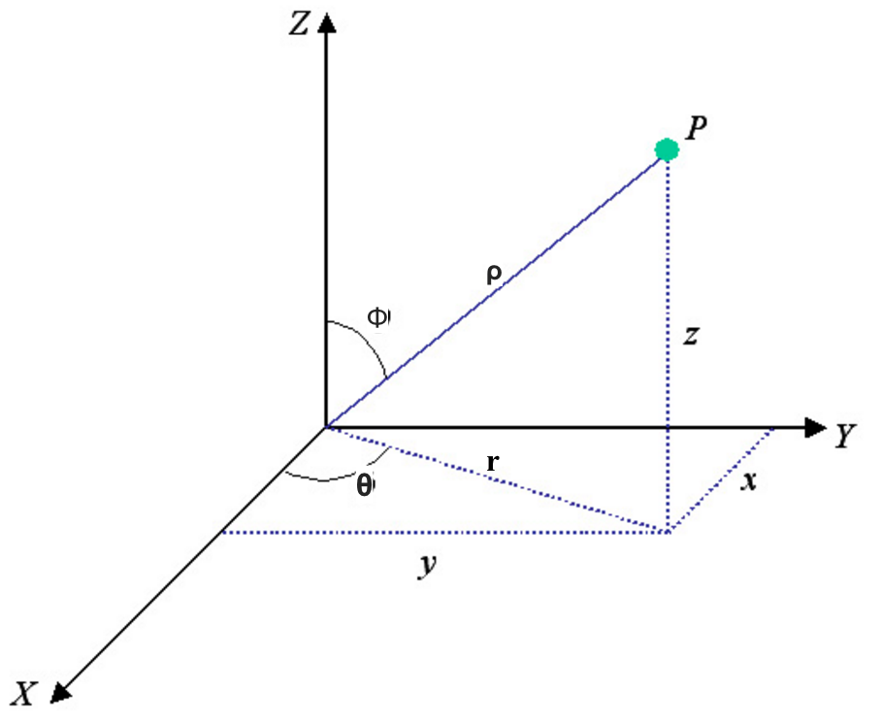
Spherical coordinate system

Slide 7
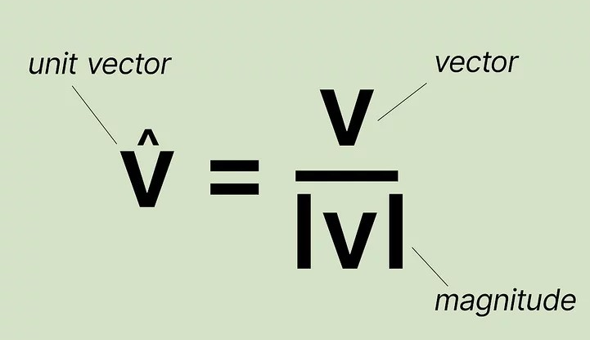
Vector and Linear Algebra
Scalar- A scalar quantity has only magnitude .
Example- Length, Area, Volume, Speed, Pressure, Temperature, etc.
Vector- A vector quantity has both magnitude and direction.
Example- Displacement, Velocity, Acceleration, Force, Weight, Lift, Drag, etc.
Unit Vector- Unit vector is a vector that has a magnitude of one and it is also known as a direction vector.
Dot product and its physical significance-The dot product is a measure of how much two vectors are aligned. So, if we have two vectors, u and v, the dot product between these two would give the length of the vector v along the vector u, or if you will, the projection of v along u.

Slide 8
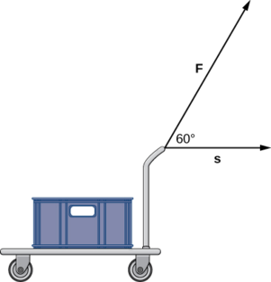
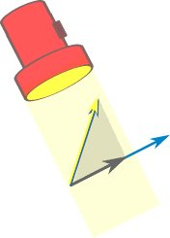
Cross Product and its physical significance
The dot product is a multiplication of two vectors that results in a scalar. In this section, we introduce a product of two vectors that generates a third vector orthogonal to the first two. Consider how we might find such a vector.
Example- Torque

Slide 9
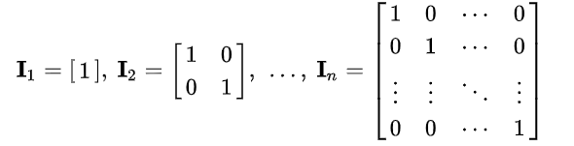
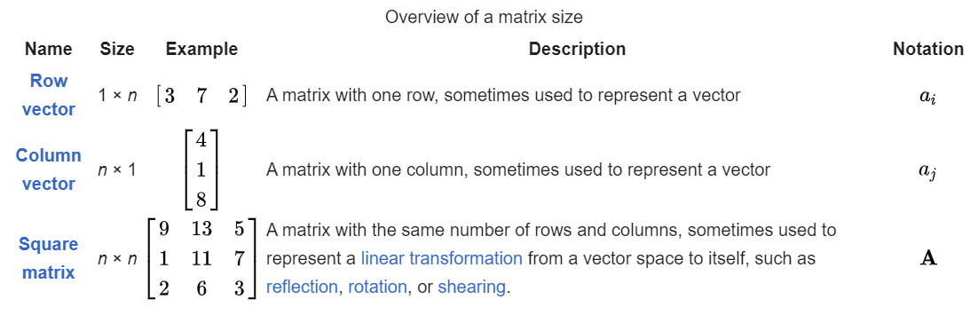
Matrices​
Identity matrix-The identity matrix I_{n} of size n is the n-by-n matrix in which all the elements on the main diagonal are equal to 1 and all other elements are equal to 0, for example,

Slide 10
C++ Programming
What is a Program?
Basics of a C++ Program.
Translator-Compiler and Interpreter.
Basic Debugging.
Data Types.
Type modifiers .
Operators.
Binary Number system.
Repetition for Statement .
Repetition-while Statement.
Repetition-do while Statement.
Switch Statement.
Break and Continue statement.
Basic of Time Complexity

Slide 11
THANK YOU

