Slide 1


Drug-Free Workplace
Annual Employee Education
2014
A safe, healthy and drug-free workplace is everyone’s business!

Slide 2

Why are we a drug-free workplace?
The administration of Brenau values safety in the workplace and wishes to ensure a safe and productive work environment for faculty, staff, students and visitors to our campus.
The goal of drug testing is not to punish offenders but rather to reduce incidences of drugs and drug use and provide assistance to employees who may not otherwise receive it.
As a participant in the program,
Brenau also experiences a
significant reduction in our worker’s
compensation premiums.

Slide 3
Objectives of Training:
Employees should understand:
    The requirements of the policy
    The availability of drug and alcohol counseling and assistance through our Employee Assistance Program
    Penalties that may be imposed upon employees for drug and alcohol use in violation of this policy

Slide 4
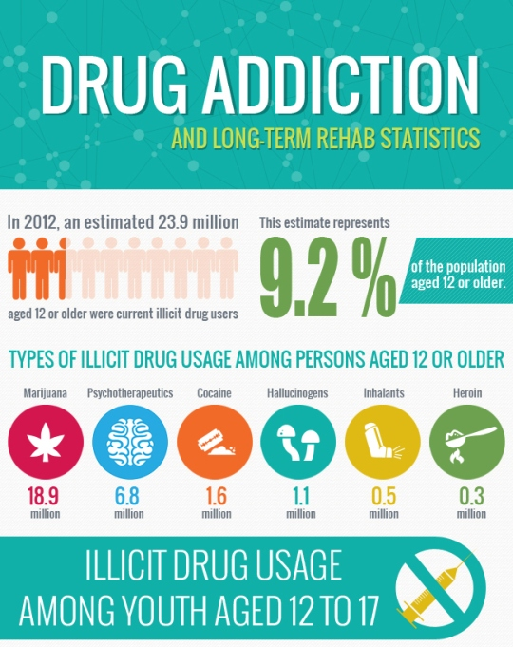
Statistics Show that Substance Abusers:
Are 5 times more likely to have an accident at work and therefore 5 times as likely to seek a worker’s compensation claim.
Are 16 times more likely to be absent from work and use 3 times as many health benefits as non-abusers.

Slide 5
General Information:
All employees and job applicants are covered by the Drug-Free Workplace policy.
Some departments may be subject to additional random testing as outlined in the policy.
It is the responsibility of each employee to review the policy periodically to ensure full understanding of the content of the policy.
It is the intention of this policy to comply with the provisions of Georgia’s Drug-Free Workplace Act, found in the Georgia Code, Sections 34-9-410 through 34-9-421, as amended.

Slide 6
Our Policy:
It is a violation of Brenau’s policy to:
(1) Use, possess, sell, trade, offer for sale, offer to buy, manufacture, distribute, make arrangement to distribute, or otherwise engage in the use of illegal drugs;
(2) Report to work under the influence or impaired by illegal drugs and/or alcohol in any detectable amount;
(3) Use prescription drugs illegally, (i.e. to use prescription drugs that have not been legally obtained or in a manner or for purpose other than prescribed) at Brenau or while conducting business off‑campus.
Violations of this policy are subject to corrective action up to and including termination

Slide 7
When are employees tested?
As a condition of employment, employees and job applicants must submit to drug testing under the following circumstances:
During the employment process (*certain departments);
If the employee has caused or contributed to an on the job injury;
When there is reasonable suspicion that an employee is illegally using drugs, abusing or using prescription drugs in an unauthorized manner, or otherwise violating the drug and alcohol policy;
Random selection of employees in the specified groups on a periodic basis.
Refer to FSG 1-08 H for details regarding random drug screening

Slide 8


Types of Testing :
Our policy includes:
Post Offer
Reasonable Suspicion
On-the-Job Injury
Random
In addition to these, we also reserve the right to revise our policy to include:
Post Rehabilitation Testing
Routine Fit for Duty

Slide 9
What happens if I test positive?
Within 5 days after receipt of a positive confirmed test result from the laboratory, the employee/applicant will be notified in writing of the fact that he/she tested positive, the consequences of the testing positive, and the options available to job applicant/employee.
If Brenau receives a confirmed positive test, the employee may be temporarily suspended (with or without pay) pending investigation and the job applicant may not be considered for employment.
All employees/job applicants have the right to contest the validity of the drug/alcohol screen.
Upon receipt of a confirmed positive test, the employee will be subject to disciplinary action.

Slide 10
Contesting or Appealing the Results:
All current and potential employees have the right to meet with the testing laboratory personnel within 5 days of receiving a positive result to contest or explain their test results.
These discussions are confidential except that information disclosed may be communicated to personnel within the university or within the lab who need such information in order to make informed decisions regarding test results or decisions concerning the continued employment of the individual.

Slide 11
Contesting or Appealing the Results
(continued):
The testing lab will retain samples in accordance with State law, so that an employee may request a retest of the sample at his/her own expense if the employee disagrees with the test result. Any additional tests must be conducted on the same specimen as the original test.
If the employee/applicant contends that the positive test result was created by taking lawful or prescribed substances, the university may suspend the individual without pay pending receipt of information to substantiate such a claim. The university’s ultimate decision regarding continued employment will not be made until all test results are clear and confirmed.

Slide 12

Employee Assistance Program (EAP):
Brenau recognizes drug abuse as a potential health, safety, and security problem. Employees needing help in dealing with such problems are encouraged to use our Employee Assistance Program (EAP) and health insurance plans, as appropriate. The costs of referrals outside of the EAP are the employee’s responsibility; these costs may be covered by the employee’s medical insurance.
When an employee is participating in rehabilitation or a return to duty program, Brenau has the right to require a drug and/or alcohol test prior to the employee’s return to work.
If the employee is to be referred to a treatment facility for evaluation, the employee's test results may be made available to the employee's counselor.
Refer to FSG 3-04 for detailed information on substance abuse and assistance

Slide 13

Refusal to Submit to Testing:
Refusal to submit to a required drug and/or alcohol test may have serious consequences such as corrective action up to and including immediate termination.
Brenau University’s drug-free workplace program is certified by the Georgia Workers Compensation Board in accordance with Title 34, Chapter 9, Article 11 of the official Code of Georgia Annotated.

Slide 14
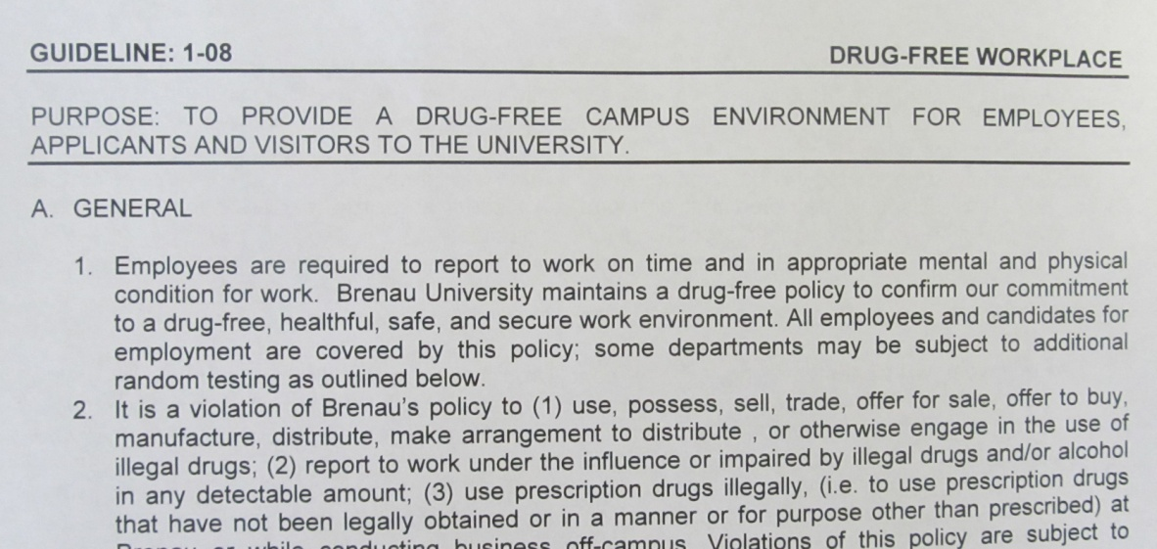
Thank you!
We all play a part in creating a work environment that supports a healthy, safe, productive, alcohol and drug-free workplace!
Questions surrounding the drug-free policy should be directed to the Human Resources Office.
Employees may visit the HR Intranet site at http://intranet.brenau.edu/hr/1-08_Drugfree.pdf to view the policy in its entirety.

