Slide 1
Housing Price Analysis
By: Rebecca Chan

Slide 2
03
01
02
05
04
Exploratory Data Analysis
Introduction
Modelling
Data Extraction
Conclusion and Recommendation

Slide 3
01
Introduction

Slide 4
Background
Housing was one of the challenges that Singapore initially faced.
Shifted towards the direction of home ownership in the late 1960s
By 1980s, homeownership has grown.
In 2022, Singapore home ownership has increased to 89.3 percent despite rising property cost.

Slide 5
Housing
Continues to be a long term financial commitment for most Singaporeans.

Slide 6
Problem Statement
Understand how does the factors cause the HDB prices to fluctuate and recommendations for the purchase of HDB
Analyze the different features related to the resale flat.

Slide 7
02
Data Extraction

Slide 8
Data Source
Resale flat data: https://beta.data.gov.sg/
csv
OneMap data: https://www.onemap.gov.sg/
Planning Area API
Population API

Slide 9
Data Source (OneMap)
Planning Area (API)
Planning Area Polygons
Names of Planning Area
Planning Area Query

Slide 10
Data Source (OneMap)
Population (API)
Transport Mode to School
Transport Mode to Work
Age Group
Religion
Spoken Language
Tenancy
Dwelling Type Household Data
Dwelling Type Population Data
Economic Status
Education Status
Ethnic Status
Household Monthly Work Income
Household Structure
Income From Work
Planning Area Industry
Language Literacy
Martial Status

Slide 11
Data Cleaning
Planning Area
Retrieve Latitude and Longitude
Map Town to Planning Area
Renamed “Kallang” to “Kallang/Whampoa”
Map “Central Area” to either “Outram” or “Rocher” based on “Street Name”
Calculate “Remaining Lease”
Resale Flat

Slide 12
03
Exploratory Data Analysis

Slide 13
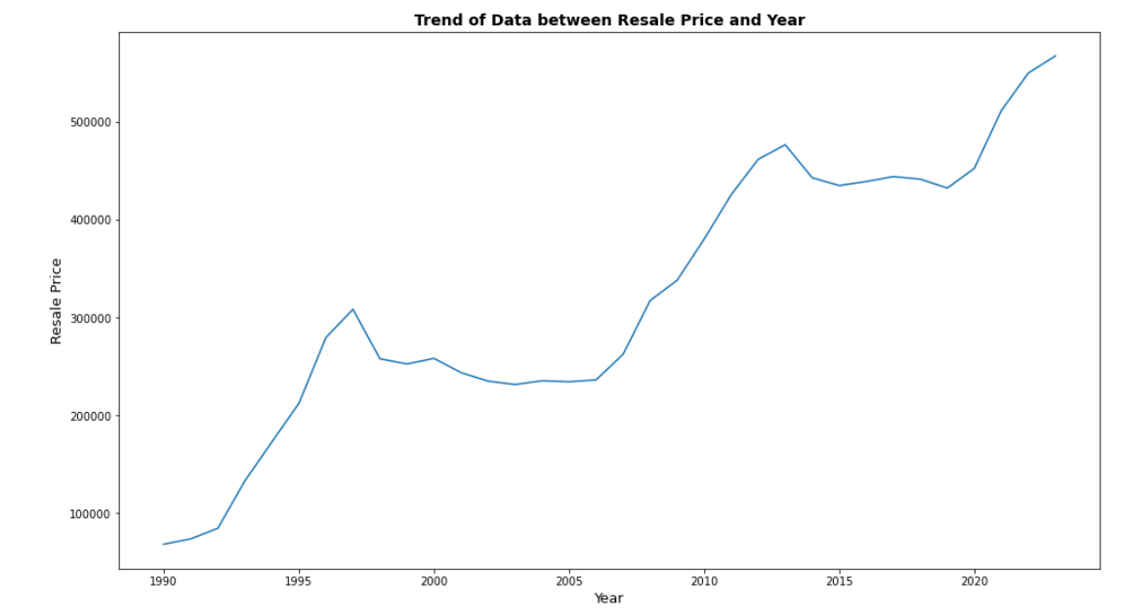
Trend: Resale Price and Year (EDA)

Slide 14
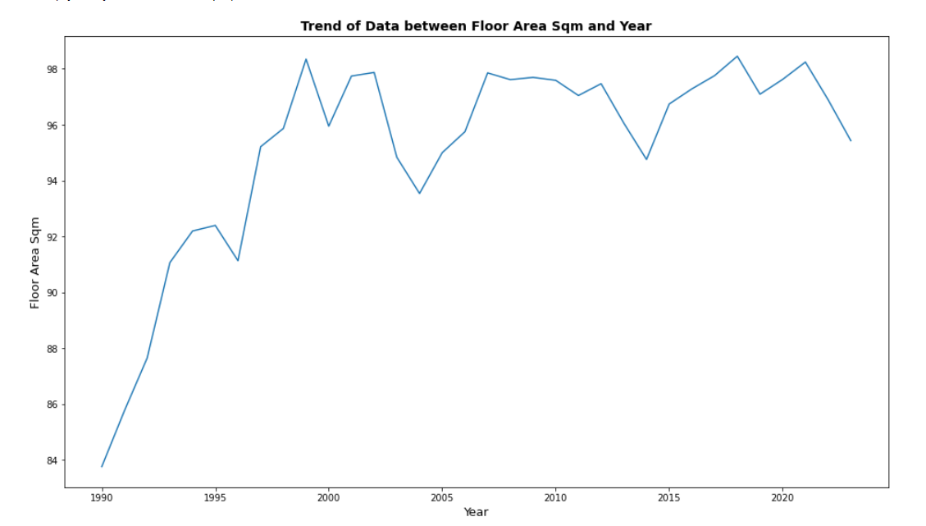
Trend: Floor Area Sqm and Year (EDA)

Slide 15
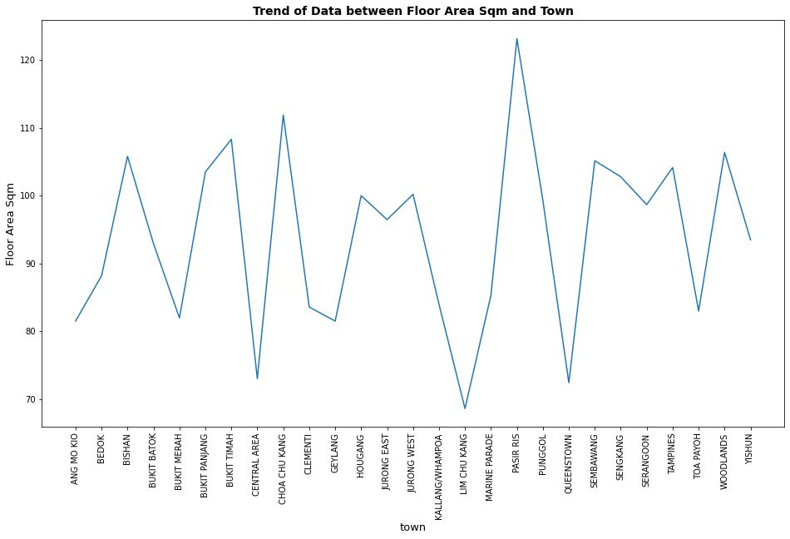
Trend: Floor Area Sqm and Year (EDA)

Slide 16
03
Modelling

Slide 17
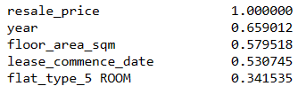
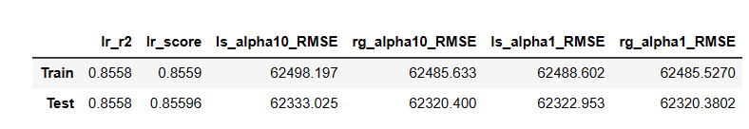
Modelling
Model
Linear Regression
Lasso Regression
Ridge Regression

Slide 18
03
Conclusion and Recommendation

Slide 19
Conclusion
Resale Flat Price increase across the years
Consider Pasir Ris, Woodlands and Choa Chu Kang for bigger flats.
Overall flat size increase from 1990 to 2000

Slide 20
Challenges Face
Retrieving dataset from One Map API.
Each API requires separate logic to extract information.
Dependent on service provider. Reach out to SLA when API was down.

Slide 21
Next Steps:
Create a new price column to take into account inflation across the years.
Retrieve Latitude and Longitude on places of interest.
Calculate distance between coordinates
Further analysis and insights from the features such as education, religion, literacy, spoken language
Explore different models such as Prophet and Time Series Analysis.

Slide 22
Thanks!
Please keep this slide for attribution

