Slide 1
Digestibility
  Digestible part of foods or nutrients is the prportion which is absorbed by the animal, which is not exreeted in the faeces.
  Digestible compounds:
  protein amino acids
  starch glucose
  fats fatty acids, monoglycerides
  Calculation:
  digestible nutrient content = nutrient intake – nutrient excretion in the faeces
  Can be expressed as a coefficient or a percentage.
  apparent or true digestibility
  The faeces contains not only the unabsorbed part of food, but also some so called endogenous compounds (erosion of epithelial cells, enzymes etc.).
  true digestibility: correction with the endogenous compounds
  apparent digestibility : without correction with the endogenous materials

Slide 2
nutrient consumed – nutrient excreted in faeces
  apparent digestibility = --------------------------------------------------------------- (%)
  nutrient consumed
  nutrient consumed – (nutrient excreted in faeces – endogenous losses)
  true digestibility =------------------------------------------------------------------------------------------------- (%)
  nutrient consumed
  Taking into account endogenous losses is important mostly in the case of proteins and amino acids.
  Endogenous losses in the faeces:
    epithelial cells of the intestine
    enzymes
  products of bacterial fermentation

Slide 3
Ileal or faecal digestibility
absorption in the small intestine
degradation in the large intestine
A
100%
B
75%
70%
5%
10%
ileal digestibility
A: 75%
B: 70%
faecal digestibility
A: 80%
B: 80%
ileal digesta contains:
faecal digesta contains:
A 25%
B 30%
A 20%
B 20%
Microbial activity in the hind gut can modify the unabsorbed part of the nutrients and so the accuracy of faecal digestibility.

Slide 4
Determination of digestibility
Animal experiments
a. Simple digestibility trial (if the feedstuff could be given to the animals as the sole item of diet, corn with poultry species, hay for ruminants)
preliminary period
experimental period
  In the experimental period the feed consumed and the faeces excreted must be measured exactly.
  C-E
  Digestibility coefficient (%) = -------------- x 100
  C
  where C = consumed nutrient content E = excreted nutrient in faeces

Slide 5
b. Difference method (if the feedstuff can not be given to the animal alone, otherwise it can cause digestive disturbances; for example cereal grains with ruminants)
accompanying feedstuff
preliminary period
experimental period
accompanying feedstuff + test feedstuff
preliminary period
experimental period
  Digestibility coefficient (%)= A-(B x b)
  d
  where A= the common digestibility coefficient of the two feedstuffs
  B= the digestibility of the accompanying feedstuff
  b= ratio of the accompanying feedstuff
  d= ratio of the test feedstuff

Slide 6
The animal number needed for digestibility trials
The ratio of the test feedstuff in the ratio (%) | number of animals
ruminants 100 50 25 <25 | 3 4 6 8
pig 100 <50 | 3 6
poultry 100 <50 | 3 6-8
The length of digestibility trials
 | preliminary period | test period
ruminants
substantial change in the feed | 20 | 6-10
small change in tghe feed | 10 | 6-10
pig
feeding cereal grains | 7 | 5
feeding green crops, grass | 14 | 7
poultry | 5 | 5

Slide 7
c. Indicator method
if we do not have special balance cages,
or total collection is not possible, like ileal sampling,
taking representative excreta samples enough
indicators, markers:
  indigestible natural compounds of the feed (lignin, acid insoluble ash (silica),
  pl. Cr₂O₃ TiO₂
requirements against indicators:
  should not be absorbed
  should not disturb digestion of nutrients
  its transit time should be steady
  its analysis should be accurate
  could be incorporated into the test diet homogenously
  A-(B x It/Ib)
  Digestibility coefficient (%)= ------------------------- A
  where A= nutrient content of the feed
  B= nutrient content of the faeces
  It= indicator content of the feed
  Ib= indicator content of the faeces

Slide 8
d. Continuous digestibility trial
  We can use it for measuring the digestibility of herbage eaten by grazing animals.
  Lignin or acid insoluble ash can be used as an indicator.
  If the fibre and lignin content of a grass increase, it decreases the digestibility of starch, fat and protein. So, the optimal grazing or cutting time can be determined.
  Representative faces samples are collected after several days and the nutrient and lignin content of both grass and faeces are determined.
e. Laboratory methods of estimating digestibility
  It is not so laborious and expensive
  Digestion of protein in non ruminants can be determined after incubation (39ºC) the feed with pepsin and hydrochloric acid, or by digestive tract secretion collected via cannulae.
    In the case of ruminants the finely ground sample of feed is incubated for 48 hours with rumen liquor in a tube under anaerobic conditions. After that the bacteria are killed by acidifying with hydrochloric acid and then digested with pepsin for a further 48 hours. The insoluble residue is filtered off, and its nutrient content is subtracted from the nutrient content of the feed. The difference is the digestible part.

Slide 9
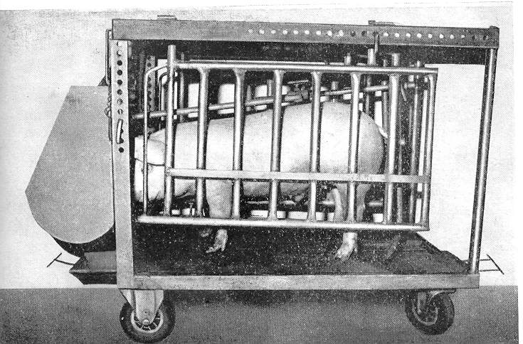
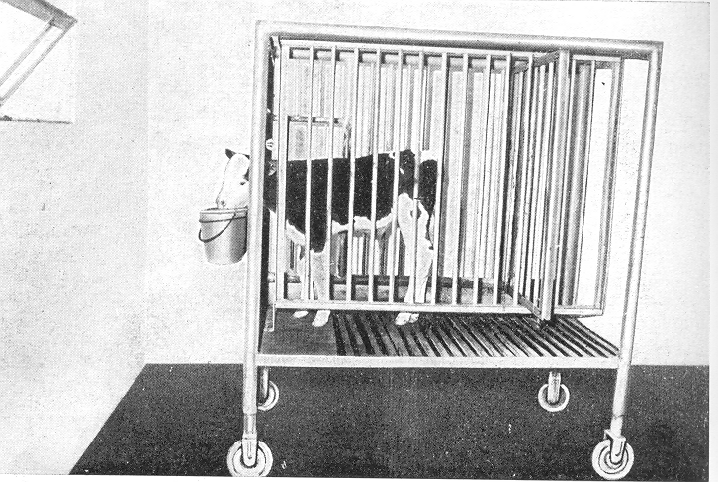
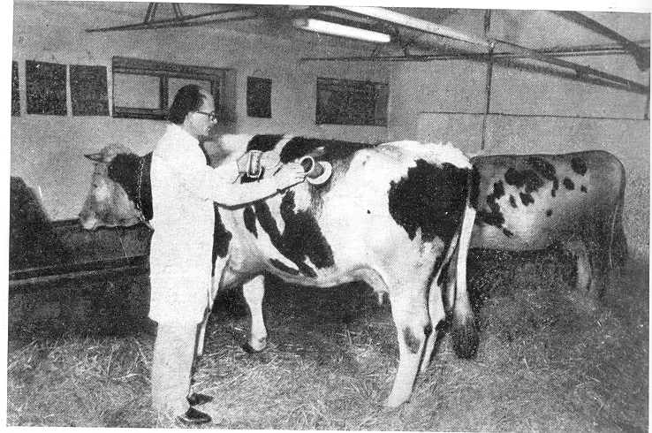
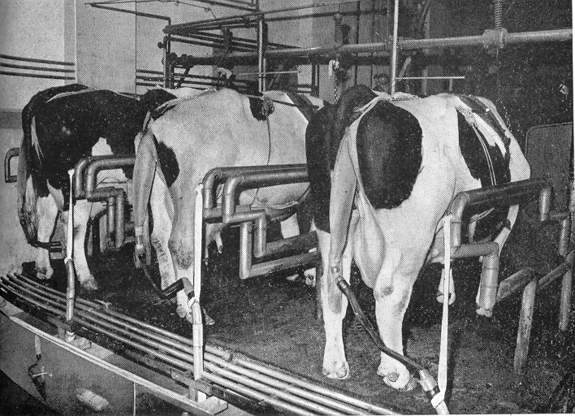

Slide 10
  Factors affecting digestibility :
  Animal factors :
  species (different digestive characteristics)
  breed (not significant differences exist between different breeds of the same species, individual differences are sometimes bigger)
  age of the animal (young animals can not digest the feeds as efficient as the adults, because of the less enzyme secretion)
  become accustomed to a feed (changing feed composition suddenly decreases digestibility mostly in the case of ruminants)

Slide 11
b. Food factors:
  fibre content (if the fibre content is too high, it effects negatively on the digestibility of the other nutrients)
  carbohydrates (sugar content of the food can cause depression in the rumen fermentation)
  enzyme supplementation of the food (it can be advantageous in young animals or against anti-nutritív factors)
  the amount of food eaten (if the amount of consumed food increase, the transit time of digesta will be quicker, so the digestibility of nutrients will be less.
  preparation of foods (grinding, pelleting, heat and steam treatment of soybean, boiling of potato etc. helps in digestion)
  anti-nutritive compounds of feedstuffs (trypsin inhibitors, solanin, glucans and xylans etc. decrease digestion)

Slide 12
  1. Calculate the digestibility coefficients of alfalfa hay, which was determined with sheep. Animals were fed 1,5 kg hay/day, their excreted 1,8 kg faeces/day.
 | alfalfa hay (g/kg) | faeces (g/kg) | digestibility coefficient (%) | digestible nutrient content (g/kg)
dry matter | 875 | 240
crude protein | 200 | 70
crude fat | 25 | 4
crude fibre | 272 | 88
N-free extract | 404 | 84

Slide 13
  2. Calculate the protein digestibility coefficient of barley protein. A difference trial was carried out with sheep.
  As an accompanying feed 1kg hay per day was fed in the first experiment. The daily faeces excretion was 1.2 kg. The crude protein content of the hay and faeces were 115 and 42 g/kg respectively.
  In a second experiment beside 1 kg hay 0.5 kg barley was fed. The crude protein content of the barley was 116 g/kg. In this experiment the daily amount of faeces was 1.5 kg, its protein content was 4%.
  Calculate the fat digestibility coefficient and digestible fat content of a broiler diet .
  According to the results of an indicator trial the fat and Cr2O3 content of the diet were 6% and 0.3% respectively. The same parameters of the faeces were 1.2% and 0.95%.

