Slide 1

MYSQL TRAINING

Slide 2


Slide 3
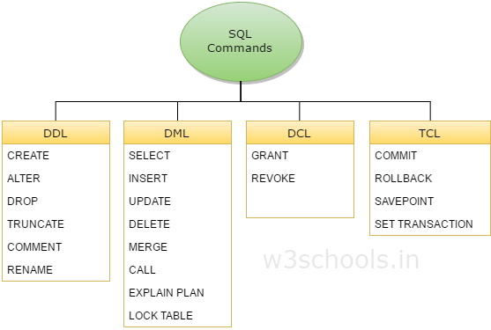

Slide 4
DDL
DDL is short name of Data Definition Language, which deals with database schemas and descriptions, of how the data should reside in the database.
CREATE – to create database and its objects like (table, index, views, store procedure, function and triggers)
ALTER – alters the structure of the existing database
DROP – delete objects from the database
TRUNCATE – remove all records from a table, including all spaces allocated for the records are removed
COMMENT – add comments to the data dictionary
RENAME – rename an object
EXPLAIN PLAN – interpretation of the data access path
LOCK TABLE – concurrency Control

Slide 5
DML
DML is short name of Data Manipulation Language which deals with data manipulation, and includes most common SQL statements such SELECT, INSERT, UPDATE, DELETE etc, and it is used to store, modify, retrieve, delete and update data in database.
SELECT – retrieve data from the a database
INSERT – insert data into a table
UPDATE – updates existing data within a table
DELETE – Delete all records from a database table
MERGE – UPSERT operation (insert or update)
CALL – call a PL/SQL or Java subprogram

Slide 6
DCL
DCL is short name of Data Control Language which includes commands such as GRANT, and mostly concerned with rights, permissions and other controls of the database system.
GRANT – allow users access privileges to database
REVOKE – withdraw users access privileges given by using the GRANT command
TCL
TCL is short name of Transaction Control Language which deals with transaction within a database.
COMMIT – commits a Transaction
ROLLBACK – rollback a transaction in case of any error occurs
SAVEPOINT – to rollback the transaction making points within groups
SET TRANSACTION – specify characteristics for the transaction

Slide 7
Guy1:We need the participants list for todays program to be stored.
Me: Yes I have it in Excel.
Guy1: But we have multiple users to access this data. Doing it in excel will be error prone
Me: So what should I do?
Guy1: Create a table in MYSQL.

Slide 8
"CREATE TABLE users( id INT NOT NULL AUTO_INCREMENT PRIMARY KEY , name VARCHAR( 25 ) NOT NULL ,
last_name VARCHAR( 25 ) NOT NULL ,
age INT NOT NULL
)";

Slide 9
The table creation command requires:
Name of the table
Names of fields
Definitions for each field

Slide 10
The MySQL DECIMAL data type is used to store exact numeric values in the database. We often use the DECIMAL data type for columns that preserve exact precision e.g., money data in accounting systems.
column_name DECIMAL(P,D);
P is the precision that represents the number of significant digits. The range of P is 1 to 65.
D is the scale that that represents the number of digits after the decimal point. The range of D is 0 and 30. MySQL requires that D is less than or equal to (<=) P.

Slide 11
CREATE TABLE `test`.`customers`(
`CustomerNumber` INT(10) NOT NULL,
`CustomerName` VARCHAR(40) NOT NULL,
`contactLastName` VARCHAR(40) NOT NULL,
`contactFirstName` VARCHAR(40) NOT NULL,
`phone` VARCHAR(30) NOT NULL,
`address1` VARCHAR(40) NOT NULL,
`address2` VARCHAR(40),
`city` VARCHAR(40) NOT NULL,
`state` VARCHAR(50) NOT NULL,
`postalcode` INT(20) NOT NULL,
`country` VARCHAR(50) NOT NULL,
PRIMARY KEY (`CustomerNumber`)
) ENGINE=INNODB CHARSET=latin7 COLLATE=latin7_general_cs;

