Slide 1
SONARQUBE
VIOLATION AND THEIR CORRECTIONS

Slide 2
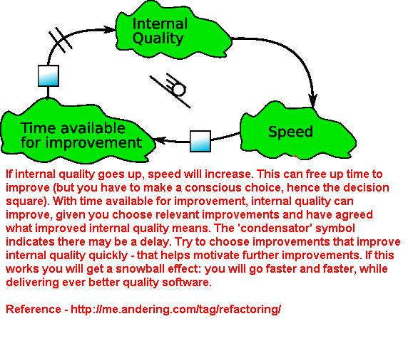
Introduction to Sonar
Software Quality Domain can be divided into Internal and External Quality.
External Quality checks Conformance to Specifications.
Internal Quality focuses on how well the software is built.
Poorly designed software needs more time and effort in maintenance, this contributes to Technical Debt.
Sonar is a tool to measure Internal Quality.

Slide 3
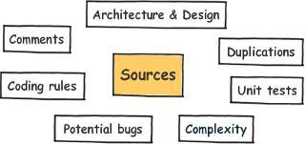
What is Sonar
Sonar is an open platform to manage code quality
Architecture and Design
Duplications
Unit Tests
Complexity
Potential Bugs
Coding Rules
Comments

Slide 4
List of Java Source Code Analyzers
Checkstyle – Checks conventions
PMD- Finds Bad Practices
FindBugs -Finds Potential Bugs
Examples For Conventions
Javadoc on public methods
Sun Naming conventions for classes, methods
Format conventions

Slide 5

What is Sonar Analysis
Sonar analysis involves inspecting the source code using source code analyzers and computing metrics
Source code analyzer is a tool that checks whether the source code follows a set of preconfigured rules
Sonar uses Checkstyle, FindBugs and PMD to analyze Java source code

Slide 6
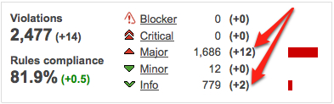

Slide 7
The diamond operator ("<>") should be used
Non Compliant Solution
List<String> strings = new ArrayList<String>();
Map<String,List<Integer>> map = new HashMap<String,List<Integer>>();
Compliant Solution
List<String> strings = new ArrayList<>();
Map<String,List<Integer>> map = new HashMap<>();
Shortcut:
Eclipse
Windows->preferences->save actions->change code style.
Or
Find (regex W+) and replace.

Slide 8
x
squid:S1854
DEAD STORES SHOULD BE REMOVED
Dead Store happens when a local variable is assigned a value including null, that is not read by any subsequent
Instruction. Calculating or retrieving a value only to overwrite it or throw it away could indicate a serious error in the code. Even if its not an error, it’s a waste of resources.
Assigning a null to a variable is also a dead store if the variable is not subsequently used.
Noncompliant Code Example
public int pow(int a, int b)
{
if(b == 0)
{
return 0;
}
int x = a;
for(int i= 1, i < b, i++)
{
x = x * a;
}
return a; //This method will become compliant by returning x.
}
.

Slide 9
USE isEmpty() to check whether a Collection is empty or not
List<String> strings = new ArrayList<>();
//non-compliant
void addEmployee()
{
if(strings.size()==0)
{
}
}
//Compliant solution
void addEmployee()
{
if(strings.isEmpty())
{
}
}

Slide 10
squid : S1213
The members of an interface or class declaration should appear in the pre-defined order
According to java code conventions defined by oracle, the members of class or interface should be defined in the following order in the source files.
Class and instance variables
Constructors
Methods
Noncompliant Code Example
public class Foo
{
private int field = 0;
public boolean isTrue()
{...}
public Foo() {...}
public static final int OPEN = 4;
}
The complaint solution is:

Slide 11
I
squid : S1149
Using UnSynchronized Collections
Early classes of the Java API, such as Vector, Hashtable and StringBuffer, were synchronized to make them thread-safe. Unfortunately, synchronization has a big negative impact on performance, even when using these collections from a single thread.
It is better to use their new unsynchronized replacements:
ArrayList or LinkedList instead of Vector
Deque instead of Stack
HashMap instead of Hashtable
StringBuilder instead of StringBuffer
Noncompliant Code Example
Vector cats = new Vector();
Compliant Solution
ArrayList cats = new ArrayList();

Slide 12
}
squid : S1192
String literals should not be duplicated
Duplicated string literals make the process of refactoring error-prone, since you must be sure to update all occurrences. On the other hand, constants can be referenced from many places, but only need to be updated in a single place.
Non Compliant Code
public void run()
{
prepare("action1");
execute("action1");
release("action1");
}
Compliant Code
private static final String ACTION_1 = "action1";
public void run()
{
prepare(ACTION_1);
execute(ACTION_1);
release(ACTION_1);
}
p

Slide 13
squid : S1148
Throwable.printStackTrace(...) should not be called
Throwable.printStackTrace(...) prints a throwable and its stack trace to some stream.
Loggers should be used instead to print throwables, as they have many advantages:
Users are able to easily retrieve the logs.
The format of log messages is uniform and allow users to browse the logs easily.
try
{
/* ... */
}
catch(Exception e)
{
e.printStackTrace(); // Noncompliant
}
try
{
/* ... */
}
catch(Exception e)
{
LOGGER.log("context", e); // Compliant
}
Log4j 1.x migrate to Log4j2.x

Slide 14
squid : S1132
It is preferable to place string literals on the left-hand side of an equals() or equalsIgnoreCase() method call. This prevents null pointer exceptions
from being raised, as a string literal can never be null by definition.
String myString = null;
System.out.println("Equal? " + myString.equals("foo")); // Noncompliant - will raise a NPE System.out.println("Equal? " + (myString != null && myString.equals("foo")));
// Noncompliant - null check could be removed
//compliant
System.out.println("Equal?" + "foo".equals(myString));

Slide 15
Short cuts in eclipse
to fix diamond operator ("<>"). use eclipse regex search to find and replace all.
Synchronized classes Vector, Hashtable, Stack and StringBuffer should not be used . eclipse find and replace.
String literals should not be duplicated. use Eclipse refactoring, extract to constant in each violation file.
Strings literals should be placed on the left side when checking for equality.
Eclipse -> Java Editor -> Enable Quick Assist Light bulb
a.equals(b) replaces to b.equals(a) we can try to avoid doing manually as much as possible which leads to human error.
Deadstores should be removed.
The members of an interface declaration or class should appear in a pre-defined order .
configuring eclipse save actions will help to fix errors

Slide 16
the below code is NOT RECOMMENDED because it has more then one exit points
private boolean isEligible(int age)
{
if(age > 18){
return true;
}
else{
return false;
}
}
private boolean isEligible(int age)
{ boolean result;
if(age > 18)
{ result = true;
}
Else
{
result = false;
}
return result;
}

Slide 17
Simplify if-else methods:
private boolean isEligible(int age)
{
boolean result;
if(age > 18)
{
result = true;
}
Else
{
result = false;
}
return result;
}
private boolean isEligible(int age)
{
return age > 18;
}

Slide 18
}
i
Combine multiple if statements into one:
For example, the below code;
if(age > 18)
{
if( voted == false)
{
// eligible to vote.
}
}
Multiple conditions in one if
if(age > 18 && !voted){ // eligible to vote}

Slide 19
USEFUL Eclipse Short cuts
Ctrl + Shift + O : Organize imports
Ctrl + Shift + T : Open Type
Ctrl + Shift + F4 : Close all Opened Editors
Ctrl + O : Open declarations
Ctrl + E : Open Editor
Ctrl +
/ : Line Comment
Alt + Shift + R : Rename
Alt + Shift + L : extract to Local Variable
Alt + Shift + M : extract to Method
F3 : Open Declaration

Slide 20
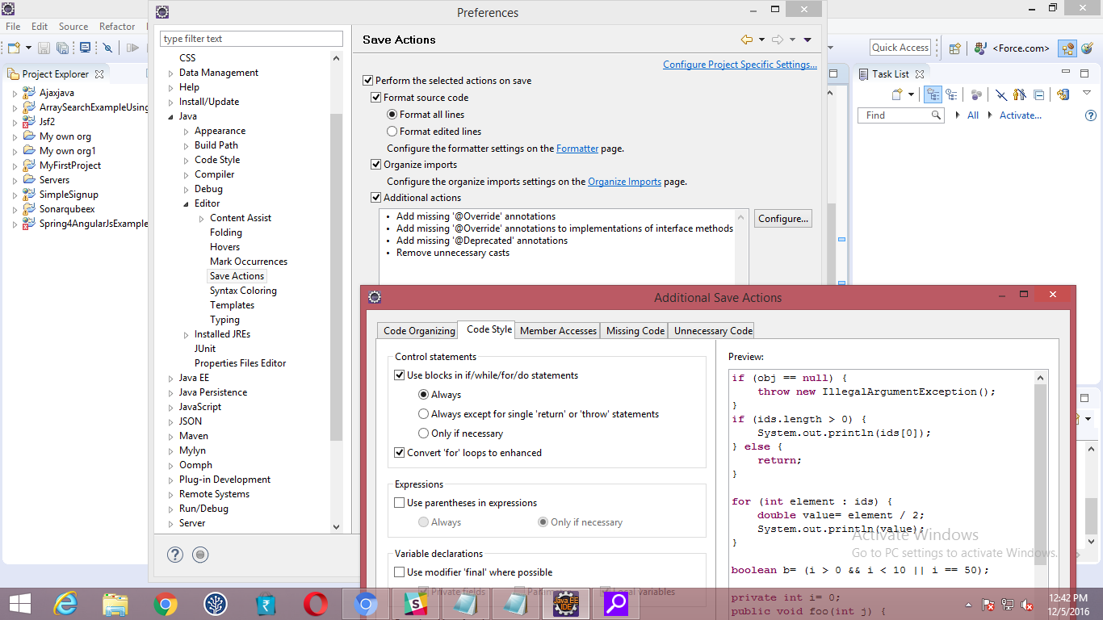

Slide 21
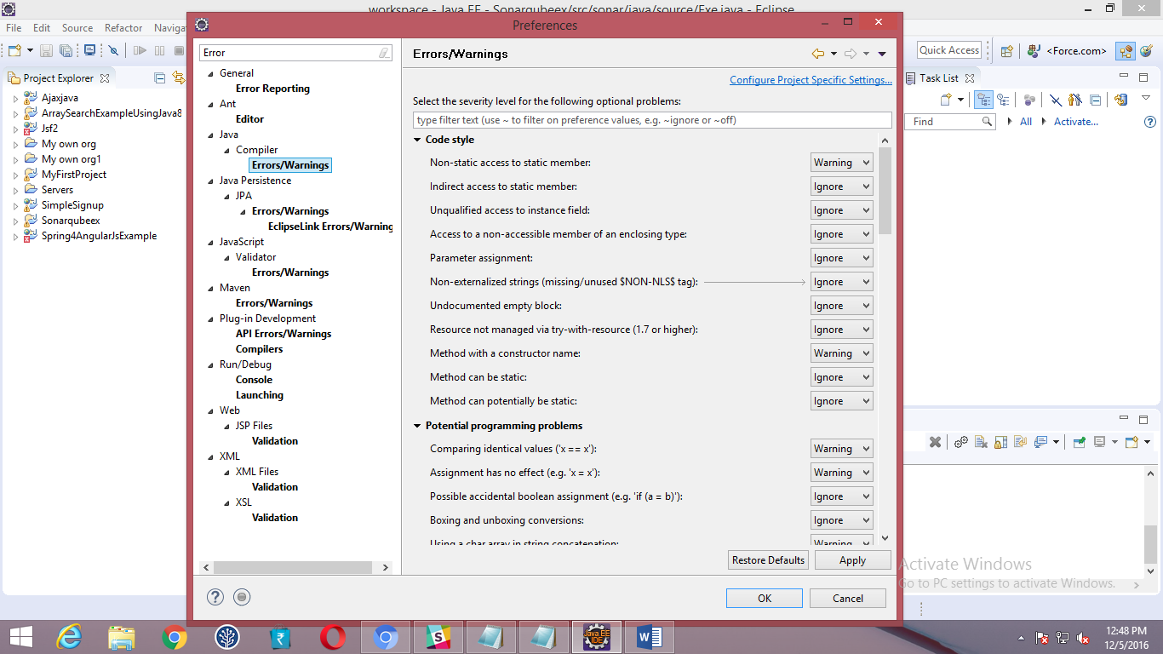

Slide 22
Use RemoveIf in Java Collections
If you want to remove elements from a collection quick, fast, and in a hurry, take a look at removeIf(), which should save you ton of time over manual iterations.
items.removeIf(i -> predicate(i));
Instead of
for (Iterator it = items.iterator(); it.hasNext();) {
if (predicate(it.next())) {
it.remove();
}

