Slide 1
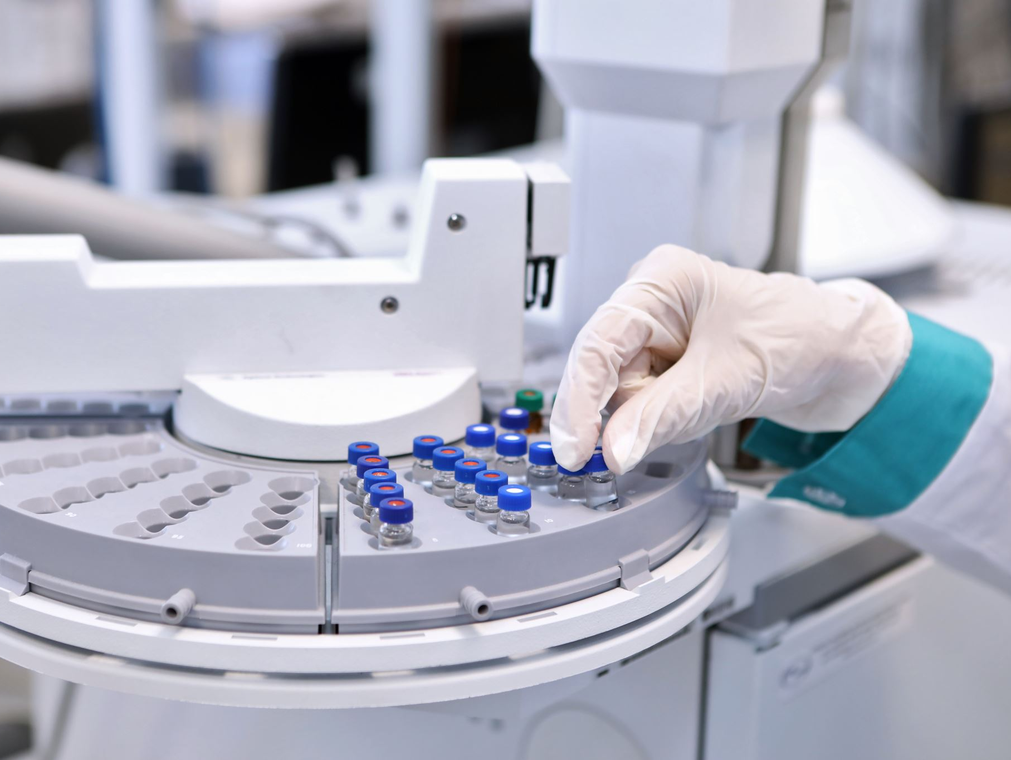
Liver Cancer Prediction: End-to-End Machine Learning Pipeline
A Machine Learning Approach for Early Cancer Detection

Slide 2
Executive Summary
Liver cancer is the fourth most common cause of death globally, accounting for over 800,000 deaths annually¹
This project develops an end-to-end machine learning pipeline for predicting liver cancer incidence.
The approach ensures data-driven recommendations for healthcare providers.
¹ Source: https://pmc.ncbi.nlm.nih.gov/articles/PMC10121295/

Slide 3
Problem Statement
Liver cancer has a high mortality rate due to late detection.
Objective:
Develop an ML model to predict liver cancer based on patient data.
Compare ML & Deep Learning models to determine the best-performing approach.
Deploy the best model for real-time predictions.

Slide 4
Exploratory Data Analysis (EDA)
Dataset Overview:
160,292 records, 25 columns.
Includes demographics, lifestyle, and medical history.
Key Visualizations & Findings:
Heatmap of correlations between numerical variables.
Distribution plots for Age, Alcohol Consumption, and Incidence Rates.
Boxplots & histograms to detect outliers and skewness.

Slide 5
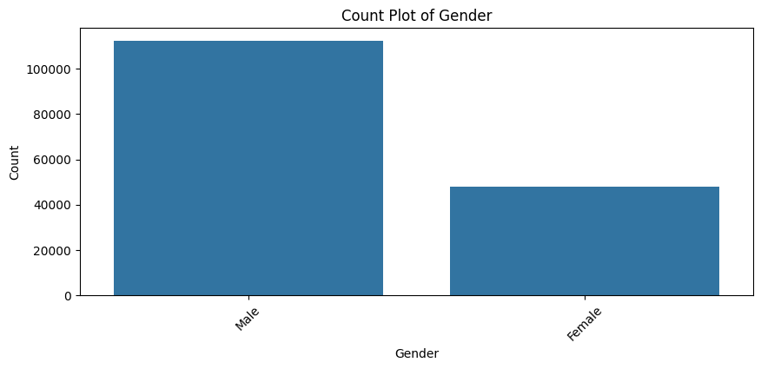
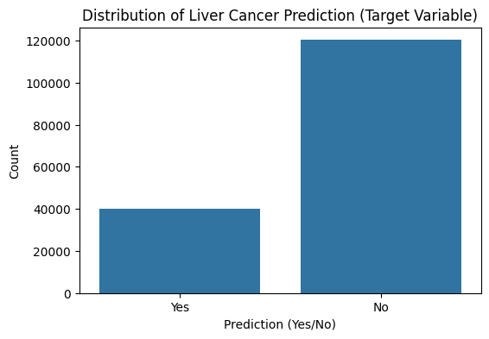
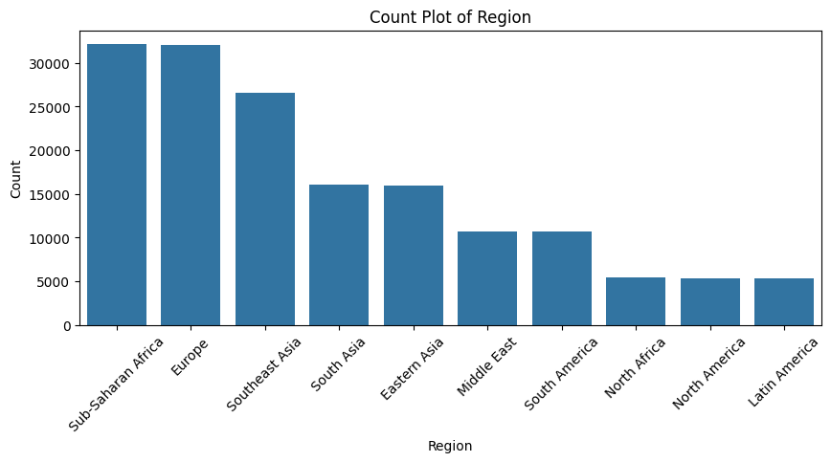
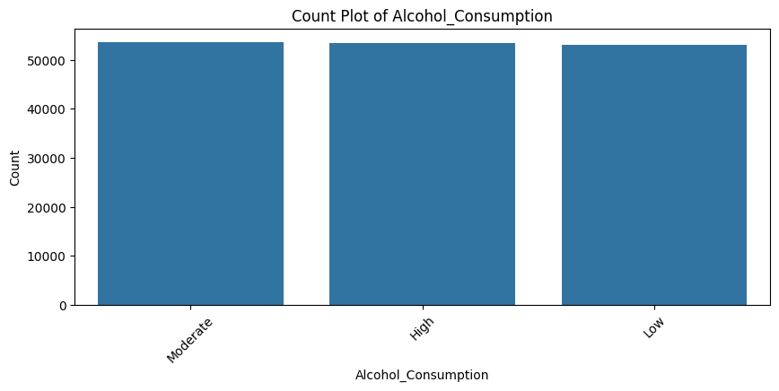
Selected EDA Figures

Slide 6
Data Preparation & Feature Engineering
Ordinal Encoding: Features like Alcohol Consumption & Healthcare Access.
Binary Encoding: Converted Yes/No features to 0/1.
One-Hot Encoding: Applied to categorical features.
Scaling: StandardScaler applied to numerical variables.
No missing values found but feature transformations were necessary.

Slide 7
Machine Learning Models & Performance
Logistic Regression (Baseline Model)
Accuracy: 50.55%
ROC-AUC Score: 50.28%
Random Forest Classifier
Accuracy: 75.03%
ROC-AUC Score: 50.24%
Gradient Boosting Classifier
Accuracy: 75.02%
ROC-AUC Score: 50.18%
Deep Learning Model
Training Accuracy: 74.68%
Validation Accuracy: 75.03%

Slide 8
Model Deployment Strategy
- Feature Engineering Pipeline saved using pickle.
- Model saved as .pkl (ML) and .keras (DL).
- Deployment on Streamlit

Slide 9
Deployment Challenges & Alternative Approach
Flask API worked locally but faced issues with Azure deployment.
GitHub Actions workflow errors caused conflicts.
Alternative: Used Streamlit for deployment.
Only the Deep Learning model was uploaded as Random Forest was too large.

Slide 10
Findings & Business Impact
Best Performing Model:
Random Forest & Deep Learning achieved ~75% accuracy.
Class imbalance impacted minority class predictions.
Business Impact:
Early detection helps improve patient outcomes.
Assists healthcare providers in prioritizing high-risk cases.
Optimizes hospital screening programs.

Slide 11
Lessons Learned & Recommendations
Challenges:
Dataset was highly imbalanced.
Some features (e.g., Country) had minimal impact.
Model performance could be improved with tuning.
Recommendations:
Implement Explainable AI (XAI) to interpret model decisions.
Fine-tune Neural Network architecture.
Integrate additional datasets for better accuracy.

Slide 12
References
- Dataset: Kaggle Liver Cancer Dataset.
- Machine Learning Frameworks: Scikit-Learn, TensorFlow.
- Deployment Resources: Streamlit.

