Slide 1


Slide 2

James Gangavarapu – Documentation, UML
Joshua Katikala – UML, Documentation, Presentation
Robert Kim – UML, Documentation
Eldin Mulalic – Team Coordinator, Documentation
Eden Taitt – Documentation, Market Research
Jason Tatum – Code
Jason’s Laptop – Curveball

Slide 3

This system is designed to aid in managing the important tasks of a hotel. It provides a tool for employees to manage room reservations, customer transactions, and other basic functions. It also provides a tool for managers to access employee information, inventory data, and other relevant data needed to reach a management decision or evaluate performance.

Slide 4

6000 lines of code, 37 page report
Purpose
Requirements
Database
System Model (Use Case Model, Object Model, Dynamic Model)
System Rationale
Test Cases
Horizontal Prototype
Functional Cost Point Analysis
COCOMO
Work Structure Document
Gantt Chart
Dictionary of Terms
Current Code
User Manual

Slide 5

SQLite
JavaFX
Netbeans

Slide 6

Login
3 main access levels: Receptionist, Supervisor, and Manager
Login using unique credentials
Reservations
Display number of check-ins/check-outs
Inventory
Track and manage inventory
Room Service
Accept and process room service requests

Slide 7
Receptionist Access
Manage reservations
Provide cost estimates
Input room service orders
Check inventory
Supervisor Access
Access employee information
Manage inventory
Access system-generated business reports
Manager Access
Add new employees

Slide 8



Slide 11
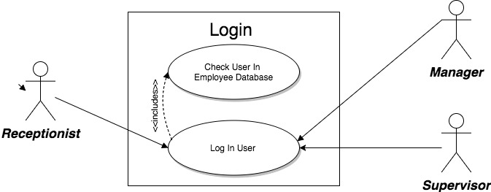

Slide 12
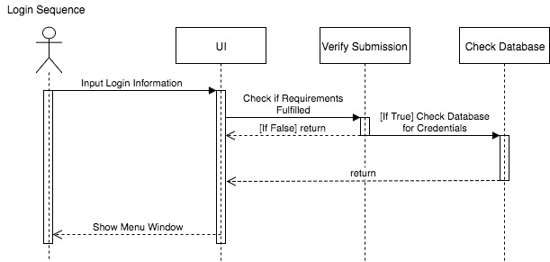

Slide 13
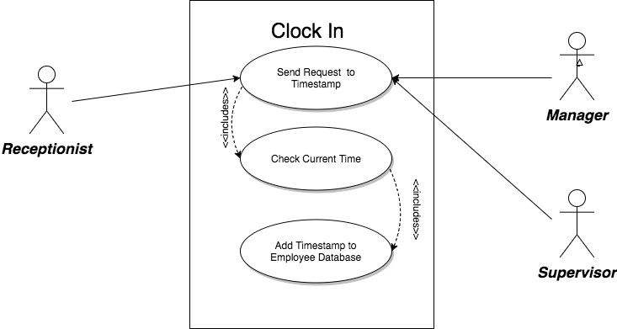

Slide 14
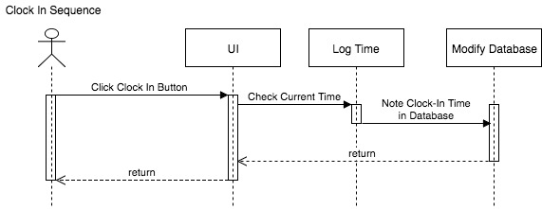

Slide 15
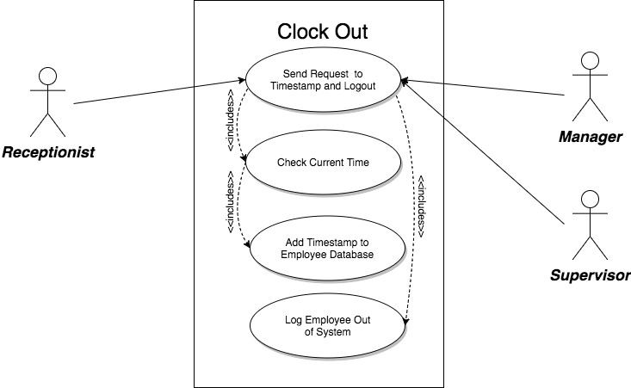

Slide 16
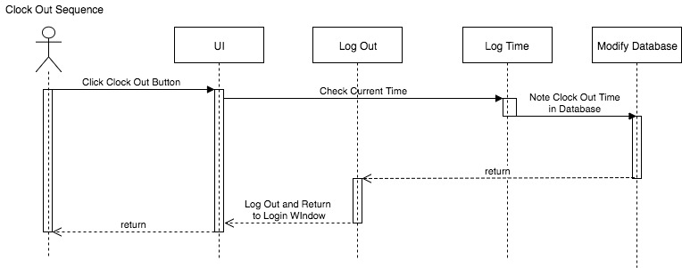

Slide 17
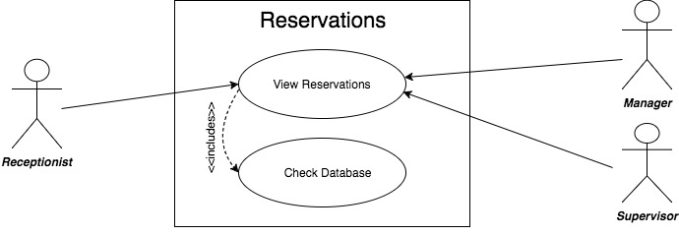

Slide 18
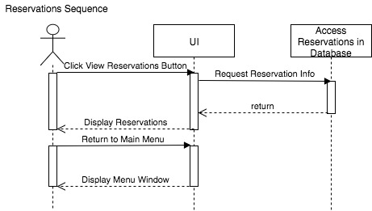

Slide 19
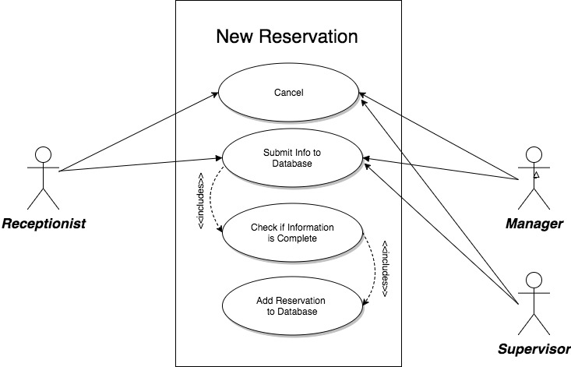

Slide 20
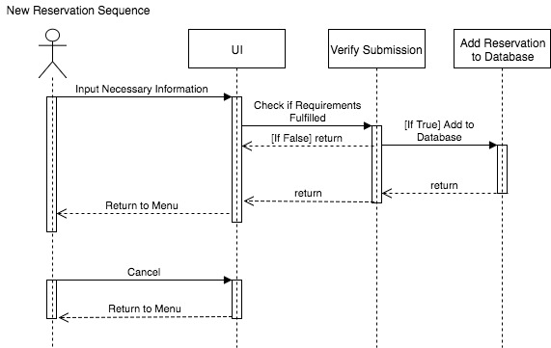

Slide 21
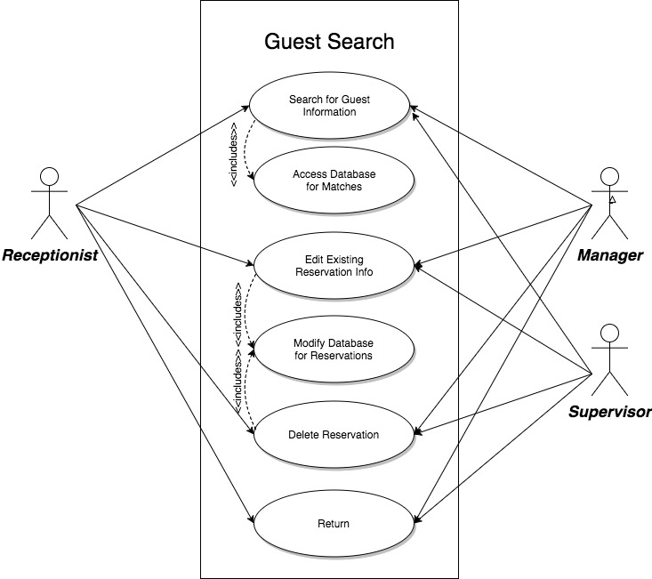

Slide 22
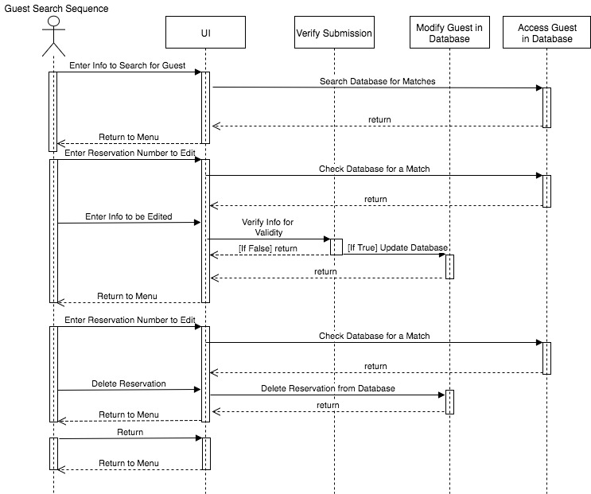

Slide 23
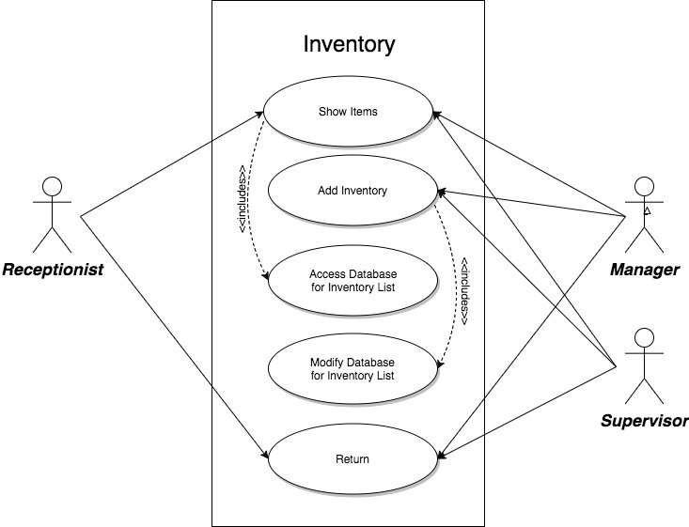

Slide 25
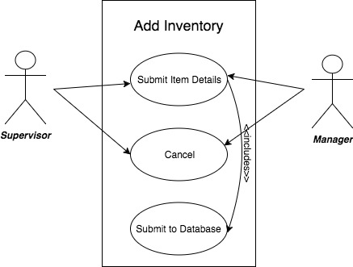

Slide 26
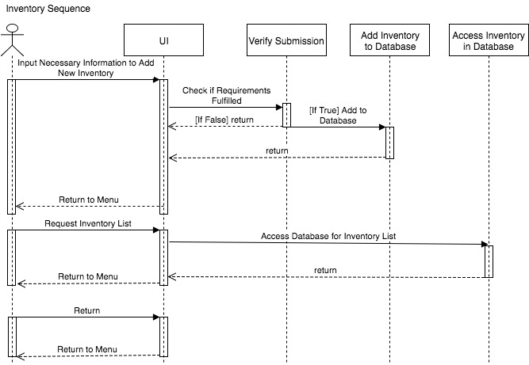

Slide 27
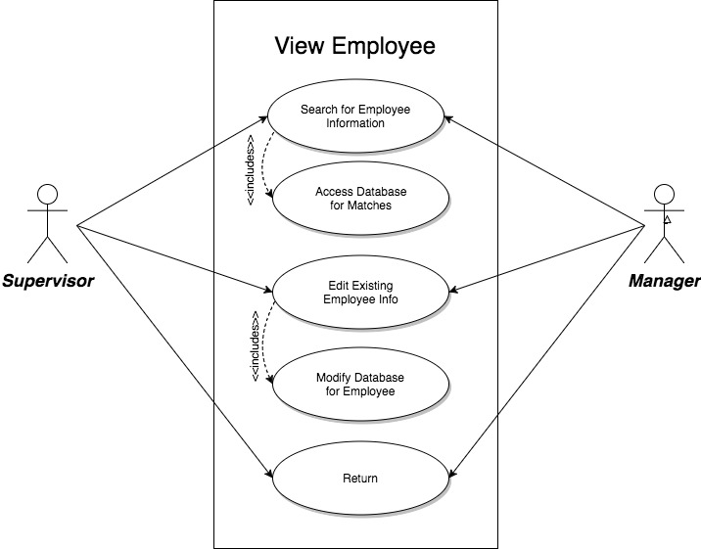

Slide 28
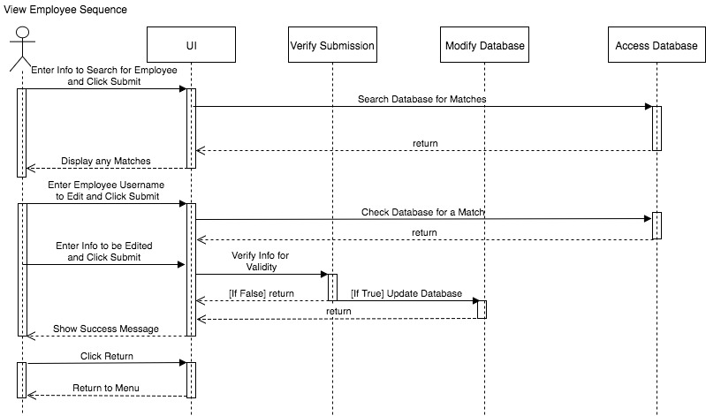

Slide 30
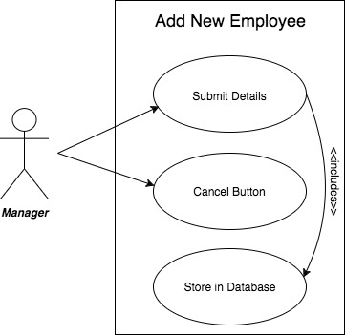

Slide 31
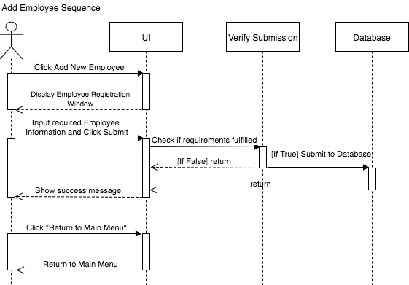

Slide 32


Slide 33


Slide 34
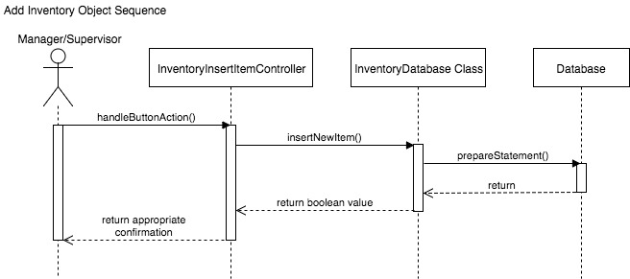

Slide 35
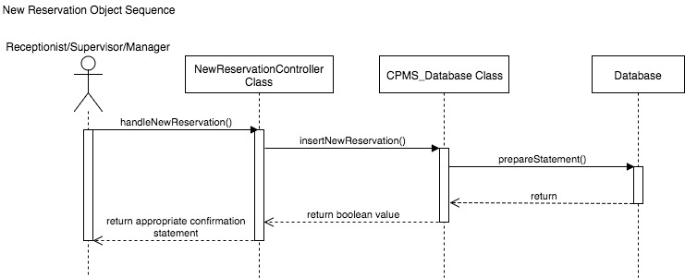

Slide 36
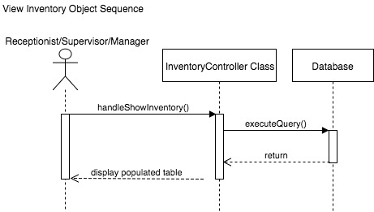

Slide 37


Slide 38

Through this presentation, we were able to demonstrate how our software is able to help with the everyday functions of a hotel. We presented some of the requirements and metrics that we used to develop the software as well as the models, such as the use cases and sequence diagrams, that show the functionality of our system. Finally, through the demonstration we were able to show how all of these things came together in the working software.

Slide 39
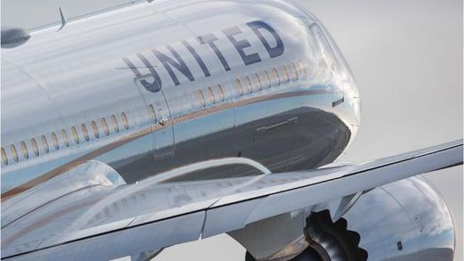
I know our project isn’t great
But at least we’re not United Airlines

