Slide 1
High Altitude Balloon Experiment

Slide 2


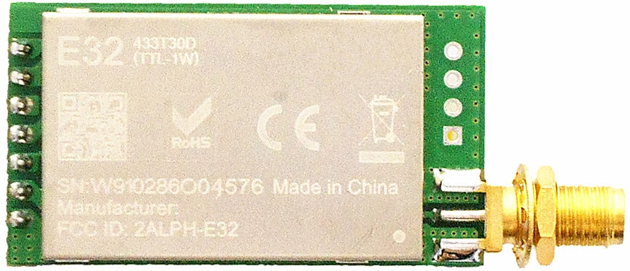

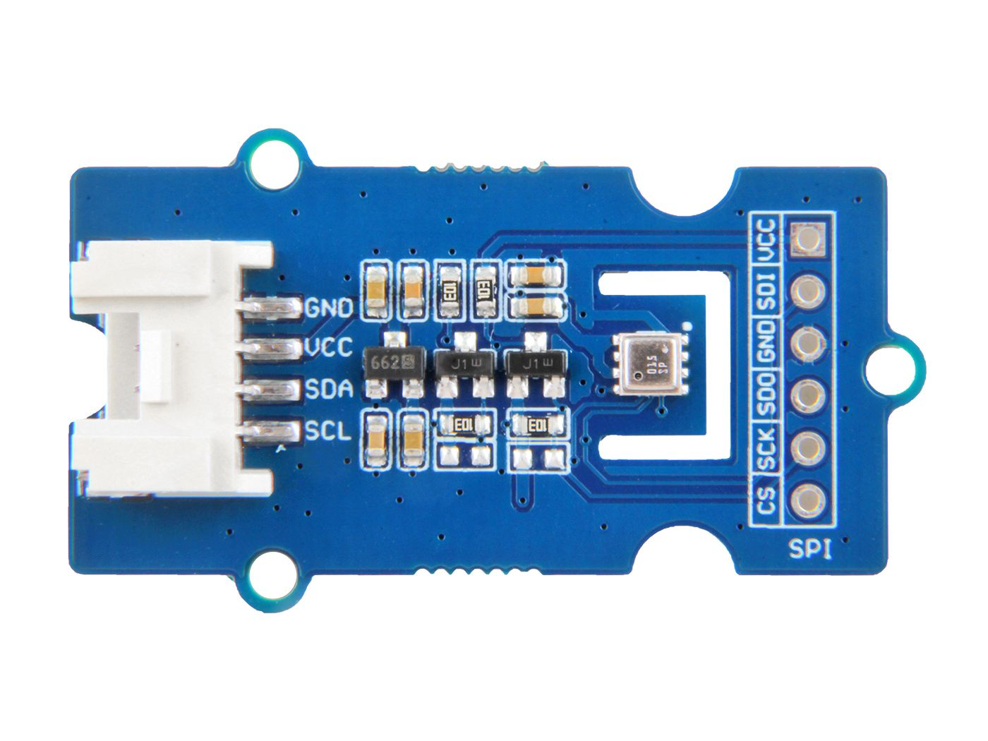

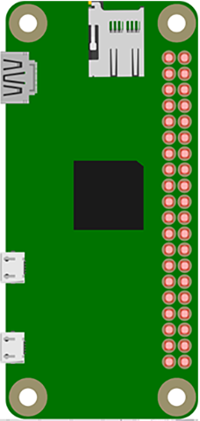
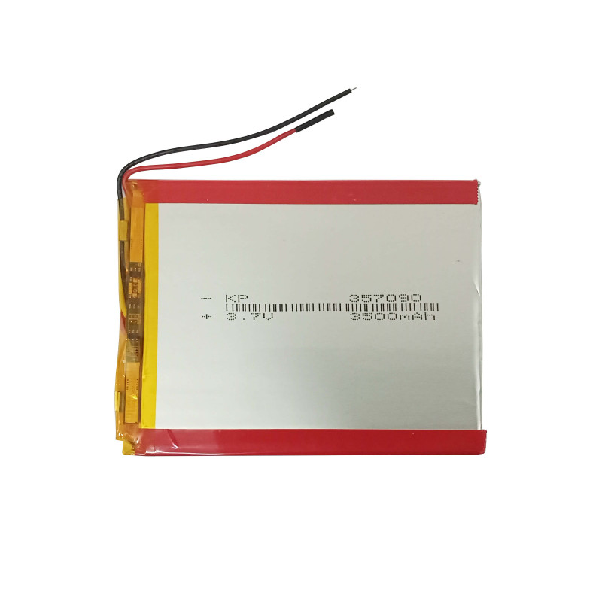
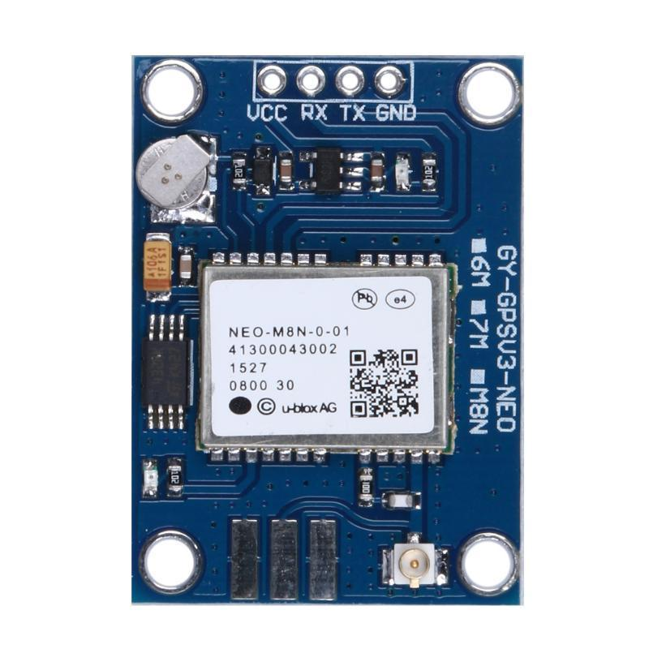
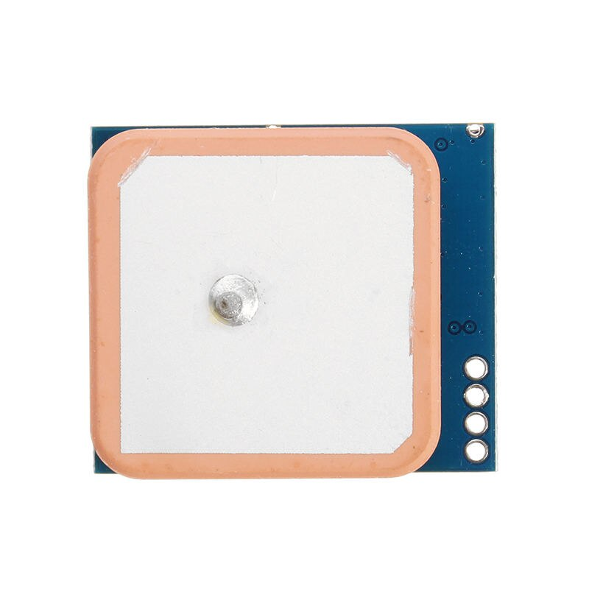

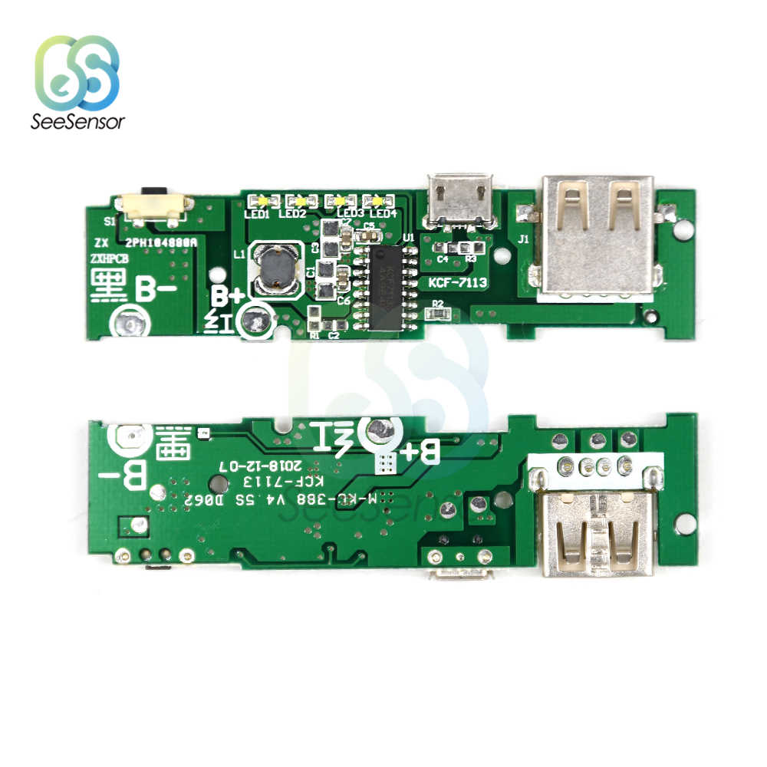
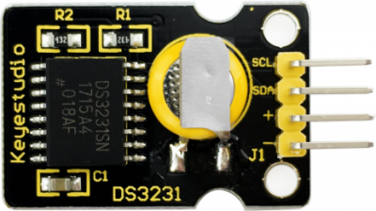
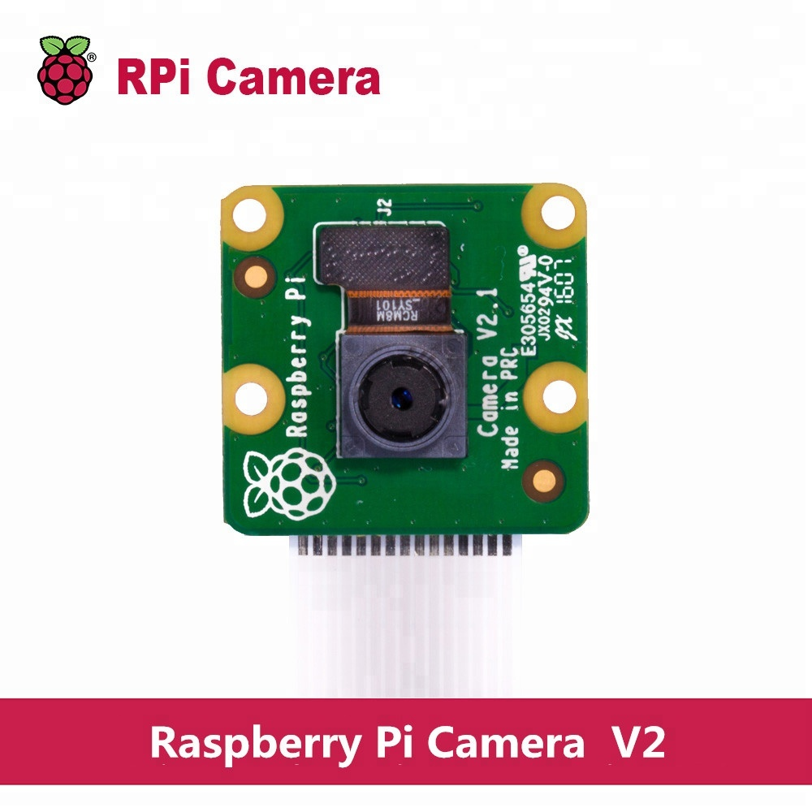
Satellite On-board System
RF Antenna
865 MHz standard antenna
Raspberry Pi Zero W Single-board computer running Linux
Lora E32 Module Radio transceiver to send/receive data to ground station
BME680 Module Pressure, Humidity, Temp and Air Quality sensor
Ublox M8N Module GPS Position and altitude Sensor
LiPo Battery
6000 mAh battery for powering the whole system
RTC DS3231 Module Realtime Clock module with inbuild battery
IP5209 BMS
Battery management system, synchronous switching charger
Camera Module Raspberry Pi Camera module v2.1 with Pi Zero connector

Slide 3
Parachute Design
5
27.2
6

