Slide 1

Standards, Specifications, Runtimes: making better containers
by Carlos Fernandes - 2019

Slide 2
Container History
AGENDA
Container Standards
Container Open-source Projects
Q&A

Slide 3
Containers over time
1982
chroot (BSD Unix)
2000
Jails (BSD Unix) – chroot enhancements
2002
Namespaces (Linux) – process isolation
2004
Zones (Solaris Unix) – snapshots concept
2005
Parallels (OpenVZ Linux) – virtualization at O.S. level
2006
Cgroups (Linux) – resources isolation (cpu, memory, disk, etc.)
2007
Workload partition (Linux) – virtualization at O.S. level
2008
LXC (Linux) – Linux container features (cgroups, namespace) put together

Slide 4
Containers over time
2013
Docker (Linux) – simple user tools for building containers

Slide 5
Containers over time
2014
Google introduces Kubernetes

Slide 6
Containers over time
The Cloud Native Computing Foundation (CNCF) was founded to promote containers. Kubernetes became a open source container cluster manager,
which was contributed to the foundation by Google as a seed technology. Founding members included Google, CoreOS, Mesosphere, Red Hat, Twitter, Huawei, Intel, Cisco, IBM, Docker, Univa, and VMware.
2015
Docker partnered with CoreOS for creating OCI (Open Container Initiative) an open governance structure for creating open industry standards around container formats and runtime.

Slide 7
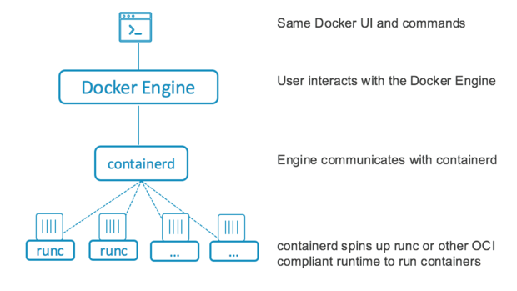
Containers over time
Docker 1.11 is launched (the engine split!)
2016
Docker is using OCI (runc) and CNCF (containerd) standards.
Runc and Containerd are part of products such as Apache Mesos, CoreOS Rocket, Kubernetes, AWS e CloudFoundry.

Slide 8
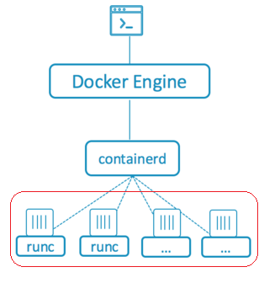
OCI – Open Container Initiative
Standards for image and container format and runtime. https://www.opencontainers.org
RUNC: the OCI-compliant runtime for executing container processes given a filesystem bundle and OCI configuration
RUNC needs two key pieces of information to create a container: an OCI runtime configuration file(config.json) and a root filesystem (bundle) containing the container filesystem

