Slide 1
Web Foundations
Code Value boot camp

Slide 2
Javascript

Slide 3
Introduction
What Can JavaScript Do?
JavaScript is the programming language of the web.
It can calculate, manipulate and validate data.
It can update and change both HTML and CSS.

Slide 4
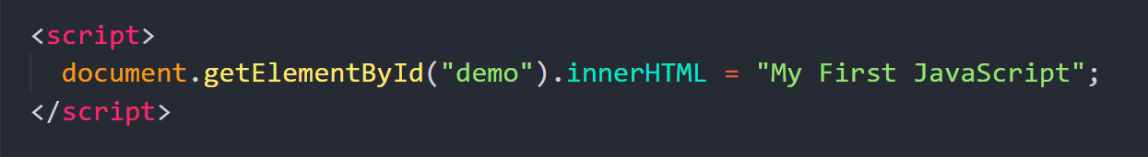
Where To
The <script> Tag
In HTML, JavaScript code is inserted between <script> and </script> tags.

Slide 5
Where To
JavaScript in <head> or <body>
You can place any number of scripts in an HTML document.
Scripts can be placed in the <body>, or in the <head> section of an HTML page, or in both.

Slide 6
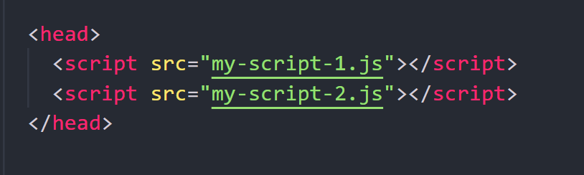
Where To
External JavaScript
Scripts can also be placed in external files:
Advantages
It separates HTML and code
It makes HTML and JavaScript easier to read and maintain
Cached JavaScript files can speed up page loads

Slide 7
Where To
External JavaScript
Scripts can also be placed in external files:
Advantages
It separates HTML and code
It makes HTML and JavaScript easier to read and maintain
Cached JavaScript files can speed up page loads

Slide 8
Syntax

Slide 9
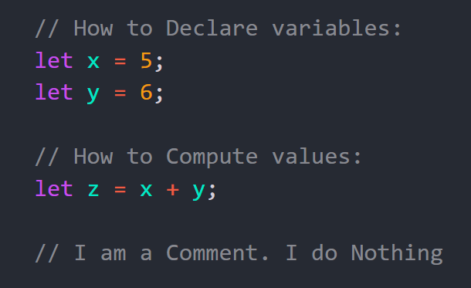
JavaScript Syntax
Syntax are the rules how programs must be constructed.
Each language has its own syntax.

Slide 10
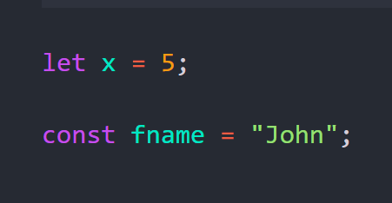
JavaScript Keywords
JavaScript keywords are used to defines actions to be performed.
The let and const keywords create variables:

Slide 11
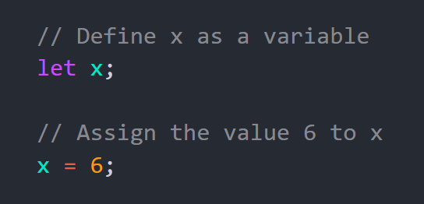
JavaScript Variables
Variables are containers for storing data values.
Variables must be identified with unique names.

Slide 12
JavaScript Identifiers
An identifier is the name you give to a variable.
Rules for identifiers:
Must start with a letter, _, or $
Can contain digits after the first character
Cannot be a reserved keyword (let, const, if, etc.)
Are case-sensitive

Slide 13
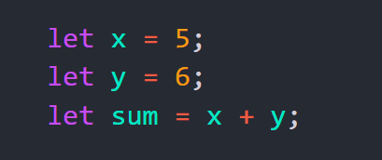
JavaScript Operators
JavaScript assignment operators (=) assign values to variables:
JavaScript uses arithmetic operators ( + - * / ) to compute values.

Slide 14
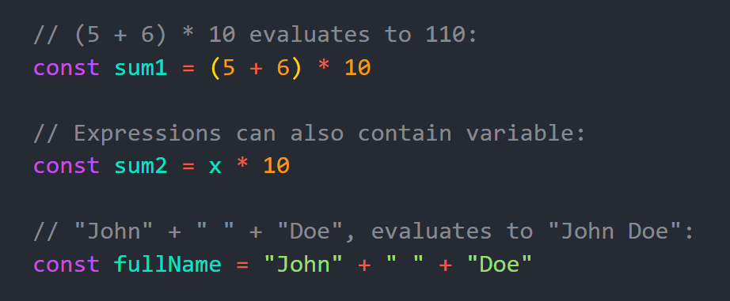
JavaScript Expressions
An expression is a combination of values, variables, and operators, which computes to a value.

Slide 15
JavaScript casing
Historically, programmers have used different ways of joining multiple words into one variable name:
Underscore: first_name, last_name, master_card, inter_city.
Pascal Case: FirstName, MasterCard, InterCity.
Camel Case: firstName, masterCard, interCity.
JavaScript programmers tend to use camel case.

Slide 16
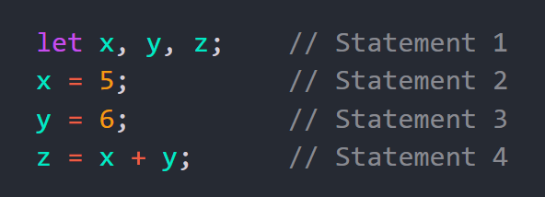
JavaScript Programs and Statements
Statements are composed of Values, Operators, Expressions, Keywords, and Comments.
A computer program is a list of "instructions" (statements) to be "executed" by a computer.
The statements are executed, one by one, in the same order as they are written.

Slide 17
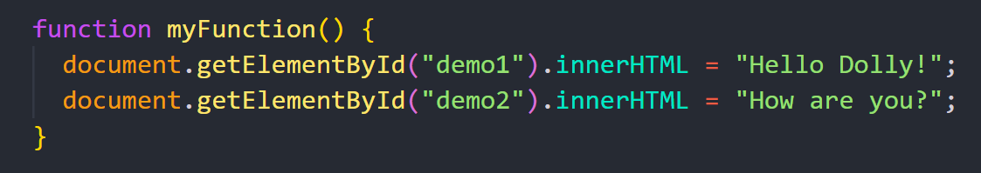
JavaScript Code Blocks
Statements can be grouped together in code blocks, inside curly brackets {...}.
The purpose is to define statements to be executed together.
For example in JavaScript functions.

Slide 18
Variables

Slide 19
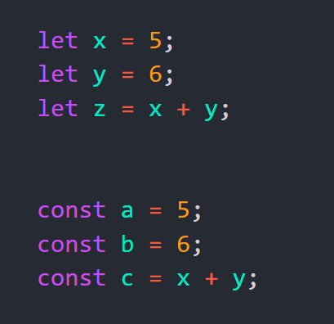
JavaScript Variables
Variables = Data Containers
JavaScript variables are containers for data.
JavaScript variables can be declared in 2 ways:
Using let
Using const

Slide 20
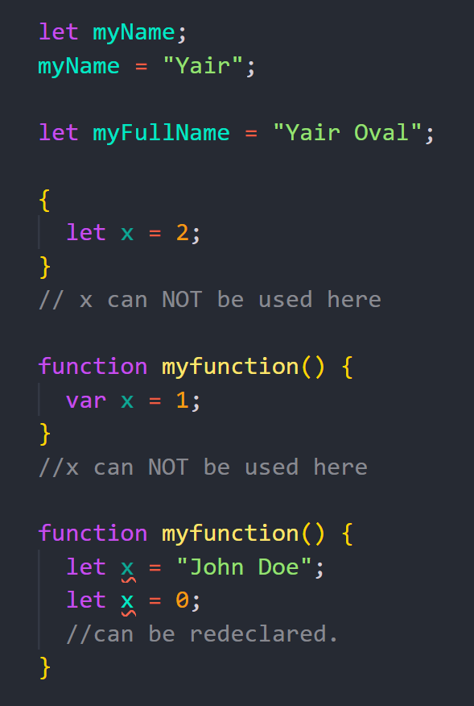
Declaring a Variable Using let
After declaration, variable has no value (undefined). To assign a value to the variable, use the equal sign.
Most often we will assign a value to the variable when we declare it.
Variables with let:
Have Block Scope
Must be Declared before use
Cannot be Redeclared in the same scope

Slide 21
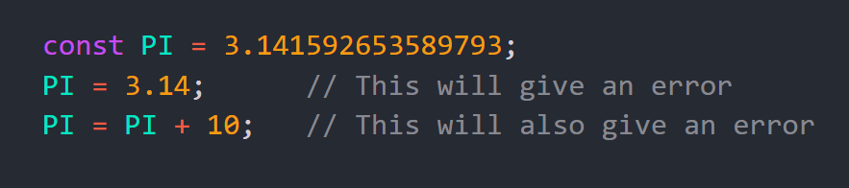
Declaring a Variable Using const
Always use const if the value should not be changed.
Variables with const:
Cannot be Redeclared
Cannot be Reassigned
Have Block Scope

Slide 22
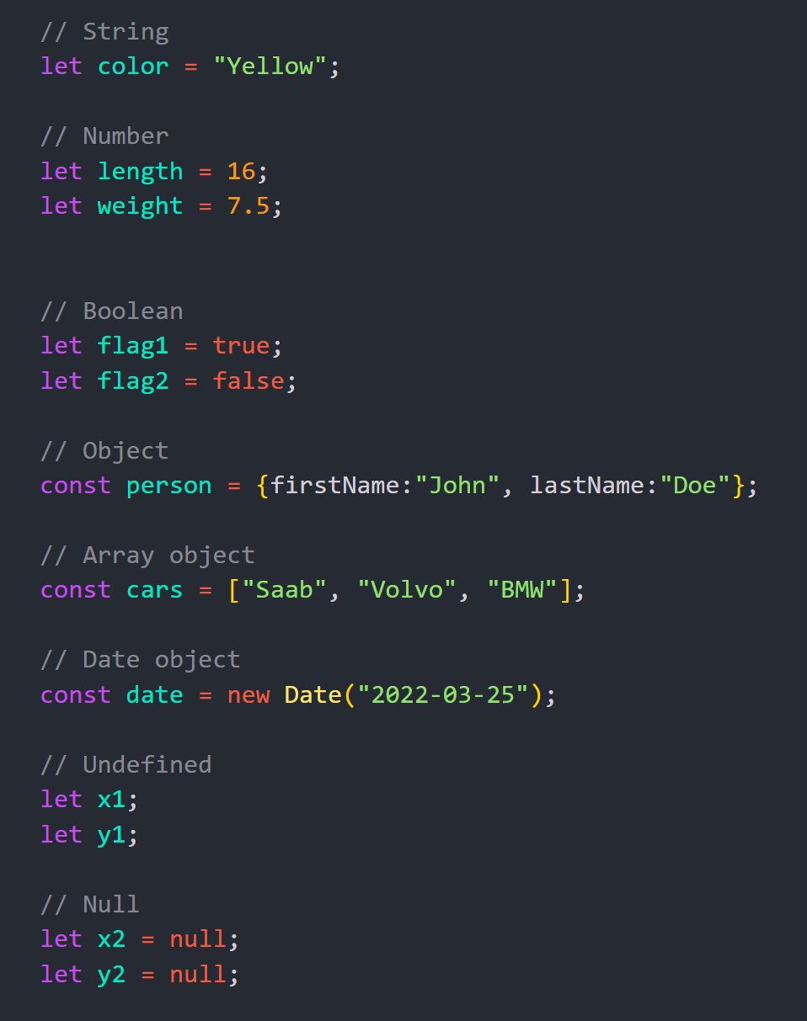
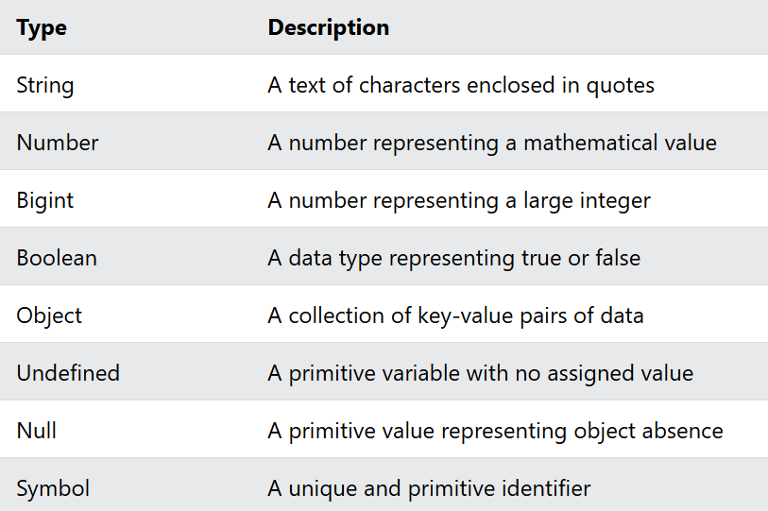
JavaScript Data Types

Slide 23
Operators

Slide 24
JavaScript Operators
Operators are for Mathematical and Logical Computations. Types of operators:
Assignment
Arithmetic
Comparison
Logical

Slide 25
JavaScript Operators
Operators are for Mathematical and Logical Computations.
Types of operators:
Assignment
Arithmetic
Comparison
Logical

Slide 26
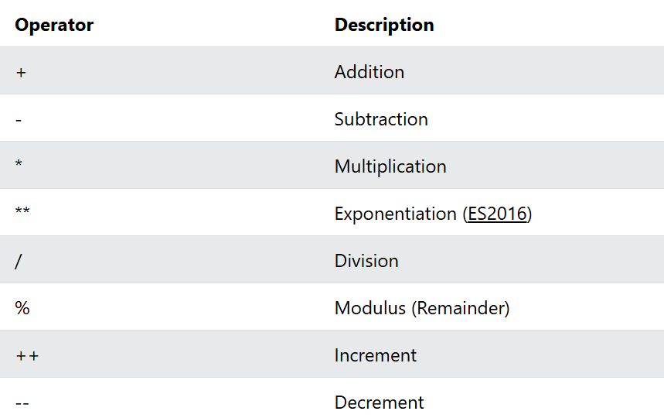
JavaScript Arithmetic Operators
Arithmetic operators perform arithmetic on numbers.

Slide 27
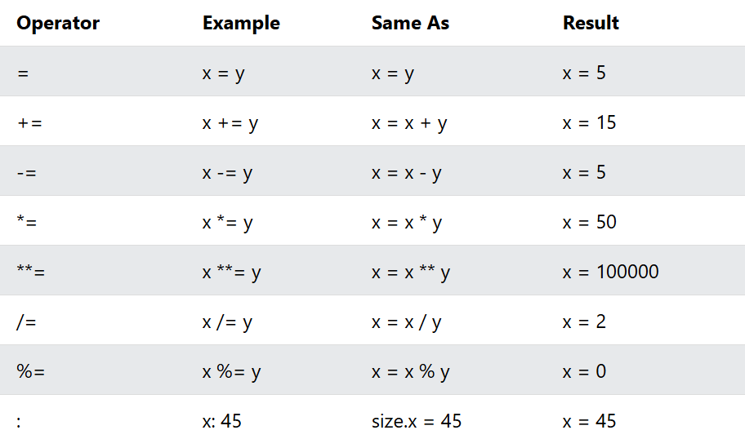
JavaScript Assignment Operators
Assignment operators assign values to variables.
Given that x = 10 and y = 5, the table below explains the assignment operators:

Slide 28
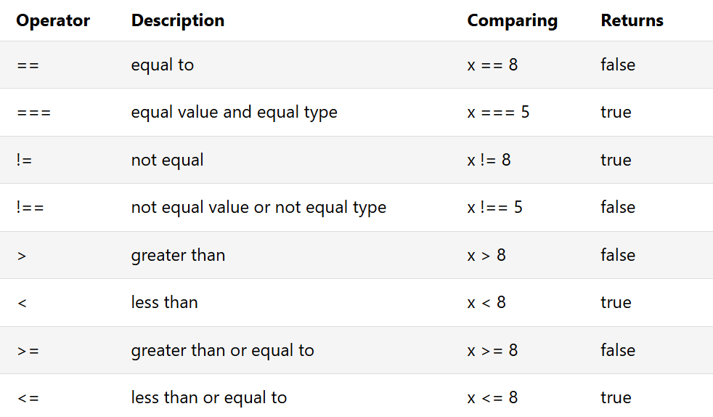
JavaScript Comparison Operators
Comparison operators are used to compare two values.
Comparison operators always return true or false.
Given that x = 5, the table below explains the comparison operators:

Slide 29
Conditional Statements

Slide 30
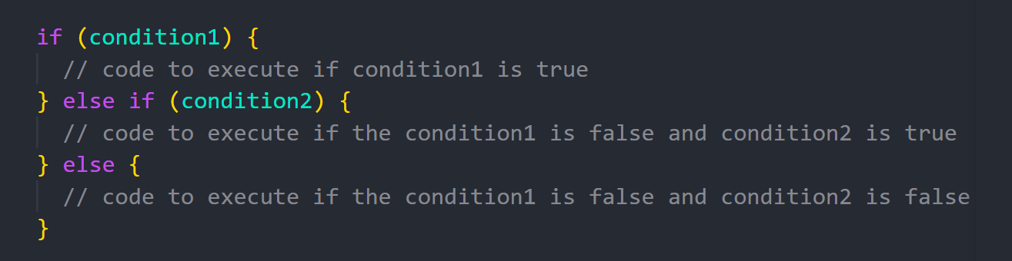
Conditional Statements
Conditional Statements allow us to perform different actions for different conditions.
Conditional statements run different code depending on true or false conditions.
Conditional statements include:
if
if...else
if...else if...else
switch

Slide 31
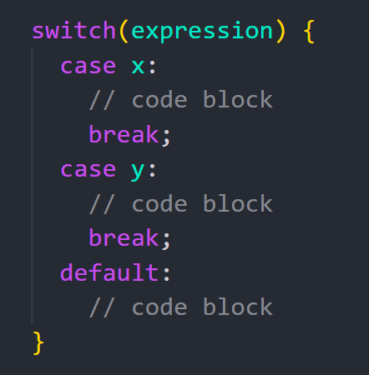
The switch Statement
Use switch to specify many alternative code blocks to be executed.

Slide 32
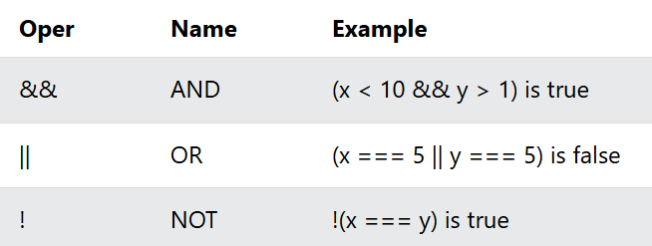
JavaScript Logical Operators
Logical operators are used to combine boolean expressions.
Given that x = 6 and y = 3, the table below explains the logical operators:

Slide 33
Loops

Slide 34
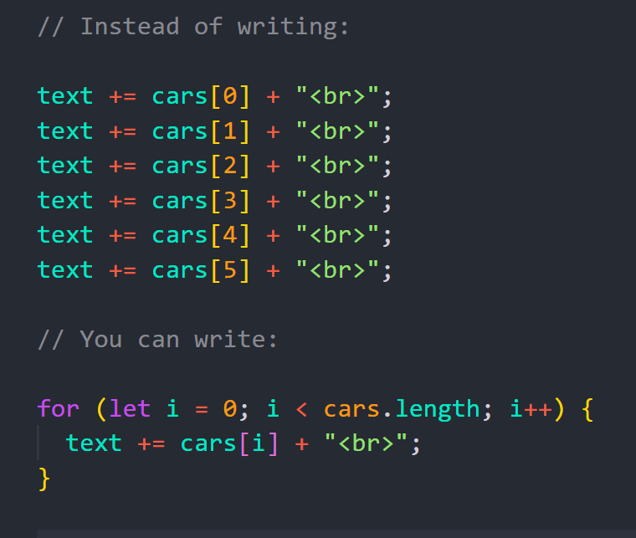
JavaScript Loops
Loops can execute a block of code a number of times.
If you want to run the same code over and over again, each time with a different value.

Slide 35
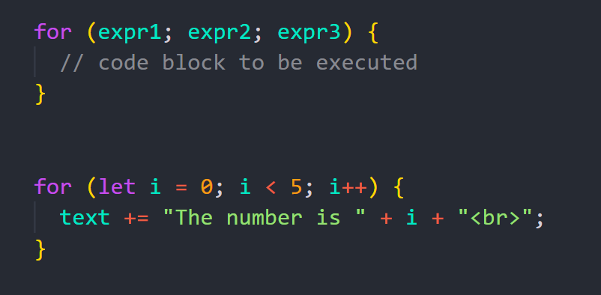
The For Loop
The for statement creates a loop with 3 optional expressions:
exp1 is executed one time before the execution of the code block.
exp2 defines the condition for executing the code block.
exp3 is executed every time the code block has been executed.

Slide 36
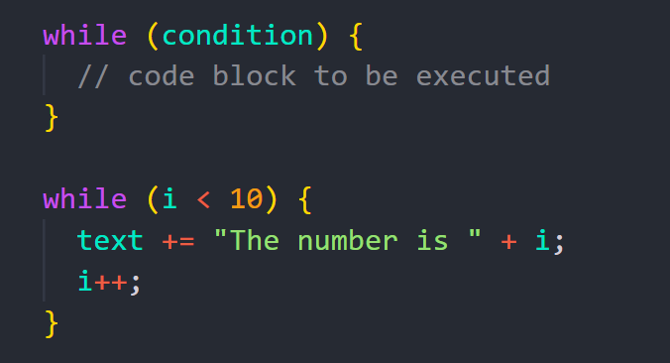
The While Loop
The while loop loops through a block of code as long as a specified condition is true.

Slide 37
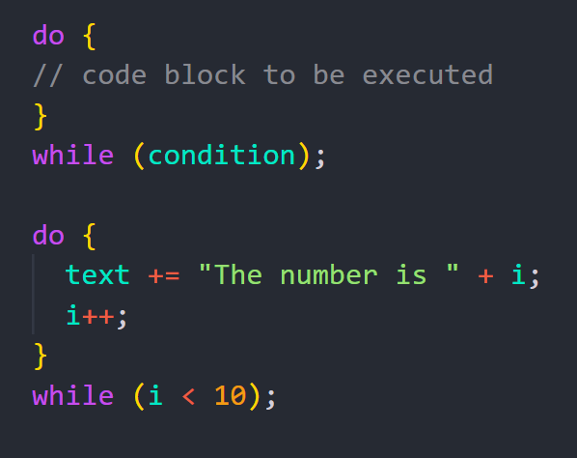
The Do While Loop
The do while loop is a variant of the while loop.
The do while loop will execute the code block once, before checking if the condition is true.

Slide 38
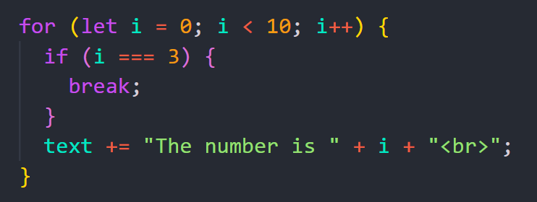
The Break Statement
The break statement "jumps out" of loops and switches.
The break statement terminates the execution of a loop or a switch statement.

Slide 39
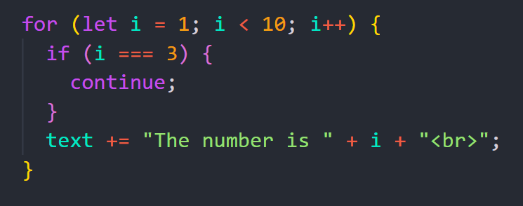
The Continue Statement
The continue statement skips the current iteration in a loop.
The remaining code in the iteration is skipped and processing moves to the next iteration.

Slide 40
Functions

Slide 41
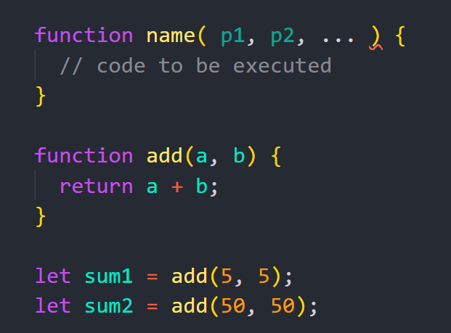
JavaScript Functions
Functions are reusable code blocks designed to perform a particular task.
Functions are executed when they are called or invoked.
Functions are fundamental in all programming.

Slide 42
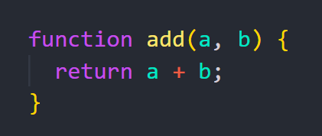
Function Input and Output
The most useful functions work like this:
Parameter Input - some parameters go into the function
Function Code - some work is done inside the function
Return Output - some value is returned from the function

Slide 43
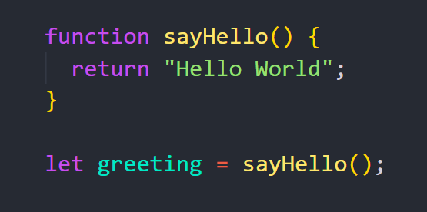
Function Invocation
The code inside a function is NOT executed when the function is defined.
The code inside a function will execute when "something" invokes the function:

