Slide 1
Web Foundations
Code Value boot camp

Slide 2
CSS (Cascading Style Sheets)

Slide 3
What Is CSS?
CSS is a styling language used to define document presentation in HTML
CSS = Cascading Style Sheets
Used to style and layout web pages
Controls colors, fonts, spacing, and positioning
Separates design (CSS) from content (HTML)
Works with HTML and JavaScript to build modern websites

Slide 4
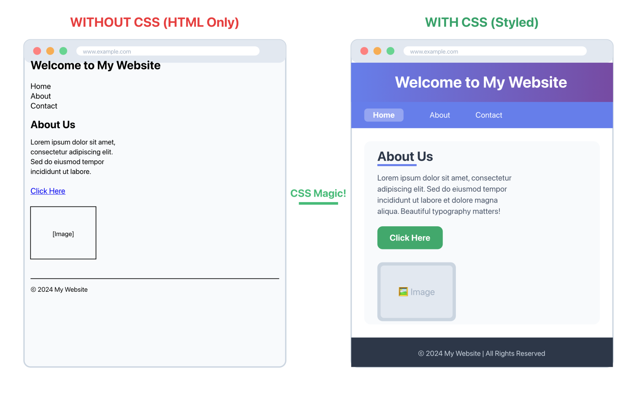

Slide 5
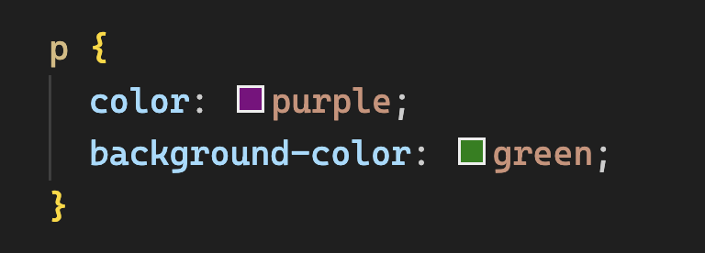
CSS Syntax
A CSS rule consists of a selector and a declaration block.
The selector tells us which HTML element(s) the rule applies to
The declaration block contains one or more property-value pairs that define the styling.

Slide 6
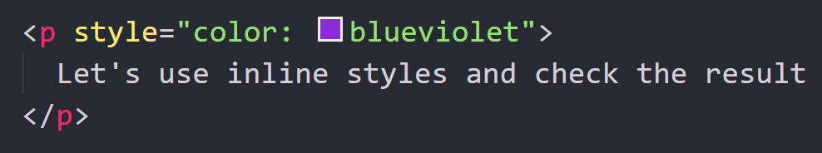
Inline Styles
Inline styles apply CSS directly to an element via the style attribute.
They are quick to use but not reusable.

Slide 7
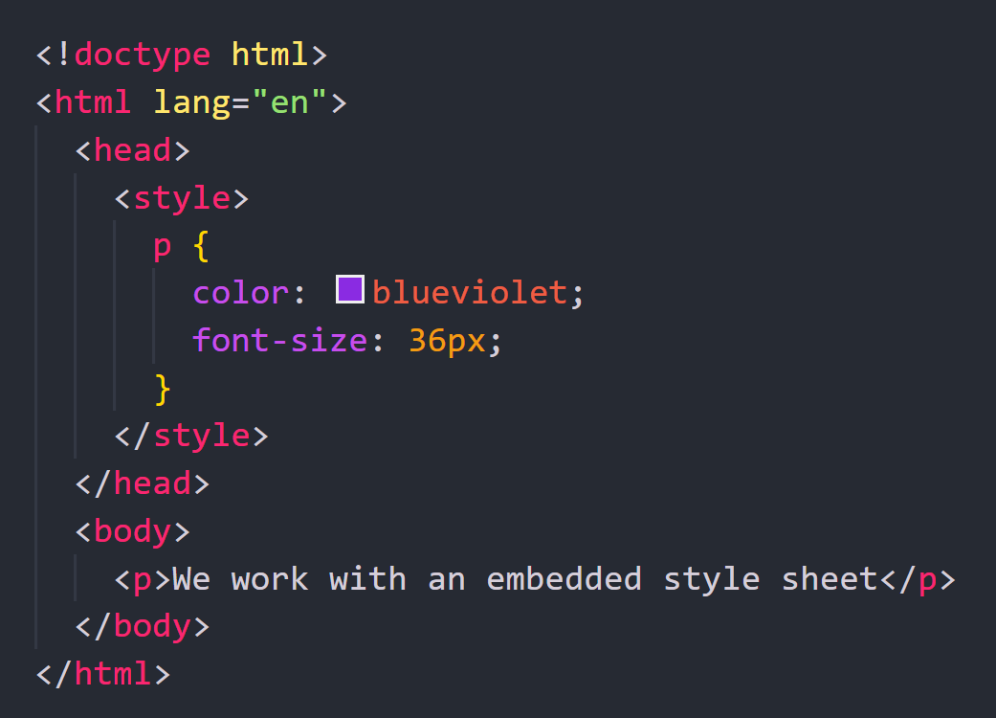
Embedded Style Sheet
An embedded style sheet is placed inside the <head> of an HTML document using <style> tags.
It styles the current page only.

Slide 8
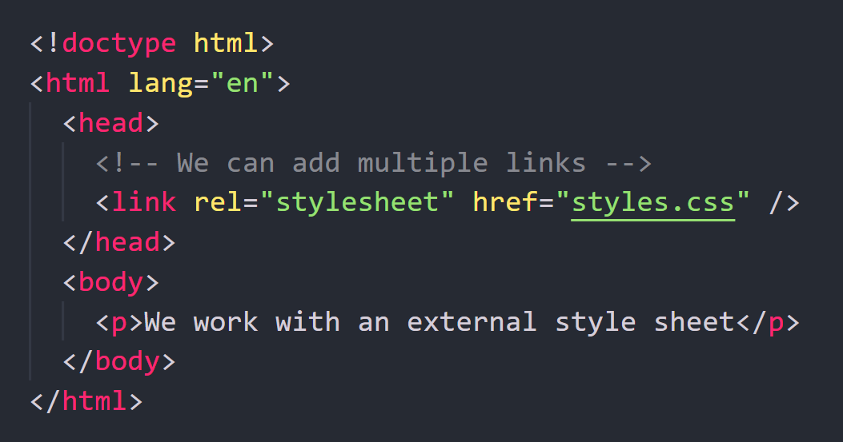
External Style Sheet
External CSS is the most scalable and preferred method.
You store styles in a separate .css file and link it using <link> in the <head>.

Slide 9
CSS Selectors

Slide 10
CSS Selectors
Determine the HTML elements to target for styling.
Tag Selector - Targets all elements of a given tag
Class Selector - Target elements that share a class name
Id Selector - Target a single unique element

Slide 11
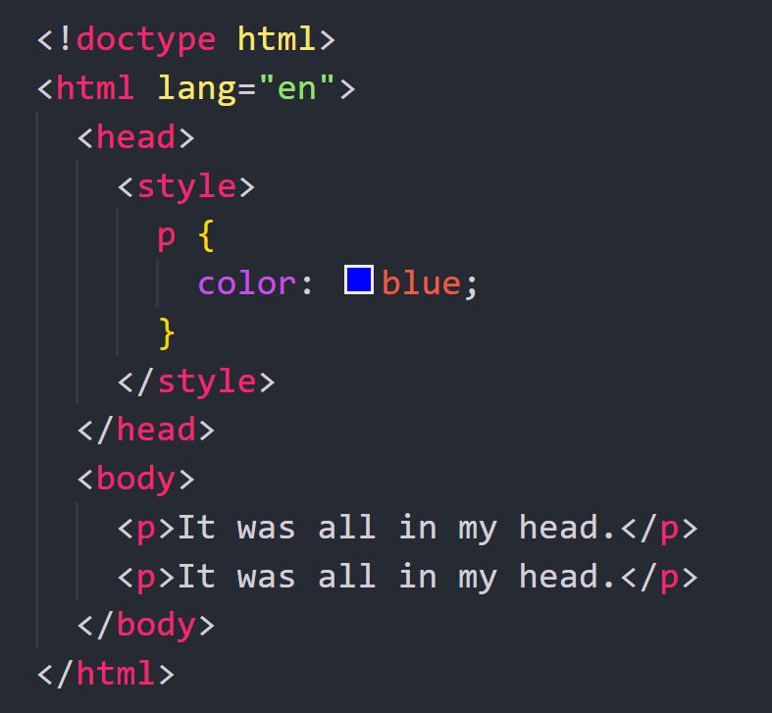
CSS Selectors - Tag Selector
A tag selector targets all elements of a given tag, applying consistent styling across the page.
To apply styles we use the tag name (p) as the selector.

Slide 12
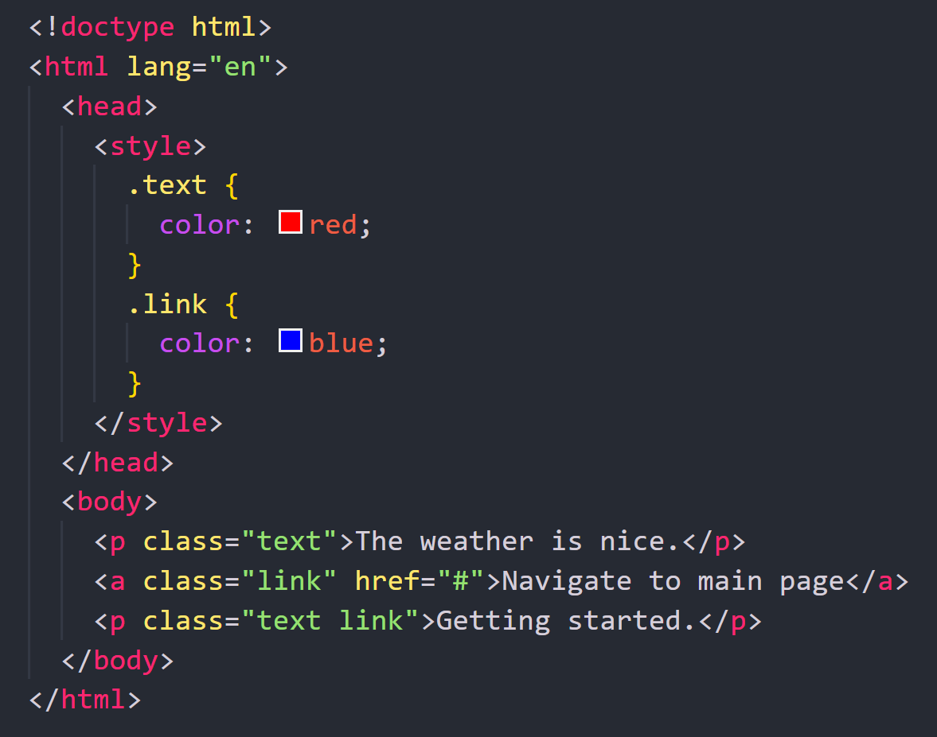
CSS Selectors - Class Selector
Class selectors target elements that share a class name, giving you more precise control.
You can assign multiple classes to a single element for flexible styling.

Slide 13
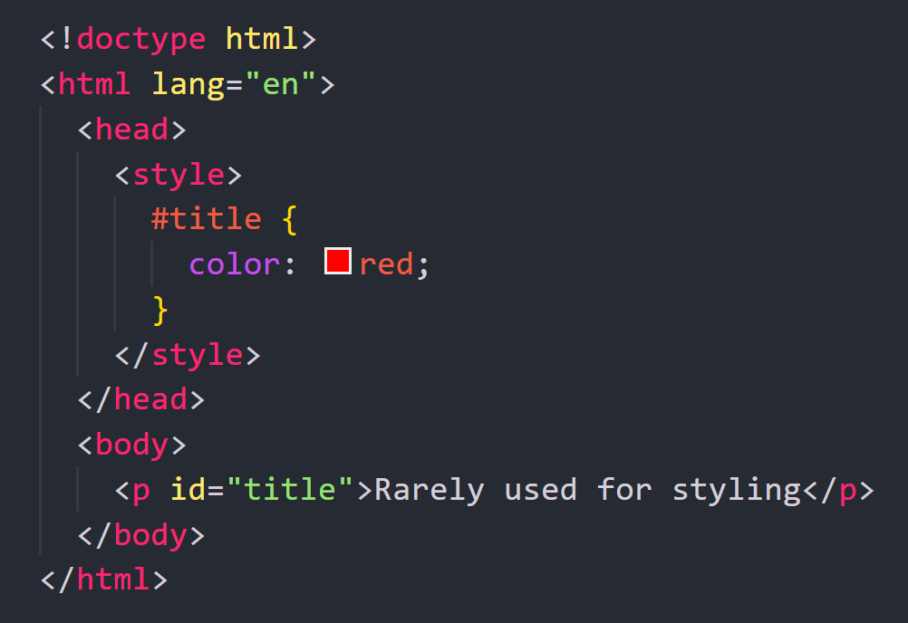
CSS Selectors - Id Selector
Id selectors target a single unique element.
Since Ids must be unique, this method is rarely used for styling.

Slide 14
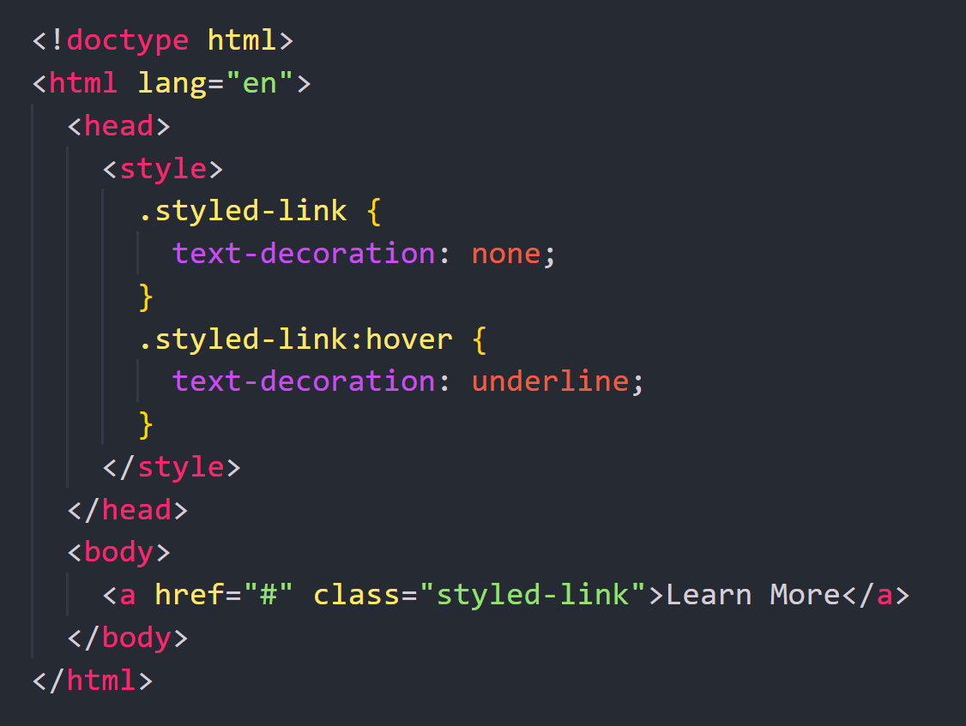
User Action Pseudo-Classes
ser action pseudo-classes allow you to style elements based on how users interact with them.
They are commonly applied to <button> and <a> elements to provide feedback during interactions.

Slide 15
Pseudo-Classes
:hover
Triggers when a user points to an element with a mouse cursor.
Great for creating interactive visual feedback.
:focus
Activates when an element receives keyboard focus.

Slide 16
Pseudo-Classes
:active
Triggered while an element is being activated, commonly during a mouse click on buttons or links.
:visited
Applies to links after the user has already visited their destination.
Browsers typically display unvisited links in blue and visited ones in purple, unless you override these styles.

Slide 17
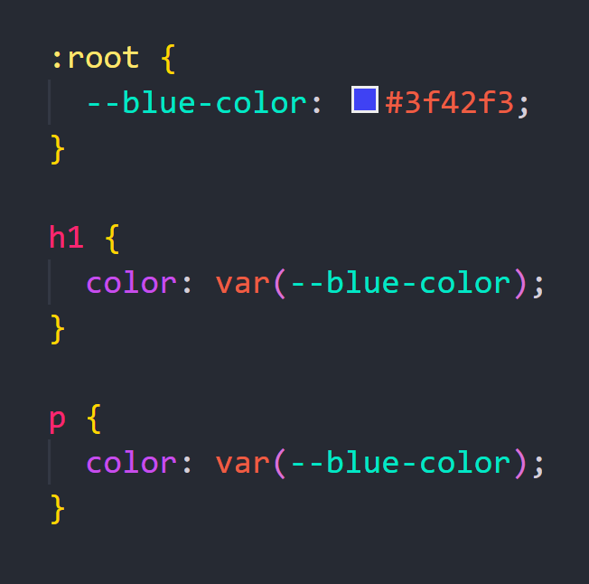
Variables
CSS variables let you store reusable values, making your styles easier to update and maintain.
Declare variables in the :root selector and prefix them with --

Slide 18
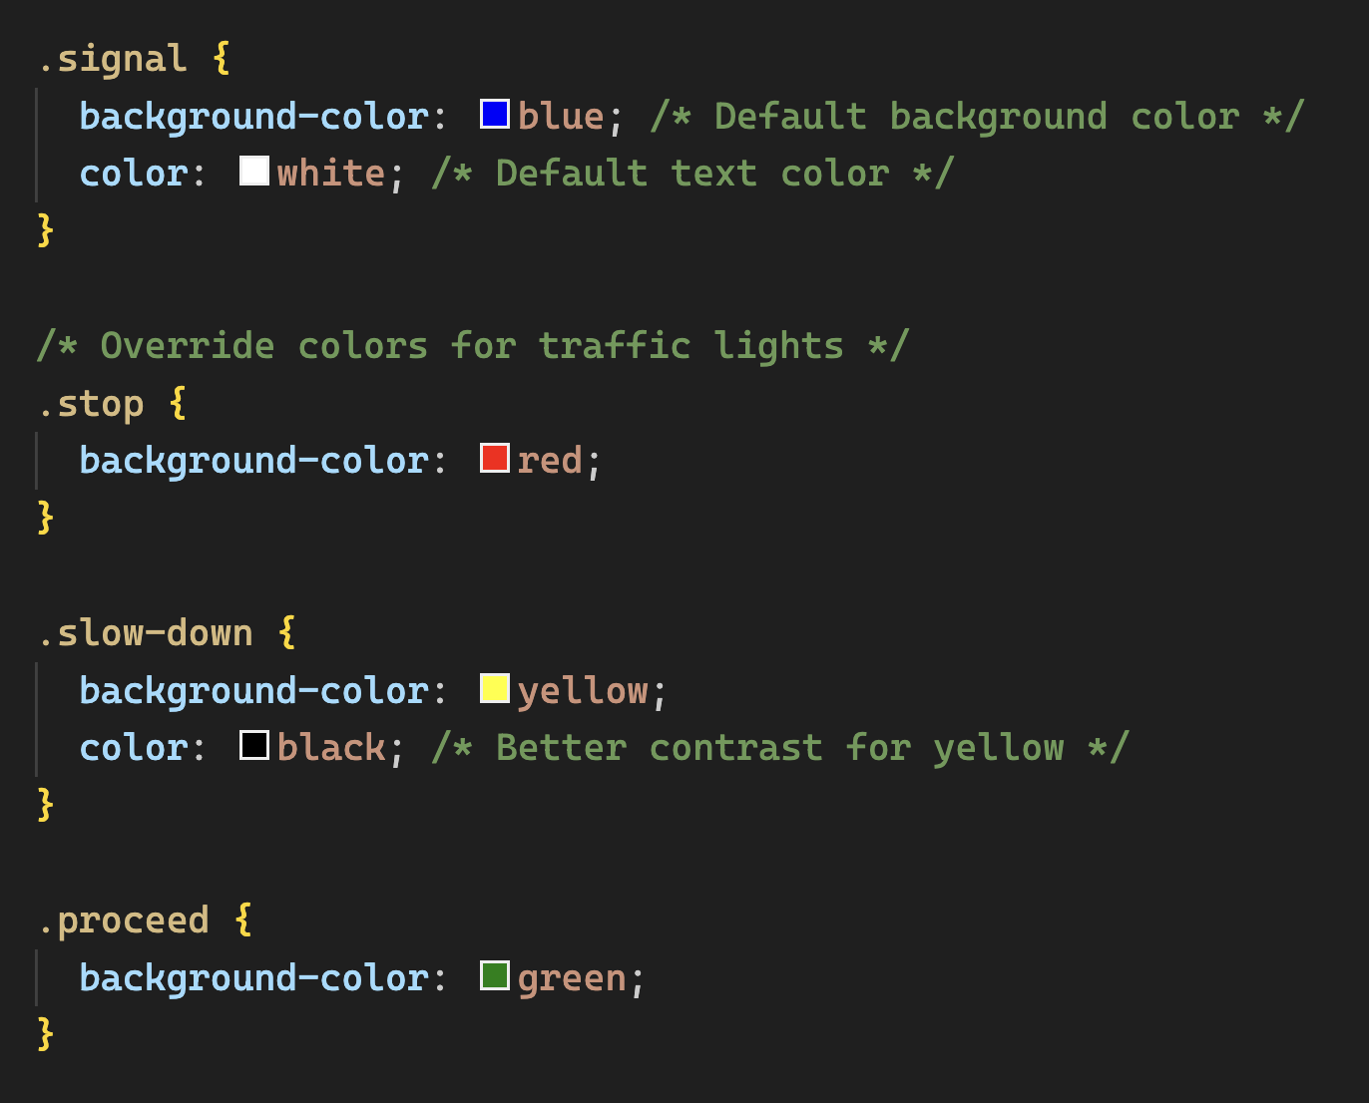
Overriding Properties
To change specific styles within a component, redefine the same property inside a more specific selector.
The base .signal class holds shared styles, while .stop, .slow-down, and .proceed override individual colors.

Slide 19
Text Style

Slide 20
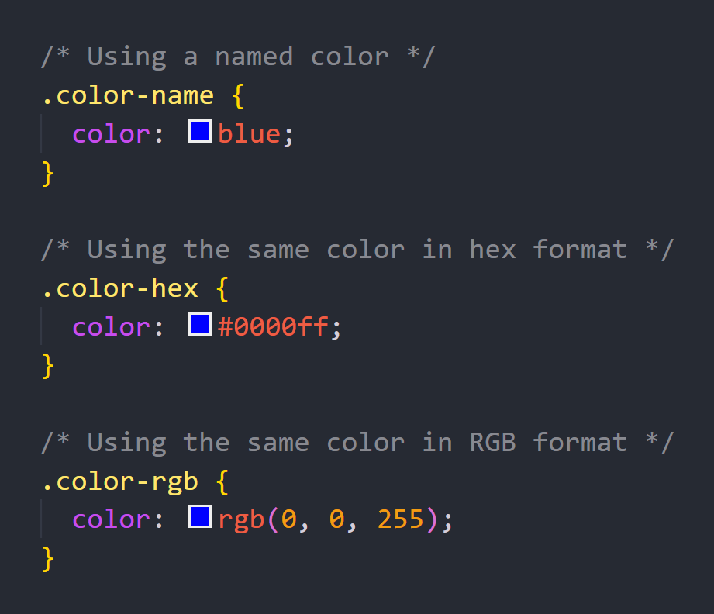
Text Colors
Text color can be applied to a text element using the CSS color property, which can be assigned a value in various formats.
The most commonly used color values are RGB, hex, and color names.

Slide 21
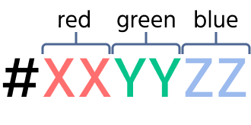
Text Colors - Formats
Hex
Hex represents colors as a six-digit code consisting of three pairs of two-digit values. Each pair represents the intensity of red, green, and blue (in that order)

Slide 22
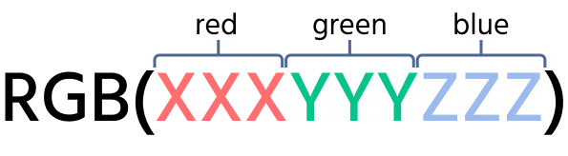
Text Colors - Formats
RGB
RGB represents colors as a series of three numbers that correspond to the intensity of red, green, and blue (in that order)

Slide 23
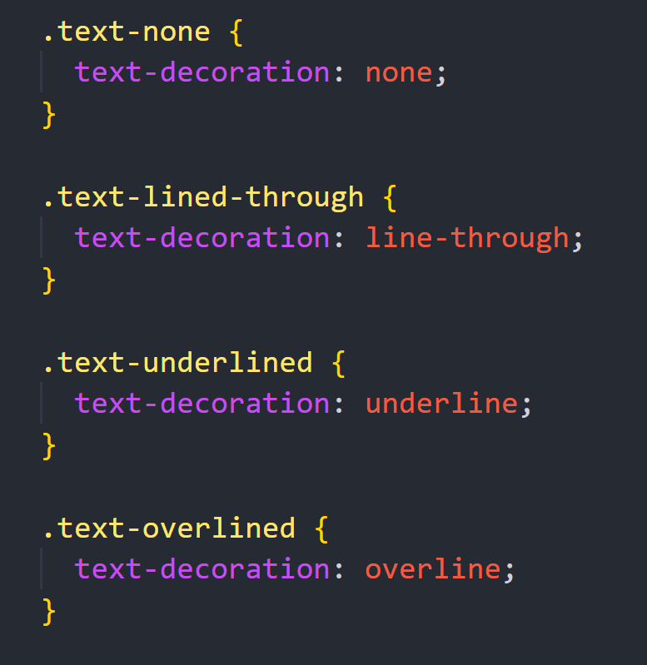
Text Styling
text-decoration
The text-decoration property can be applied to any text content, including links, headings, paragraphs, and lists.
It adds line effects such as underlining.

Slide 24
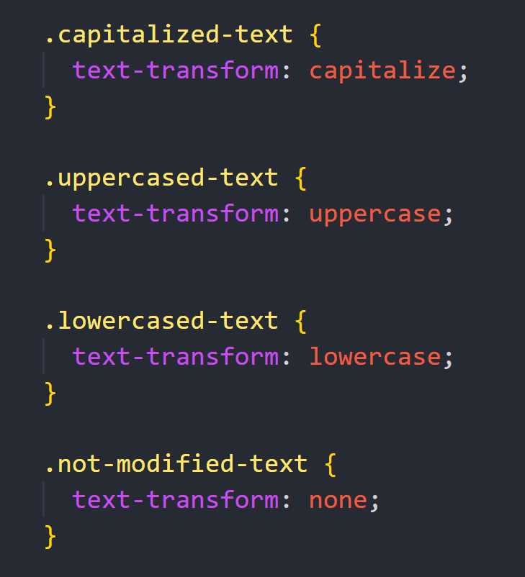
Text Styling
text-transform
The text-transform property allows us to change the capitalization of text content in HTML elements.

Slide 25
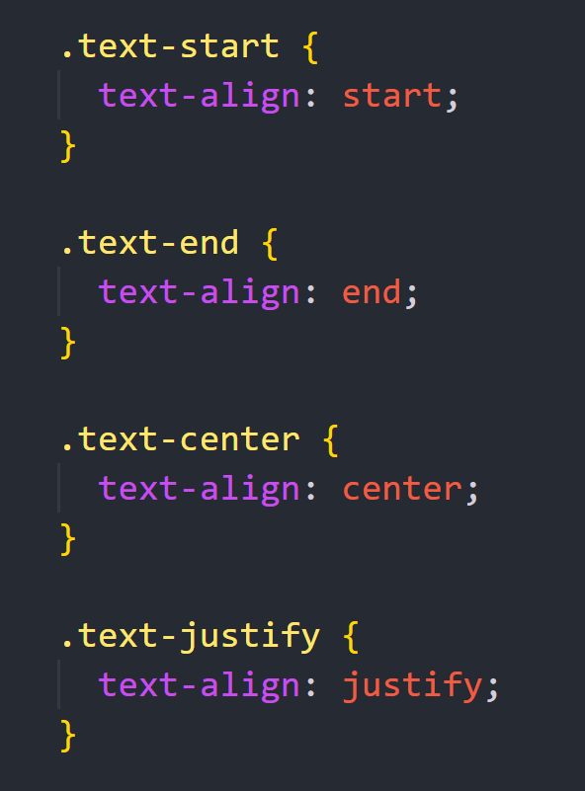
Text Styling
text-align
The text-align property allows you to horizontally align text content.

Slide 26
Text Formatting
line-height
line-height controls the vertical spacing between lines of text.
Browsers set a default value based on the font, but you can customize it using several formats:
multiplier unitless multiplies the font-size
value in px specific height, e.g., 24px;
value in em relative value, similar to multiplier (1.4em = font-size × 1.4);
percent works like multiplier (120% = font-size × 1.2).

Slide 27
Text Formatting
letter-spacing
letter-spacing sets horizontal spacing between characters.
normal: default spacing;
value in px: fixed extra spacing;
value in em: spacing relative to font-size.

Slide 28
Adding Custom Fonts
Fonts significantly shape the look and feel of a website.
High-quality typography improves readability and makes a design more memorable.
Google Fonts Service
There are many exciting fonts available for free use.
Let's explore the options provided by https://fonts.google.com

Slide 29
Using Font Properties
font-family
Defines the typeface used to display text.
You can set one font or a list of fallback fonts separated by commas.
font-size
Controls the size of text.
px: fixed size.
em/rem: size relative to the parent or root element.

Slide 30
Using Font Properties
font-weight
Controls the thickness of text. Numeric values: 100–900.
Keywords: normal, bold, lighter.
font-style
Specifies the style of the text: normal, italic, or oblique.

Slide 31
CSS Box Model

Slide 32
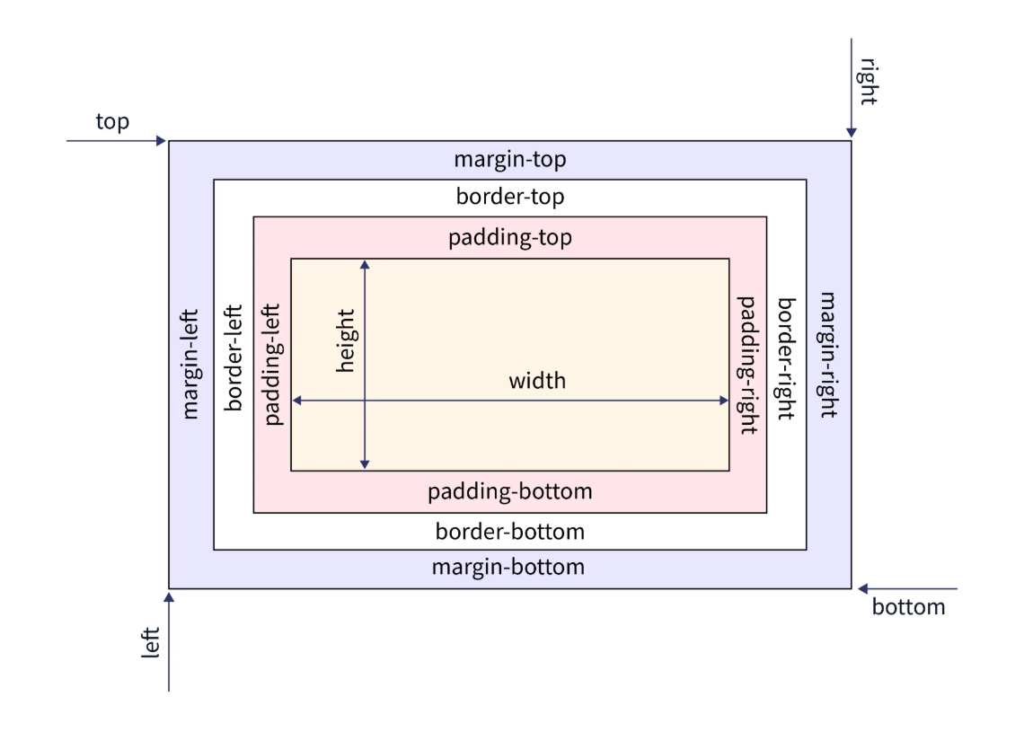
What Is the CSS Box Model
HTML elements are rendered as rectangular boxes on a web page. Each element has its content area, padding, border, and margin.
The padding is the area between the content and the border.
The border surrounds the element. By default, the border width is 0.
The margin is the space between the border and other elements on the page.

Slide 33
width and height
width and height properties are used to define the size of an element.
Most elements, having only the width property is often sufficient, as the height will be determined automatically.

Slide 34
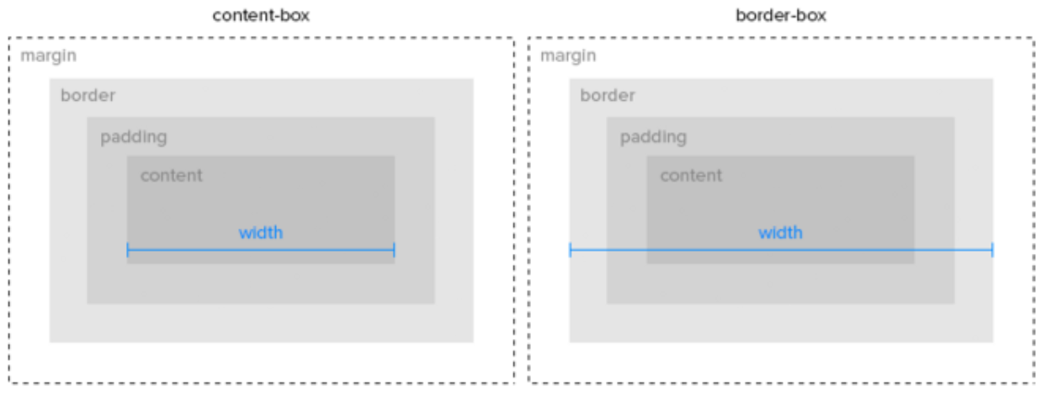
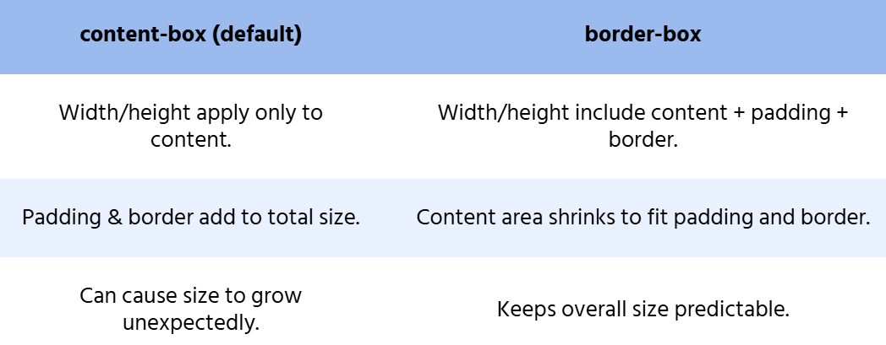
Box Sizing
The box-sizing property is used to control how the total size of an element is calculated.

Slide 35
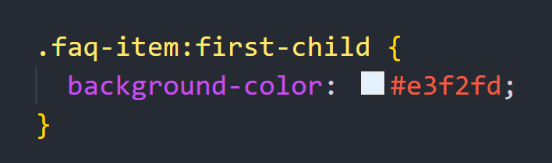
Structural and Functional Pseudo-Classes
Pseudo-classes allow you to target elements precisely based on their order within a container.
:first-child
The :first-child pseudo-class targets an element that is the first child of its parent, regardless of its tag or class name.

Slide 36
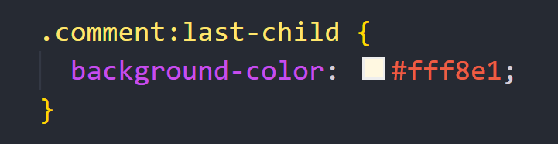
Structural and Functional Pseudo-Classes
:last-child
The :last-child pseudo-class targets the last child of its parent, allowing us to modify any of its properties.

Slide 37
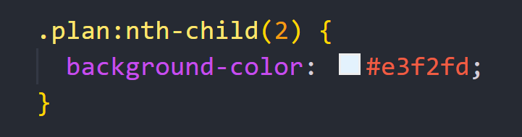
Structural and Functional Pseudo-Classes
:nth-child
The :nth-child pseudo-class allows you to select elements based on their position within a list of siblings.

Slide 38
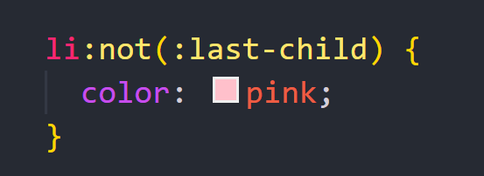
Structural and Functional Pseudo-Classes
:not()
The :not() pseudo-class targets elements that do not match a specified selector.

Slide 39
Block, Inline, and Inline-Block

Slide 40
Block, Inline, and Inline-Block
HTML elements behave differently depending on whether they are block, inline, or inline-block.
Block Elements
Start on a new line;
Take up the full width of their container;
Support width, height, margin, padding, and border.
Common examples: <div>, <p>, <ul>, <li>, <h1>–<h6>.

Slide 41
Block, Inline, and Inline-Block
Inline Elements
Stay on the same line;
Take only the space needed for their content;
Cannot have width or height applied (but border works).
Common examples: <a>, <span>, <img>, <input>.

Slide 42
Block, Inline, and Inline-Block
Inline-block Elements
Stay inline, like text;
Support width, height, margin, padding, and border, like block elements.
Examples: <button>, <select>, <textarea>.

Slide 43
Working with Block-Level Elements
Block-level elements are rectangular and stack on top of each other, preventing other elements from sharing the same line.
This behavior is controlled by the CSS property display: block.
Key points about block-level elements:
They default to display: block
Their width spans the full width of the parent container
Their height is determined by the content but can be customized with CSS
They always start on a new line
Properties like border, margin, padding, width, and height can be adjusted.

Slide 44
Working with Inline-Level Elements
Inline elements stay on a single line and wrap to the next line when space runs out.
This behavior is controlled by the CSS property display: inline.
Key points about inline elements:
They default to display: inline
Their width and height are determined by their content and cannot be explicitly set
Only horizontal properties like padding, margin, and border can be applied.

Slide 45
Flexbox

Slide 46
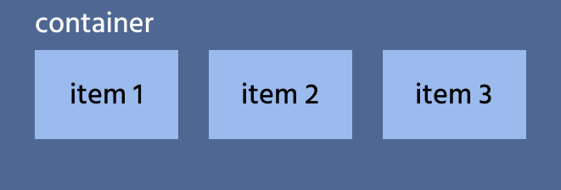
What Is Flexbox?
Designed to simplify the organization of elements within a container.
Flexbox uses a parent-child relationship.
The parent is called the flex container, which controls the layout.
The children are called flex items.

Slide 47
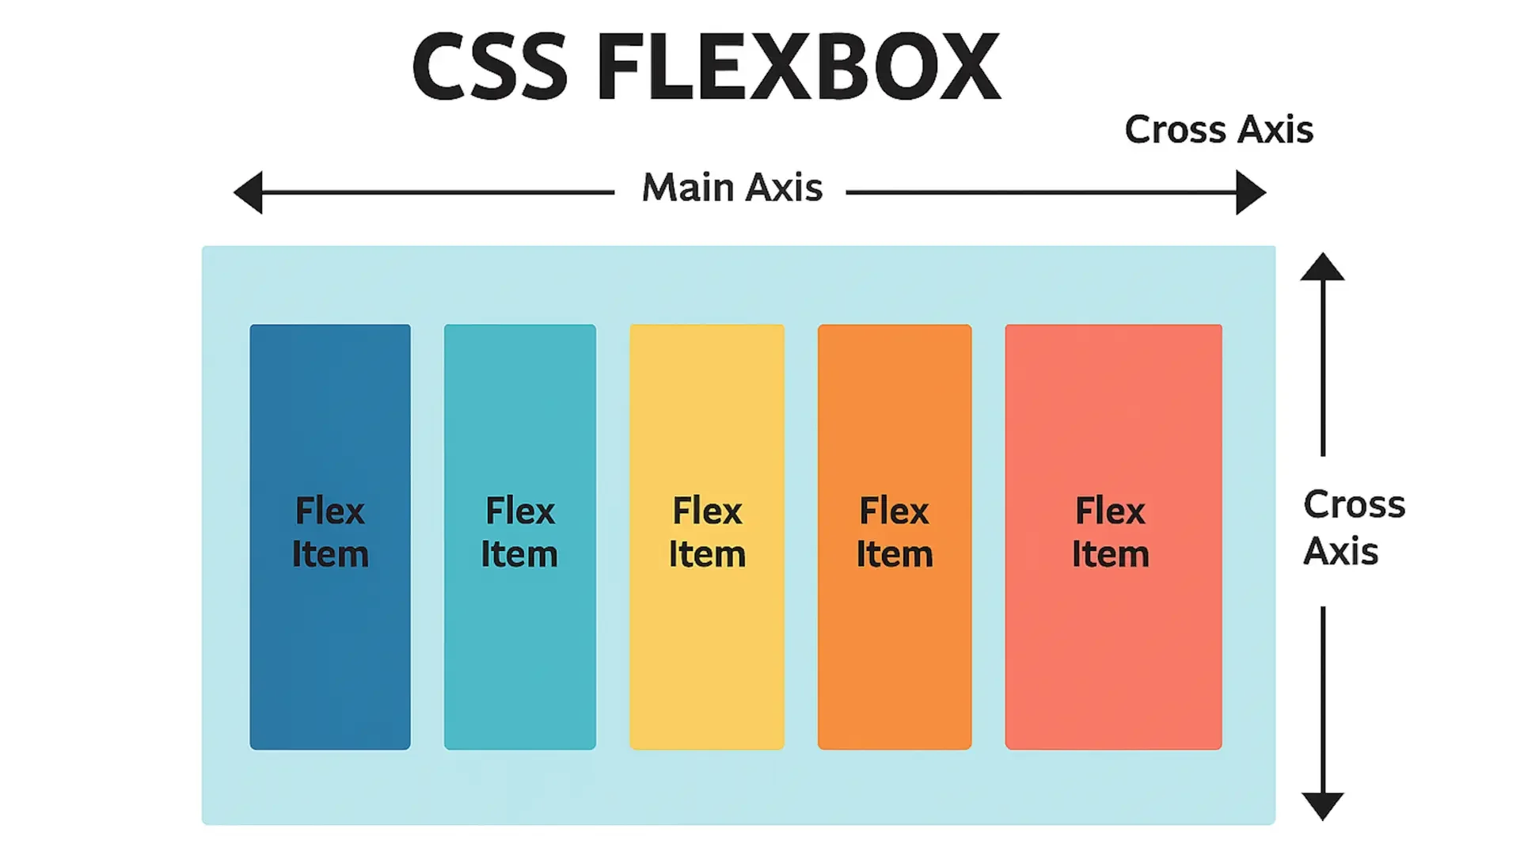
Flexbox in Action
To enable Flexbox, simply apply the display: flex; property to the parent element.

Slide 48
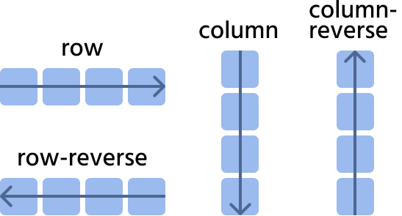
Flex Direction
The flex-direction property enables us to determine the direction in which flex items are arranged.
By default, this property is set to row.

Slide 49
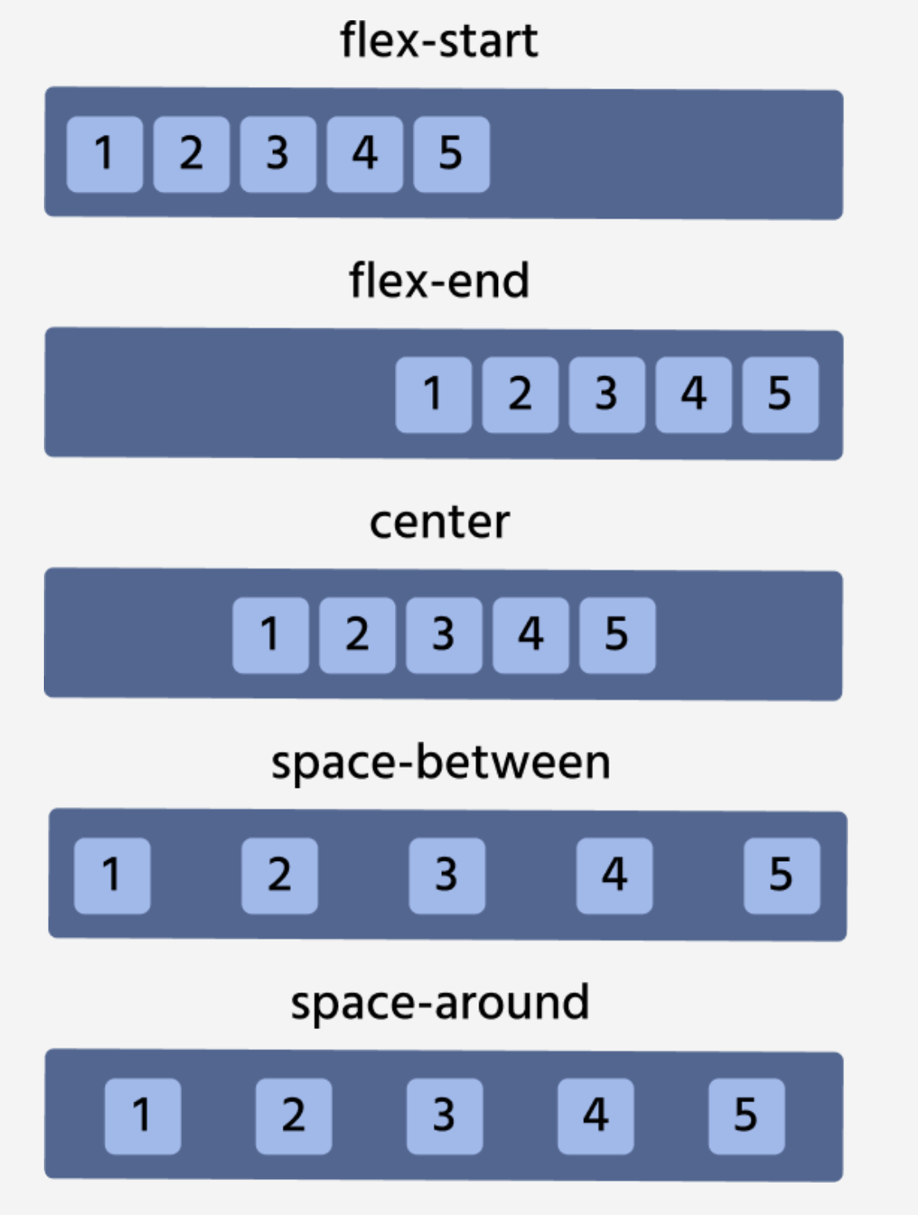
Justifying Content Horizontally
The justify-content property is instrumental in determining the position of flex items along the main axis.
Its default value is flex-start.

Slide 50
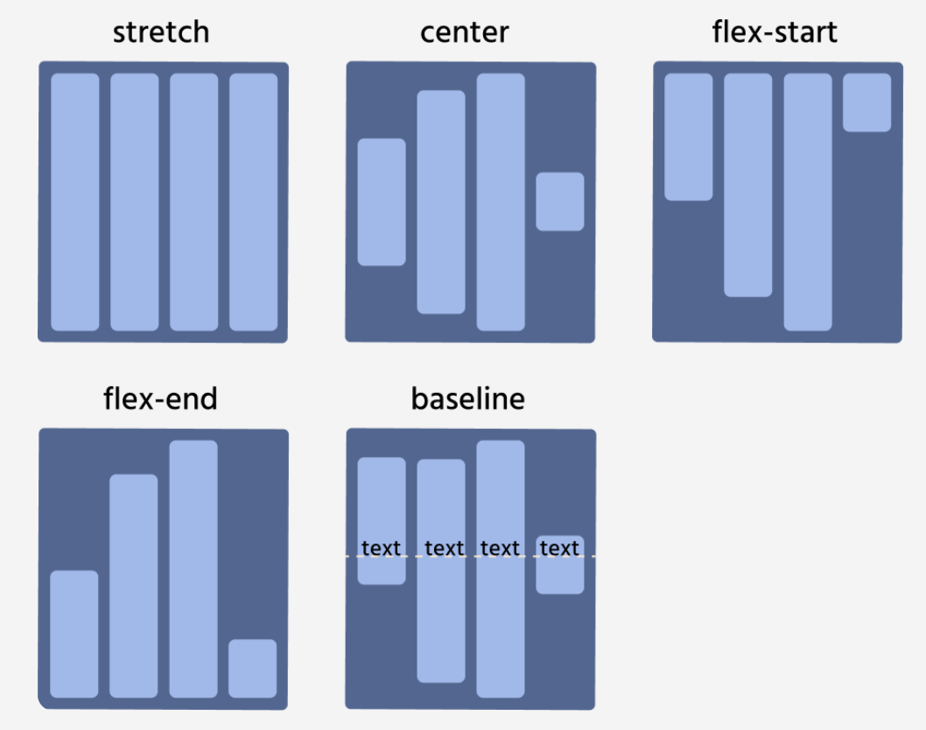
Aligning Items Vertically
The align-items property governs the vertical arrangement of flex items.
Its default value is stretch.

