Slide 1

Computational Statistics & Machine Learning
Deep Hyperbolic Embedding Models for Zero-Shot Learning
Hermanni Hälvä
Supervisor: Prof. Bradley Love, Experimental Psychology UCL
09/2018

Slide 2
Introduction
Deep Learning: state-of-the-art results on virtually all computer vision tasks over the past decade
However,,,most achievements rely on well defined training environments
Generalization far from human visual system
Zero-shot learning a particularly challenging problem
Aim: create a DL framework with more ‘human-like’ hierarchical understanding of object categorization
Why? Important for decisions under uncertainty (robots, self-driving cars..)
How? Combine hyperbolic geometry, semantic embeddings and deep learning

Slide 3

Deep Learning & Limitations
Deep Learning:
Backpropagation (chain rule) implemented with some optimization algorithm e.g. SGD:
Problem: use one-hot labels which are orthogonal!
Cat = [0, 0, 1], Dog = [1, 0, 0], Table = [0, 1, 0]
Space has no clear structure – ZSL is difficult (impossible?)

Slide 4
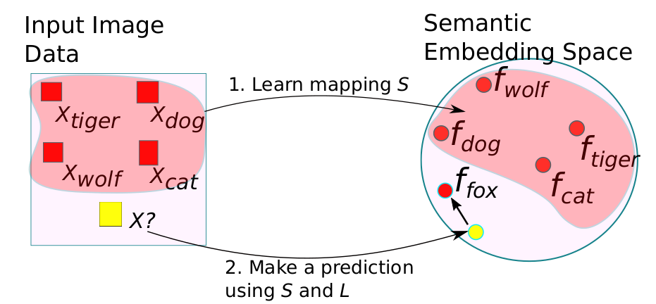
Zero-Shot Learning & Semantic Embeddings
Semantic embeddings – vector space where related words are nearby
Classic approach to ZSL:
    Build semantic embedding space for ‘all words’
    Learn a mapping from a subset of images to subset of words (e.g. DNN)
    Use this mapping to project any new images to semantic embedding space
    Find nearest neighbour

Slide 5
Contextual similarity vs. Hierarchical taxonomy
Problem with previous approach: Semantic embedding based on contextual similarity
Assumes: contextual similarity corresponds to visual similarity
  Not always true: e.g. Cars & Roads
Humans recognize tens of thousands object categories despite infinite visual variations
Variation not random (Rosch et al.[24]): tree-like hierarchical structure of visual object categories
e.g. organization of biological taxa by physical appearance, objects built-up from smaller parts
Enables humans to perform zero-shot learning
Idea: build semantic embedding based on semantic hierarchies instead of contextual similarities

Slide 6
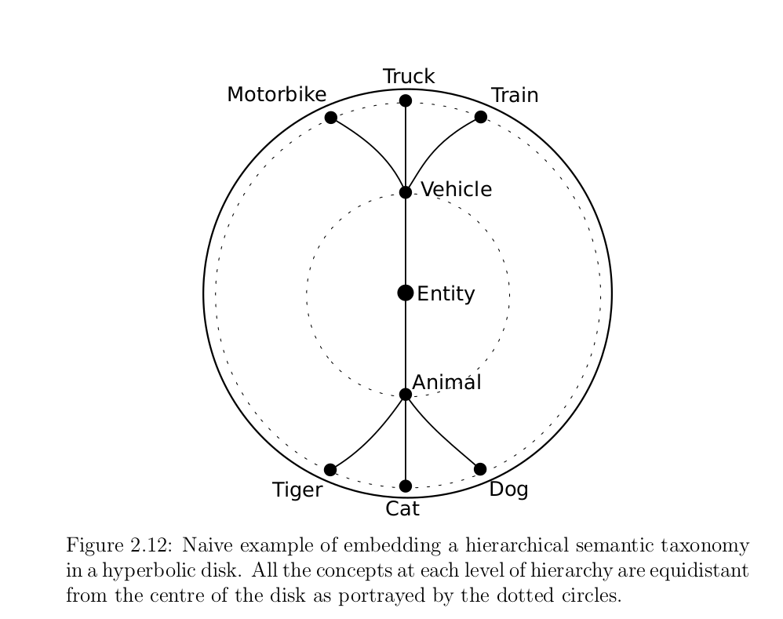
Hierarchical Semantic Embeddings??
Idea: build semantic embedding based on semantic hierarchies instead of contextual similarities
Problem: We run out of space!
  Area of circle grows quadratically
  Trees exponentially

Slide 7
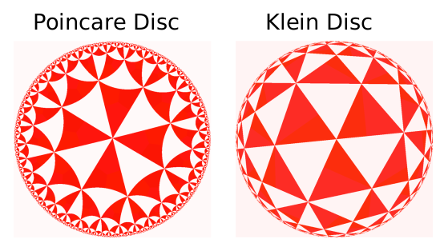
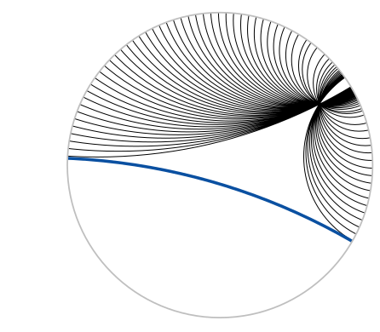
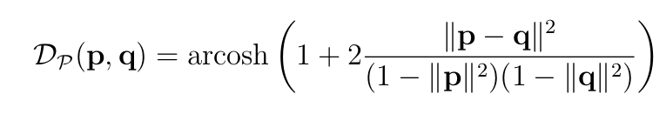
Hyperbolic Semantic Embeddings!
Nickel & Kiela (2017): build hierarchical embeddings in hyperbolic space
Hyperbolic space: constant negative curvature -> space expands exponentially

Slide 8
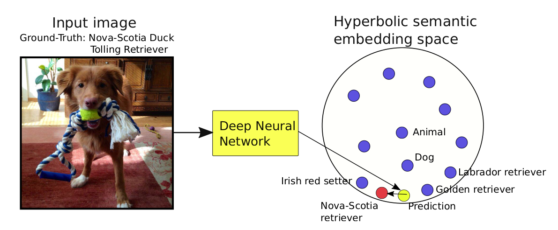
Our contribution
ZSL exploits hyperbolic semantic embeddings
ZSL based on hierarchical categorization vs. earlier Euclidean contextual similarities

Slide 9
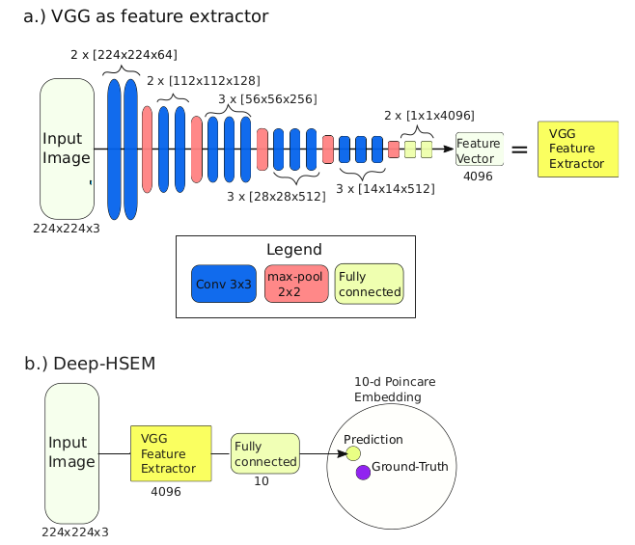
Deep Hyperbolic Semantic Embedding Model (Deep-HSEM)
Essentially Hyperbolic space equivalent of DeViSE (Frome et al. [2])
Model Architecture:

Slide 10
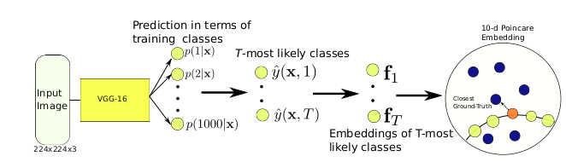

Convex Hyperbolic Semantic Embedding Model
(Convex-HSEM)
Deep-HSEM tendency overfit the complex transformation from images to embedding
Instead, take pre-trained model and calculate predictions as convex combinations (Norouzi et al. [3])
Calculating convex combinations in hyperbolic space? Einstein gyro-midpoint:

Slide 11
Training & Evaluation
Use Nickel & Kiela (2017) to learn hyperbolic semantic embedding for all english words in the WordNet database (hierarchical tree of 82K nouns and their connections)
Learn mapping from training images to their hyperbolic embedding space location
ImageNet 1K (1000 classes, around 1million images) for training
Zero-shot recognition on ~20k classes, around 14 million images (previously unseen)
Compare to similarity based Euclidean embedding methods

Slide 12
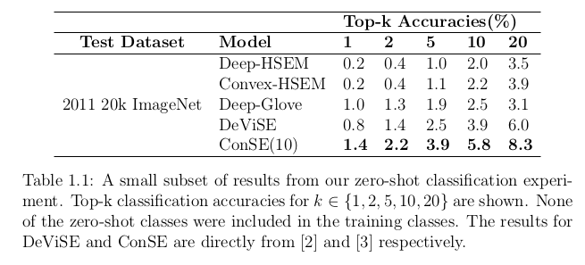
Results: Task 1
Standard zero shot classification accuracies

Slide 13
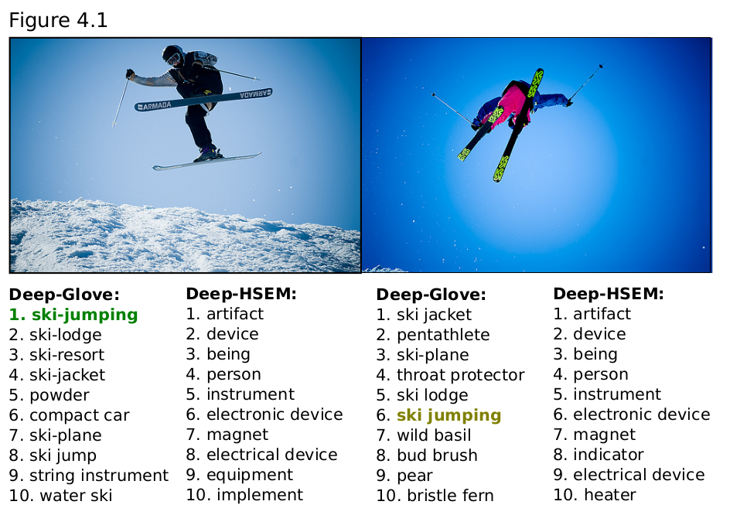
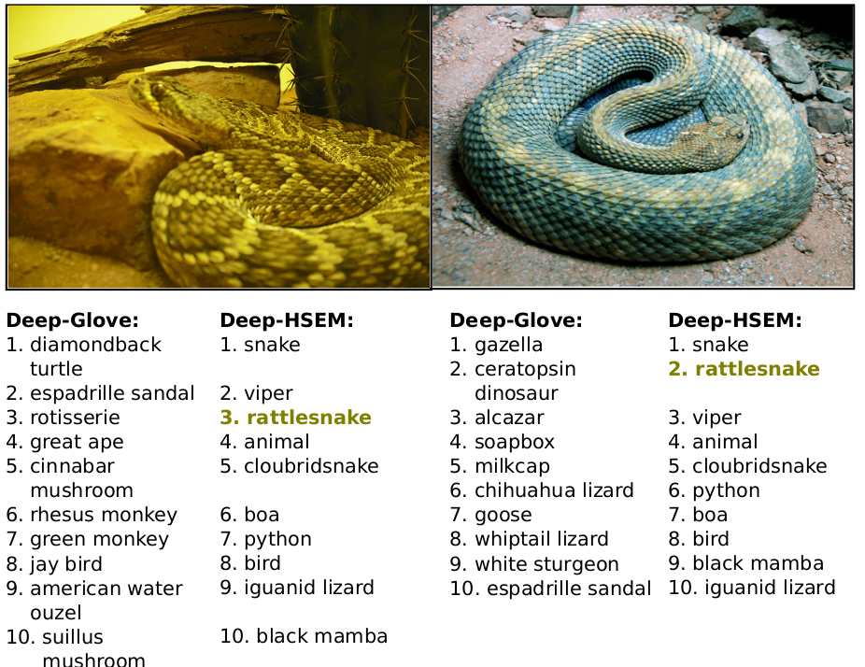
Results: Task 1
Standard zero shot classification accuracies

Slide 14
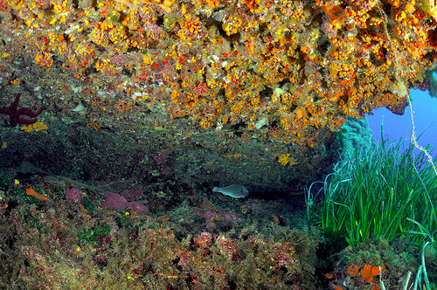
Problem with this task?
How would you label this image?

Slide 15
Problem with this task?
How would you label this image? A: Benthos

Slide 16
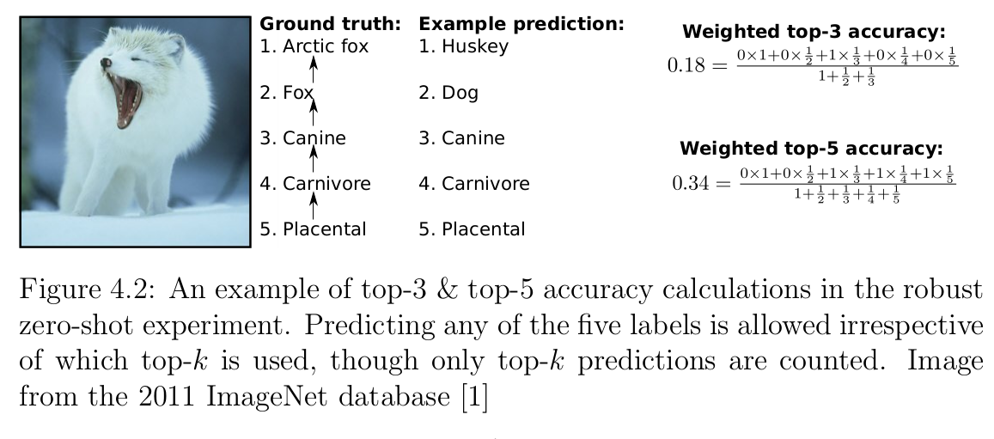
New Task – Robust ZSL
What we really want is ‘robust guesses’

Slide 17
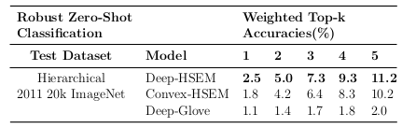
Robust ZSL - Results
What we really want is ‘robust guesses’

Slide 18
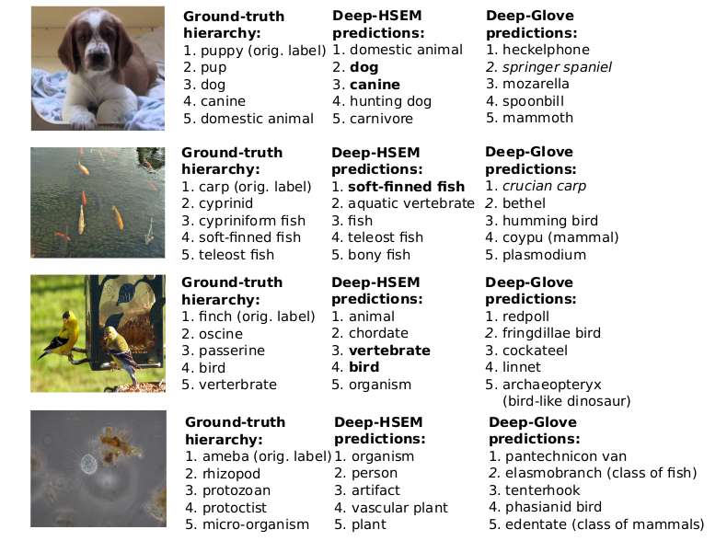
Robust ZSL examples

