Slide 1
Computer Organization & Design
The Hardware/Software Interface
计算机组成与设计
Chapter2
Instructions: Language of the Machine
Kun Yang 杨坤
College of Computer Science and Technology
Zhejiang University
kuny@zju.edu.cn

Slide 2
The process of compiling
Machine language(机器语言)
  Computers only understands electrical signalson/off
  Binary numbers express machine instructions
  ex. 1000110010100000 means to add two numbers
Assembly language(汇编语言)
  Symbolic notations ex. add A, B
  The assembler translates them into machine instruction
High-level programming language(高级编程语言)
  Notations more closer to the natural language ex. A + B
  The compiler translates into assembly language
  Advantages over assembly language
    Think in a more natural language
    Programs can be independent of hardware

Slide 3
Outline
Introduction
Operations of the computer hardware (计算机硬件的操作)
Operands of the computer hardware(计算机硬件的操作数)
Signed and unsigned numbers (有符号和无符号数)
Representing instructions in the computer(计算机中指令的表示)
Logical operations(逻辑操作)
Instructions for making decision(决策指令)
Supporting procedures in computer hardware(计算机对过程的支持)
Instruction addressing (指令的寻址)

Slide 4
2.1 Introduction
Language of the machine
  Instructions → Statement
  Instruction set → Syntax
Design goals
  Maximize performance
  Minimize cost
  Reduce design time
Our chosen instruction set: RISC-V
  Developed at Berkeley starting in 2010

Slide 5
The RISC-V Instruction Set
Used as the example throughout the book
Developed at UC Berkeley as open ISA
Now managed by the RISC-V Foundation (riscv.org)
Typical of many modern ISAs
  See RISC-V Reference Data tear-out card
Similar ISAs have a large share of embedded core market
  Applications in consumer electronics, network/storage equipment, cameras, printers, …

Slide 6
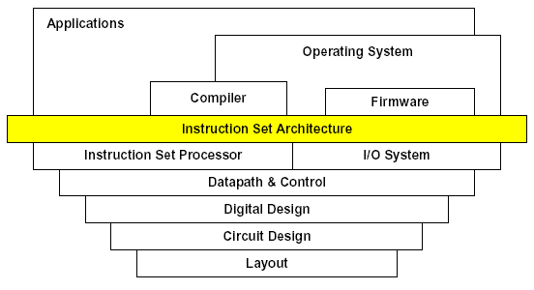
Instruction characteristics wide variety
wide variety
Operators
Op
Operands
Type of internal storage in processor
The number of the memory operand In the instruction
Operations in the instruction Set
Type and Size of Operands
Representing Instructions in the Computer
  Encoding

Slide 7
Stored-program concept
Today’s computers are built on 2 key principles: (Stored-program concept)
  ①Instruction are represented as numbers.
  ②Programs can be stored in memory to be read or written just like numbers.
Von Neumann’ Computer

Slide 8
2.2 Operations of the Computer Hardware
Every computer must be able to perform arithmetic
  Only one operation per instruction
  Exactly three variables add a,b,c a←b+c
All arithmetic operations have this form
Design Principle 1: Simplicity favors regularity
  Regularity makes implementation simpler
  Simplicity enables higher performance at lower cost

Slide 9
Arithmetic
Example 2.2 Compiling a complex C statement
  C code:
  f = ( g + h ) – ( i + j );
  RISC-V code:
  add t0, g, h # temporary variable t0 contains g + h
  add t1, i, j # temporary variable t1 contains i + j
  sub f, t0, t1 # f gets t0 – t1
  RISC-V assembly language
Category | Instruction | Example | Meaning | Comments
Arithmetic | add | add a,b,c | a←b+c | Always three operand
 | subtract | sub a,b,c | a←b-c | Always three operand

Slide 10
2.3 Operands of the Computer Hardware
Arithmetic instructions use register
operands
RISC-V has a 32 × 64-bit register file
  Use for frequently accessed data
  64-bit data is called a “doubleword”
    32 x 64-bit general purpose registers x0 to x31
  32-bit data is called a “word”
Design Principle 2: Smaller is faster
  c.f. main memory: millions of locations

Slide 11
RISC-V Registers
Name | Register name | Usage | Preserved On call?
x0 | 0 | The constant value 0 | n.a.
x1(ra) | 1 | Return address(link register) | yes
x2(sp) | 2 | Stack pointer | yes
x3(gp) | 3 | Global pointer | yes
x4(tp) | 4 | Thread pointer | yes
x5-x7 | 5-7 | Temporaries | no
x8-x9 | 8-9 | Saved | yes
x10-x17 | 10-17 | Arguments/results | no
x18-x27 | 18-27 | Saved | yes
x28-x31 | 28-31 | Temporaries | no

Slide 12
Register Operand Example
C code:
f = (g + h) - (i + j);
  f, …, j in x19, x20, …, x23
Compiled RISC-V code:
add x5, x20, x21
add x6, x22, x23
sub x19, x5, x6

Slide 13
Memory Operands
Main memory used for composite data
  Arrays, structures, dynamic data
To apply arithmetic operations
  Load values from memory into registers
  Store result from register to memory
Memory is byte addressed
  Each address identifies an 8-bit byte
RISC-V is Little Endian
  Least-significant byte at least address of a word
  c.f. Big Endian: most-significant byte at least address
RISC-V does not require words to be aligned in memory
  Unlike some other ISAs
3
1
0
0
2
1
0
1
1
0
1
0
1
Address
D
a
t
a
Processor
Memory

Slide 14
Memory Alignment
正确
struct {
int a;
char b;
char c[2];
char d[3]
float e;
}
e
d[1]
d[2]
No use
No use
b
c[0]
c[1]
d[0]
a
错误
e
No use
No use
因为一次只能读出4字节内存中的一行
这样布局，e变量不能一次读出
d[1]
d[2]
e
b
c[0]
c[1]
d[0]
a

Slide 15
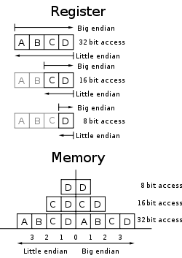
Endianness/byte order
Big end：Left Least Addr.
  PowerPC
  Byte1:01 Byte0:02 = 513
Little end：Right Least Addr.
  RISC-V
  Byte1:01 Byte0:02 = 258
Bi-endian
  MIPS, ARM , Alpha, SPARC

Slide 16
Memory Operand Example
C code:
A[12] = h + A[8];
  h in x21, base address of A in x22
Compiled RISC-V code:
  Index 8 requires offset of 64
    8 bytes per doubleword
  Offset: the constant in a data transfer instruction
  Base register: the register added to form the address
ld x9, 64(x22)
add x9, x21, x9
sd x9, 96(x22)

Slide 17
Register vs. Memory
Registers are faster to access than memory
Operating on memory data requires loads and stores
  More instructions to be executed
Compiler must use registers for variables as much as possible
  Only spill to memory for less frequently used variables
  Register optimization is important!

Slide 18
Discussion：How to represent?
Constant
g = h + 55
  Many time a program
  will use a constant in an operation

Slide 19
Constant or immediate Operands
Many time a program will use a constant in an operation
  Incrementing index to point to next element of array
  Add the constant 4 to register x9
  Assuming AddrConstants 4 is address pointer of constant 4
x3
….
4
ld x9, AddrConstant4(x3) // x9=constant 4
add x22, x22, x9
Immediate: Other method for adding constant 4 to x22
  Avoids the load instruction
  Offer versions of the instruction
    addi x22, x22, 4 // x22= x22+ 4
  Constant zero: a register x0
Design Principle 3: Make common case fast (Why?)

Slide 20
Brief summary
RISC-V operands
Name | Example | Comments
32 register | x0~x31 | Fast locations for data. In RISC-V, data must be in registers to perform arithmetic. Register x0 always equals 0.
2⁶¹ memory double words | Memory[0], Memory[8] , …… , Memory[18446744073709551608] | Accessed only by data transfer instructions. RISC-V uses byte addresses, so sequential doubleword accesses differ by 8. Memory holds data structures, arrays, and spilled registers.
RISC-V assembly language
Category | Instruction | Example | Meaning | Comments
Arithmetic | add | add x5,x6,x7 | x5=x6 + x7 | Add two source register operands
 | subtract | sub x5,x6,x7 | x5=x6 - x7 | First source register subtracts second one
 | add immediate | addi x5,x6,20 | x5=x6+20 | Used to add constants
Data transfer | load doubleword | ld x5, 40(x6) | x5=Memory[x6+40] | doubleword from memory to register
 | store doubleword | sd x5, 40(x6) | Memory[x6+40]=x5 | doubleword from register to memory

Slide 21
2.4 Signed and unsigned numbers
Bits are just bits (no inherent meaning): conventions define relationship between bits and numbers
Binary numbers (base 2)
0000 0001 0010 0011 0100 0101 0110 0111 1000 1001...
decimal: 0...2^{n}-1
Of course it gets more complicated:
numbers are finite (overflow)
fractions and real numbers
negative numbers
How do we represent negative numbers?
which bit patterns will represent which numbers?

Slide 22
Unsigned Binary Integers
Given an n-bit number
Range: 0 to +2^{n} – 1
Example
  0000 0000 … 0000 1011₂
  = 0 + … + 1×2³ + 0×2² +1×2¹ +1×2⁰
  = 0 + … + 8 + 0 + 2 + 1 = 11₁₀
Using 64 bits: 0 to +18,446,774,073,709,551,615

Slide 23
2s-Complement Signed Integers
Given an n-bit number
Range: –2^{n – 1} to +2^{n – 1} – 1
Example
  1111 1111 … 1111 1100₂
  = –1×2³¹ + 1×2³⁰ + … + 1×2² +0×2¹ +0×2⁰
  = –2,147,483,648 + 2,147,483,644 = –4₁₀
Using 64 bits: −9,223,372,036,854,775,808
to 9,223,372,036,854,775,807

Slide 24
2s-Complement Signed Integers
Bit 63 is sign bit
  1 for negative numbers
  0 for non-negative numbers
–(–2^{n – 1}) can’t be represented
Non-negative numbers have the same unsigned and 2s-complement representation
Some specific numbers
  0: 0000 0000 … 0000
  –1: 1111 1111 … 1111
  Most-negative: 1000 0000 … 0000
  Most-positive: 0111 1111 … 1111

Slide 25
Signed Negation
Complement and add 1
  Complement means 1 → 0, 0 → 1
Example: negate +2
  +2 = 0000 0000 … 0010_{two}
  –2 = 1111 1111 … 1101_{two} + 1
  = 1111 1111 … 1110_{two}

Slide 26
2.5 Representing Instructions in the computer
All information in computer consists of binary bits
Instructions are encoded in binary
  Called machine code
Mapping registers into numbers
  map registers x0 to x31 onto registers 0 to 31
RISC-V instructions
  Encoded as 32-bit instruction words
  Small number of formats encoding operation code (opcode), register numbers, …
  Regularity

Slide 27
Example: Translating assembly code
(p81) Translating assembly into machine instruction
  RISC-V code
  add x9, x20, x21
  Decimal version of machine code
  | 0 | 21 | 20 | 0 | 9 | 51 |
  Binary version of machine code
  | 0000000 | 10101 | 10100 | 000 | 01001 | 0110011 |
  7 bits 5 bits 5 bits 3 bits 5 bits 7 bits

Slide 28
Hexadecimal
Base 16
  Compact representation of bit strings
  4 bits per hex digit
0 | 0000 | 4 | 0100 | 8 | 1000 | c | 1100
1 | 0001 | 5 | 0101 | 9 | 1001 | d | 1101
2 | 0010 | 6 | 0110 | a | 1010 | e | 1110
3 | 0011 | 7 | 0111 | b | 1011 | f | 1111
Example: eca8 6420
  1110 1100 1010 1000 0110 0100 0010 0000

Slide 29
RISC-V R-Format Instructions
funct7
rs2
rs1
funct3
rd
opcode
7 bits
5 bits
5 bits
3 bits
5 bits
7 bits
Instruction fields
  opcode: operation code
  rd: destination register number
  funct3: 3-bit function code (additional opcode)
  rs1: the first source register number
  rs2: the second source register number
  funct7: 7-bit function code (additional opcode)
Design Principle 3
  Good design demands good compromises
All instructions in RISC-V have the same length
  Conflict: same length ←--→ single instruction

Slide 30
R-format Example
funct7
rs2
rs1
funct3
rd
opcode
7 bits
5 bits
5 bits
3 bits
5 bits
7 bits
add x9,x20,x21
0
21
20
0
9
51
0000000
10101
10100
000
01001
0110011
0000 0001 0101 1010 0000 0100 1011 0011_{two} =
015A04B3₁₆

Slide 31
RISC-V I-Format Instructions
immediate
rs1
funct3
rd
opcode
12 bits
5 bits
3 bits
5 bits
7 bits
Immediate arithmetic and load instructions
  rs1: source or base address register number
  immediate: constant operand, or offset added to base address
    2s-complement, sign extended
Design Principle 3: Good design demands good compromises
  Different formats complicate decoding, but allow 32-bit instructions uniformly
  Keep formats as similar as possible
Example：ld x9, 64(x22)
  22 (x22) is placed rs1;
  64 is placed immediate
  9 (x9) is placed rd

Slide 32
RISC-V S-Format Instructions
imm[11:5]
rs2
rs1
funct3
imm[4:0]
opcode
7 bits
5 bits
5 bits
3 bits
5 bits
7 bits
Different immediate format for store instructions
  rs1: base address register number
  rs2: source operand register number
  immediate: offset added to base address
    Split so that rs1 and rs2 fields always in the same place
Example：sd x9, 64(x22)
  22 (x22) is placed rs1;
  64 is placed immediate
  9 (x9) is placed rs2

Slide 33
RISC-V instruction encoding
Name | Format | Example |  |  |  |  |  | Comment
add | R | 0 | 3 | 2 | 0 | 1 | 51 | add x1, x2, x3
sub | R | 32 | 3 | 2 | 0 | 1 | 51 | sub x1, x2, x3
addi | I | 1000 |  | 2 | 0 | 1 | 19 | addi x1,x2,1000
ld | I | 1000 |  | 2 | 3 | 1 | 3 | ld x1, 1000(x2)
sd | S | 31 | 1 | 2 | 3 | 8 | 35 | sd x1, 1000(x2)

Slide 34
Example
Example(p85) Translating assembly into machine instruction
C code:
  A[30] = h + A[30] + 1 ;
  ( Assume: h ---- x21 base address of A ---- x10 )
  RISC-V assembly code:
  ld x9, 240(x10) // temporary reg x9 gets A[30]
  add x9, x21, x9 // temporary reg x9 gets h + A[30]
  addi x9, x9, 1 // temporary reg x9 gets h + A[30] + 1
  sd x9, 240(x10) // stores h + A[30] + 1 back into A[30]
  RISC-V machine language code:
    Decimal version
ld | immediate | rs1 | funct3 | rd | opcode |
  240 10 3 9 3

Slide 35
add | funct7 | rs2 | rs1 | funct3 | rd | opcode |
  0 9 21 0 9 51
addi | immediate | rs1 | funct3 | rd | opcode |
  1 9 0 9 19
sd | im[11:5] | rs2 | rs1 | funct3 | im[4:0] | opcode |
  7 9 10 3 16 35
Two key principles of today’s computers
  Instructions are represented as numbers
  Programs can be stored in memory like numbers
Stored-program

Slide 36
RISC-V fields (format)
Imm Region: ±2¹¹
Name | Fields |  |  |  |  |  | Comments
Field size | ₃₁ 7bits ₂₅ | ₂₄ 5bits ₂₀ | ₁₉ 5bits ₁₅ | ₁₄ 3bits ₁₂ | ₁₁ 5bits ₇ | ₆ 7bits ₀ | All RISC-V instruction 32 bits
R-type | funct7 | rs2 | rs1 | funct3 | rd | opcode | Arithmetic instruction format
I-type | immediate[11:0] |  | rs1 | funct3 | rd | opcode | Loads & immediate arithmetic
S-type | immed[11:5] | rs2 | rs1 | funct3 | immed[4:0] | opcode | Stores
SB-type | imm[12,10:5] | rs2 | rs1 | funct3 | imm[4:1,11] | opcode | Conditional branch format
UJ-type | immediate[20,10:1,11,19:12] |  |  |  | rd | opcode | Unconditional jump format
U-type | immediate[31:12] |  |  |  | rd | opcode | Upper immediate format
op：basic operation of the instruction, traditionally called the opcode.
rd： destination register number.
funct3：3-bit function code (additional opcode).
rs1： the first register source operand.
rs2： the second register source operand.
funct7 7-bit function code (additional opcode).
Must bear in mind !
Notes:
I_imm = {{20{inst[31]}}, inst [31:20]}; //addi/lw
S_imm = {{20{inst[31]}}, Inst[31:25], inst[11:7]}; //sw
SB_imm = {{19{inst [31]}}, inst[31], inst [7], inst[30:25], inst[11:8],1'b0}; //Branch
UJ = {{11{inst[31]}}, inst [31], inst[19:12], inst[20], inst[30:21],1'b0}; //jal/J
U_imm = {inst [31:12], 12’h0} //Lui

Slide 37
MIPS fields (format)
Field size | 6bits | 5bits | 5bits | 5bits | 5bits | 6bits | All MIPS instruction 32 bits
R-format | op | rs | rt | rd | shamt | funct | Arithmetic instruction format
i-format | op | rs | rt | Imm/Word address |  |  | Data transfer ,branch format
J-format | op | target address (word) |  |  |  |  | Unconditional jump
Region: ±2¹⁵
op：basic operation of the instruction, traditionally called the opcode.
rs： the first register source operand.
rt： the second register source operand.
rd： the register destination operand.
shamt： shift amount.
funct： function, this field selects the specific variant of the operation in the op field.

Slide 38
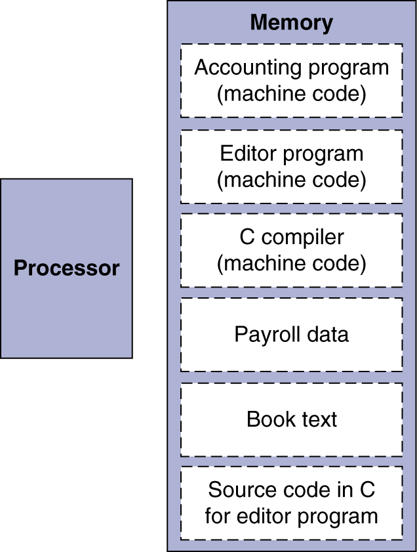
Stored Program Computer
The BIG Picture
Instructions represented in binary, just like data
Instructions and data stored in memory
Programs can operate on programs
  e.g., compilers, linkers, …
Binary compatibility allows compiled programs to work on different computers
  Standardized ISAs

Slide 39
2.6 Logical Operations
Instructions for bitwise manipulation
Operation | C | Java | RISC-V
Shift left | << | << | slli
Shift right | >> | >>> | srli
Bit-by-bit AND | & | & | and, andi
Bit-by-bit OR | | | | | or, ori
Bit-by-bit XOR | ^ | ^ | xor, xori
Bit-by-bit NOT | ~ | ~
Useful for extracting and inserting groups of bits in a word

Slide 40
Shift Operations
funct6
immed
rs1
funct3
rd
opcode
6 bits
6 bits
5 bits
3 bits
5 bits
7 bits
immed: how many positions to shift
Shift left logical
  Shift left and fill with 0 bits
  slli by i bits multiplies by 2^{i}
Shift right logical
  Shift right and fill with 0 bits
  srli by i bits divides by 2^{i} (unsigned only)

Slide 41
AND Operations
Useful to mask bits in a word
  Select some bits, clear others to 0
and x9,x10,x11
x10
00000000 00000000 00000000 00000000 00000000 00000000 00001101 11000000
x11
00000000 00000000 00000000 00000000 00000000 00000000 00111100 00000000
x9
00000000 00000000 00000000 00000000 00000000 00000000 00001100 00000000

Slide 42
OR Operations
Useful to include bits in a word
  Set some bits to 1, leave others unchanged
or x9,x10,x11
x10
00000000 00000000 00000000 00000000 00000000 00000000 00001101 11000000
x11
00000000 00000000 00000000 00000000 00000000 00000000 00111100 00000000
x9
00000000 00000000 00000000 00000000 00000000 00000000 00111101 11000000

Slide 43
XOR Operations
Differencing operation
  Set some bits to 1, leave others unchanged
xor x9,x10,x12 // NOT operation
x10
00000000 00000000 00000000 00000000 00000000 00000000 00001101 11000000
x12
11111111 11111111 11111111 11111111 11111111 11111111 11111111 11111111
x9
11111111 11111111 11111111 11111111 11111111 11111111 11110010 00111111

Slide 44
RISC-V operands
Name | Example | Comments
32 registers | x0-x31 | Fast locations for data. In RISC-V, data must be in registers to perform arithmetic. Register x0 always equals 0.
2⁶¹ memory double words | Memory[0], Memory[8], …, Memory[18,446,744,073,709,551,608]] | Accessed only by data transfer instructions. RISC-V uses byte addresses, so sequential double word accesses differ by 8. Memory holds data structures, arrays, and spilled registers.
RISC-V assembly language
Category | Instruction | Example | Meaning | Comments
Logical | and | and x5, x6, 3 | x5=x6 & 3 | Arithmetic shift right by register
 | inclusive or | or x5,x6,x7 | x5=x6 | x7 | Bit-by-bit OR
 | exclusive or | xor x5,x6,x7 | x5=x6 ^ x7 | Bit-by-bit XOR
 | and immediate | andi x5,x6,20 | x5=x6 & 20 | Bit-by-bit AND reg. with constant
 | inclusive or immediate | ori x5,x6,20 | x5=x6 | 20 | Bit-by-bit OR reg. with constant
 | exclusive or immediate | xori x5,x6,20 | X5=x6 ^ 20 | Bit-by-bit XOR reg. with constant
Shift | shift left logical | sll x5, x6, x7 | x5=x6 << x7 | Shift left by register
 | shift right logical | srl x5, x6, x7 | x5=x6 >> x7 | Shift right by register
 | shift right arithmetic | sra x5, x6, x7 | x5=x6 >> x7 | Arithmetic shift right by register
 | shift left logical immediate | slli x5, x6, 3 | x5=x6 << 3 | Shift left by immediate

Slide 45
2.7 Instructions for making decisions
Branch instructions
  beq register1, register2, L1
  bne register1, register2, L1
Example 2.9 Compiling an if statement to a branch
( Assume: f ~ j ---- x19 ~ x23 )
  C code:
  if ( i = = j ) goto L1 ;
  f = g + h ;
  L1: f = f - i ;
  RISC-V assembly code:
  beq x21, x22, L1 # go to L1 if i equals j
  add x19, x20, x21 # f = g + h ( skipped if i equals j )
  L1: sub x19, x19, x22 # f = f - i ( always executed )

Slide 46
Branch
Example 2.10
Compiling if-then-else into Conditional Branches
( Assume: f ~ j ---- x19 ~ x23 )
  C code:
  if ( i = = j ) f = g + h ;
  else f = g - h ;
  RISCV assembly code:
  bne x22, x23, Else # go to Else if i != j
  add x19, x20, x21 # f = g + h ( Executed if i = = j if)
  beq x0, x0, EXIT # go to Exit
Else: sub x19, x20, x21 # f = g - h ( Executed if i ≠ j else)
Exit: # the first instruction of the next C
…… statement
i↑j
i==j?
F=g+h
F=g - h
Exit:

Slide 47
Supports LOOPs
Example 2.11 Compiling a loop with variable array index
( Assume: g ~ j ----x19 ~ x23 base of A[i] ---- x25)
  C code:
  Loop: g = g + A[i] ; // A is an array of 100 words
  i = i + j ;
  if ( i != h ) goto Loop ;
  RISC-V assembly code:
  Loop: slli x10, x22, 3 # temp reg x10 = 8 * i
  add x10, x10, x25 # x10 = address of A[i]
  ld x19 , 0(x10) # temp reg x19 = A[i]
  add x20, x20, x19 # g = g + A[i]
  add x22, x22, x23 # i = i + j
  bne x22, x21, Loop # go to Loop if i != h

Slide 48
Supports while
Example 2.12 Compiling a while loop
( Assume: i ~ k---- x22 and x24 base of save ---- x25)
  C code:
  while ( save[i] = = k )
  i = + i ;
  RISCV assembly code:
  Loop: slli x10, x22, 3 # temp reg $t1 = 8 * i
  add x10, x10, x25 # x10 = address of save[i]
  ld x9, 0(x10) # x9 gets save[i]
  bne x9, x24, Exit # go to Exit if save[i] != k
  addi x22, x22, 1 # i += 1
  beq x0, x0, Loop # go to Loop
  Exit:

Slide 49
Most popular Compare Operation
-- set on less than : slt
set on less than -slt
  If the first reg. is less than second reg. then sets third reg to 1
  slt x5, x19, x20 # x5=1 if x19 < x20
Example 2.13 Compiling a less than test
( Assume: a -- s0 b -- s1 )
  C language:
  if (a < b), goto Less
  RISCV assembly code:
  slt x5, x8, x9 #x5 = 1 if x8 < x9 ( a < b)
  bne x5, zero, Less # go to Less if x5 != 0 (that is, if a < b)
  ……
  Less:

Slide 50
More Conditional Operations
blt rs1, rs2, L1
  if (rs1 < rs2) branch to instruction labeled L1
bge rs1, rs2, L1
  if (rs1 >= rs2) branch to instruction labeled L1
Example
  if (a > b) a += 1;
  a in x22, b in x23
  bge x23, x22, Exit # branch if b >= a
  addi x22, x22, 1
  Exit:

Slide 51
Signed vs. Unsigned
Signed comparison: blt, bge
Unsigned comparison: bltu, bgeu
Example
  x22 = 1111 1111 1111 1111 1111 1111 1111 1111
  x23 = 0000 0000 0000 0000 0000 0000 0000 0001
  x22 < x23 # signed
    –1 < +1
  x22 > x23 # unsigned
    +4,294,967,295 > +1

Slide 52
Hold out Case/Switch
used to select one of many alternatives
Example 2.14
Compiling a switch using jump address table
( Assume: f ~ k --x20 ~ x25 x5 contains 4/8)
  C code:
  switch ( k ) {
  case 0 : f = i + j ; break ; /* k = 0 */
  case 1 : f = g + h ; break ; /* k = 1 */
  case 2 : f = g - h ; break ; /* k = 2 */
  case 3 : f = i - j ; break ; /* k = 3 */
  }

Slide 53
Jump register & jump address table
Jump with register content
jalr x1, 100(x6)
jump address table
 | …………
P1 address | Program 1
 | …………
P2 address | Program 2
 | …………
P3 address | Program 3
 | …………
P4 address | Program 4
 | …………
x7←x6+ 4/8*K
K=0 | P1 address
K=1 | P2 address
K=2 | P3 address
K=3 | P4 address
x6
Notes:
J是伪指令：Jalr zero, xxx(zero)

Slide 54
RISC-V assembly code:
Boundary
  blt x25, x0, Exit # test if k < 0
  bge x25, x5, Exit # if k >= 4, go to Exit
  slli x7, x25, 3 # temp reg x7 = 8 * k (0<=k<=3)
  add x7, x7, x6 # x7 = address of JumpTable[k]
  ld x7, 0(x7) # temp reg x7 gets JumpTable[k]
  jalr x1, 0(x7) # jump based on register x7(entrance)
Exit:
jump address table
x7= x6 +8 * k:
L0: add $s0, $s3, $s4 # k = 0 so f gets i + j
  jalr x0, 0(x1) # end of this case so go to Exit
L1: add $s0, $s1, $s2 # k = 1 so f gets g + h
  jalr x0, 0(x1) # end of this case so go to Exit
L2: sub $s0, $s1, $s2 # k = 2 so f gets g - h
  jalr x0, 0(x1) # end of this case so go to Exit
L3: sub $s0, $s3, $s4 # k = 3 so f gets i - j
  jalr x0, 0(x1) # end of switch statement
L0:address
L1:address
L2: address
L3:address
Memory1
Memory2
Notes:
J是伪指令：Jalr zero, xxx(zero)

Slide 55
Important conception--Basic Blocks
A basic block is a sequence of instructions with
  No embedded branches (except at end)
  No branch targets/branch lables (except at beginning)
A compiler identifies basic blocks for optimization
An advanced processor can accelerate execution of basic blocks

Slide 56
2.8 Supporting Procedures in Computer Hardware
Procedure/function be used to structure programs
  A stored subroutine that performs a specific task based on the parameters with which it is provided
    easier to understand, allow code to be reused
  Six step
  Place Parameters in a place where the procedure can access them
  Transfer control to the procedure：jump to
  Acquire the storage resources needed for the procedure
  Perform the desired task
  Place the result value in a place where the calling program can access it
  Return control to the point of origin

Slide 57
Procedure Call Instructions
Instruction for procedures: jal ( jump-and-link )
Caller jal x1, ProcedureAddress
  Address of following instruction put in x1
  Jumps to target address
Procedure return: jump and link register
Callee jalr x0, 0(x1)
  Like jal, but jumps to 0 + address in x1
  Use x0 as rd (x0 cannot be changed)
  Can also be used for computed jumps
    e.g., for case/switch statements
PC+4 → ra
Special registers

Slide 58
Using More Registers
More Registers for procedure calling
  a0 ~ a7(x10-x17): eight argument registers to pass parameters & return values
  ra/x1：one return address register to return to origin point
Stack
  ideal data structure for spilling registers
    Push, pop
    Stack pointer ( sp )
Stack grow from higher address
to lower address
  Push: sp= sp - 8
  Pop: sp = sp + 8
High address
data
PUSH
data
data
addi sp,sp,-8
sd …,8(sp)
sp(top)
Low address
ld …,8(sp)
addi sp,sp,8

Slide 59
Example 2.15 Compiling a leaf procedure
( Assume: g, …, j in x10, …, x13 and f in x20)
  C code:
  long long int leaf_example (
  long long int g, long long int h,
  long long int i, long long int j){
  long long int f;
  f = (g + h) - (i + j);
  return f;
  }
  RISC-V assembly code:
  addi sp, sp, -24 # adjust stack to make room for 3 items
  sd x5, 16(sp) #These three instructions save three
  sd x6, 8(sp) # register x5,x6,x20
  sd x20, 0(sp) # Let’s consider why it need to be done.
High address
($t1)
($t0)
($s0)
$sp(-24)
Low address
Save value
Return value
PUSH

Slide 60
add x5,x10,x11 # register x5contains g + h
add x6,x12,x1 # register x6 contains i + j
sub x20,x5,x6 # f = x5- x6, which is ( g + h ) – ( i + j )
addi x10,x20,0 # copy f to return register ( x10 = x20 + 0)
ld x20, 0(sp) # restore register x20 for caller
ld x6, 8(sp) # restore register x6 for caller
ld x5, 16(sp) # restore register x5 for caller
addi sp, sp, +24 # adjust stack to delete 3 items
jalr x0,0(x1) # jump back to calling routine
But maybe some of the three are not used by the caller
  So, this way might be inefficient
  Two classes of registers
    t0 ~ t6: 7 temporary registers, by the callee not preserved
    s0 ~ s11: 12 saved registers, must be preserved If used
POP
to save x5, x6, x20 on stack

Slide 61
RISC-V operands
Name | Example | Comments
32 registers | x0-x31 | Fast locations for data. In RISC-V, data must be in registers to perform arithmetic. Register x0 always equals 0.
2⁶¹ memory words | Memory[0], Memory[8], …, Memory[18,446,744,073,709,551,608]] | Accessed only by data transfer instructions. RISC-V uses byte addresses, so sequential double word accesses differ by 8. Memory holds data structures, arrays, and spilled registers.
Name | Register no. | Usage | Preserved on call
x0(zero) | 0 | The constant value 0 | n.a.
x1(ra) | 1 | Return address(link register) | yes
x2(sp) | 2 | Stack pointer | yes
x3(gp) | 3 | Global pointer | yes
x4(tp) | 4 | Thread pointer | yes
x5-x7(t0-t2) | 5-7 | Temporaries | no
x8(s0/fp) | 8 | Saved/frame point | Yes
x9(s1) | 9 | Saved | Yes
x10-x17(a0-a7) | 10-17 | Arguments/results | no
x18-x27(s2-s11) | 18-27 | Saved | yes
x28-x31(t3-t6) | 28-31 | Temporaries | No
PC | - | Program counter | Yes
Notes:
K0，k1：26-27

Slide 62
The values of the stack pointer and stack before, during and after procedure call in Example 2.15
High address
sp
sp
Content of register x5
Content of register x6
sp
Content of register x20
Low address
a
.
b
.
c
.

Slide 63
Nested Procedures
Example 2.16 Compiling a recursive procedure ( Assume: n -- a0 )
  C code for n!
  int fact ( int n )
  {
  if ( n < 1 ) return ( 1 ) ;
  else return ( n * fact ( n - 1 ) ) ;
  }
  RISC-V assembly code
  fact: addi sp, sp, 16 # adjust stack for 2 items
  sd ra, 8(sp) # save the return address：x1
  sd a0, 0($sp) # save the argument n: x10
addi t0, a0, -1 # x5 = n - 1
bge t0, zero, L1 # if n >= 1, go to L1(else)
addi a0, zero, 1 # return 1 if n <1
addi sp, sp, 16 # Recover sp (Why not recover x1and x10 ?)
jalr zero, 0(ra) # return to caller
  Argument n in a0
  Result in a0

Slide 64
Nested Procedures-Continue
    L1: addi a0, a0, -1 # n >= 1: argument gets ( n - 1 )
jal ra, fact # call fact with ( n - 1)
add t1, a0, zero #move result of fact(n - 1) to x6(t1)
ld a0, 0(sp) # return from jal: restore argument n
ld ra, 8(sp) # restore the return address
add sp, sp, 16 # adjust stack pointer to pop 2 items
mul a0, a0, t1 # return n*fact ( n - 1 )
jalr zero, 0(ra) # return to the caller
Why a0 is saved? Why ra is saved?
Preserved things across a procedure call
Saved registers( s0 ~ s11), stack pointer register( $sp ),
return address register( ra/x1 ), stack above the stack pointer
Not preserved things across a procedure call
Temporary registers( t0 ~ t7 ), argument registers( a0 ~ a7),
return value registers( a0 ~ a7), stack below the stack pointer

Slide 65
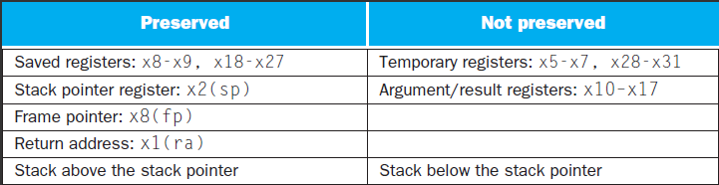
What is and what is not preserved across a procedure call

Slide 66
Stack allocation before, during and after procedure call

Slide 67
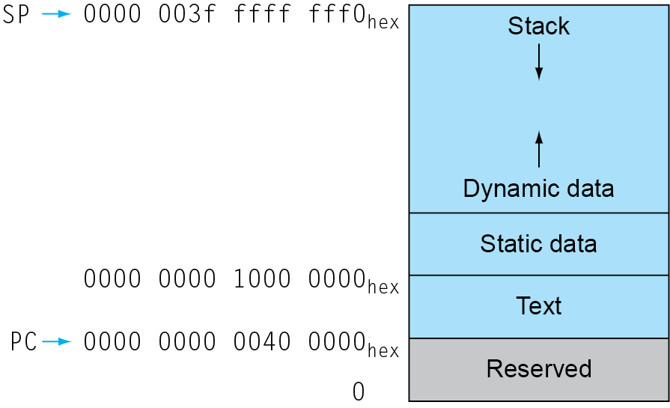
Memory Layout
Text: program code
Static data: global variables
  e.g., static variables in C, constant arrays and strings
  x3 (global pointer) initialized to address allowing ±offsets into this segment
Dynamic data: heap
  E.g., malloc in C, new in Java
Stack: automatic storage
Storage class of C variables
  automatic
  static
Notes:
Procedure frame and frame pointer ( $fp )
The importance of $fp： automatic
Global pointer ( $gp )： static

Slide 68
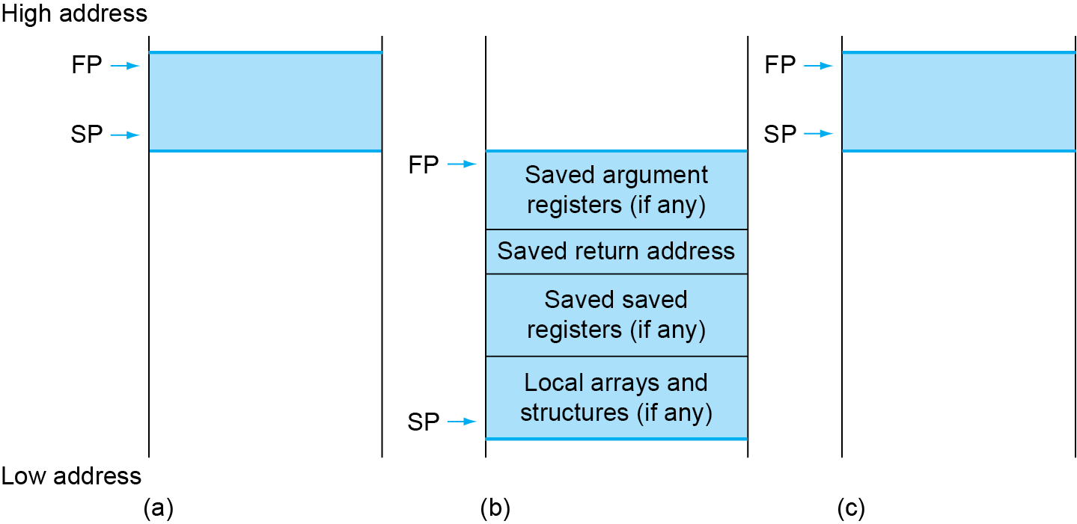
Local Data on the Stack
Allocating Space for New Data on the Stack
  Procedure frame/activation record
    The segment of stack containing a procedure’s saved registers and local variables
  Frame pointer
    A value denoting the location of saved register and local variables for a given procedure
    Local data allocated
    by callee
      e.g., C automatic
      variables
    Procedure frame (activ-
    ation record)
      Used by some compilers to
      manage stack storage

Slide 69
RISC-V operands
Name | Example | Comments
32 registers | x0-x31 | Fast locations for data. In RISC-V, data must be in registers to perform arithmetic. Register x0 always equals 0.
2⁶¹ memory words | Memory[0], Memory[8], …, Memory[18,446,744,073,709,551,608]] | Accessed only by data transfer instructions. RISC-V uses byte addresses, so sequential double word accesses differ by 8. Memory holds data structures, arrays, and spilled registers.
Name | Register no. | Usage | Preserved on call
x0(zero) | 0 | The constant value 0 | n.a.
x1(ra) | 1 | Return address(link register) | yes
x2(sp) | 2 | Stack pointer | yes
x3(gp) | 3 | Global pointer | yes
x4(tp) | 4 | Thread pointer | yes
x5-x7(t0-t2) | 5-7 | Temporaries | no
x8(s0/fp) | 8 | Saved/frame point | Yes
x9(s1) | 9 | Saved | Yes
x10-x17(a0-a7) | 10-17 | Arguments/results | no
x18-x27(s2-s11) | 18-27 | Saved | yes
x28-x31(t3-t6) | 28-31 | Temporaries | No
PC | - | Auipc(Add Upper Immediate to PC) | Yes
Notes:
K0，k1：26-27

Slide 70
RISC-V assembly language
Category | Instruction | Example | Meaning | Comments
Arithmetic | add | add x5,x6,x7 | x5=x6 + x7 | Add two source register operands
 | subtract | sub x5,x6,x7 | x5=x6 - x7 | First source register subtracts second one
 | add immediate | addi x5,x6,20 | x5=x6+20 | Used to add constants
Data transfer | load doubleword | ld x5, 40(x6) | x5=Memory[x6+40] | doubleword from memory to register
 | store doubleword | sd x5, 40(x6) | Memory[x6+40]=x5 | doubleword from register to memory
 | load word | lw x5, 40(x6) | x5=Memory[x6+40] | word from memory to register
 | load word, unsigned | lwu x5, 40(x6) | x5=Memory[x6+40] | Unsigned word from memory to register
 | store word | sw x5, 40(x6) | Memory[x6+40]=x5 | word from register to memory
 | load halfword | lh x5, 40(x6) | x5=Memory[x6+40] | Halfword from memory to register
Category | Instruction | Example | Meaning | Comments
Data transfer | load halfword, unsigned | lhu x5, 40(x6) | x5=Memory[x6+40] | Unsigned halfword from memory to register
 | store halfword | sh x5, 40(x6) | Memory[x6+40]=x5 | halfword from register to memory
 | load byte | lb x5, 40(x6) | x5=Memory[x6+40] | byte from memory to register
 | load word, unsigned | lbu x5, 40(x6) | x5=Memory[x6+40] | Unsigned byte from memory to register
 | store byte | sb x5, 40(x6) | Memory[x6+40]=x5 | byte from register to memory
 | load reserved | lr.d x5,(x6) | x5=Memory[x6] | Load;1st half of atomic swap
 | store conditional | sc.d x7,x5,(x6) | Memory[x6]=x5; x7 = 0/1 | Store;2nd half of atomic swap
 | Load upper immediate | lui x5,0x12345 | x5=0x12345000 | Loads 20-bits constant shifted left 12 bits

Slide 71
RISC-V assembly language
Category | Instruction | Example | Meaning | Comments
Logical | and | and x5, x6, 3 | x5=x6 & 3 | Arithmetic shift right by register
 | inclusive or | or x5,x6,x7 | x5=x6 | x7 | Bit-by-bit OR
 | exclusive or | xor x5,x6,x7 | x5=x6 ^ x7 | Bit-by-bit XOR
 | and immediate | andi x5,x6,20 | x5=x6 & 20 | Bit-by-bit AND reg. with constant
 | inclusive or immediate | ori x5,x6,20 | x5=x6 | 20 | Bit-by-bit OR reg. with constant
 | exclusive or immediate | xori x5,x6,20 | X5=x6 ^ 20 | Bit-by-bit XOR reg. with constant
Shift | shift left logical | sll x5, x6, x7 | x5=x6 << x7 | Shift left by register
 | shift right logical | srl x5, x6, x7 | x5=x6 >> x7 | Shift right by register
 | shift right arithmetic | sra x5, x6, x7 | x5=x6 >> x7 | Arithmetic shift right by register
 | shift left logical immediate | slli x5, x6, 3 | x5=x6 << 3 | Shift left by immediate
Category | Instruction | Example | Meaning | Comments
Shift | shift right logical immediate | srli x5,x6,3 | x5=x6 >> 3 | Shift right by immediate
 | shift right arithmetic immediate | srai x5,x6,3 | x5=x6 >> 3 | Arithmetic shift right by immediate
Conditional branch | branch if equal | beq x5, x6, 100 | if(x5 == x6) go to PC+100 | PC-relative branch if registers equal
 | branch if not equal | bne x5, x6, 100 | if(x5 != x6) go to PC+100 | PC-relative branch if registers not equal
 | branch if less than | blt x5, x6, 100 | if(x5 < x6) go to PC+100 | PC-relative branch if registers less
 | branch if greater or equal | bge x5, x6, 100 | if(x5 >= x6) go to PC+100 | PC-relative branch if registers greater or equal
 | branch if less, unsigned | bltu x5, x6, 100 | if(x5 >= x6) go to PC+100 | PC-relative branch if registers less, unsigned
 | branch if greater or equal, unsigned | bgeu x5, x6, 100 | if(x5 >= x6) go to PC+100 | PC-relative branch if registers greater or equal, unsigned
Category | Instruction | Example | Meaning | Comments
Unconditional branch | jump and link | jal x1, 100 | x1 = PC + 4; go to PC+100 | PC-relative procedure call
 | jump and link register | jalr x1, 100(x5) | x1 = PC + 4; go to x5+100 | procedure return; indirect call

Slide 72
MIPS machine language
Name | Format | Example |  |  |  |  |  | Comment
add | R | 0 | 18 | 19 | 17 | 0 | 32 | add $s1, $s2, $s3
sub | R | 0 | 18 | 19 | 17 | 0 | 34 | sub $s1, $s2, $s3
lw | I | 35 | 18 | 17 | 100 |  |  | lw $s1, 100($s2)
sw | I | 43 | 18 | 17 | 100 |  |  | sw $s1, 100($s2)
and | R | 0 | 18 | 19 | 17 | 0 | 36 | and $s1, $s2, $s3
or | R | 0 | 18 | 19 | 17 | 0 | 37 | or $s1, $s2, $s3
nor | R | 0 | 18 | 19 | 17 | 0 | 39 | nor $s1, $s2, $s3
addi | I | 12 | 18 | 17 | 100 |  |  | addi $s1, $s2,100
ori | I | 13 | 18 | 17 | 100 |  |  | ori $s1, $s2,100
sll | R | 0 | 0 | 18 | 17 | 10 | 0 | sll $s1, $s2,10
srl | R | 0 | 0 | 18 | 17 | 10 | 2 | srl $s1, $s2,10
beq | I | 4 | 17 | 18 | 25 |  |  | beq $s1, $s2,100
bne | I | 5 | 17 | 18 | 25 |  |  | bne $s1, $s2,100
slt | R | 0 | 18 | 19 | 17 | 0 | 42 | slt $s1, $s2,$s3
j | J | 2 | 2500 |  |  |  |  | j 10000(see section 2.9)
jr | R | 0 | 31 | 0 | 0 | 0 | 8 | j Sra
jal | J | 3 | 2500 |  |  |  |  | jar 10000(see section 2.9)
Field size |  | 6bits | 5bits | 5bits | 5bits | 5bits | 6bits | All MIPS instruction 32 bits
R-format | R | op | rs | rt | rd | shamt | funct | Arithmetic instruction format
i-format | I | op | rs | rt | address |  |  | Data transfer ,branch format
请同学课后改为RISC-V体系构架加深指令构架理解
同时了解MIPS指令构架

Slide 73
2.9 Communicating with People
Character Data
Byte-encoded character sets
  ASCII ( American Standard Code for Information Interchange )
    128 characters：95 graphic, 33 control
  Latin-1: 256 characters
    ASCII, +96 more graphic characters
Unicode: 32-bit character set
  Used in Java, C++ wide characters, …
  Most of the world’s alphabets, plus symbols
  UTF-8, UTF-16: variable-length encodings
Notes:
Three choices for representing a string
Place the length of the string in the first position
An accompanying variable has the length
A character in the last position to mark the end of a string
C uses the third choice
Terminate a string with a byte whose value is 0 ( null in ASCII )

Slide 74
Byte/Halfword/Word Operations
RISC-V byte/halfword/word load/store
  Load byte/halfword/word: Sign extend to 64 bits in rd
    lb rd, offset(rs1)
    lh rd, offset(rs1)
    lw rd, offset(rs1)
  Load byte/halfword/word unsigned: 0 extend to 64 bits in rd
    lbu rd, offset(rs1)
    lhu rd, offset(rs1)
    lwu rd, offset(rs1)
  Store byte/halfword/word: Store rightmost 8/16/32 bits
    sb rs2, offset(rs1)
    sh rs2, offset(rs1)
    sw rs2, offset(rs1)

Slide 75
String Copy Example
Example 2.17 Compiling a string copy procedure
( Assume: base addresses for i -- x19, x’s base --x10, y’s base --x11 )
  C code：Y→X
  void strcpy ( char x[ ] , char y[ ] )
  { size_t i ;
  i = 0 ;
  while ( ( x[ i ] = y[ i ] ) != ‘\ 0’ ) /* copy and test byte */
  i += 1 ;
  }
  RISC-V assembly code:
  strcpy: addi sp, sp, 8 # adjust stack for 1 doubleword
  sd s3, 0(sp) # save x19
  add s3, zero, zero # i = 0
  L1: add t0, s3, a1 # x5 = address of y[ i
  lbu t1, 0(t0) # x6 = y [ i ]
  add t2, s3, a0 # x7 = address of x[ i ]
  sb t1, 0(t2) # x[ i ] = y[ i ]
Notes:
a0=x10
t0=x5
s2=x18

Slide 76
beq t1, zero, L2 # if y[i] == 0 then exit
addi s3, s3, 1 # i = i + 1
jal zero, L1 # next iteration of loop
L2: ld s3, 0(sp) # restore saved old s3
addi sp, sp, 8 # pop 1 double word from stack
jalr zero 0(x1) # return
Optimization for example 2.17
  strcpy is a leaf procedure
  Allocate i to a temporary register t3/x28
For a leaf procedure
  The compiler exhausts all temporary registers
  Then use the registers it must save

Slide 77
2.10 RISC V Addressing for 32-Bit Immediate and Addresses
Wide Bit Immediate addressing
  most constants is short and fit into 12-bit field
  Set upper 20 bits of a constants in a register with load upper immediate (lui rd, constant)
instruction format (U-type)
  lui x19, 976 # 0x003D0
31 12 | 11 7 | 6 0
immediate[31:12] | rd | Opcode
20bits | 5bits | 7bits
31 12 | 11 7 | 6 0
0000 0000 0011 1101 0000 | 10011 | 011 0111
Instruction
Filling zero
Register
0000 0000 0011 1101 0000 | 00000 | 0000000

Slide 78
32-bit Constants
Example 2.19 Loading a 32-bit constant
  The 32-bit constant:
  0000 0000 0011 1101 0000 1001 0000 0000 (976*16³ + 2304=4000000)₁₀
  RISC V code:
  lui s3, 976 # 976 decimal = 0000 0000 0011 1101 0000 binary
  (The value of s3 afterward is: 0000 0000 0011 1101 0000 0000 0000 0000)
  addi s3, s3, 2304 # 2304 decimal = 1001 0000 0000 binary
  The value of s3 afterward is:
Note：Why does it need two steps?
0000 0000 0000 0000
0000 0000 0000 0000
0000 0000 0011 1101 0000
1001 0000 0000

Slide 79
Branch Addressing
Addressing in branches
  Branch instructions specify
    Opcode, two registers, target address
  Most branch targets are near branch
    Forward or backward
SB-type: bne x10, x11, 2000， //2000 = 0111 1101 0000
  PC-relative addressing
  Target address = PC + Branch offset
  = PC + immediate × 2
inst[31:0]
0 | 111110 | 01011 | 01010 | 001 | 1000 | 0 | 1100011
imm[12] | imm[10:5] | rs2 | rs1 | funct3 | imm[4:1] | imm[11] | opcode
imm[31:0]
Inst[31] signextension | Inst[7] | Inst[30:25] | Inst[11:8] | 1’B0

Slide 80
Jump Addressing
Jump and link (jal)
  target uses 20-bit immediate for larger range
UJ format:
jal x0, 2000 # 2000₁₀ =(0 00000000 0 111 1101 0000)₂
For more long jumps：eg, to 32-bit absolute address
  lui: load address[31:12] to temp register
  jalr: add address[11:0] and jump to target
UJ = {{11{inst[31]}}, inst [31], inst[19:12], inst[20], inst[30:21],1'b0};
31 1bit 10bits 1bit 8bits 12 |  |  |  | 11 7 |  | 6 0
inn[20] | imm[10:1] | imm[11] | imm[19:12] | rd |  | Opcode
20bit |  |  |  | 5bit |  | 7bit
31 1bit 10bits 1bit 8bits 12 |  |  |  | 11 7 |  | 6 0
0 | 1111101000 | 0 | 00000000 | 00000 |  | 1101111
20bit |  |  |  | 5bit |  | 7bit

Slide 81
Show branch offset in machine language
Example 2.20 P116/p94
  C language:
  while (save[i]==k) i=i+1;
  RISC-V assembler code in Example 2.12:
  Loop: slli a0, s6, 3 # temp reg x10 = 8 * i
  add a0, a0, s9 # x10 = address of save[i]
  ld s1, 0(a0) # temp reg x9 = save[i]
  bne s1, s8, Exit # go to Exit if save[i] != k
  addi s6, s6, 1 # i = i + j
  beq zero,zero, Loop # go to Loop
  Exit:
Notes:
a0：x10
S2：x18
t0：x5

Slide 82
Instructions Addressing and their Offset
  Modification:
    All RISC-V instructions are 4 bytes long
    PC-relative addressing refers to the number of halfwords
      The address field at 80012 above should be 6 instead of 12
 |  | instructions Code with Binary |  |  |  |  |  | Hex
 | Address | fun7 | rs2 | rs1 | fun3 | rd/offset | OP
Loop：slli | 80000 | 0000000 | 00011 | 10110 | 001 | 01010 | 0010011 | 003B1513
add | 80004 | 0000000 | 11001 | 01010 | 000 | 01010 | 0110011 | 01950533
ld | 80008 | 0000000 | 00000 | 01010 | 011 | 01001 | 0000011 | 00053483
bne | 80012 | 0000000 | 11000 | 01001 | 001 | 01100 | 1100011 | 01849663
addi | 80016 | 0000000 | 00001 | 10110 | 000 | 10110 | 0010011 | 001B0B13
beq | 80020 | 1111111 | 00000 | 00000 | 000 | 10101 | 1100011 | FE0006E3
Exit： | 80024 | ……
-10
6 =0110
-20 = 80000 - 80020
PC + offset ： 12 = 80024 - 80012

Slide 83
While branch target is far away
Inserts an unconditional jump to target
  Invert the condition so that the branch decides whether to skip the jump
Example 2.21 p117：Branching far away
  Given a branch:
  beq a0, zero, L1
  Rewrite it to offer a much greater branching distance:
    bne a0, zero, L2
    jal zero, L1
    L2:

Slide 84
Summary of RISC-V architecture in Ch. 2
RISC-V Instruction Format and Their Operands
Name | Fields |  |  |  |  |  |  | Comments
Field size | ₃₁ 7bits ₂₅ | ₂₄ 5bits ₂₀ |  | ₁₉ 5bits ₁₅ | ₁₄ 3bits ₁₂ | ₁₁ 5bits ₇ | ₆ 7bits ₀ | All RISC-V instruction 32 b
R-type | funct7 | rs2 |  | rs1 | funct3 | rd | opcode | Arithmetic instruction format
I-type | immediate[11:0] |  |  | rs1 | funct3 | rd | opcode | Loads & immediate arithmetic
S-type | immed[11:5] |  | rs2 | rs1 | funct3 | immed[4:0] | opcode | Stores
SB-type | imm[12,10:5] |  | rs2 | rs1 | funct3 | imm[4:1,11] | opcode | Conditional branch format
UJ-type | immediate[20,10:1,11,19:12] |  |  |  |  | rd | opcode | Unconditional jump format
U-type | immediate[31:12] |  |  |  |  | rd | opcode | Upper immediate format
Name | Operands
32 registers | $zero, ra, sp, gp, tp, t0-t6, s0~s11, a0~a7
Mem words | Memory[0], Memory[8], Memory[10], . . , Memory[18,446,744,073,709,551,608]
Name | Register no. | Usage(Register conventions) | Preserved on call
x0(zero) | 0 | The constant value 0 | n.a.
x1(ra) | 1 | Return address(link register) | yes
x2(sp) | 2 | Stack pointer | yes
x3(gp) | 3 | Global pointer | yes
x4(tp) | 4 | Thread pointer | yes
x5-x7(t0-t2) | 5-7 | Temporaries | no
x8(s0/fp) | 8 | Saved/frame point | Yes
x9(s1) | 9 | Saved | Yes
x10-x17(a0-a7) | 10-17 | Arguments/results | no
x18-x27(s2-s11) | 18-27 | Saved | yes
x28-x31(t3-t6) | 28-31 | Temporaries | No
PC | - | Auipc(Add Upper Immediate to PC)

Slide 85
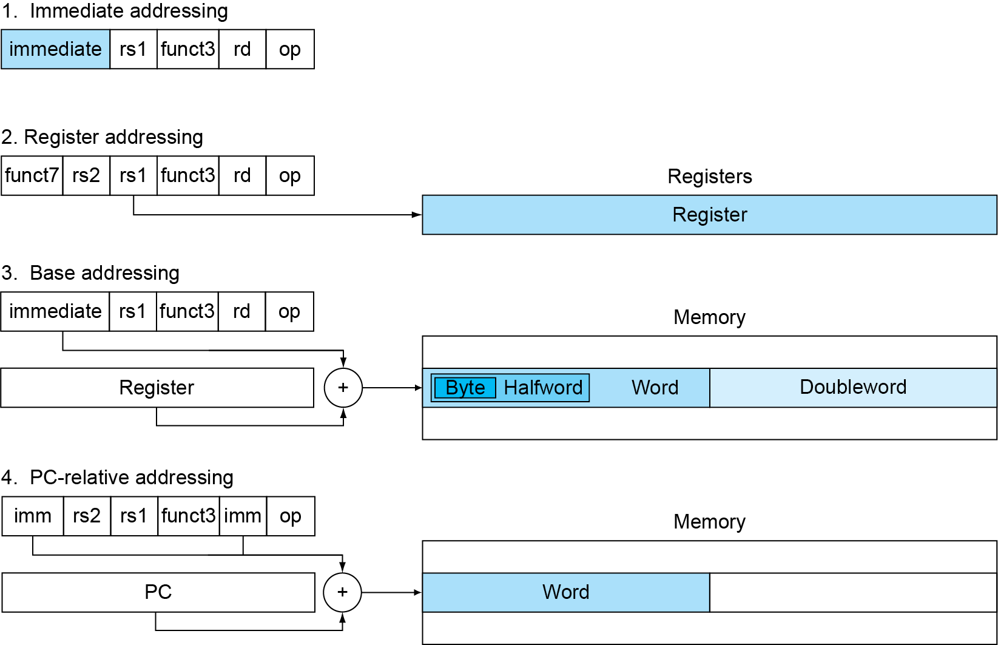
RISC-V Addressing Summary
addi x5,x6,4
add x5,x6,x7
ld x5,100(x6)
beq x5,x6,L1

Slide 86
RISC-V Disassembly
Example 2.22 P120： Decoding machine code
  Machine instruction(0x00578833)
  ( Bits: 31 25 24 20 7 2 0 )
  0000000 00101 01111 000 10000 0110011
  Decoding
    Determine the operation from opcode
    opcode: 0110011→ R-type arithmetic instruction
    funct7 and funct3 are all 0 → add instruction
    Determine other fields
    rs2: x5/t0; rs1: x15/a5; rd: x16/a7
    Show the assembly instruction：
  add a7, a5, t0 (Note: add rd,rs,rt)
funct7 | rs2 | rs1 | funct3 | rd | opcode
000 0000 | 00101 | 01111 | 000 | 10000 | 0110011
p107-P119

Slide 87
Summary of RISC-V instruction encoding
Format | Instruction | Opcode | Funct3 | Funct6/7
R-type | add | 0110011 | 000 | 0000000
 | sub | 0110011 | 000 | 0100000
 | sll | 0110011 | 001 | 0000000
 | xor | 0110011 | 100 | 0000000
 | srl | 0110011 | 101 | 0000000
 | sra | 0110011 | 101 | 0000000
 | or | 0110011 | 110 | 0000000
 | and | 0110011 | 111 | 0000000
 | lr.d | 0110011 | 011 | 0001000
 | sc.d | 0110011 | 011 | 0001100
Why not beqi?

Slide 88
Summary of RISC-V instruction encoding
Format | Instruction | Opcode | Funct3 | Funct6/7
I-type | lb | 0000011 | 000 | n.a.
 | lh | 0000011 | 001 | n.a.
 | lw | 0000011 | 010 | n.a.
 | ld | 0000011 | 011 | n.a.
 | lbu | 0000011 | 100 | n.a.
 | lhu | 0000011 | 101 | n.a.
 | lwu | 0000011 | 110 | n.a.
 | addi | 0010011 | 000 | n.a.
 | slli | 0010011 | 001 | 000000
 | xori | 0010011 | 100 | n.a.
 | srli | 0010011 | 101 | 000000
 | srai | 0010011 | 101 | 010000
 | ori | 0010011 | 110 | n.a.
 | andi | 0010011 | 111 | n.a.
 | jalr | 1100111 | 000 | n.a.

Slide 89
Summary of RISC-V instruction encoding
Format | Instruction | Opcode | Funct3 | Funct6/7
S-type | sb | 0100011 | 000 | n.a.
 | sh | 0100011 | 001 | n.a.
 | sw | 0100011 | 010 | n.a.
 | sd | 0100011 | 111 | n.a.
SB-type | beq | 1100111 | 000 | n.a.
 | bne | 1100111 | 001 | n.a.
 | blt | 1100111 | 100 | n.a.
 | bge | 1100111 | 101 | n.a.
 | bltu | 1100111 | 110 | n.a.
 | bgeu | 1100111 | 111 | n.a.
U-type | lui | 0110111 | n.a. | n.a.
UJ-type | jal | 1101111 | n.a. | n.a.

Slide 90
2.11 Synchronization in RISC-V
Two processors sharing an area of memory
  P1 writes, then P2 reads
  Data race if P1 and P2 don’t synchronize
    Result depends of order of accesses
Hardware support required
  Atomic read/write memory operation
  No other access to the location allowed between the read and write
Could be a single instruction
  E.g., atomic swap of register ↔ memory
  Or an atomic pair of instructions

Slide 91
Synchronization in RISC-V
Load reserved: lr.d rd,(rs1)
  Load from address in rs1 to rd
  Place reservation on memory address
Store conditional: sc.d rd,(rs1),rs2
  Store from rs2 to address in rs1
  Succeeds if location not changed since the lr.d
    Returns 0 in rd
  Fails if location is changed
    Returns non-zero value in rd

Slide 92
Synchronization in RISC-V
Example 1: atomic swap (to test/set lock variable)
  again: lr.d x10,(x20)
  sc.d x11,(x20),x23 // X11 = status
  bne x11,x0,again // branch if store failed
  addi x23,x10,0 // X23 = loaded value
Example 2: lock
  addi x12,x0,1 // copy locked value
  again: lr.d x10,(x20) // read lock
  bne x10,x0,again // check if it is 0 yet
  sc.d x11,(x20),x12 // attempt to store
  bne x11,x0,again // branch if fails
  Unlock:
  sd x0,0(x20) // free lock

Slide 93
2.12 Translating and starting a program

Slide 94
Producing an Object Module
Assembler (or compiler) translates program into machine instructions
Provides information for building a complete program from the pieces
  Header: described contents of object module
  Text segment: translated instructions
  Static data segment: data allocated for the life of the program
  Relocation info: for contents that depend on absolute location of loaded program
  Symbol table: global definitions and external refs
  Debug info: for associating with source code

Slide 95
Object file header
 | Name | Procedure A
 | Text size | 100_{hex}
 | Data size | 20_{hex}
Text segment | Address | instruction
 | 0 | ld x10, 0(gp)
 | 4 | jal x1, 0
 | …… | --
Data segment | 0 | (X)
 | …… | ……
Relocation information | Address | Instruction type | Dependency
 | 0 | ld | X
 | 4 | jal | B
Symbol table | label | Address
 | X | --
 | B | --

Slide 96
Link
  Object modules(including library routine) → executable program
  3 step of Link
    Place code and data modules symbolically in memory
    Determine the addresses of data and instruction labels
    Patch both the internal and external references (Address of invoke)
$sp
7fff fffc_{hex}
Stack
Dynamic data
$gp
1000 8000_{hex}
Static data
1000 0000_{hex}
Text
PC
0040 0000_{hex}
0
Reserved

Slide 97
Loading a Program
Load from image file on disk into memory
  1. Read header to determine segment sizes
  2. Create virtual address space
  3. Copy text and initialized data into memory
    Or set page table entries so they can be faulted in
  4. Set up arguments on stack
  5. Initialize registers (including sp, fp, gp)
  6. Jump to startup routine
    Copies arguments to x10, … and calls main
    When main returns, do exit syscall

Slide 98
Dynamic Linking
Only link/load library procedure when it is called
  Requires procedure code to be relocatable
  Avoids image bloat caused by static linking of all (transitively) referenced libraries
  Automatically picks up new library versions

Slide 99
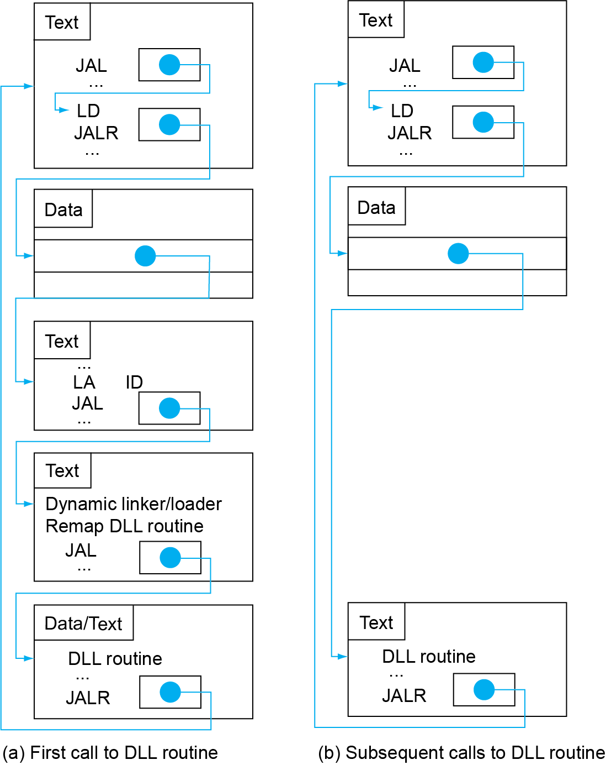
Lazy Linkage
Indirection table
Stub: Loads routine ID,
Jump to linker/loader
Linker/loader code
Dynamically
mapped code

Slide 100
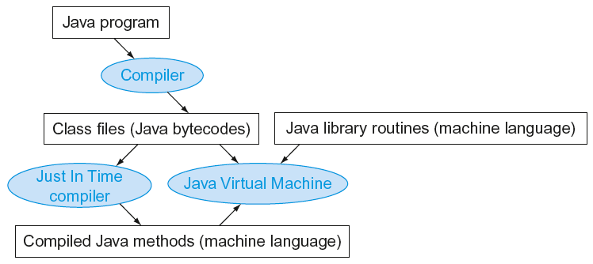
Starting Java Applications
Simple portable instruction set for the JVM
Compiles bytecodes of “hot” methods into native code for host machine
Interprets bytecodes

Slide 101
2.13 A C Sort Example To Put it All Together
Three general steps for translating C procedures
  Allocate registers to program variables
  Produce code for the body of the procedures
  Preserve registers across the procedures invocation
Procedure swap
  C code
  void swap ( long long v[ ] , size_t k )
  {
  long lon temp ;
  temp = v[ k ] ;
  v[ k ] = v[ k + 1 ] ;
  v[ k + 1 ] = temp ;
  }

Slide 102
The Procedure Swap
  Register allocation for swap
  v ---- x10 k ---- x11 temp ---- x5
  swap is a leaf procedure, nothing to preserve
  RISC-V code for the procedure swap
    Procedure body
  swap: slli x6, x11, 3 // x6 = k * 8
  add x6, x10, x6 // x6 = v + ( k * 8 )
  ld x5, 0(x6) // x5 ← v[ k ]
  ld x7, 8(x6) // x7 ← v[ k + 1 ]
  sd x7, 0(x6) // v[k+1] → v[ k ]
  sd x5, 8(x6) // v[k] → v[ k + 1 ]
    Procedure return
  jalr x0, 0(x1) // return to calling routine

Slide 103
The Sort Procedure in C
Procedure sort
  C code
  void sort (long long v[ ] , size_t n )
  {
  size_t i , j ;
  for ( i = 0 ; i < n ; i + = 1 ) {
  for ( j = i - 1 ; j >= 0 && v[j] > v[j+1] ; j -= 1 )
  swap ( v , j ) ;
  }
  }
  Register allocation for sort
  v ---- x10 n ---- x11 i ---- x19 j ---- x20
  Passing parameters in sort
  Preserving registers in sort
  x1 , x19, x20, x21, x22

Slide 104
The Outer Loop
Skeleton of outer loop:
  for (i = 0; i <n; i += 1) {
lui x19,0 // i = 0
for1tst:
bge x19,x11,exit1 // go to exit1 if x19 ≥ x11 (i≥n)
(body of outer for-loop)
addi x19,x19,1 // i += 1
jal. x0,for1tst // branch to test of outer loop
exit1:

Slide 105
The Inner Loop
Skeleton of inner loop:
  for (j = i − 1; j >= 0 && v[j] > v[j + 1]; j − = 1) {
addi x20,x19,-1 // j = i −1
for2tst:
blt x20,x0,exit2 // go to exit2 if X20 < 0 (j < 0)
slli x5,x20,3 // reg x5 = j * 8
add x5,x10,x5 // reg x5 = v + (j * 8)
ld x6,0(x5) // reg x6 = v[j]
ld x7,8(x5) // reg x7 = v[j + 1]
ble x6,x7,exit2 // go to exit2 if x6 ≤ x7
mv x21, x10 // copy parameter x10 into x21
mv x22, x11 // copy parameter x11 into x22
mv x10, x21 // first swap parameter is v
mv x11, x20 // second swap parameter is j
jal x1,swap // call swap
addi x20,x20,-1 // j –= 1
jal x0, for2tst // branch to test of inner loop
exit2:

Slide 106
Preserving Registers
    Saving registers
  sort: addi sp, sp, -40 // make room on stack for 5 registers
  sd x1, 32(sp) // save return address on stack
  sd x22, 24(sp) // save x22 on stack
  sd x21, 16(sp) // save x21 on stack
  sd x20, 8(sp) // save x20 on stack
  sd x19, 0(sp) // save x19 on stack
    Procedure body{Outer loop {Inner loop} }
    Restoring registers
    exit1: ld x19, 0(sp) // restore x19 from stack
    ld x20, 8(sp) // restore x20 from stack
    ld x21, 16(sp) // restore x21 from stack
    ld x22, 24(sp) // restore x22 from stack
    ld x1, 32(sp) // restore return address from stack
    addi sp, sp, 40 // restore stack pointer
    Procedure return
    jalr x0, 0(x0) // return to calling routine

Slide 107
2.14 Arrays versus Pointers
Array indexing involves
  Multiplying index by element size
  Adding to array base address
Pointers correspond directly to memory addresses
  Can avoid indexing complexity

Slide 108
Example: Clearing an Array
clear1(int array[], int size) { int i; for (i = 0; i < size; i += 1) array[i] = 0; } | clear2(int *array, int size) { int *p; for (p = &array[0]; p < &array[size]; p = p + 1) *p = 0; }
li x5,0 // i = 0 loop1: slli x6,x5,3 // x6 = i * 8 add x7,x10,x6 // x7 = address // of array[i] sd x0,0(x7) // array[i] = 0 addi x5,x5,1 // i = i + 1 blt x5,x11,loop1 // if (i<size) // go to loop1 | mv x5,x10 // p = address // of array[0] slli x6,x11,3 // x6 = size * 8 add x7,x10,x6 // x7 = address // of array[size] loop2: sd x0,0(x5) // Memory[p] = 0 addi x5,x5,8 // p = p + 8 bltu x5,x7,loop2 // if (p<&array[size]) // go to loop2

Slide 109
Comparison of Array vs. Ptr
Multiply “strength reduced” to shift
Array version requires shift to be inside loop
  Part of index calculation for incremented i
  c.f. incrementing pointer
Compiler can achieve same effect as manual use of pointers
  Induction variable elimination
  Better to make program clearer and safer

Slide 110
2.16 Real Stuff: MIPS Instructions
MIPS: commercial predecessor to RISC-V
Similar basic set of instructions
  32-bit instructions
  32 general purpose registers, register 0 is always 0
  32 floating-point registers
  Memory accessed only by load/store instructions
    Consistent use of addressing modes for all data sizes
Different conditional branches
  For <, <=, >, >=
  RISC-V: blt, bge, bltu, bgeu
  MIPS: slt, sltu (set less than, result is 0 or 1)
    Then use beq, bne to complete the branch

Slide 111
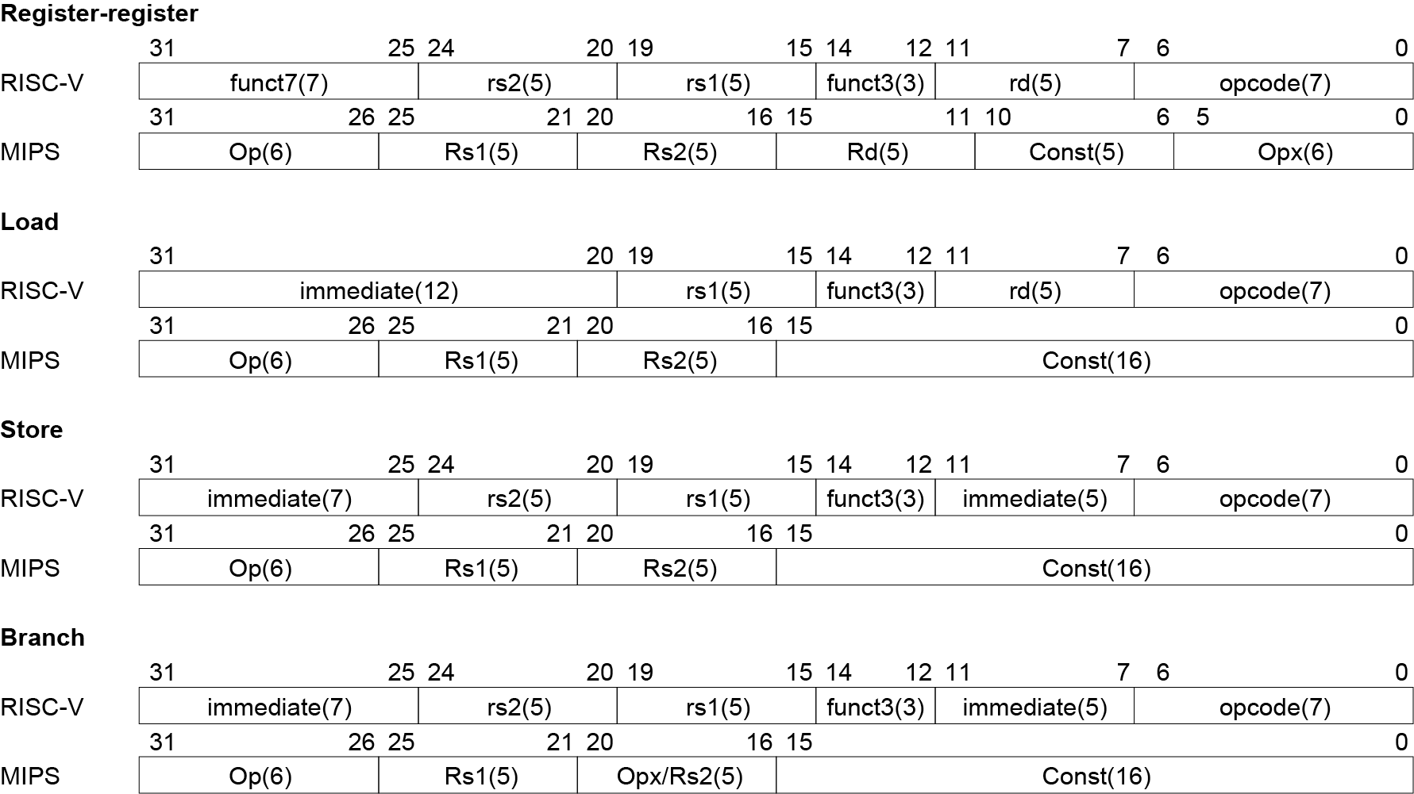
Instruction Encoding

Slide 112
2.17 Real Stuff: The Intel x86 ISA
Evolution with backward compatibility
  8080 (1974): 8-bit microprocessor
    Accumulator, plus 3 index-register pairs
  8086 (1978): 16-bit extension to 8080
    Complex instruction set (CISC)
  8087 (1980): floating-point coprocessor
    Adds FP instructions and register stack
  80286 (1982): 24-bit addresses, MMU
    Segmented memory mapping and protection
  80386 (1985): 32-bit extension (now IA-32)
    Additional addressing modes and operations
    Paged memory mapping as well as segments

Slide 113
The Intel x86 ISA
Further evolution…
  i486 (1989): pipelined, on-chip caches and FPU
    Compatible competitors: AMD, Cyrix, …
  Pentium (1993): superscalar, 64-bit datapath
    Later versions added MMX (Multi-Media eXtension) instructions
    The infamous FDIV bug
  Pentium Pro (1995), Pentium II (1997)
    New microarchitecture (see Colwell, The Pentium Chronicles)
  Pentium III (1999)
    Added SSE (Streaming SIMD Extensions) and associated registers
  Pentium 4 (2001)
    New microarchitecture
    Added SSE2 instructions

Slide 114
The Intel x86 ISA
And further…
  AMD64 (2003): extended architecture to 64 bits
  EM64T – Extended Memory 64 Technology (2004)
    AMD64 adopted by Intel (with refinements)
    Added SSE3 instructions
  Intel Core (2006)
    Added SSE4 instructions, virtual machine support
  AMD64 (announced 2007): SSE5 instructions
    Intel declined to follow, instead…
  Advanced Vector Extension (announced 2008)
    Longer SSE registers, more instructions
If Intel didn’t extend with compatibility, its competitors would!
  Technical elegance ≠ market success

Slide 115
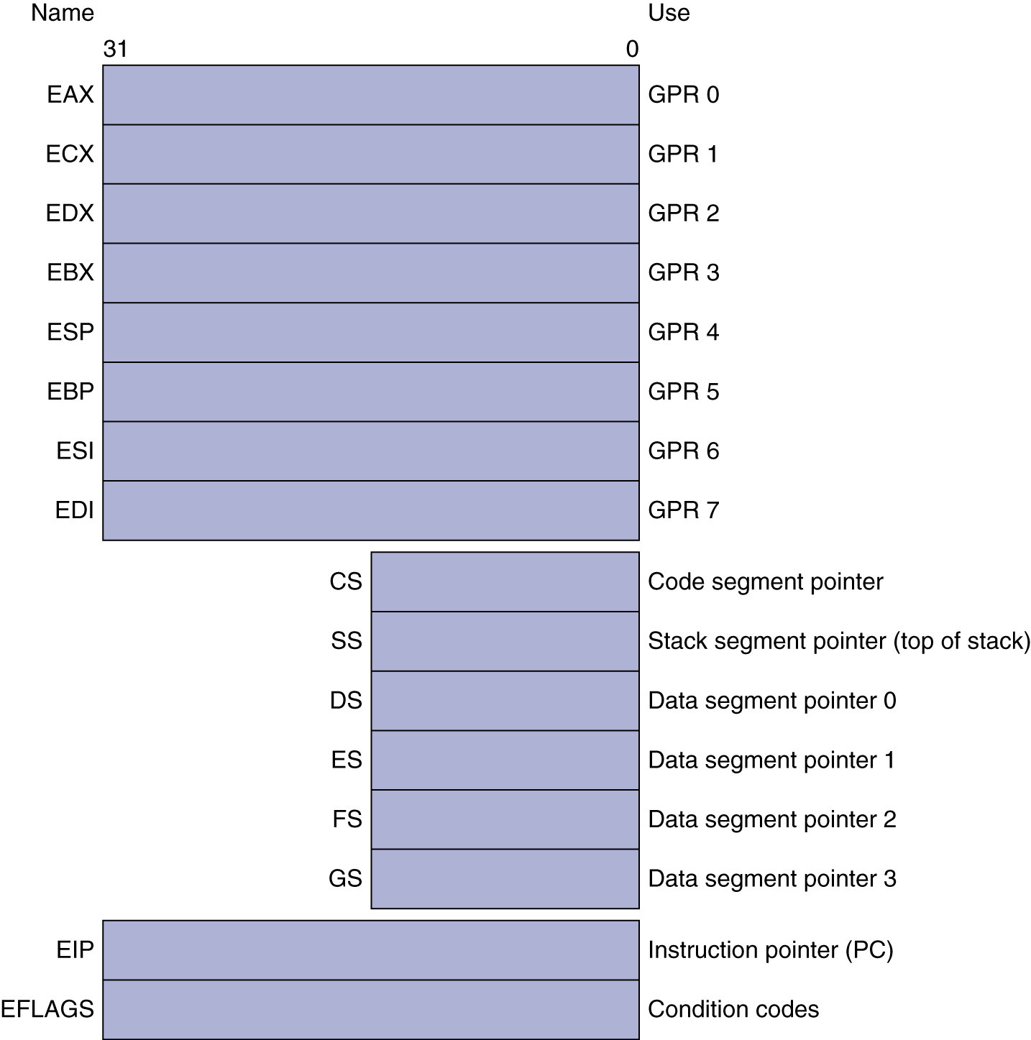
Basic x86 Registers

Slide 116
Basic x86 Addressing Modes
Two operands per instruction
Source/dest operand | Second source operand
Register | Register
Register | Immediate
Register | Memory
Memory | Register
Memory | Immediate
Memory addressing modes
  Address in register
  Address = R_{base} + displacement
  Address = R_{base} + 2^{scale} × R_{index} (scale = 0, 1, 2, or 3)
  Address = R_{base} + 2^{scale} × R_{index} + displacement

Slide 117
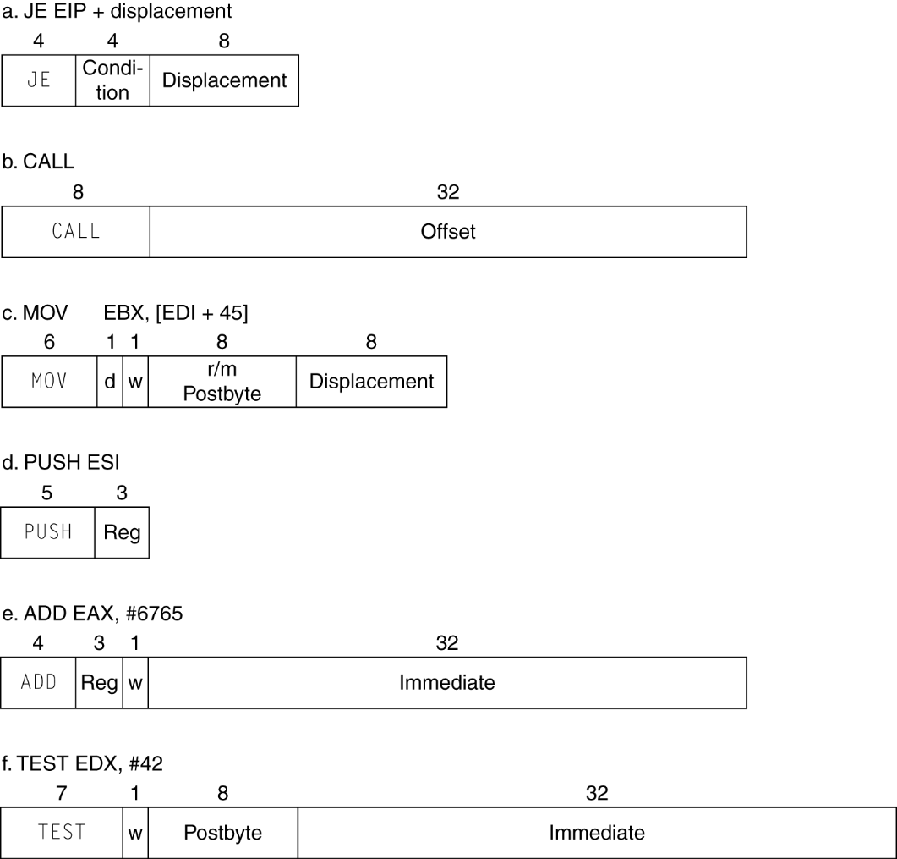
x86 Instruction Encoding
Variable length encoding
  Postfix bytes specify addressing mode
  Prefix bytes modify operation
    Operand length, repetition, locking, …

Slide 118
Implementing IA-32
Complex instruction set makes implementation difficult
  Hardware translates instructions to simpler microoperations
    Simple instructions: 1–1
    Complex instructions: 1–many
  Microengine similar to RISC
  Market share makes this economically viable
Comparable performance to RISC
  Compilers avoid complex instructions

Slide 119
2.18 Other RISC-V Instructions
Base integer instructions (RV64I)
  Those previously described, plus
  auipc rd, immed // rd = (imm<<12) + pc
    follow by jalr (adds 12-bit immed) for long jump
  slt, sltu, slti, sltui: set less than (like MIPS)
  addw, subw, addiw: 32-bit add/sub
  sllw, srlw, srlw, slliw, srliw, sraiw: 32-bit shift
32-bit variant: RV32I
  registers are 32-bits wide, 32-bit operations

Slide 120
Instruction Set Extensions
M: integer multiply, divide, remainder
A: atomic memory operations
F: single-precision floating point
D: double-precision floating point
C: compressed instructions
  16-bit encoding for frequently used instructions

Slide 121
Fallacies
Powerful instruction ⇒ higher performance
  Fewer instructions required
  But complex instructions are hard to implement
    May slow down all instructions, including simple ones
  Compilers are good at making fast code from simple instructions
Use assembly code for high performance
  But modern compilers are better at dealing with modern processors
  More lines of code ⇒ more errors and less productivity

Slide 122
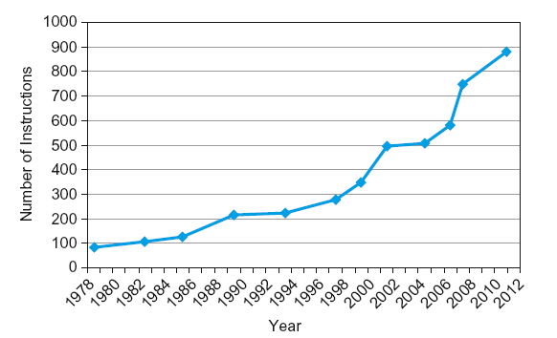
Fallacies
Backward compatibility ⇒ instruction set doesn’t change
  But they do accrete more instructions
x86 instruction set

Slide 123
Pitfalls
Sequential words are not at sequential addresses
  Increment by 4, not by 1!
Keeping a pointer to an automatic variable after procedure returns
  e.g., passing pointer back via an argument
  Pointer becomes invalid when stack popped

Slide 124
Summary
Design principles
  1. Simplicity favors regularity
  2. Smaller is faster
  3. Good design demands good compromises
Make the common case fast
Layers of software/hardware
  Compiler, assembler, hardware
RISC-V: typical of RISC ISAs
  c.f. x86

Slide 125
Homework
2.4, 2.8, 2.12, 2.14, 2.17, 2.22, 2.24, 2.29

