Slide 1
Logistic Regression

Slide 2
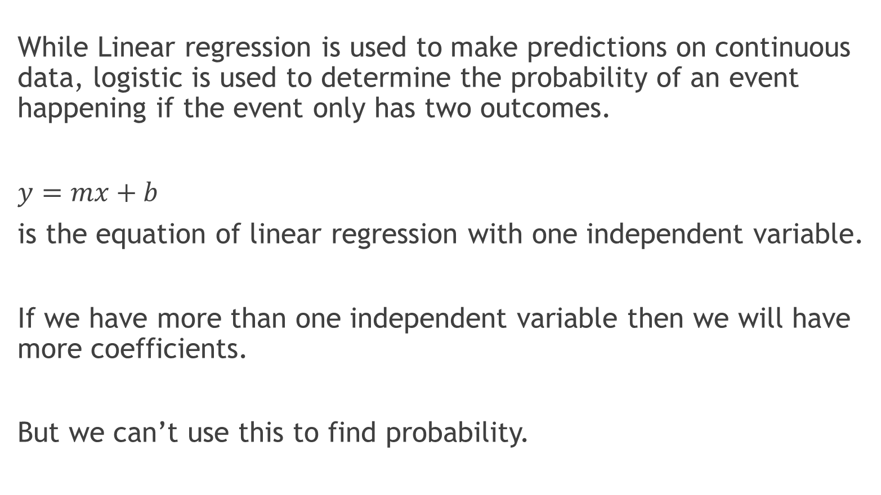
Linear Vs Logistic
While Linear regression is used to make predictions on continuous data, logistic is used to determine the probability of an event happening if the event only has two outcomes.
$y=mx+b$
is the equation of linear regression with one independent variable.
If we have more than one independent variable then we will have more coefficients.
But we can’t use this to find probability.

Slide 3
When do we use logistic regression?
Whenever we have two outcomes.
Examples:
If students studied for a certain time, would they pass an exam or not?
Can a person with a certain credit score, get a home loan or not?
In case of student study time, there are only two outcomes. Either the student passes the exam or does not.

Slide 4
An Example
Graph of study hours and pass, 0 indicates fail and 1 indicates pass.

Slide 5
Goals of Logistic Regression
Model and use the model for prediction.
Create a model using the independent variables to determine the probability of an event occurring
Use the model to predict probability that an observation would fall into one category or other.

Slide 6
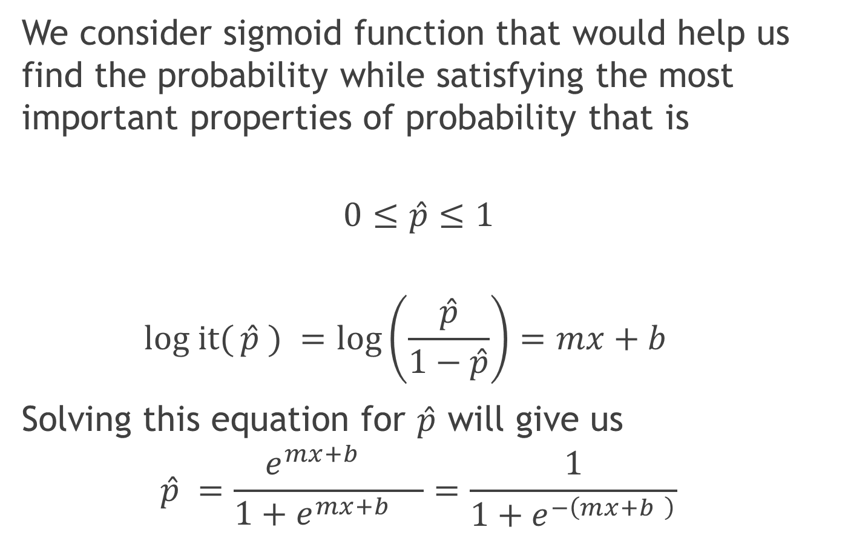
Sigmoid function
We consider sigmoid function that would help us find the probability while satisfying the most important properties of probability that is
$$0≤\hat{p}≤1$$
$$log it({\hat{p} ) }=log\left(\frac{\hat{p}}{1−\hat{p}}\right)=mx+b$$
Solving this equation for $\hat{p}$ will give us
$$\hat{p} =\frac{e^{mx+b }}{1+e^{mx+b }}=\frac{1}{1+e^{−\left(mx+b \right)}}$$

Slide 7
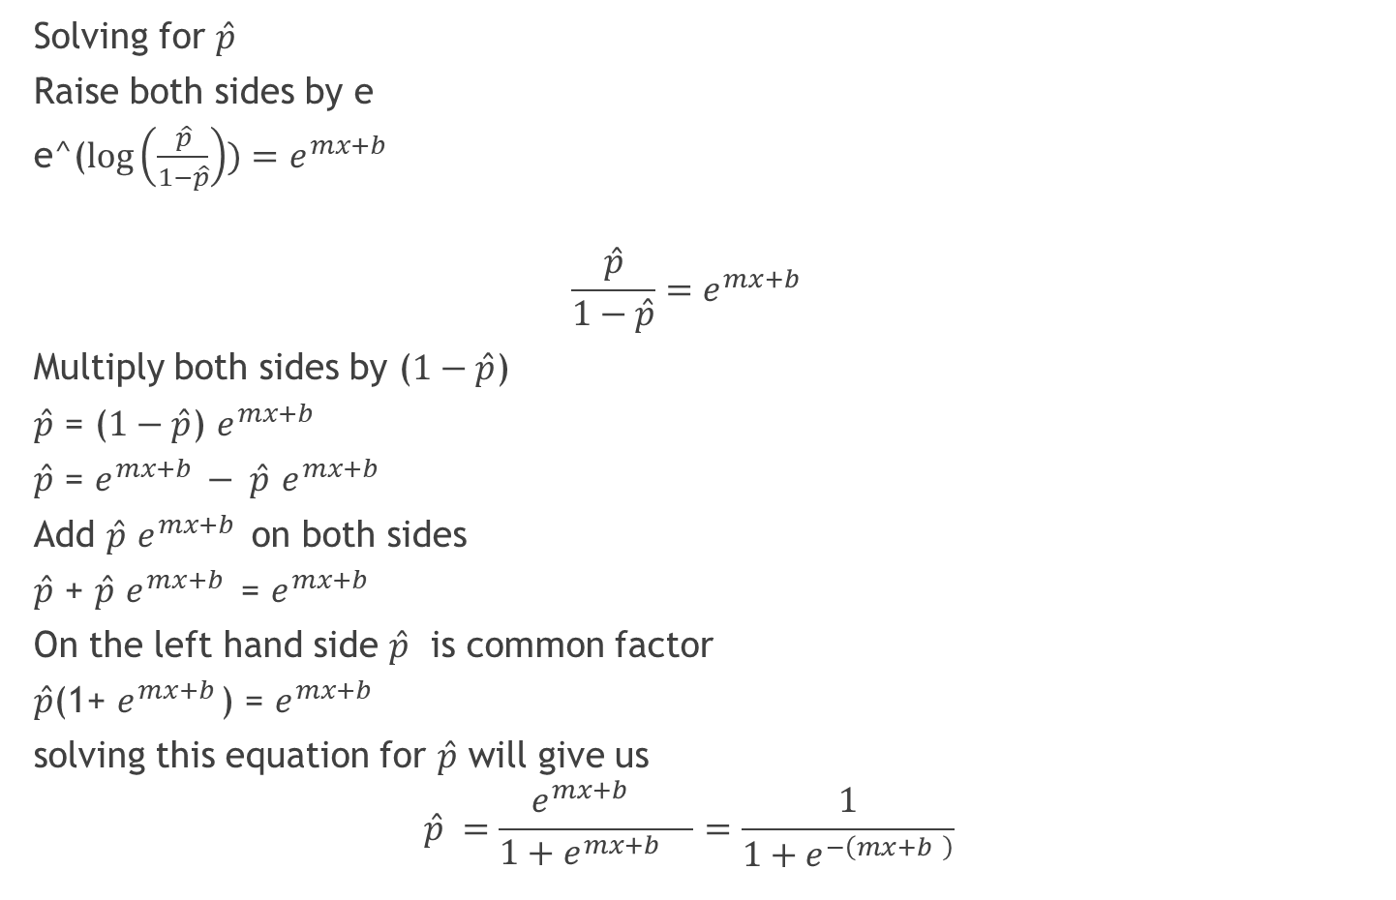

Solving for $\hat{p}$
Solving for $\hat{p}$
Raise both sides by e
e^($log\left(\frac{\hat{p}}{1−\hat{p}}\right))=e^{mx+b }$
$$\frac{\hat{p}}{1−\hat{p}}=e^{mx+b }$$
Multiply both sides by ($1−\hat{p}$)
$\hat{p}$ = ($1−\hat{p}$) $e^{mx+b }$
$\hat{p}$ = $e^{mx+b }− \hat{p}$ $e^{mx+b }$
Add $\hat{p}$ $e^{mx+b }$ on both sides
$\hat{p}$ + $\hat{p}$ $e^{mx+b }$ = $e^{mx+b }$
On the left hand side $\hat{p}$ is common factor
$\hat{p}$(1+ $e^{mx+b }$) = $e^{mx+b }$
solving this equation for $\hat{p}$ will give us
$$\hat{p} =\frac{e^{mx+b }}{1+e^{mx+b }}=\frac{1}{1+e^{−\left(mx+b \right)}}$$

Slide 8
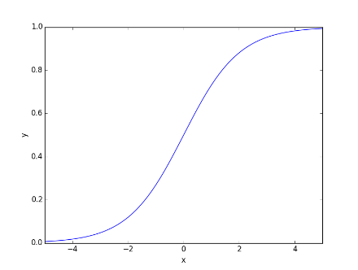
Sigmoid function graph
Sigmoid function looks like an ‘S’ with values between 0 and 1 making it ideal for logit function.

Slide 9
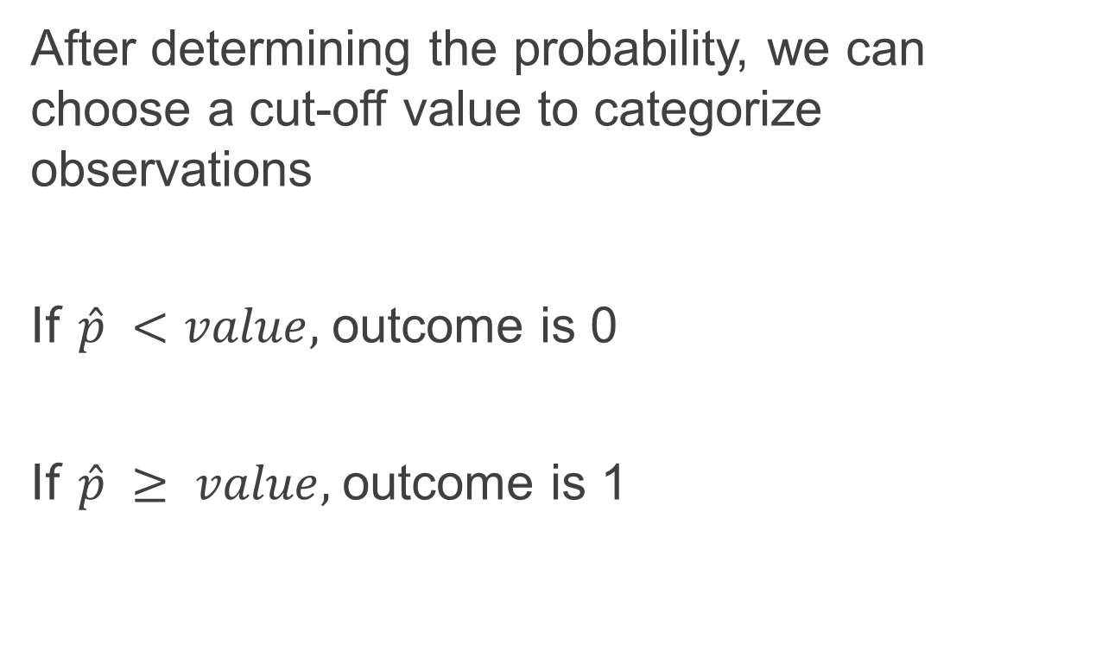
Classification
After determining the probability, we can choose a cut-off value to categorize observations
If $\hat{p} <value,$outcome is 0
If $\hat{p} ≥ value,$outcome is 1

Slide 10
Study Hours | Pass
0.5 | 0
0.75 | 0
1.00 | 0
1.25 | 0
1.50 | 0
1.75 | 0
1.75 | 1
2 | 1
2.25 | 1
2.50 | 1
2.75 | 1
3.00 | 0
3.25 | 1
3.50 | 0
4.00 | 1
4.25 | 1
4.50 | 1
4.75 | 1
5.00 | 1
5.50 | 1
Considering this data from Wikipedia
https://en.wikipedia.org/wiki/Logistic_regression

