Slide 1
SVM Multi-class Explanation

Slide 2
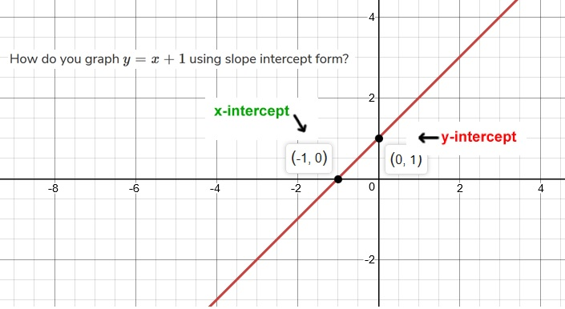
y = x+1
y-x-1 = f(x,y) - eq(1)
On one side of this line, the values are positive and on the other side, the values are negative.
X=2, y=0
f < 0

Slide 3
One vs One
Circle vs Stars
Stars vs Triangles
?
Circle vs Triangles

Slide 4
One vs Rest
Stars vs rest
Triangles vs rest
?
Circle vs Rest

