Slide 1
Convolutional neural network

Slide 2
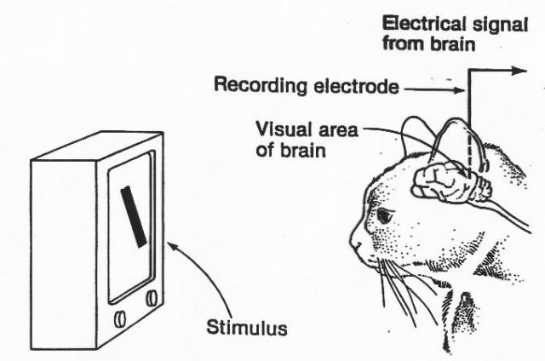
Hubel and Wiesel cat experiment
https://goodpsychology.files.wordpress.com/2013/03/hubel-experiment.jpg
https://youtu.be/IOHayh06LJ4
https://www.youtube.com/watch?v=Gv6Edl-pidA

Slide 3
LeNet
http://www.pyimagesearch.com/2016/08/01/lenet-convolutional-neural-network-in-python/

Slide 4


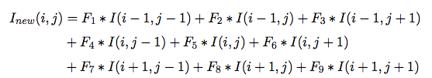
Convolution

Slide 5
Convolution
Padding ‘SAME’ will add 0 to edge, so that the image size can be maintained.
Stride is specified as a tuple with 2 values (stride_x, stride_y). So, stride = (2, 2) implies that we will jump 2 pixels after convolution. This will reduce the image by half. It is preferable to use (1, 1) and padding=‘same’, so that image size is not modified by convolution.
Kernel specified as a tuple with two values, (width, height). So, stride = (2,2), will shrink the image by half.

Slide 6
Maxpooling
10 | 6 | 4 | 6
8 | 2 | 12 | 5
45 | 23 | -20 | -30
-10 | 12 | 30 | 64
10 | 12
45 | 64

Slide 7
MAXPooling
Padding ‘SAME’ will add 0 to edge, so that the image size can be maintained.
Stride is specified as a tuple with 2 values (stride_x, stride_y). So, stride = (2, 2) implies that we will jump 2 pixels after max pooling. This reduces the image size by half.

Slide 8
LeNet
10 outputs
28 x 28 image
Conv1
Conv2
Max pooling
Max pooling
RELU with dropout

Slide 9
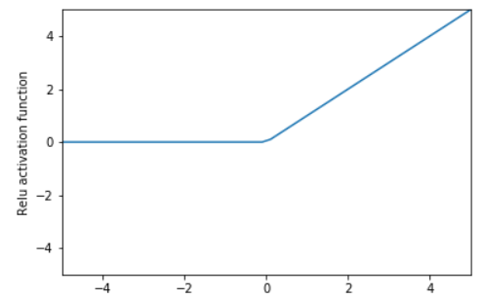
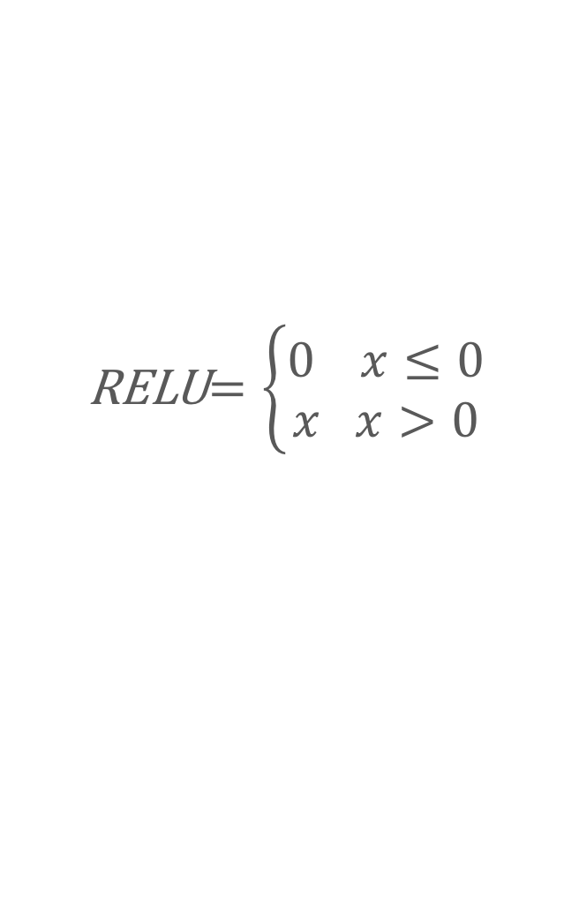
RELU activation
RELU$=\left\{\begin{aligned}0 x≤0 \\ x x>0\end{aligned}\right.$

Slide 10
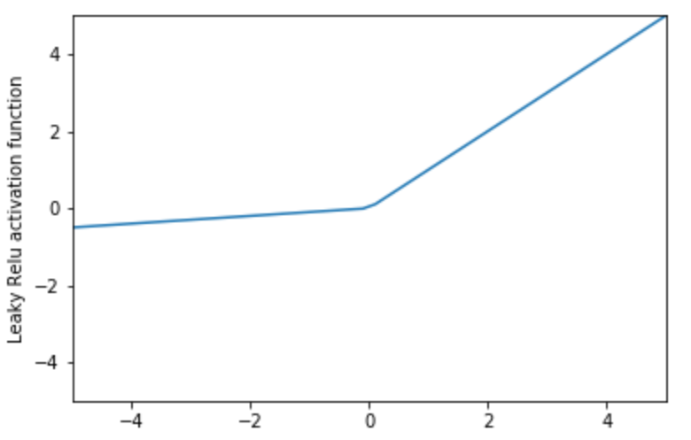
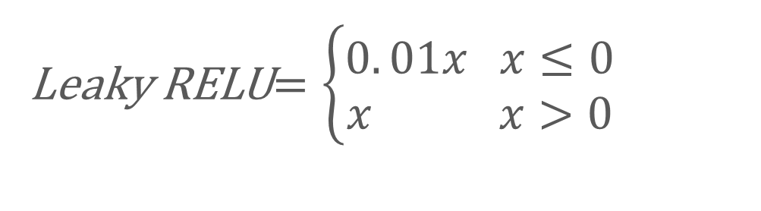
Leaky RELU activation
Leaky RELU$=\left\{\begin{aligned}0. 01x x≤0 \\ x x>0\end{aligned}\right.$

Slide 11
Overfitting
Poor fitting
y
Overfitting
x

Slide 12
Dropout to avoid overfitting
Dropout for training and not testing or predicting.
Drop a set of edges during training to avoid overfitting.
Works like ensemble method.
Similar in idea to resilience in a computer network.

Slide 13
https://medium.com/@amarbudhiraja/https-medium-com-amarbudhiraja-learning-less-to-learn-better-dropout-in-deep-machine-learning-74334da4bfc5

Slide 14
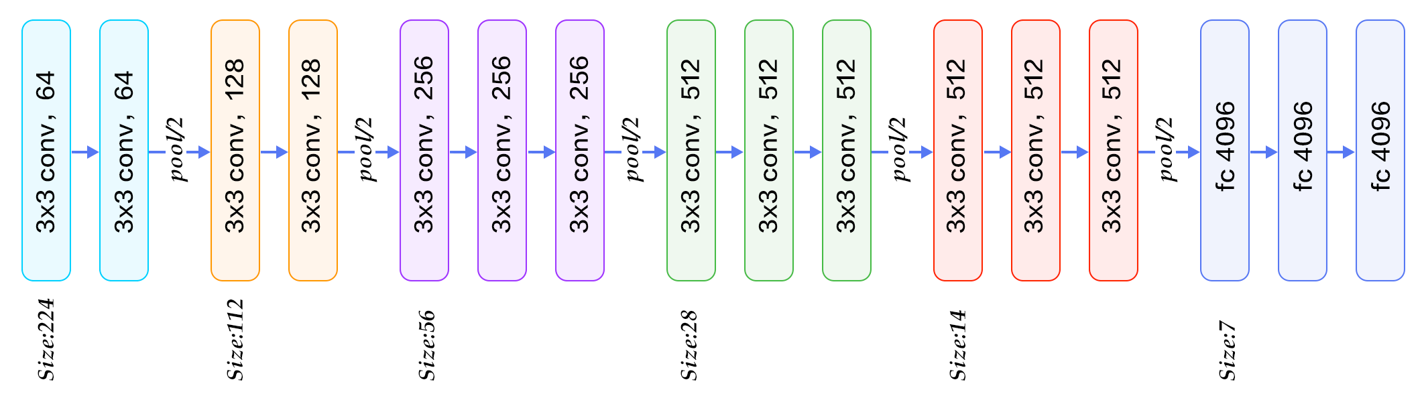
Visual Geometry Group - VGG16
https://www.quora.com/What-is-the-VGG-neural-network

Slide 15
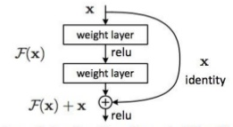
RESNET
https://www.slideshare.net/SomnathBanerjee17/lenet-to-resnet

Slide 16
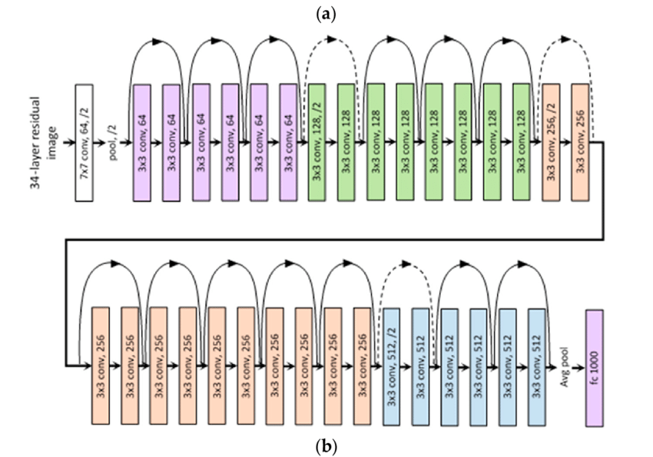
RESNET
https://www.slideshare.net/SomnathBanerjee17/lenet-to-resnet

Slide 17
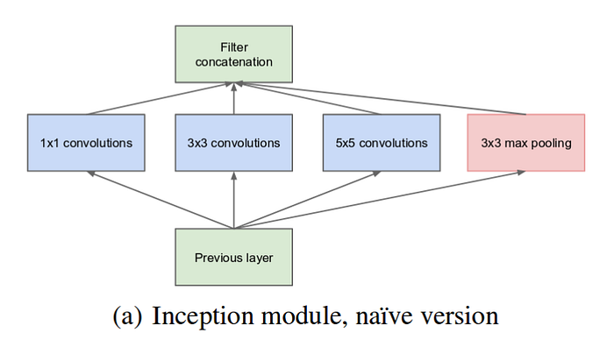
Inception
https://towardsdatascience.com/a-simple-guide-to-the-versions-of-the-inception-network-7fc52b863202

Slide 18
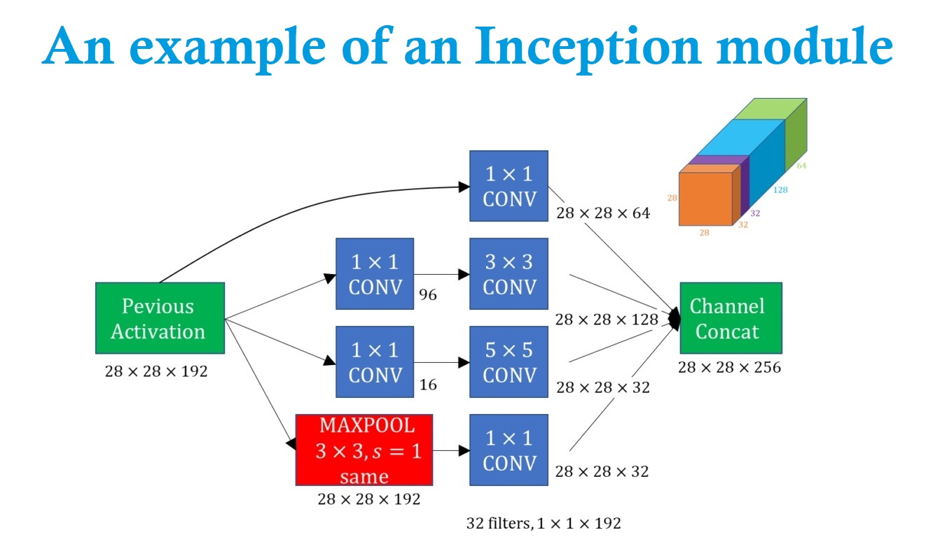
Inception – Another Example
https://datahacker.rs/deep-learning-inception-network/

Slide 19
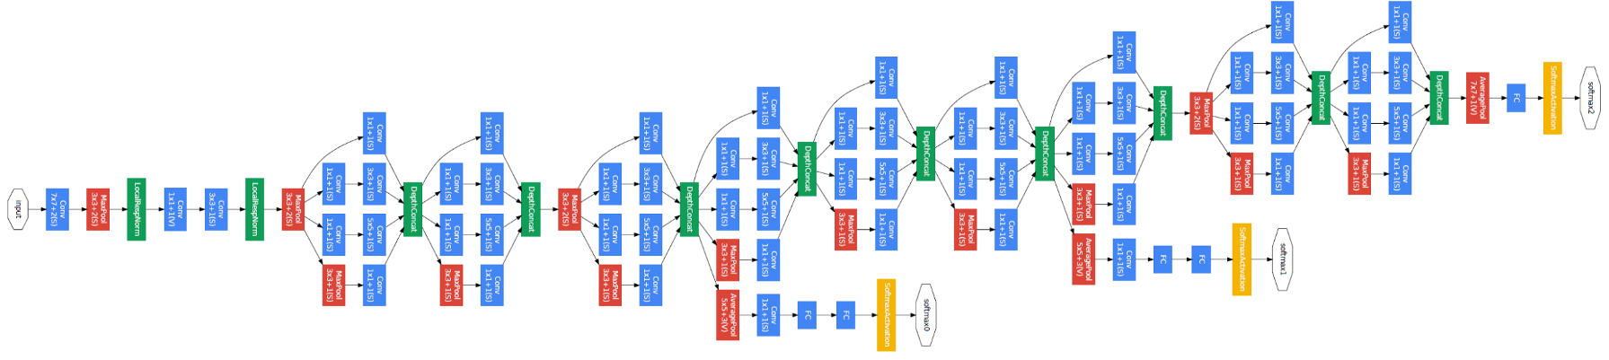
Inception
https://www.slideshare.net/SomnathBanerjee17/lenet-to-resnet

Slide 20
Reference
Ian Goodfellow et.al., “Deep learning”, Chapter 9
https://github.com/merantix/picasso Python module for visualizing CNN
http://cs231n.github.io/convolutional-networks/
https://www.youtube.com/watch?v=s716QXfApa0
https://www.youtube.com/watch?v=FmpDIaiMIeA
https://codelabs.developers.google.com/codelabs/cloud-tensorflow-mnist#9

