Slide 1
Decision tree

Slide 2


Slide 3
Decision tree
Decision Tree is a supervised learning technique used for classification.
We use features to build a tree.
The tree should have
a root
branches
leaves.
We start with a feature as a root and then use other features to branch the tree.

Slide 4
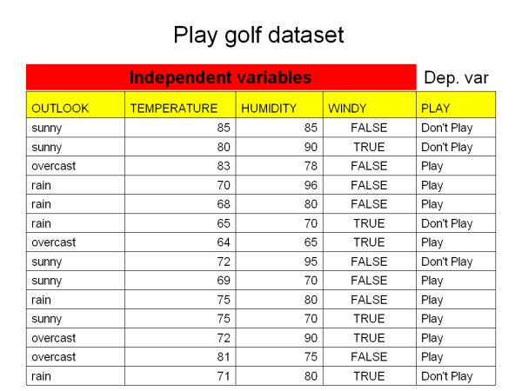
Let us consider a dataset.

Slide 5
For the same data set, using different features, several decision trees can be built; which one to use?
The one that gives the most information and has least entropy.
In simple terms, we want a tree which gives most information with minimum number of levels.

Slide 6
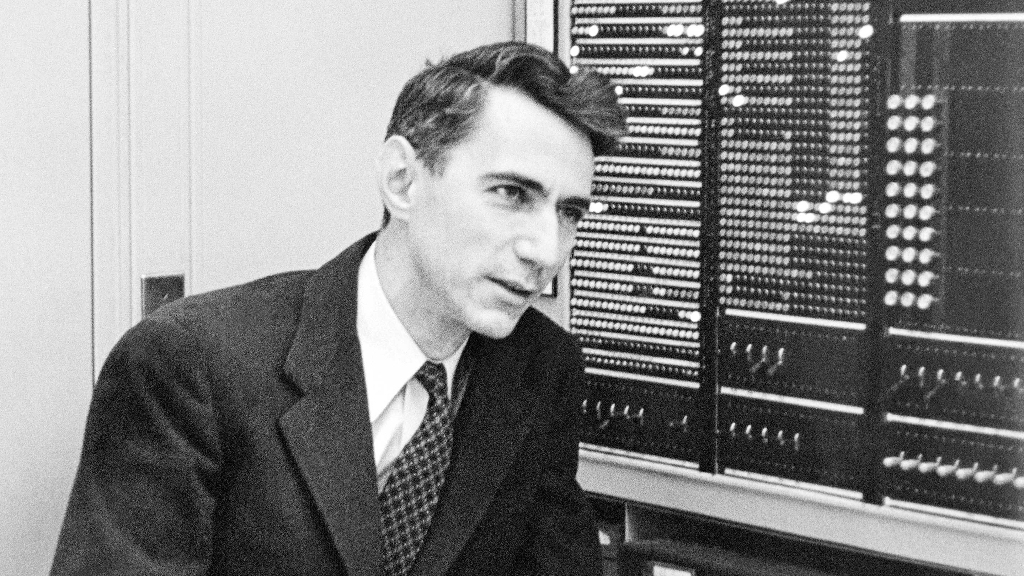
Father Of Information Theory
Claude Shannon
https://en.wikipedia.org/wiki/Claude_Shannon
https://www.quantamagazine.org/how-claude-shannons-information-theory-invented-the-future-20201222/

Slide 7
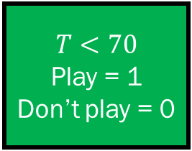
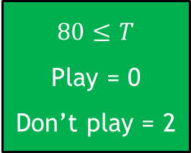
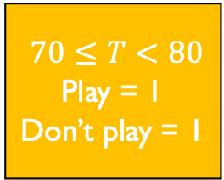
Let’s construct a decision tree
Play Golf dataset
n = 14
Outcome = play golf
Outlook
Play = 9
Don’t play = 5
Sunny
Play = 2
Don’t play = 3
Cloudy
Play = 4
Don’t play = 0
Rainy
Play = 3
Don’t Play = 2
$$T<70$$
Play = 1
Don’t play = 0
$70≤T<80$
Play = 1
Don’t play = 1
$$80≤T$$
Play = 0
Don’t play = 2
Windy False
Play = 3
Don’t play = 0
Windy True
Play = 0
Don’t play = 2
Outlook = Sunny
Temperature = 85
Humidity = 75
Windy = False
Play/Don’t Play ?
Traversing through the tree, we can say that for the given data point, the target is Don’t Play.
Windy True
Play = 1
Don’t play = 0
Windy False
Play = 0
Don’t play = 1

Slide 8

Information gain theorem
$$Entropy= \sum_{i=1}^{c}{−p_{i} ln⁡(p_{i})}$$
$$Gain\left(A, B\right)=Entropy\left(A\right)−Entropy(A, B)$$

Slide 9
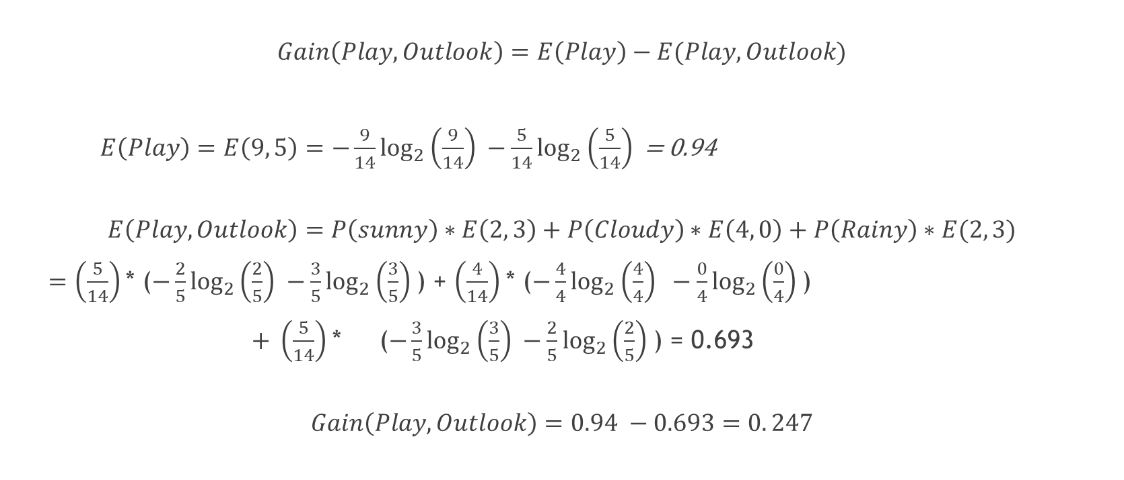

Compute the information gain
$$Entropy= \sum_{i=1}^{c}{−p_{i} ln⁡(p_{i})}$$
$$Gain\left(A, B\right)=Entropy\left(A\right)−Entropy(A, B)$$
Play? || Outlook | Sunny | Cloudy | Rainy | Total
Play | 2 | 4 | 3 | 9
Don’t play | 3 | 0 | 2 | 5
Total | 5 | 4 | 5 | 14
$$Gain\left(Play, Outlook\right)=E\left(Play\right)−E(Play, Outlook)$$
$E\left(Play\right)=E\left(9, 5\right)=−\frac{9}{14}\log_{2}\left(\frac{9}{14}\right) −\frac{5}{14}\log_{2}\left(\frac{5}{14}\right)$ = 0.94
$$E\left(Play, Outlook\right)=P\left(sunny\right)∗E\left(2, 3\right)+P\left(Cloudy\right)∗E\left(4, 0\right)+P\left(Rainy\right)∗E(2, 3)$$
$=\left(\frac{5}{14}\right)$* ($−\frac{2}{5}\log_{2}\left(\frac{2}{5}\right) −\frac{3}{5}\log_{2}\left(\frac{3}{5}\right)$) + $\left(\frac{4}{14}\right)$* ($−\frac{4}{4}\log_{2}\left(\frac{4}{4}\right) −\frac{0}{4}\log_{2}\left(\frac{0}{4}\right)$)
$+ \left(\frac{5}{14}\right)$* ($−\frac{3}{5}\log_{2}\left(\frac{3}{5}\right) −\frac{2}{5}\log_{2}\left(\frac{2}{5}\right)$) = 0.693
$$Gain\left(Play, Outlook\right)=0.94 −0.693=0. 247$$

Slide 10
Iterative Dichotomiser 3 (ID3)
Algorithm:
Start at root node also known as parent node.
Split the parent node at the feature to minimize the sum of entropy which will maximize information gain.
Assign training data to new child nodes
Repeat steps 1 and 2 for each new child node until the nodes can’t be split or reach a stopping criteria.
When do we stop?
When the nodes can’t be split any further.
Maximum tree depth is reached.
Splitting a node doesn’t yield new information gain.

Slide 11
Takeaway lessons
We chose the outlook as the root node so that we can have the maximum split, three. Your choice of a root varies from dataset to dataset.
We arrived at the leaf nodes (green in color) in the least number of levels.

Slide 12
What will Sklearn use?
Sklearn will automatically choose a root following the ID3 algorithm that would have the maximum information gain.

Slide 13
Advantages of Decision Tree
Easy to interpret
Limited data preparation as features do not have to be scaled
Not easily influenced by outliers
Non-parametric and hence less reliant on feature distribution.

Slide 14
Disadvantages of Decision Tree
Overfitting
A small change during retraining can result in a significant change in the tree structure

