Slide 1
Linear Regression

Slide 2
Learning Objectives
Linear Regression and Multi-linear Regression
An Example
Correlation
Loss Function
Metrics to valid the model and goodness of fit

Slide 3
An Example
Study time (min) | Score out of 100
16 | 50
34 | 61
8 | 45
38 | 60
39 | 60
40 | 67
54 | 65
21 | 59
16 | 57
67 | 73
40 | 68
43 | 71
47 | 75
56 | 71
60 | 88
80 | 94
Does study hours have
influence on exam score?

Slide 4
Scatterplot

Slide 5
What is our Goal?
We want to derive a linear mathematical equation that can be used to predict exam score if study time is given.
We want to build a simple model that is computationally efficient.

Slide 6
Bivariant Analysis
Understanding how two variables are related to each other can help us simplify our model.
With this pursuit in mind, we will look at how two variables are linearly related using a measure called “Correlation.”

Slide 7
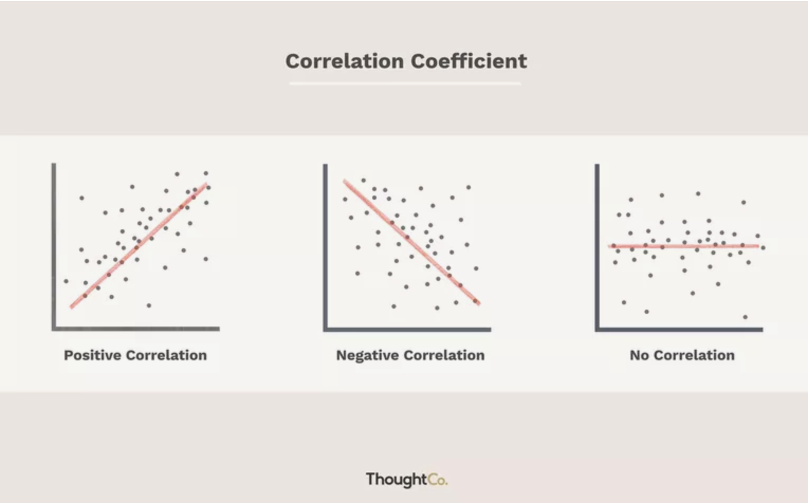
Correlation Coefficient - Relationship
Correlation Coefficient helps us understand bivariant behavior.

Slide 8
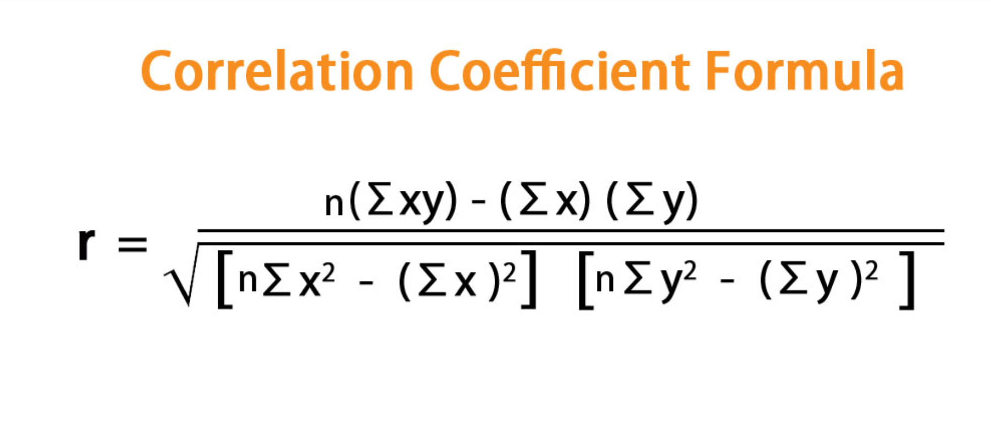
Correlation Coefficient - Formula
The range for Correlation Coefficient, r is between -1 to 1, including the end points.
Features that are negatively correlated will have negative r values.
Features that are positively correlated will have positive r values.
Features that are not correlated, r=0.

Slide 9
Correlation between study time and exam score
Study hours and exam score are positively related.
This means, the more time someone spends studying
the more score they will get.

Slide 10
Formal Definition
Linear regression is used to make predictions on continuous data.
It is used to relate one dependent variable with one or more independent variables.

Slide 11
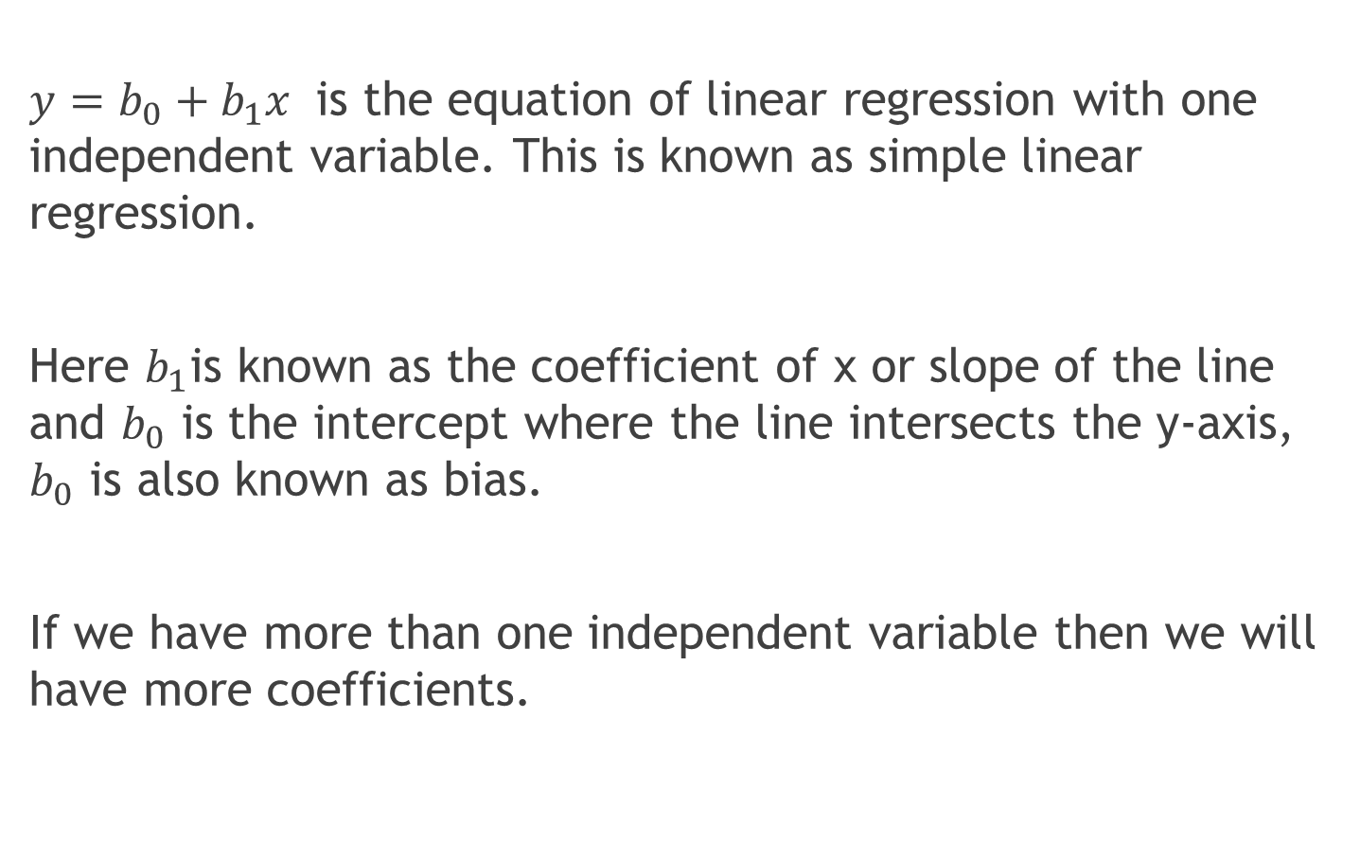
Linear Regression Formula
$y=b_{0}+b_{1}x$ is the equation of linear regression with one independent variable. This is known as simple linear regression.
Here $b_{1}$is known as the coefficient of x or slope of the line and $b_{0}$ is the intercept where the line intersects the y-axis, $b_{0}$ is also known as bias.
If we have more than one independent variable then we will have more coefficients.

Slide 12
Can we fit the line?

Slide 13
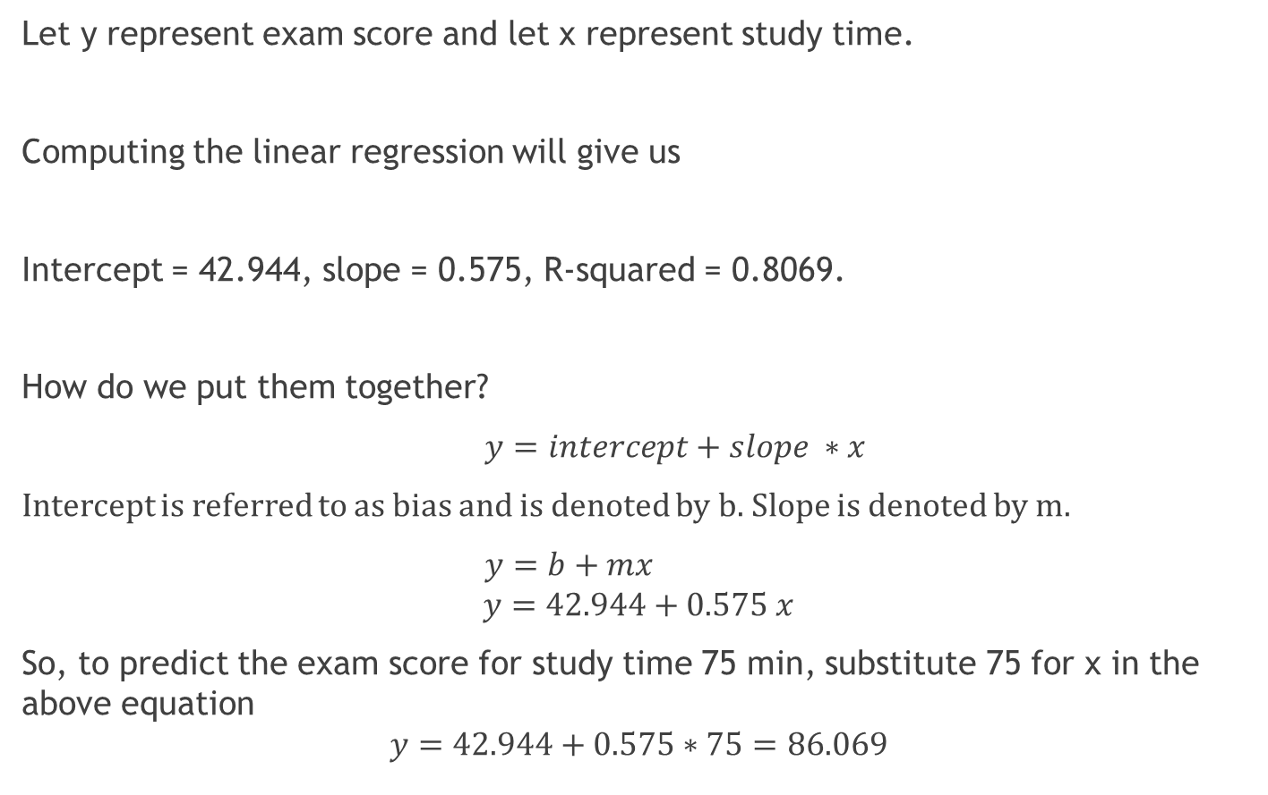
What’s the equation?
Let y represent exam score and let x represent study time.
Computing the linear regression will give us
Intercept = 42.944, slope = 0.575, R-squared = 0.8069.
How do we put them together?
$y=intercept+slope ∗x$
Intercept is referred to as bias and is denoted by b. Slope is denoted by m.
$y=b+mx$
$$y=42.944+0.575 x$$
So, to predict the exam score for study time 75 min, substitute 75 for x in the above equation
$$y=42.944+0.575∗75=86.069$$

Slide 14
How do we know our model is a good fit?
To determine if our model is a good fit for the given dataset, we have the following metrics:
Mean Squared Error, mse
Mean Absolute Error, mae
R-squared

Slide 15
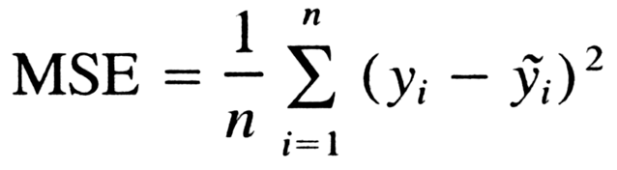
MSE Details
Mean Squared Error, mse –
Takes on values in the range of 0 to infinity.
Is sensitive to outliers.
mse doesn’t have an upper bound, so mse of the train and mse of test should be computed.

Slide 16
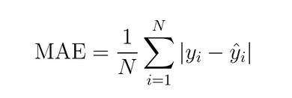
Mean Absolute Error Details
Mean Absolute Error, mae –
Takes on values in the range of 0 to infinity
Is not sensitive to outliers

Slide 17
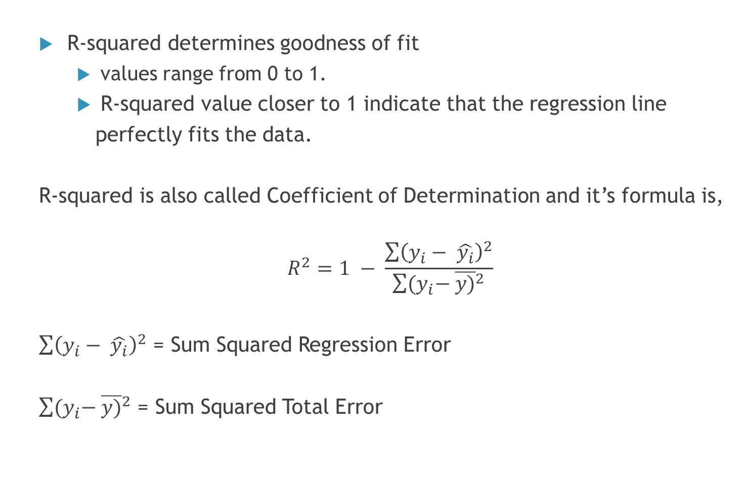
R-squared Details
R-squared determines goodness of fit
values range from 0 to 1.
R-squared value closer to 1 indicate that the regression line
perfectly fits the data.
R-squared is also called Coefficient of Determination and it’s formula is,
$$R^{2}=1 − \frac{\sum{{\left(y_{i}− \hat{y_{i}}\right)}^{2}}}{\sum{{(y}_{i}− {\overline{y)}}^{2}}}$$
$\sum{{\left(y_{i}− \hat{y_{i}}\right)}^{2}}$ = Sum Squared Regression Error
$\sum{{(y}_{i}− {\overline{y)}}^{2}}$ = Sum Squared Total Error

Slide 18
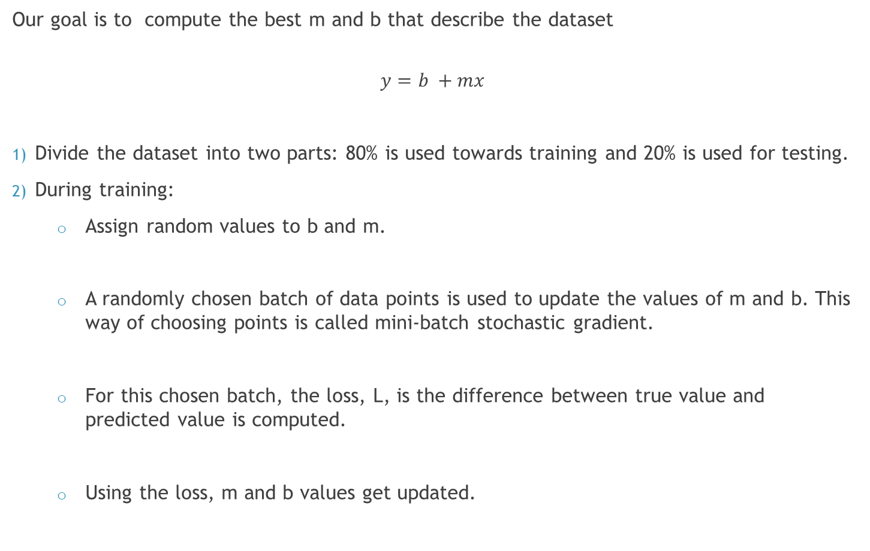
Steps Involved in Linear Regression
Our goal is to compute the best m and b that describe the dataset
$$y=b +mx$$
Divide the dataset into two parts: 80% is used towards training and 20% is used for testing.
During training:
Assign random values to b and m.
A randomly chosen batch of data points is used to update the values of m and b. This way of choosing points is called mini-batch stochastic gradient.
For this chosen batch, the loss, L, is the difference between true value and predicted value is computed.
Using the loss, m and b values get updated.

Slide 19
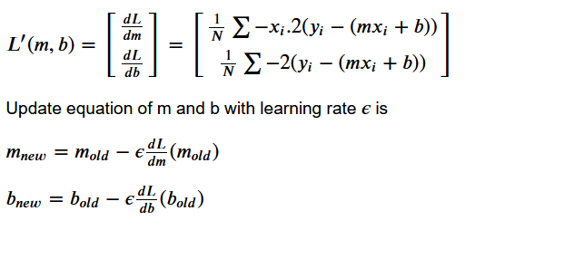

Loss Function with MSE
With Mean Squared Error as our Loss,
The equation for the Loss function is
$$L\left(m,b\right)=\frac{1}{N} \sum{(y_{i}−\left(mx_{i}+b\right))}$$
Our goal is to find m and b that would minimize L.
For this we take the first derivative of L so that we can use it to update m and b.

Slide 20
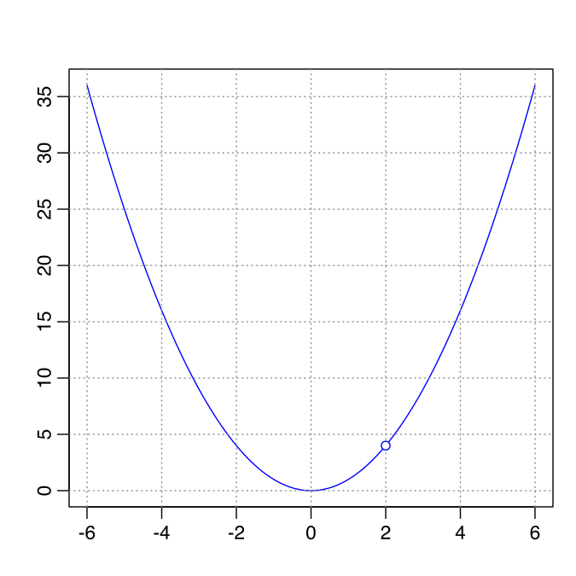
Loss Function Graph

Slide 21
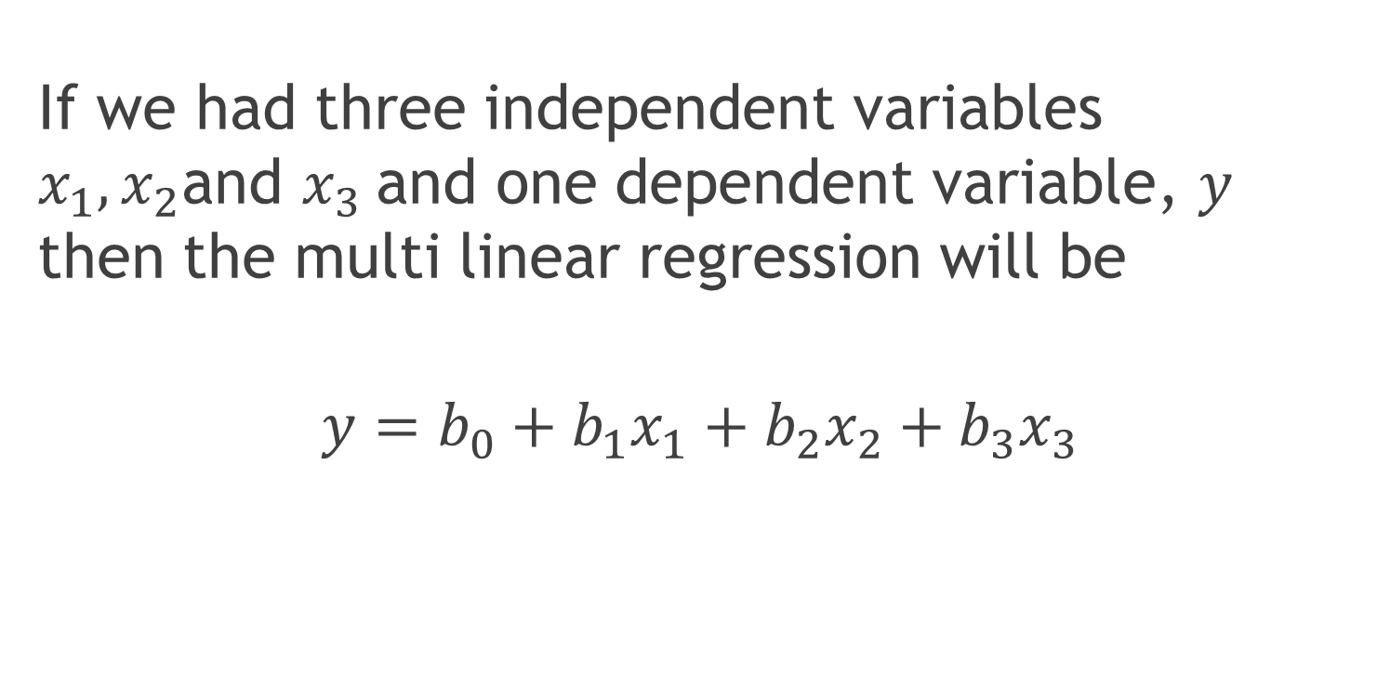
Multi Linear Regression
If we had three independent variables $x_{1},x_{2}$and $x_{3}$and one dependent variable, $y$ then the multi linear regression will be
$$y=b_{0}+b_{1}x_{1}+b_{2}x_{2}+b_{3}x_{3}$$

Slide 22
References
Links
https://machinelearningmastery.com/linear-regression
-for-machine-learning/
https://scikit-learn.org/stable/modules/generated/
sklearn.linear_model.LinearRegression.html

